Slide 1
Community Zone and Central Discovery Index: Two Systems with One Goal

Slide 2

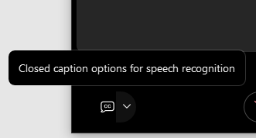
A few points about WebEx
Technical issues? Exit and rejoin the WebEx session.
Select All Panelists in the To: dropdown menu to submit questions via WebEx Chat.
Turn captions on and off in the lower-left corner of the WebEx screen

Slide 3

What is the Community Zone (CZ) and what does it do?
What is the Central Discovery Index (CDI) and what does it do?
How do the CZ and CDI work together?
Agenda

Slide 4
What is the Community Zone (CZ) and what does it do?
What is the Central Discovery Index (CDI) and what does it do?
How do the CZ and CDI work together?
Agenda

Slide 5
Community Zone and Central Discovery Index: Two Systems with One Goal
The goal of the Community Zone and the Central Discovery Index is to provide access to your electronic resources.

Slide 6
Community Zone (CZ)
Centralized service for streamlining end-to-end workflows from selection to acquisitions to electronic resource management.
Shared Space
Accessible to all Alma institutions
Managed by Ex Libris
Maintained collaboratively by Ex Libris and customers.

Slide 7
What makes up the Community Zone?
Community Catalog
Bibliographic records
Electronic resources
Central Knowledge Base
Electronic Collections
Portfolios
Linking information
Coverage
Service
Authority Vocabularies
Full list of vocabularies available in the Customer
Knowledge Center

Slide 8
Unified Resource Management
Alma
ILS
Integrated Library
System
ERMS
Electronic Resource Management System
DAM
Digital Asset
Management

Slide 9
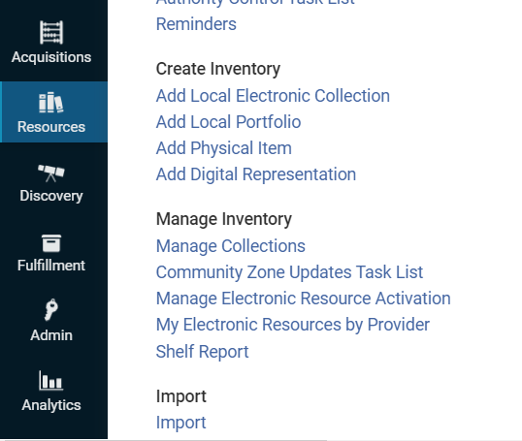
Community Zone Updates Task List
Review changes that were done in the CZ
Updates are synchronized on Sunday at midnight in your time zone by the Synchronize Changes from the Community Zone job
  Copies changed authorities and resources form the CZ to your NZ/IZ
  Adds changes to the Community Zone Updates Task List
Alma > Resources > Manage Inventory > Community Zone Updates Task List

Slide 10
Central Knowledge Base (CKB)
Alma FAQ on the Central Knowledge Base in the Customer Knowledge Center.
What types of metadata are found in the CKB?
CKB updates.
User community involvement in the development of the CKB?
Localization of electronic resources.

Slide 11
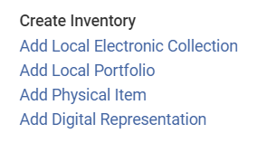

What if the CZ does not have the electronic resource for which I am looking?
2. Suggest that the collection and data be added to the Community Zone via the Content area of Ex Libris Idea Exchange
1. Create a local electronic resource Alma > Resources > Create Inventory

Slide 12
What is the Community Zone (CZ) and what does it do?
What is the Central Discovery Index (CDI) and what does it do?
How do the CZ and CDI work together?
Agenda

Slide 13
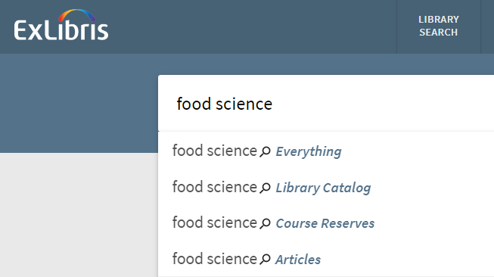
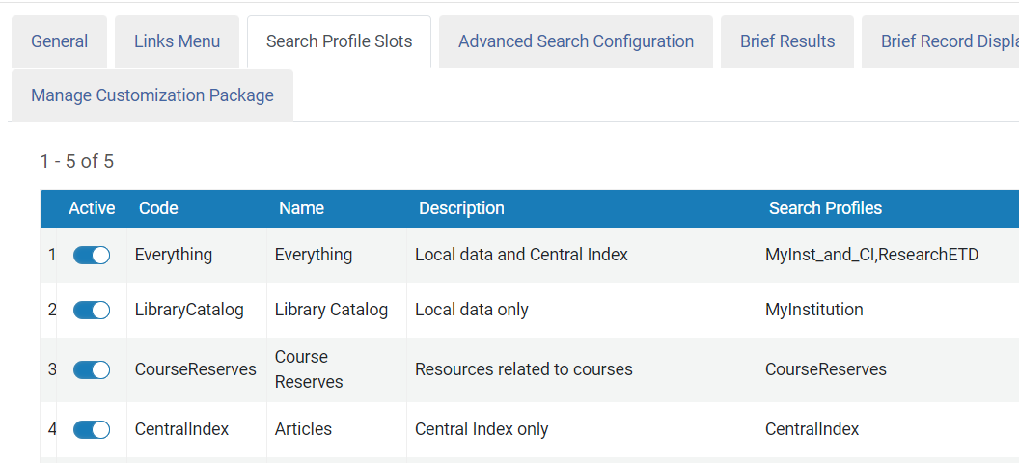
Central Discovery Index (CDI)
Unified index that supports Summon, Primo and Primo VE.
Search profile slots that have been configured to use the CentralIndex search profile search CDI content and includes that content in search results.

Slide 14
What’s in the CDI
Over 5 billion citations
Commercial and Open Access content from global and local providers
Most resources are free to search—some require a subscription
Content includes 29 CDI resource types that were determined in collaboration with the IGELU and ELUNA user groups.

Slide 15
What is the Community Zone (CZ) and what does it do?
What is the Central Discovery Index (CDI) and what does it do?
How do the CZ and CDI work together?
Agenda

Slide 16
Alma/CZ/CDI Workflow
2. Order/Activation Workflow in Alma
4. Central Discovery Index harvests the file
1. Locate electronic resource in the Community Zone
3. Alma creates CDI holdings file
5. Electronic holdings display in Discovery within
48 hours

Slide 17
Community Zone and Central Discovery Index: Two Systems with One Goal
The goal of the Community Zone and the Central Discovery Index is to provide access to your electronic resources.

Slide 18
Resources
18

Slide 19
Knowledge Base Resources
Working with Community Zone Electronic Resources
CDI—The Central Discovery Index
Community Zone Contribution Guidelines
EasyActive Collections List—Resources that are not searchable without a subscription.
Alma Single Activation Source for CDI
CDI Record Summary and Sources

Slide 20

Premium Services - a more individualized approach
Premium Services are one-on-one services to customers that are interested in workflow optimization, individualized training, hands-on configuration, or other individualized assistance with Ex Libris products
Premium.Services@clarivate.com
Notes:
If you would like more information on paid service engagements from Ex Libris to fill gaps in local expertise, support workflow changes, and optimize your use of our products, please email us at Premium.Services@exlibrisgroup.com. We would love to talk more with you about how we can meet your needs.

Slide 21
Please fill out the survey that will appear when you close the WebEx meeting

