Slide 1
Resource Sharing - Lost Item Workflow

Slide 2
Scenario 1

Slide 3
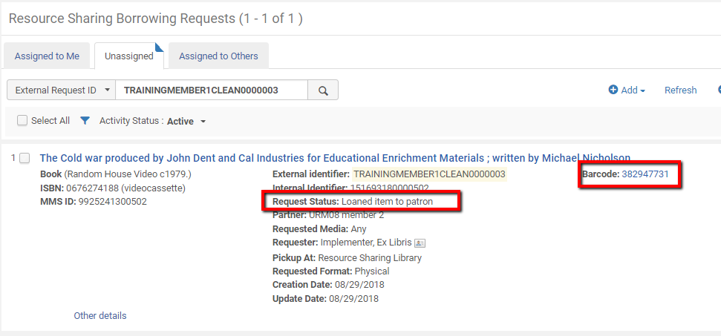
Borrowing request
Borrower has sent a request. Item was received and loaned to the patron.

Slide 4
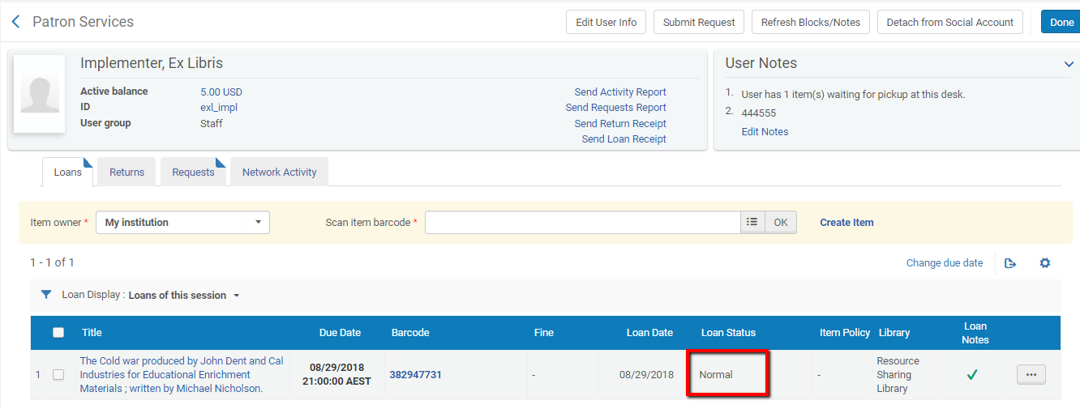
Borrowing patron loan
A standard loan is registered on the patron's loan list

Slide 5
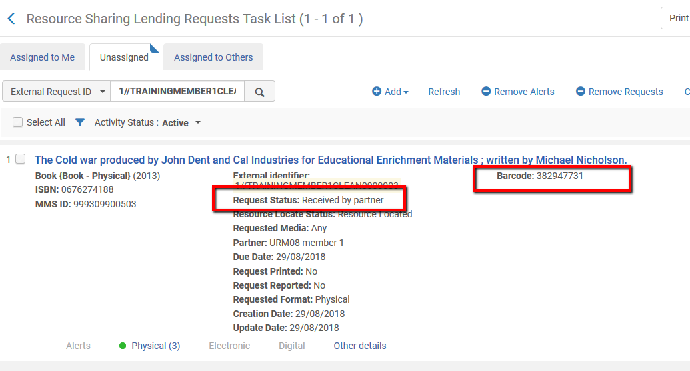
Lending request
On the lending side, the request is registered as ‘Received by partner’.

Slide 6
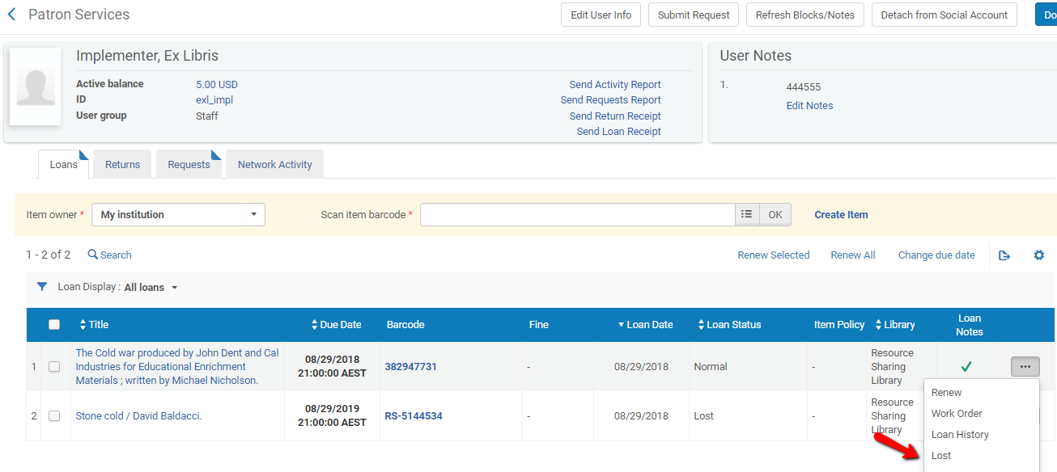
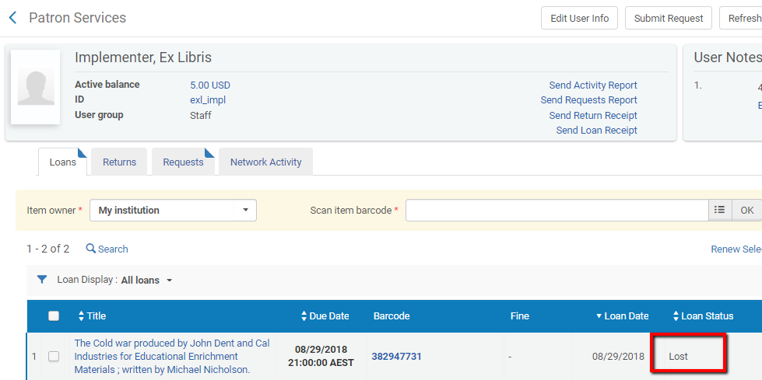
Patron reports that item is lost
The patron reports that the item is lost, just as is done for regular loans.
Staff at the circulation desk update the loan status
No fee is created !

Slide 7
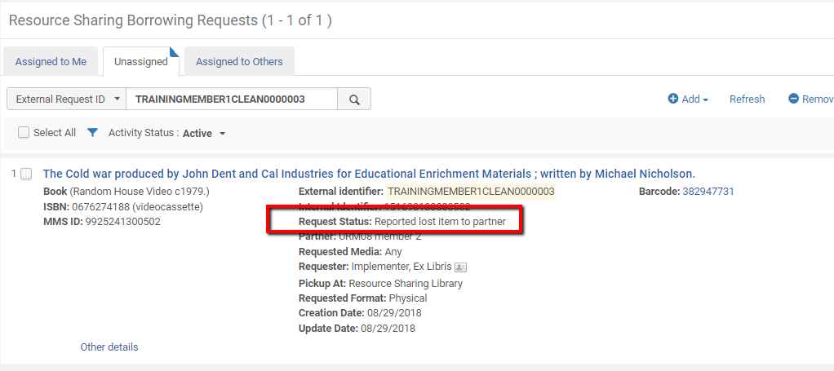
Borrower request is automatically updated

Slide 8
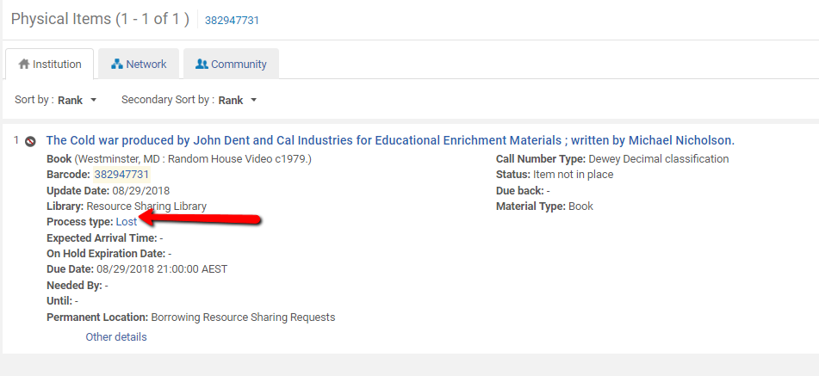
Item at borrower side is automatically updated

Slide 9
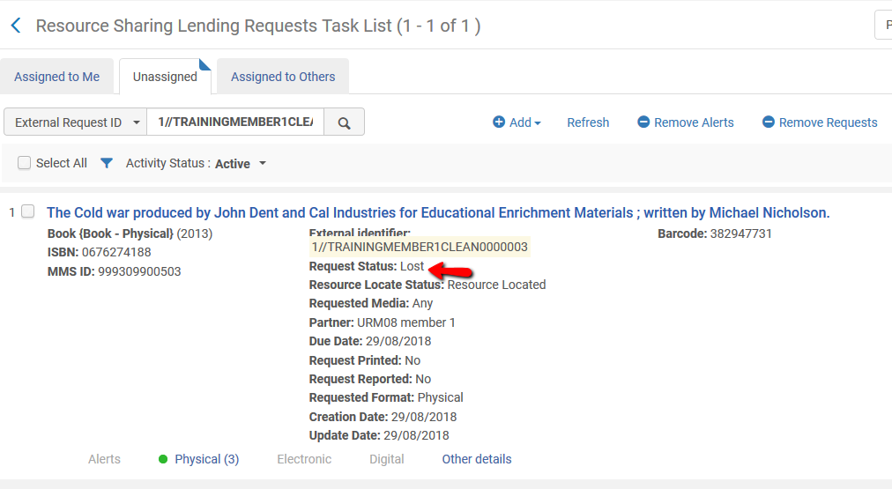
Lender request is automatically updated
Where ISO is used, the lender side is automatically updated. Where no ISO is in place, the action on the borrower side triggered an email to the lender

Slide 10
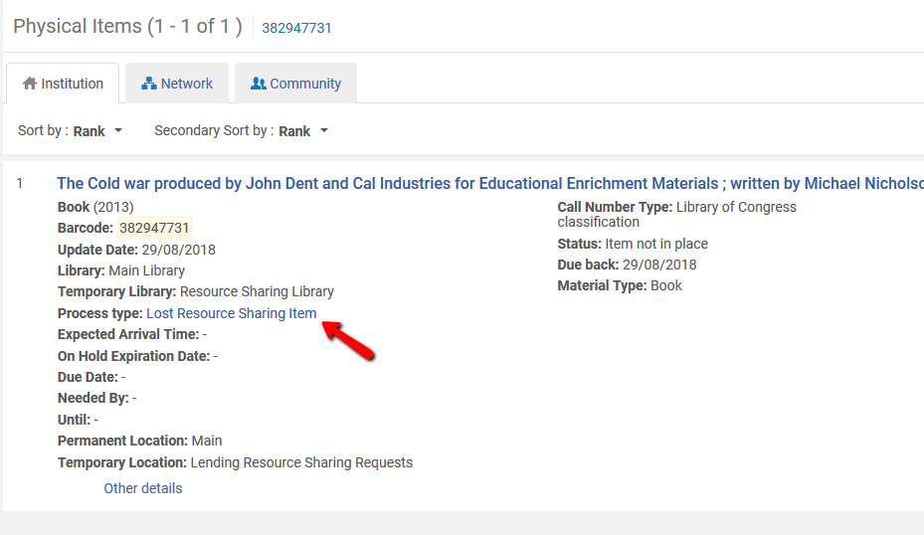
Item on lender side is updated
The update of the request status on the lender side updated the item status as well.
The update of the status may have happened automatically via ISO, or manually (using a row action – see slide 12) when ISO is not in place

Slide 11
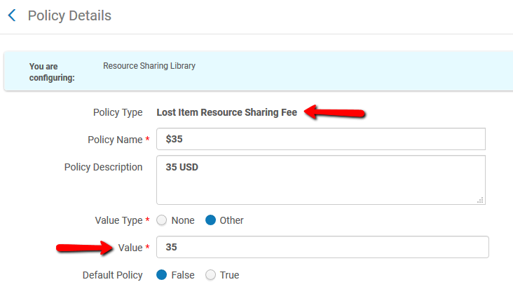
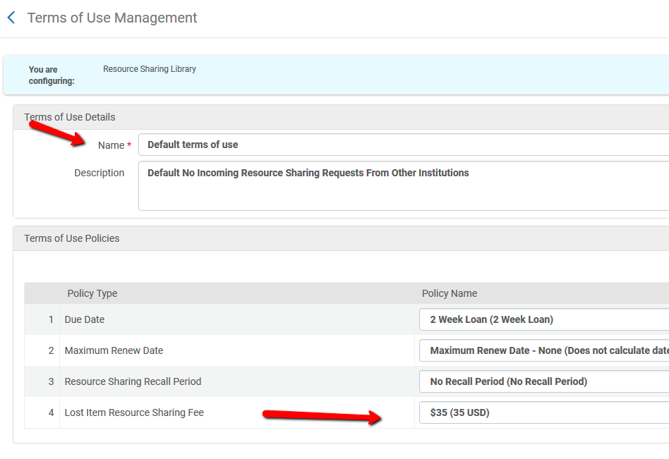
Lost Item Fee Policy at lender is $35
The Lending Request TOU can be set with a policy for a lost item fee

Slide 12
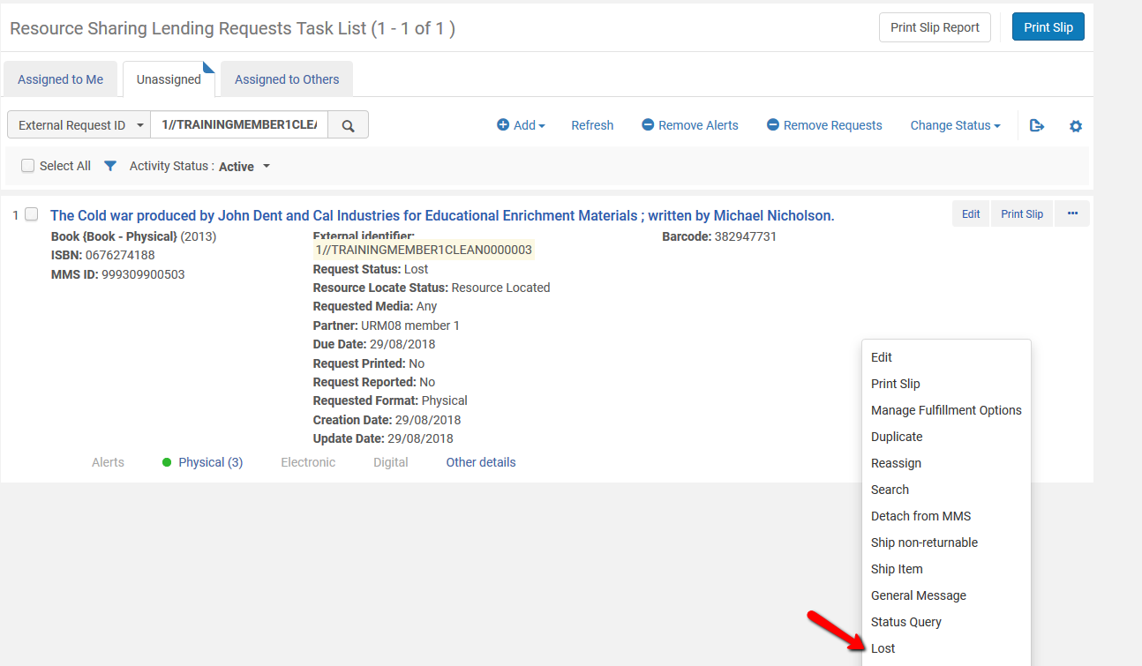
Lender reports a fine
The fee is not applied automatically. The lender must use the ‘Lost’ row action to assign the fee, and notify the borrower

Slide 13
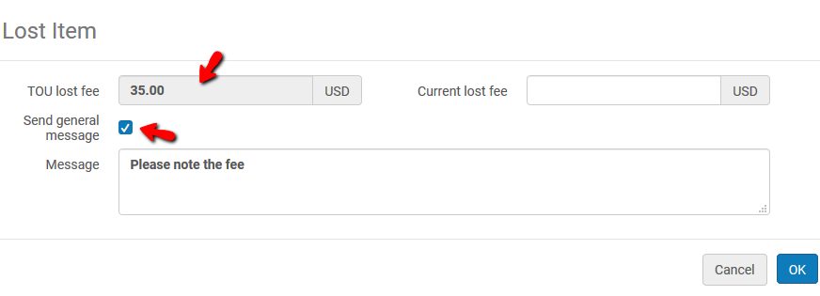
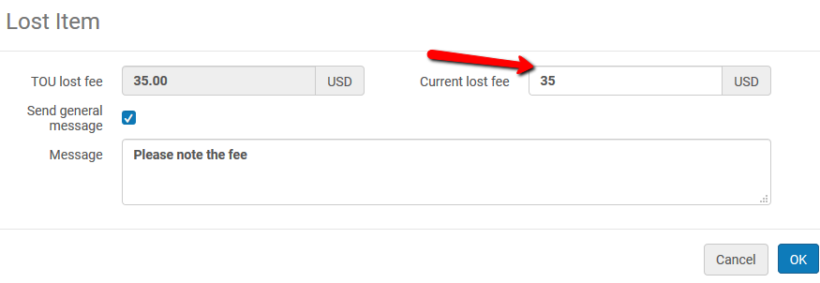
Calculated Fee is shown, and may be chosen
When using the row action, the operator can see the TOU fee policy , and can choose to use it (by filling in the ‘Current lost fee’ field). This will create a fee that will be registered on the lending request
The operator can choose to also send a general message (ISO or email ) to the borrower with the fee information

Slide 14
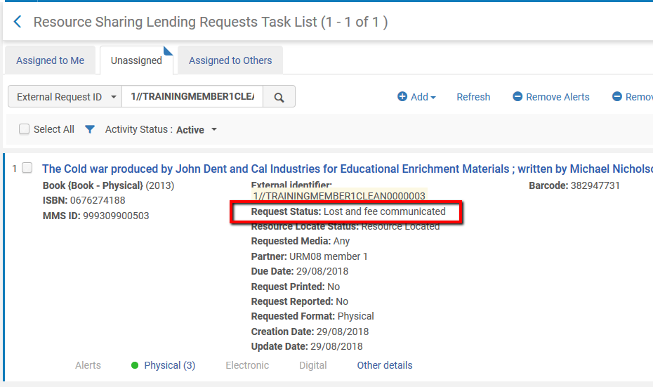
Fee and status is updated
Assigning the fee will change the request status to reflect the action taken

Slide 15
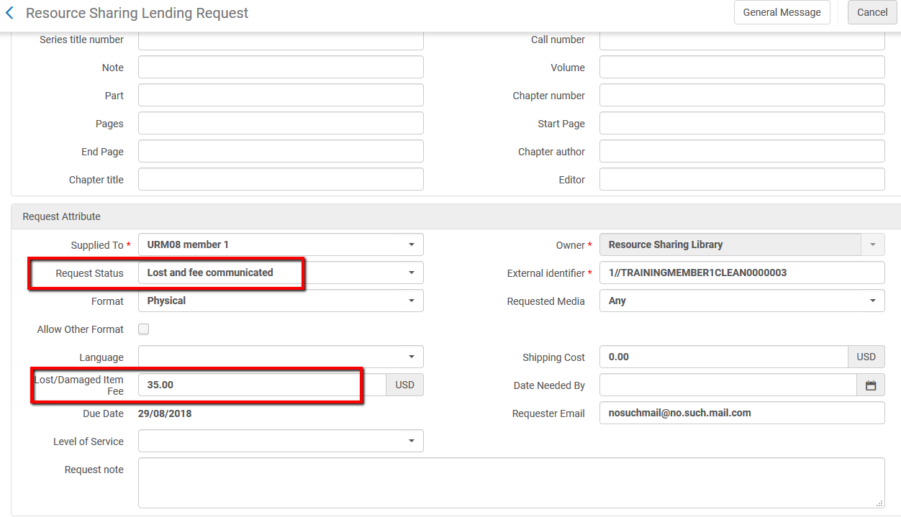
Fee and status is updated
The fee is registered on the request

Slide 16
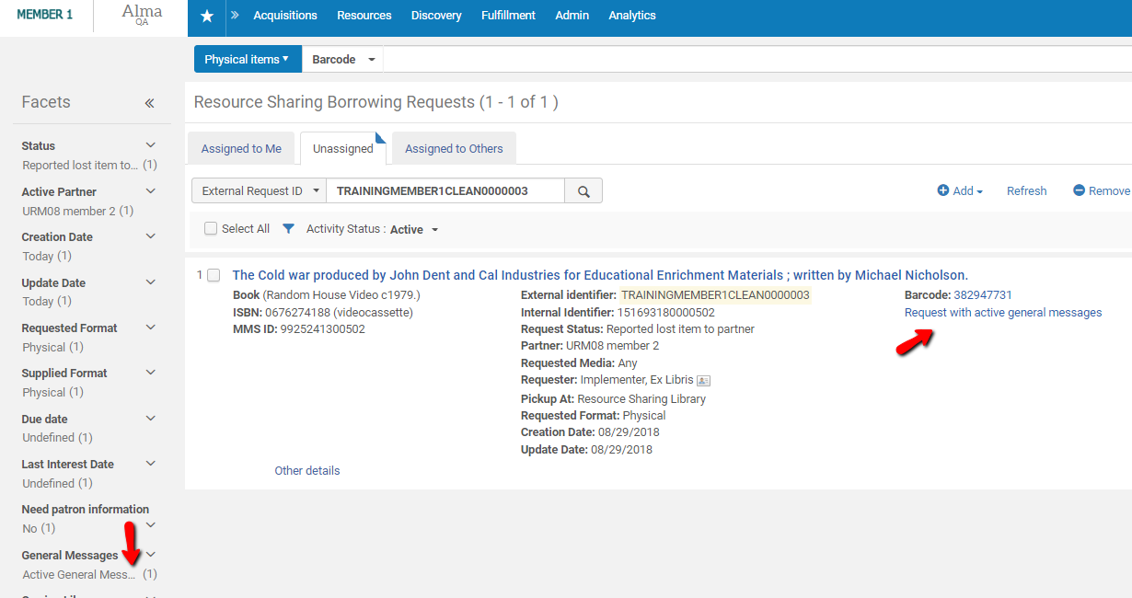
Borrower received the general message
Borrower receives the message (via email or ISO message)

Slide 17
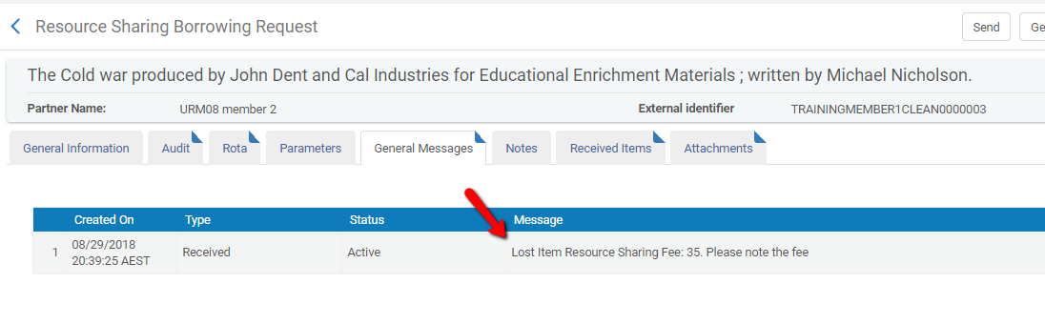
Borrower received the general message

Slide 18
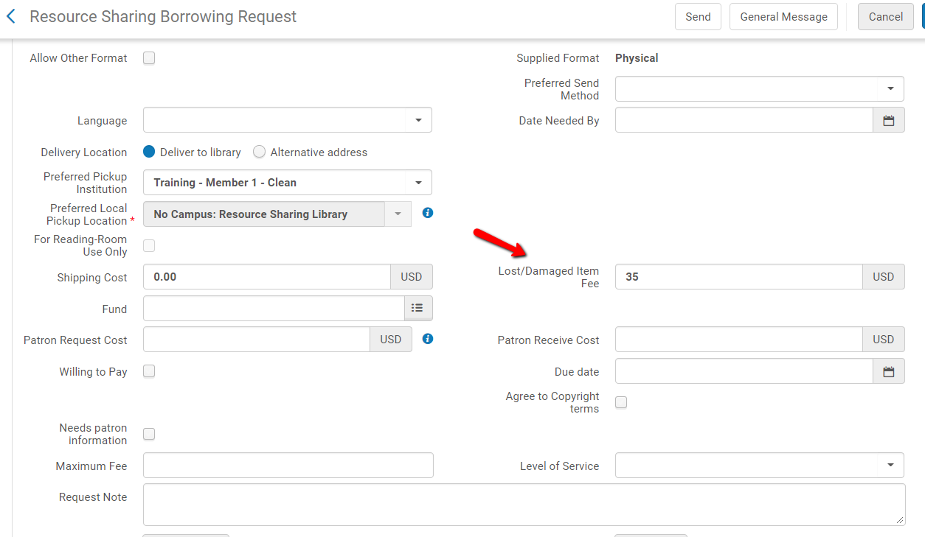
Borrower updates the fee (and dismisses the message)

Slide 19
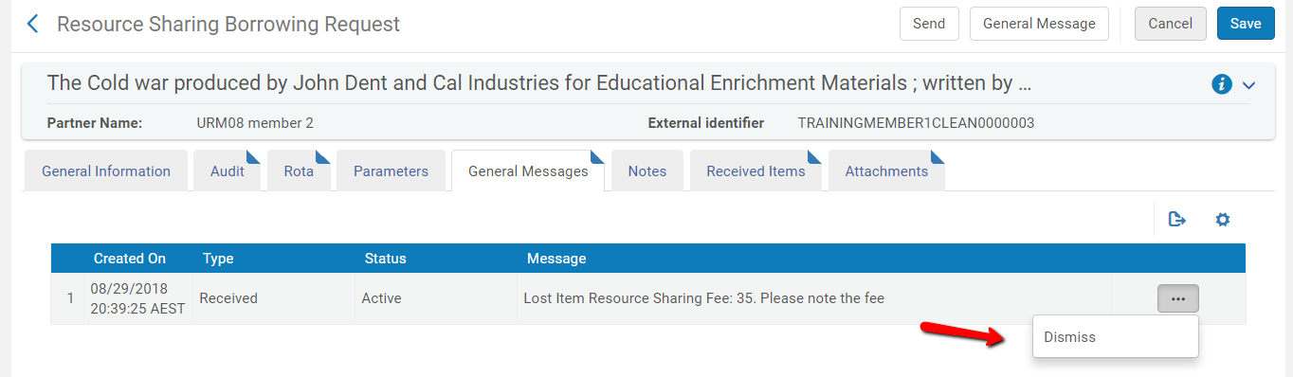
Borrower updates the fee (and dismisses the message)

Slide 20
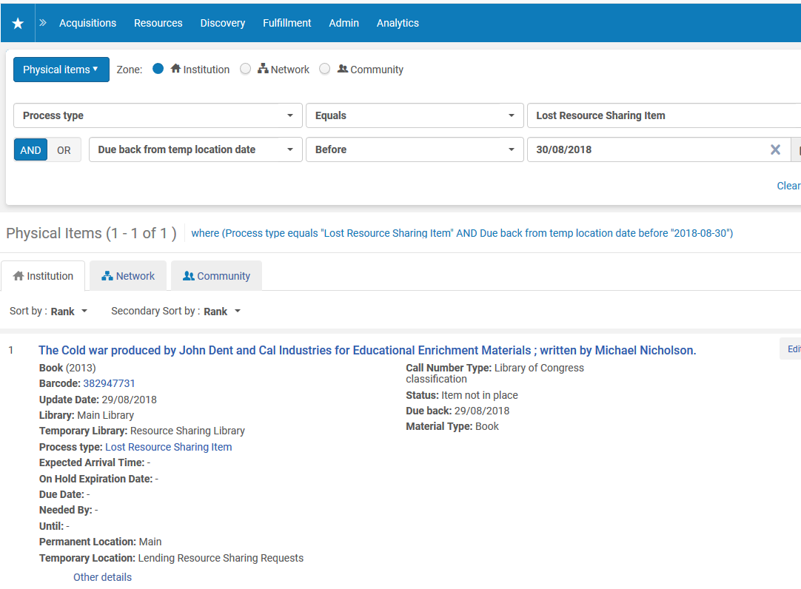
Lender can report on resource sharing lost items
The lender can use the ‘Lost Resource Sharing Item’ process type to identify the lost items, save them as a set, and to run jobs such as ‘Withdraw Items’, on the set.

Slide 21
Scenario 2

Slide 22
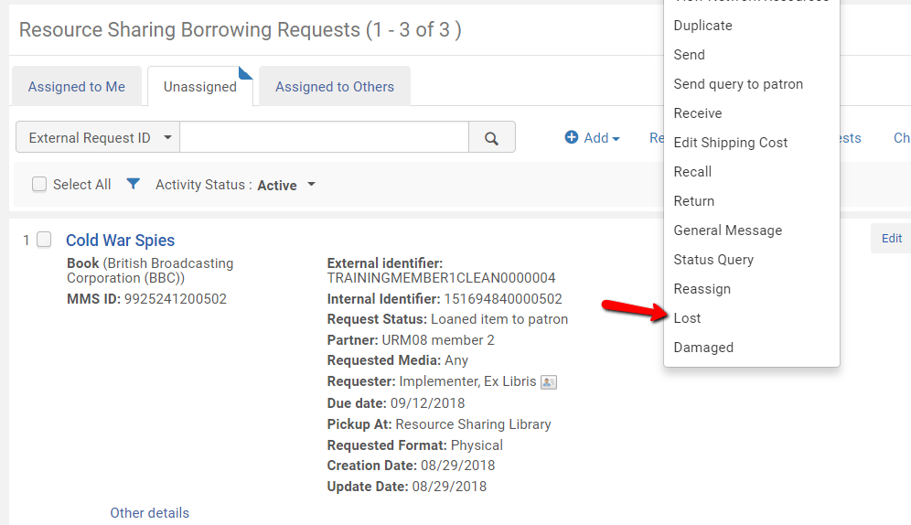
Lost is triggered from task list
The borrower can trigger the ‘Lost Item’ workflow from the resource sharing task list.

Slide 23
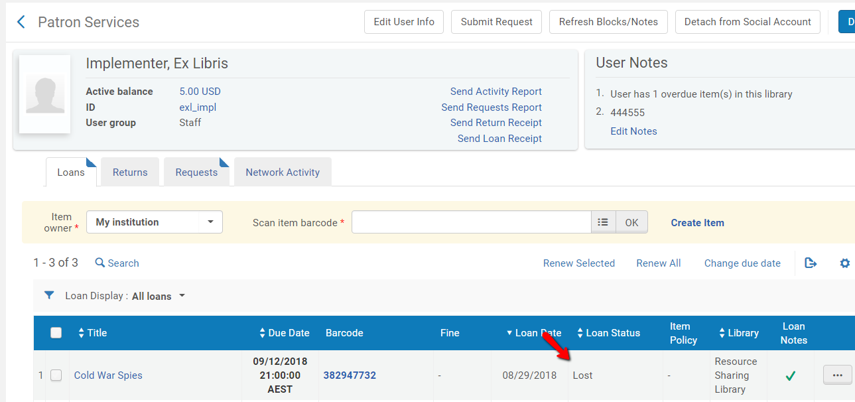
Loan is updated

Slide 24
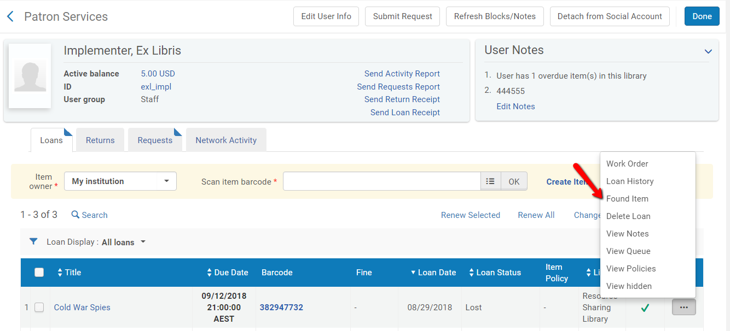
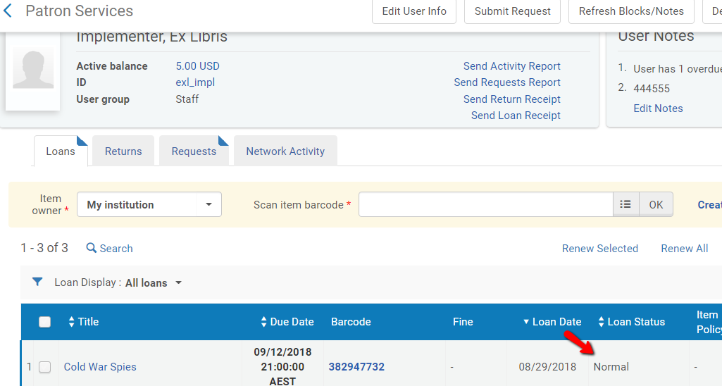
Item is found
If the item is found, it can be managed just as for regular loans.

Slide 25
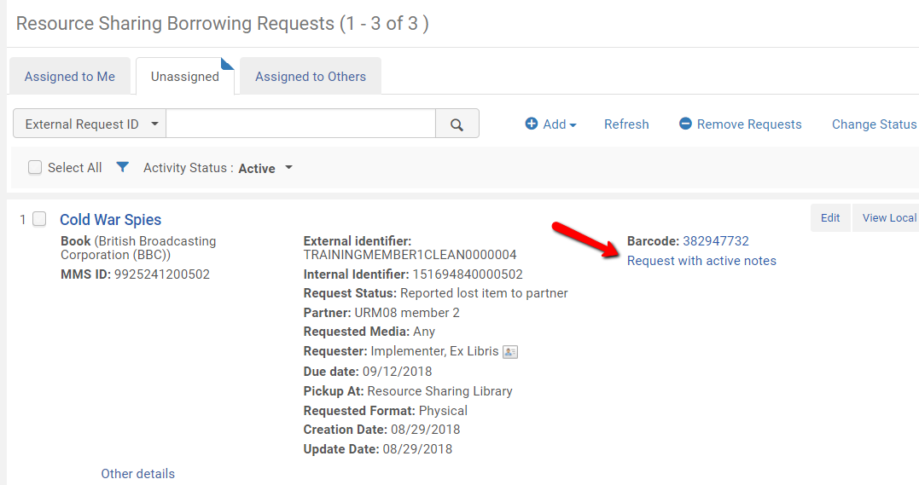
Dismissible note is created on request
Using the ‘Found Item’ action from the patron services workbench will automatically assign a note to the borrowing request. This allows the operator on the borrower side to identify this condition, to manage the status of the borrowing request, and to update the lender (using a general message)

Slide 26
Thank you
Moshe.shechter@exlibrisgroup.com

