Slide 1
Resource Sharing Topology
Moshe Shechter | Alma Product Manager

Slide 2
Agenda
Basic Terminology
Configuration Elements

Slide 3
Basic Terminology

Slide 4
Basic Terminology
When setting up resource sharing, we will always be setting up configuration that describes
  ‘My’ side of the process
  The ‘other’ side of the process

Slide 5
Basic Terminology
For workflows in which I am the borrower:
  ‘My’ side of the process is the borrower side
  The ‘other’ side of the process is the lender side
For workflows in which I am the lender:
  ‘My’ side of the process is the lender side
  The ‘other’ side of the process is the borrower side
Any library may be implementing only a borrower workflow or only a lender workflow. Still, both the ‘my’ and the ‘other’ side must be configured

Slide 6

Basic Terminology
Some coordination is required between how the ‘my’ and the ‘other’ side is configured in my Alma system and how the ‘my’ and the ‘other’ side is configured at the peer (Alma or other ) library
Me
The resource sharing partner
Other System
My Side
My Side
Other Side
Other Side

Slide 7
Configuration Elements
The ‘My’ Side

Slide 8
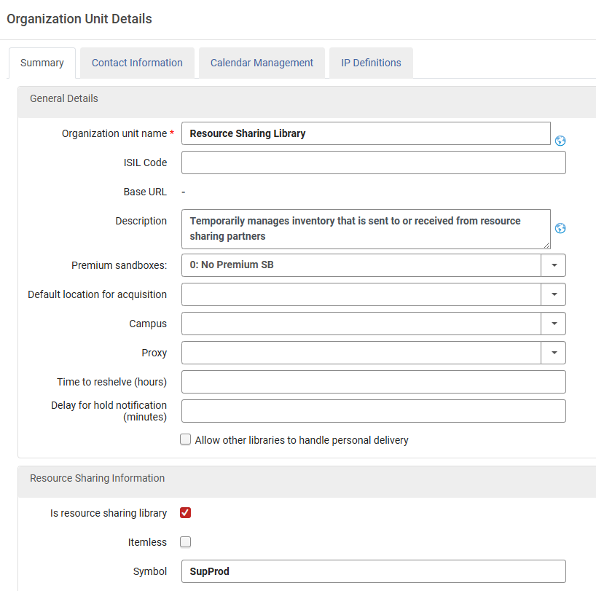
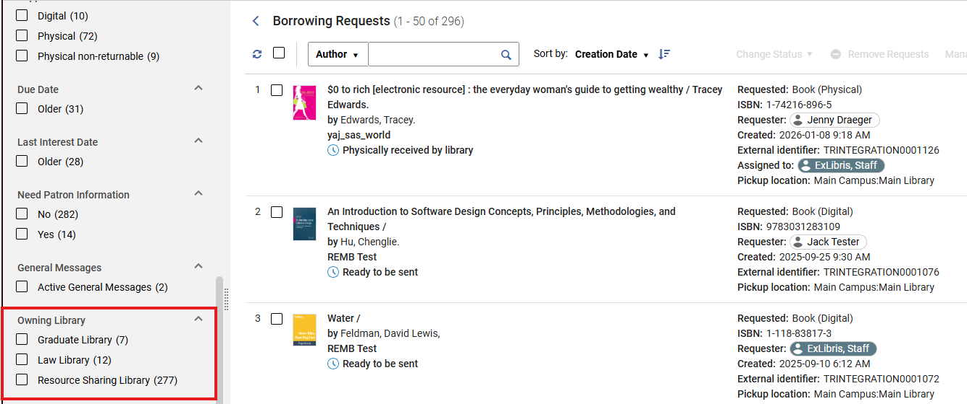
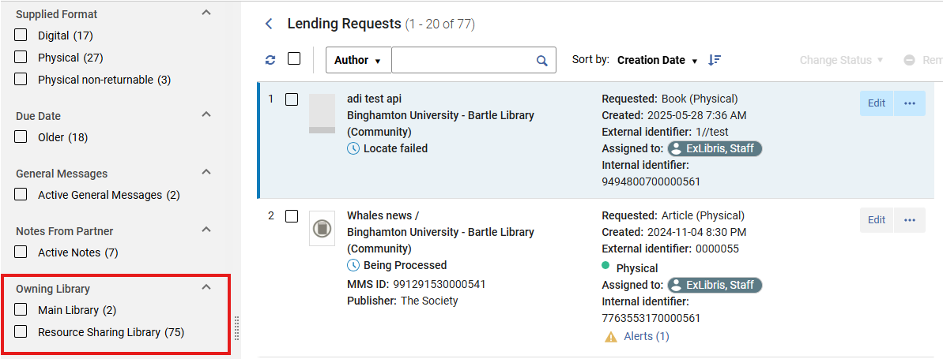
The Resource Sharing Library
The ‘My’ side is the Resource Sharing Library. It owns:
  The borrowing requests I manage as borrower
  The lending requests I manage as lender

Slide 9
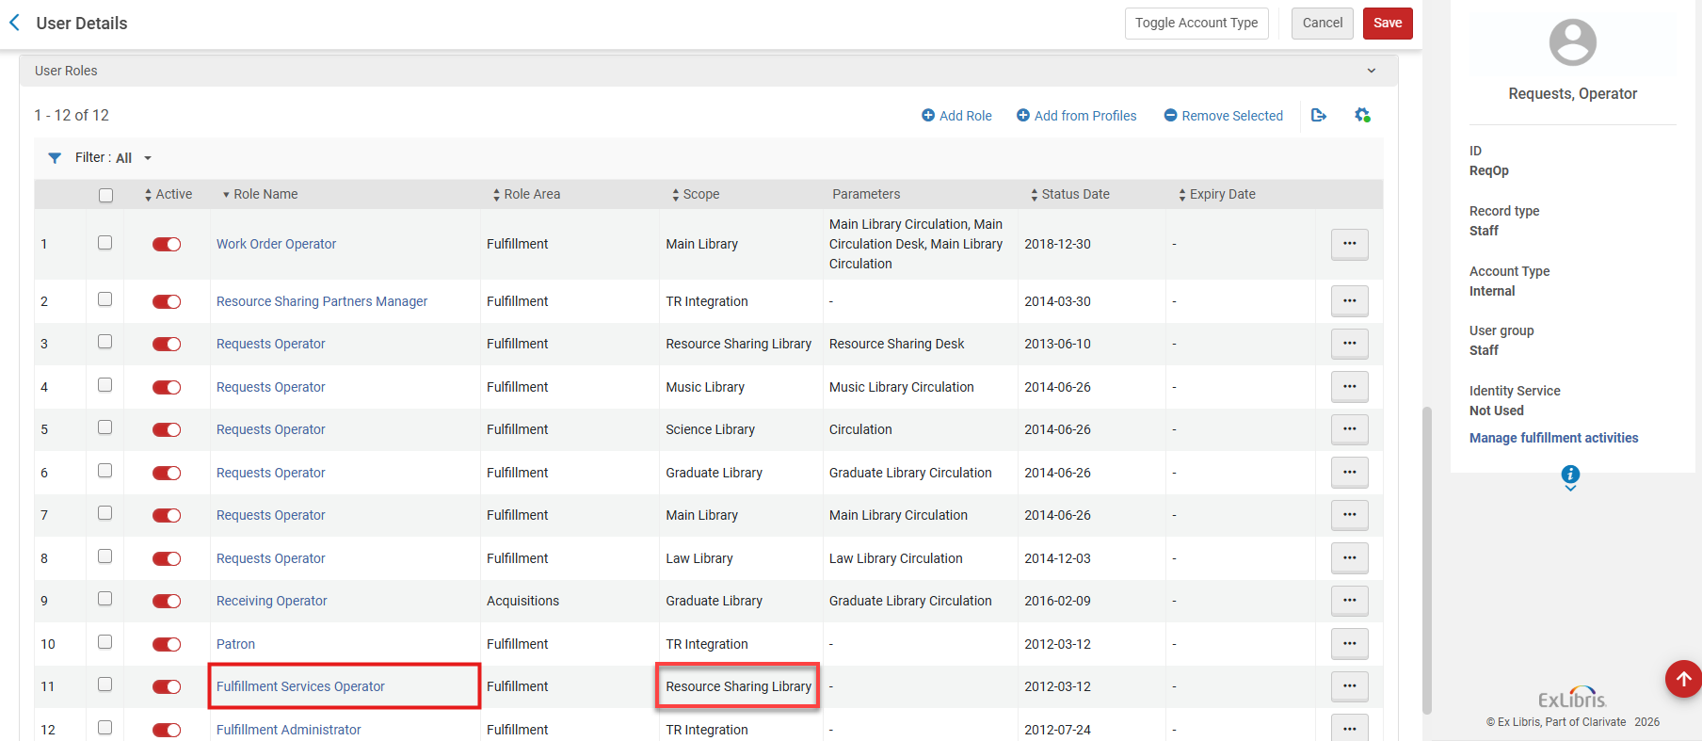
The Resource Sharing Library
In order for my staff to be able to view and monitor ‘my’ borrowing and lending requests, their user account/s must be linked to a Fulfillment Services Operator role, at the scope of the resource sharing library

Slide 10
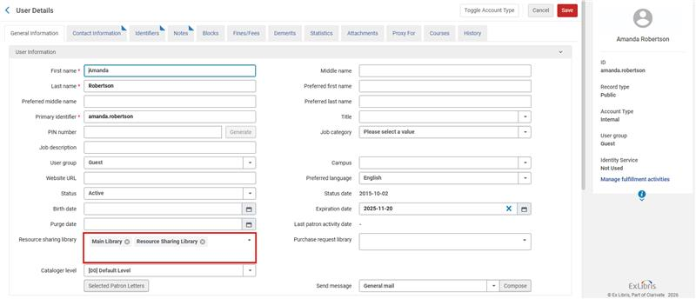
The Resource Sharing Library
In order for patrons to be able to place borrowing requests, they must be linked to one or more resource sharing library(ies)

Slide 11
The Resource Sharing Library
An institution may manage a single resource sharing library, where all borrowing and lending requests are managed
An institution may manage one resource sharing library per every campus
An institution may manage every ‘regular’ library as a separate resource sharing library (e.g. the main library, the humanities library etc.)
An institution may manage one resource sharing library for multiple libraries (one for the law library and one for the rest of the institution no matter in which campus any of these libraries are located)

Slide 12
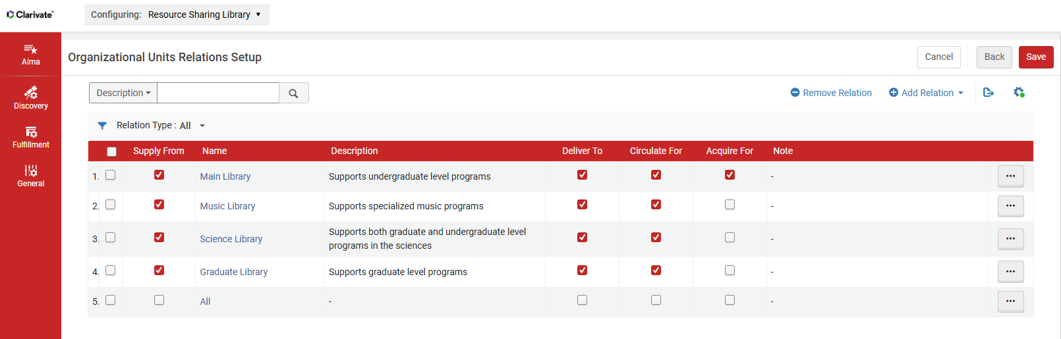
The Resource Sharing Library
The resource sharing library has relations with other libraries, determining:
  In what libraries the items requested for borrowing may be picked up
  What libraries items may be taken from and shipped in order to fulfill a lending request

Slide 13
Configuration Elements
The ‘Other’ Side

Slide 14
The Partner Record
The ‘other’ side is the partner record. It defines:
  How the other side will be contacted , be defining:
    The Profile Type (ISO/Email/SLNP/NCIP)
    The partner’s Parameters
  How the locate process will be run, by defining:
    The Locate Profile to use
    The Holdings Code
  How the workflow will be managed, be defining:
    Whether the partner supports borrowing and lending
    Borrowing and Lending Workflow Profiles

Slide 15
The Partner Record
The partner record may represent an ‘other side’ institution, or any subdivision of the ‘other side’ institution:
  A specific library
  A group of libraries
  A campus
This may be done by setting up the Holdings Code to match the code at the ‘other side’

Slide 16
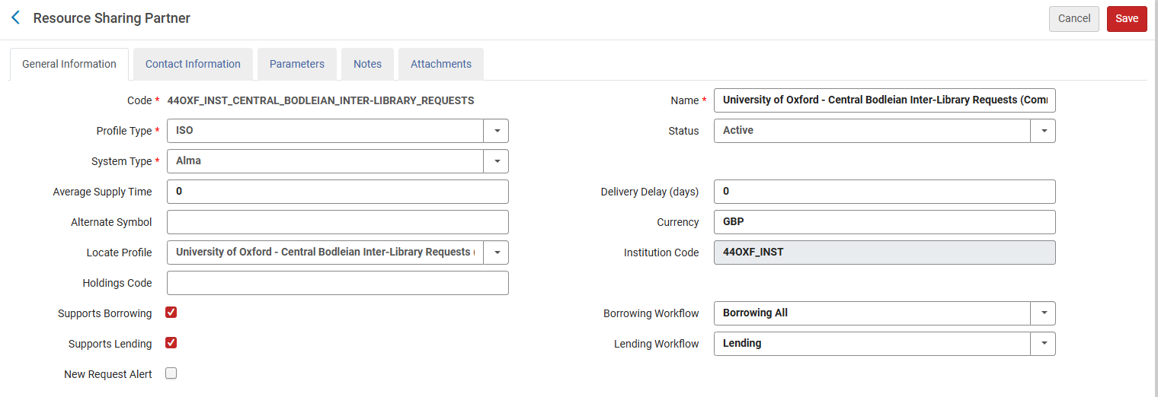
Partner Record Example 1
Partner represents an ‘other side’ institution:
There is no Holdings Code

Slide 17
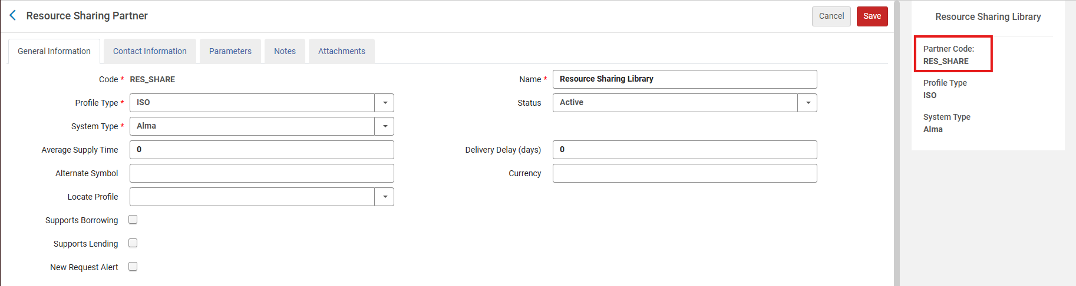
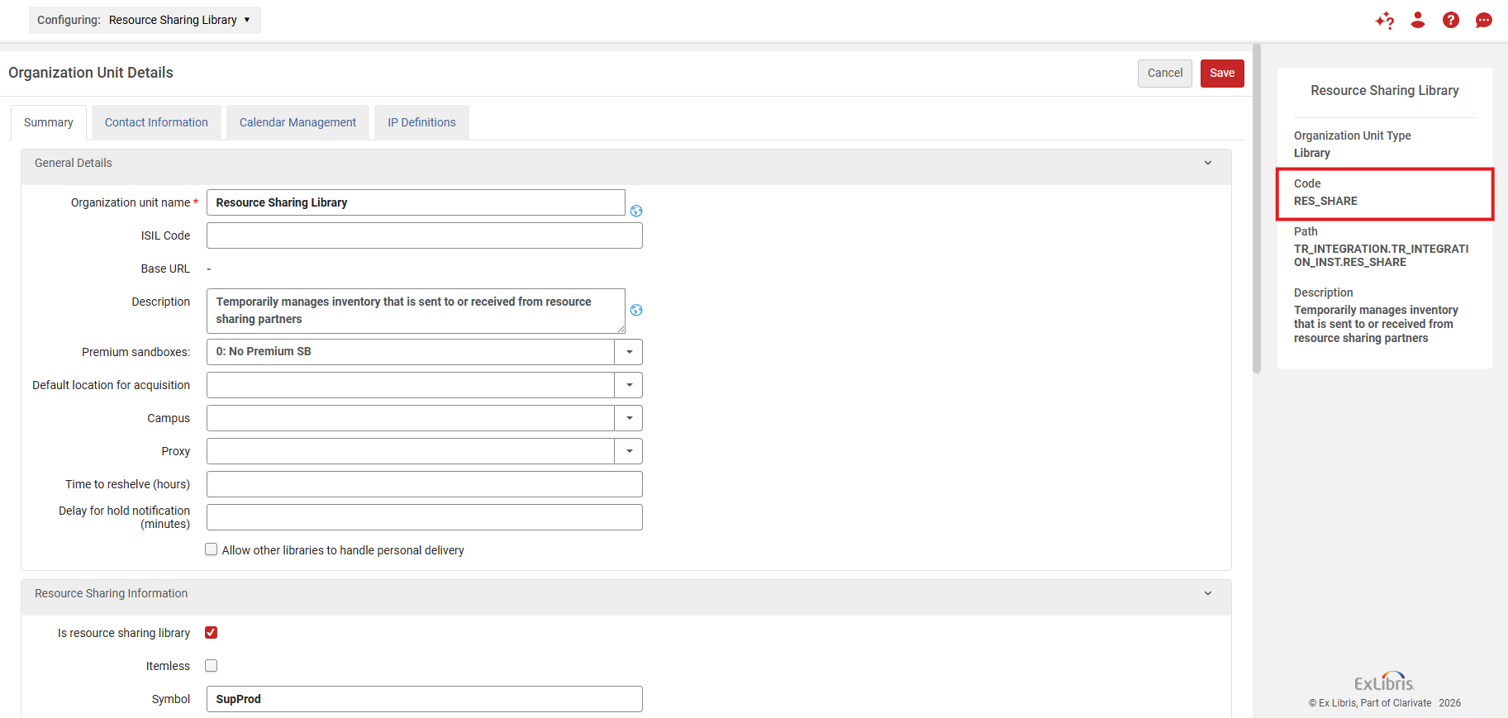
The Partner Record Example 2
Partner represents an ‘other side’ library:
Configuration at my institution
Configuration at the institution I want to borrow from or lend to

Slide 18
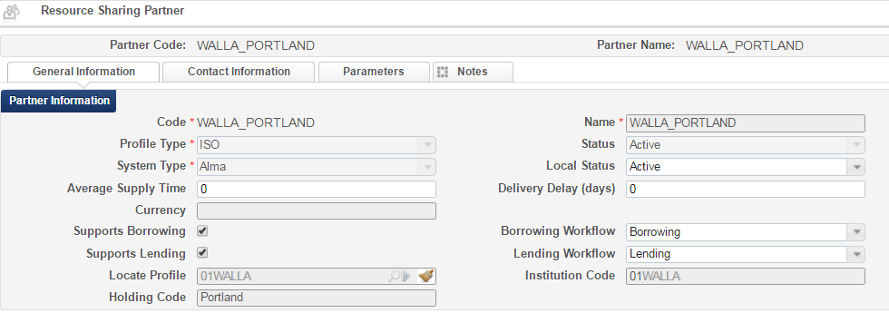
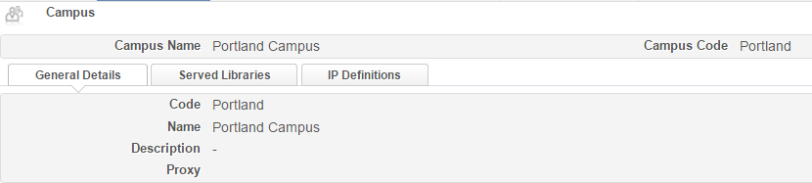
The Partner Record Example 3
Partner represents an ‘other side’ campus:
Configuration at my institution
The Holdings Code on the partner record matches a campus code at the other institution
Configuration at the institution I want to borrow from or lend to

Slide 19
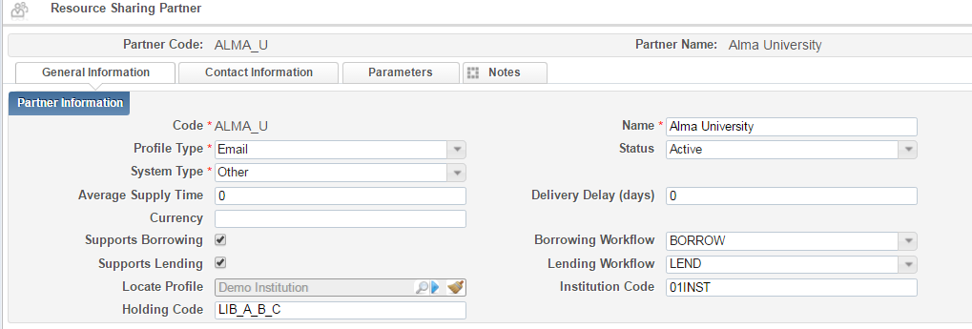
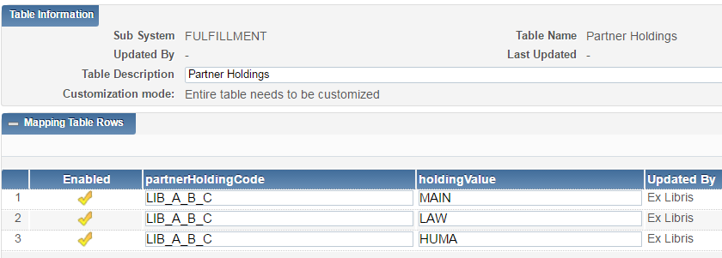
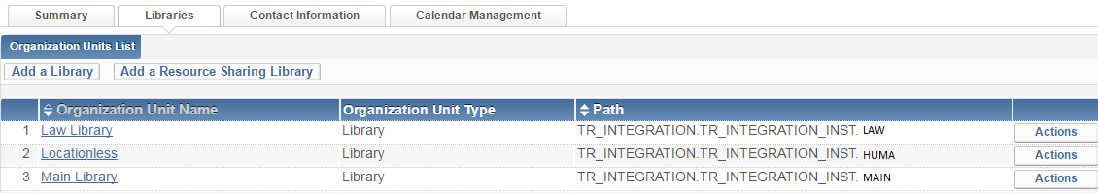
The Partner Record Example 3
Partner represents a number of ‘other side’ libraries:
Configuration at my institution
The Holdings Code on the partner record matches a mapped code to library codes at the other institution
Note: To update this mapping table contact support
Configuration at the institution I want to borrow from or lend to

Slide 20
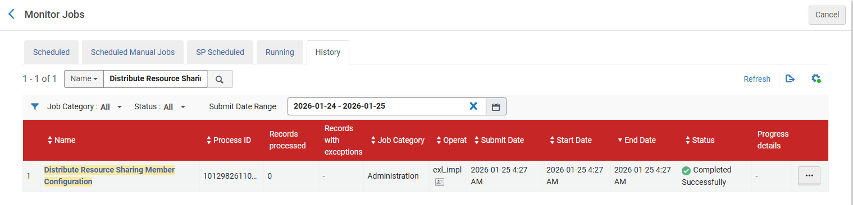
The Partner Record
The list of partners is managed at the institution level
Members of a Network Zone Collaborative Network may centrally manage the list of partners in the Network Zone. A job distributes the partners list to the member institutions.

Slide 21
Moshe.shechter@exlibrisgroup.com

