Slide 1
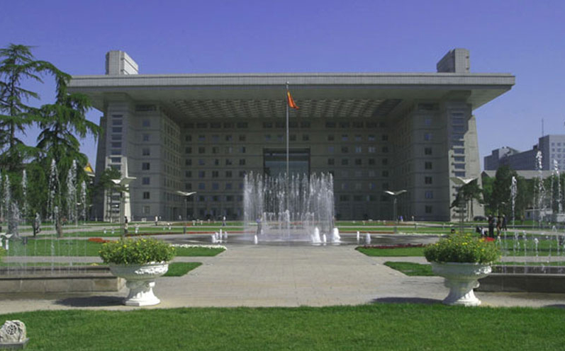

Digitization Requests Flow
Yoel Kortick
Senior Librarian
http://english.bnu.edu.cn/

Slide 2


The Digitization Department
The Digitization profile rules
Creating digitization requests
Processing digitization requests
Reporting on the digitization requests
https://slidemodel.com/templates/animated-rainbow-business-powerpoint-template/
http://image.shutterstock.com/z/stock-photo-business-hand-writing-blank-agenda-list-130255148.jpg

Slide 3
The Digitization Department
Digitization requests in Alma are handled via the digitization department
Digitization departments are available from the fulfillment configuration menu under “Digital Fulfillment > Digitization Departments”
Multiple digitization departments may exists for various combinations of libraries.

Slide 4
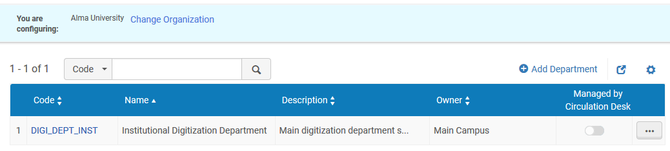
The Digitization Department
This is the “Institutional Digitization Department”

Slide 5
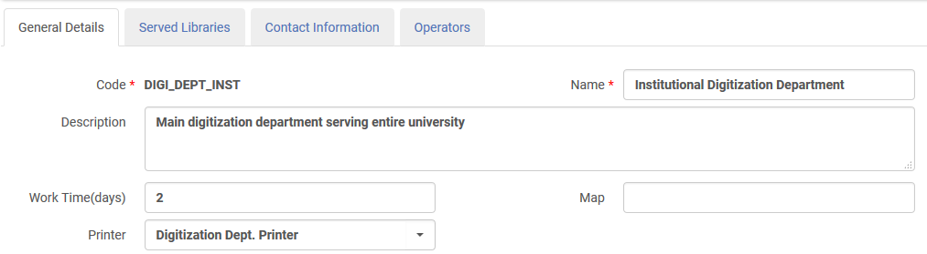
The Digitization Department
General Details tab
The amount of time the item will remain in the department before it is expected to be returned to the location from where it came
The Printer to where the slips will be printed

Slide 6
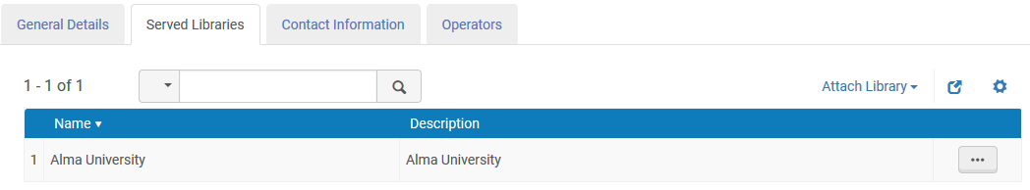
The Digitization Department
Served Libraries tab
The Digitization Department can be defined to work for only specific libraries or for the entire institution. In this case it is for the entire institution.

Slide 7
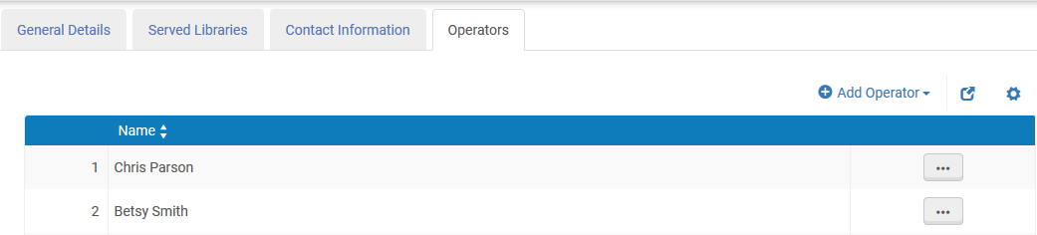
The Digitization Department
Operators tab
These are the staff users who can handle digitization requests in the digitization department.

Slide 8
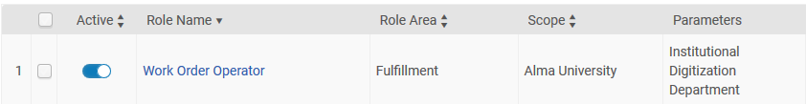
The Digitization Department
An operator in the digitization department will have a role appearing as follows in the user record:

Slide 9
The Digitization Department
The Digitization profile rules
Creating digitization requests
Processing digitization requests
Reporting on the digitization requests
https://slidemodel.com/templates/animated-rainbow-business-powerpoint-template/
http://image.shutterstock.com/z/stock-photo-business-hand-writing-blank-agenda-list-130255148.jpg

Slide 10
The Digitization Profile Rules
The behavior of the request, including for example whether or not it will need copyright clearance and approval, whether it will be deposited in the repository, or whether it will be document delivery, is determined via the digitization profile rules.
Digitization Profile Rules are available from the fulfillment configuration menu under “Fulfillment > Copyright Management > Digitization and Copyright Rules”

Slide 11
The Digitization Profile Rules
Rule 1
We will now look at the first rule.
It states:
If
(it is a Staff digitization request) and (it is not a partial request)
and (user group is not distance learner)
then
(digitization target = digital inventory representation)
and (require approval) and (require copyright clearance)

Slide 12
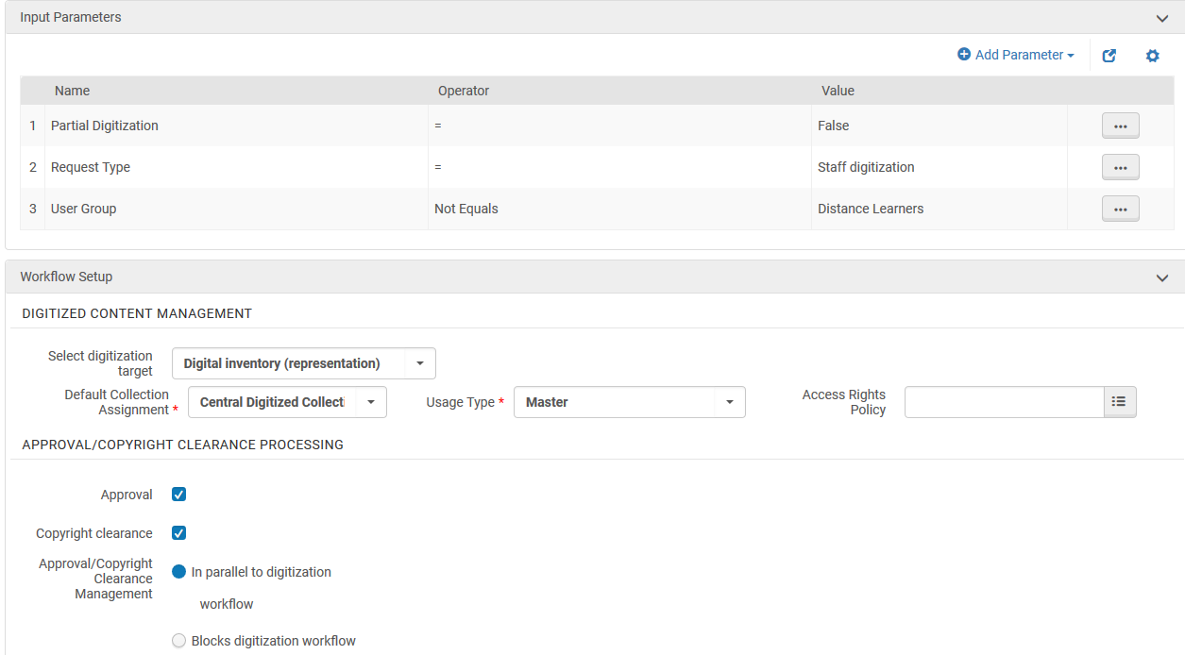
The Digitization Profile Rules
Rule 1
This means it will become part of the repository

Slide 13
The Digitization Profile Rules
Rule 1
In rule 1 we defined that request type = staff digitization and also that user group is not ‘Distance Learners’.
This is ‘acceptable’ to do and perhaps an institution would want to define all rules with a user group.
However, technically speaking, if the request type = staff digitization then including a parameter about the user group is not necessary.
This is because the parameter ‘user group’ is only used when it is a patron digitization and not staff digitization.

Slide 14
The Digitization Profile Rules
Rule 2
We will now look at the second rule.
It states:
If
(it is a Patron digitization request) and (it is a partial request)
and (user group is not distance learner)
then
(digitization target = document delivery attachment)
and (require approval) and (require copyright clearance)

Slide 15
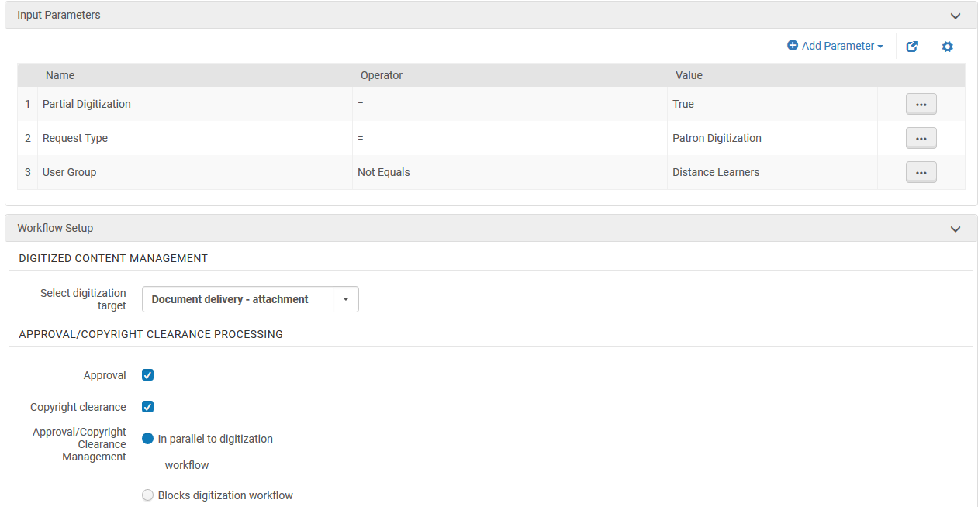
The Digitization Profile Rules
Rule 2
This means the file will be an attachment in the email to the user

Slide 16
The Digitization Profile Rules
Rule 3
We will now look at the third rule.
It states:
If
(user group is distance learner)
then
(digitization target = document delivery link with 3 views)
and
(do not require approval) and
(do not require copyright clearance)

Slide 17
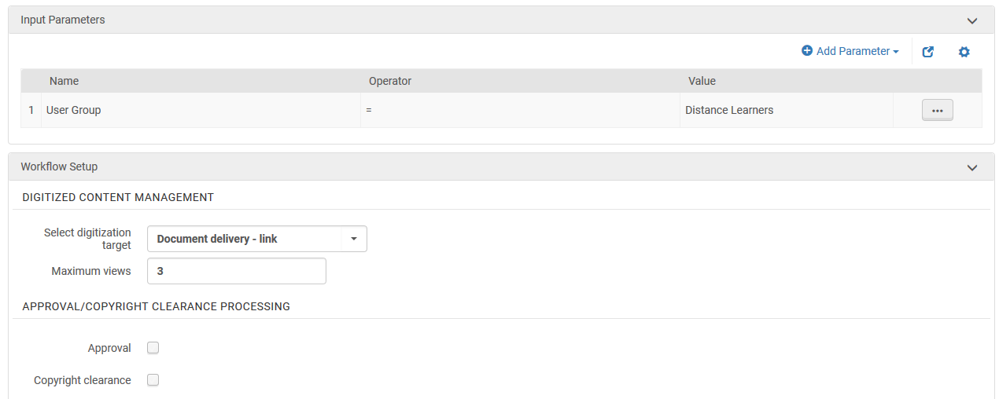
The Digitization Profile Rules
Rule 3
This means the file will be a link in the email to the user and will work for maximum number of views

Slide 18
The Digitization Profile Rules
Default rule
Used if the criteria of other rules are not met.
It states:
If
(anything)
then
(digitization target = digital inventory representation)
and (require approval) and (require copyright clearance)

Slide 19
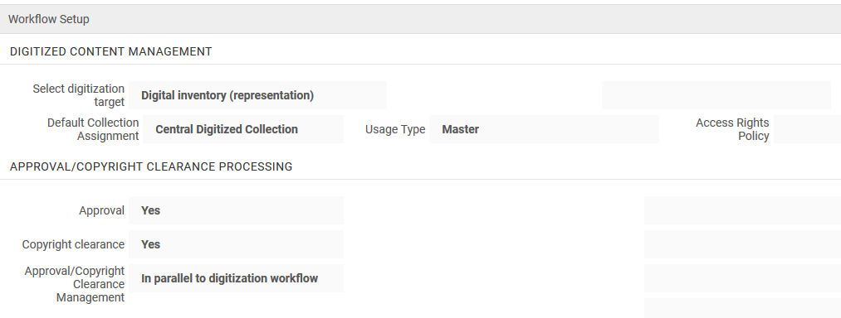
The Digitization Profile Rules
Default Rule
Here are is the default rule
This means the file will be an attachment in the email to the user

Slide 20
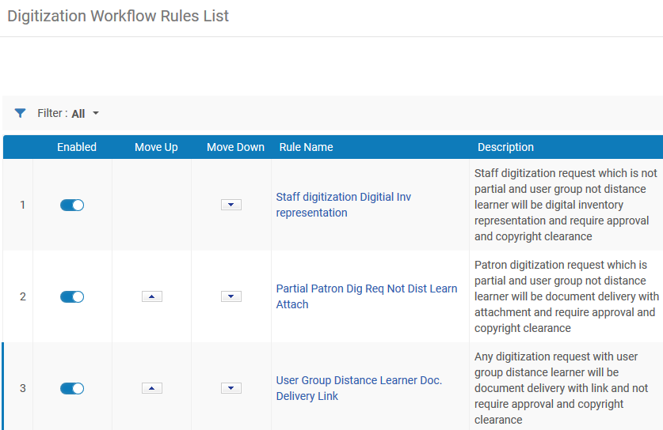
The Digitization Profile Rules
Here are the three rules

Slide 21
The Digitization Department
The Digitization profile rules
Creating digitization requests
Processing digitization requests
Reporting on the digitization requests
https://slidemodel.com/templates/animated-rainbow-business-powerpoint-template/
http://image.shutterstock.com/z/stock-photo-business-hand-writing-blank-agenda-list-130255148.jpg

Slide 22
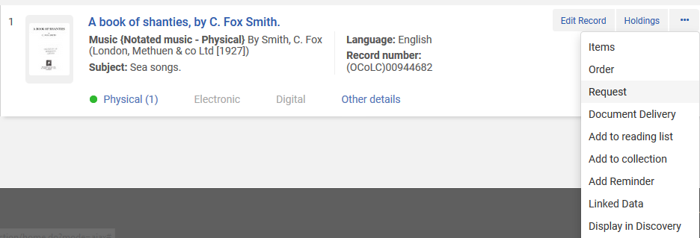
Creating digitization requests
First request
From the Alma repository search click “Request”

Slide 23
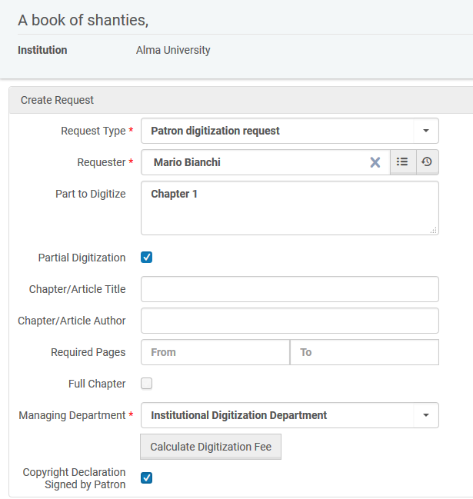
Creating digitization requests
First request
Create a patron digitization request which is a partial request for “A book of Shanties” for patron Mario Bianchi (User Group Undergraduate Student)

Slide 24
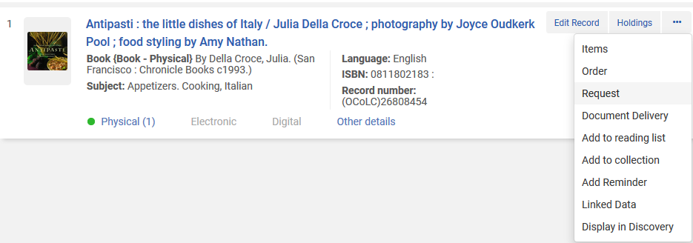
Creating digitization requests
Second request
From the Alma repository search click “Request”

Slide 25
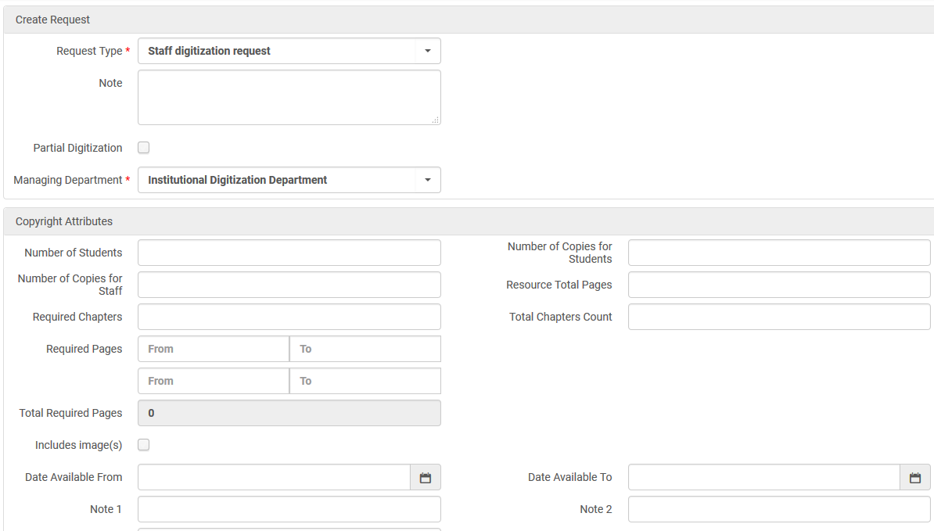
Creating digitization requests
Second request
Create a staff digitization request for “Antipasti the little dishes of Italy” and do not make it partial

Slide 26
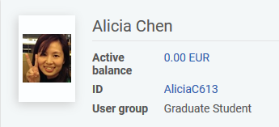
Creating digitization requests
Third request
It is also possible to create the requests via Primo
Here the digitization request is created by user Alicia who is User group “Graduate Student”

Slide 27
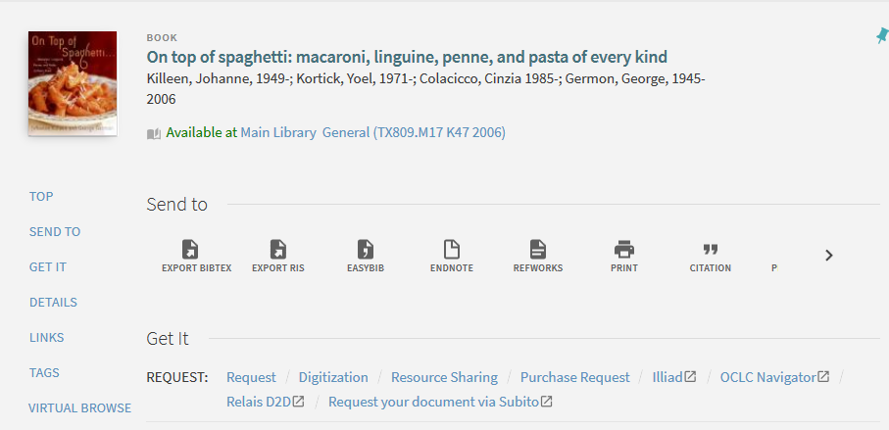
Creating digitization requests
Third request
Alicia Creates the request

Slide 28
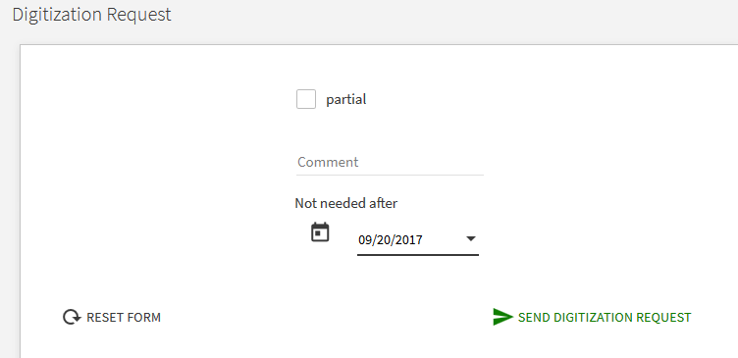
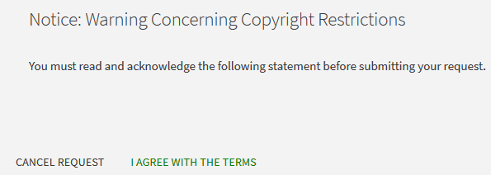

Creating digitization requests
Third request

Slide 29
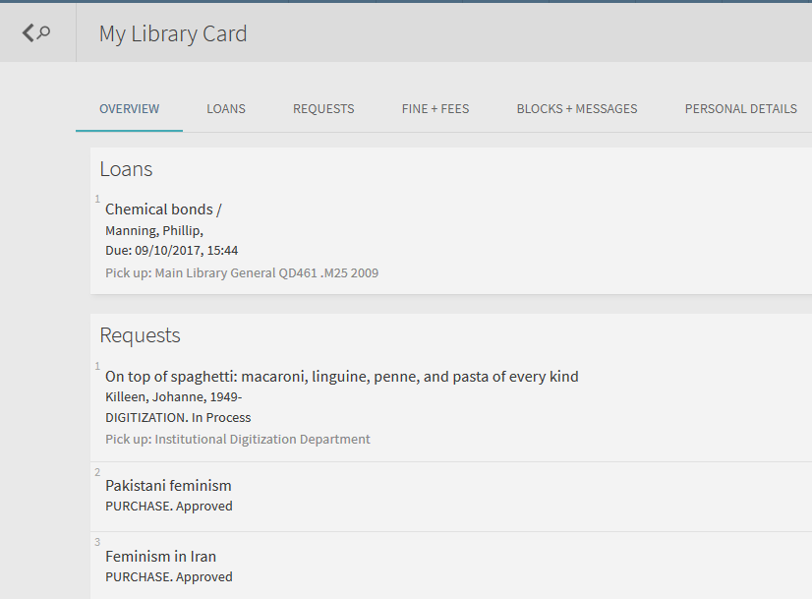
Creating digitization requests
Third request
And it will appear in the Library Card of the patron in Primo

Slide 30
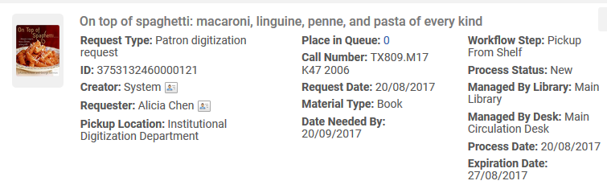
Creating digitization requests
Third request
When the request is made via Primo it is considered a Patron Digitization Request
We saw that she has user group ‘Graduate Student’

Slide 31
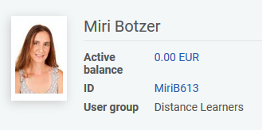
Creating digitization requests
Fourth request
Again we will create the request via Primo
Here the digitization request is created by user Miri who is User group “Distance Learners”

Slide 32
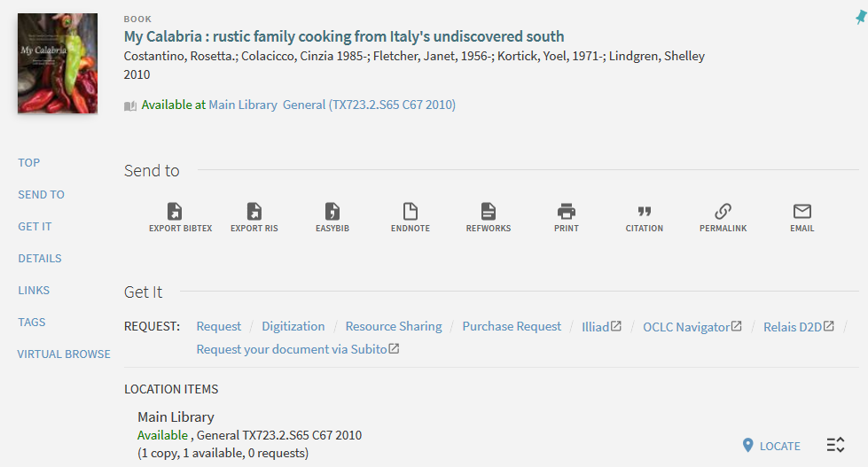
Creating digitization requests
Fourth request
Miri Creates the request

Slide 33
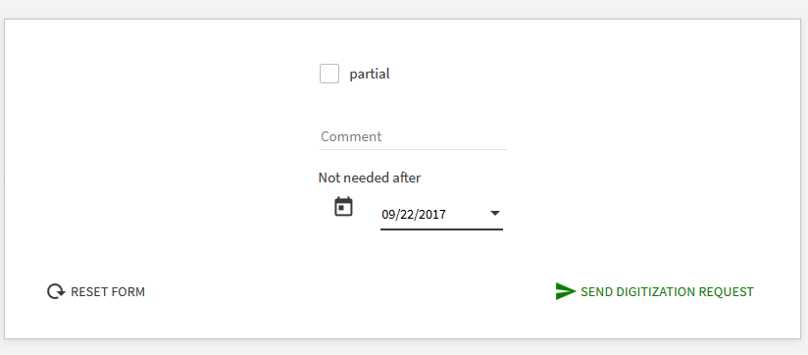
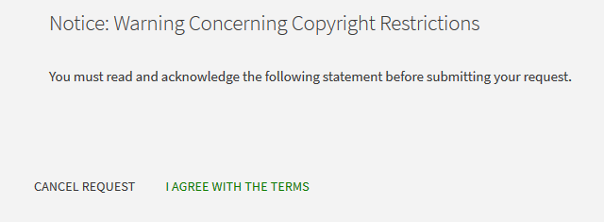
Creating digitization requests
Fourth request

Slide 34
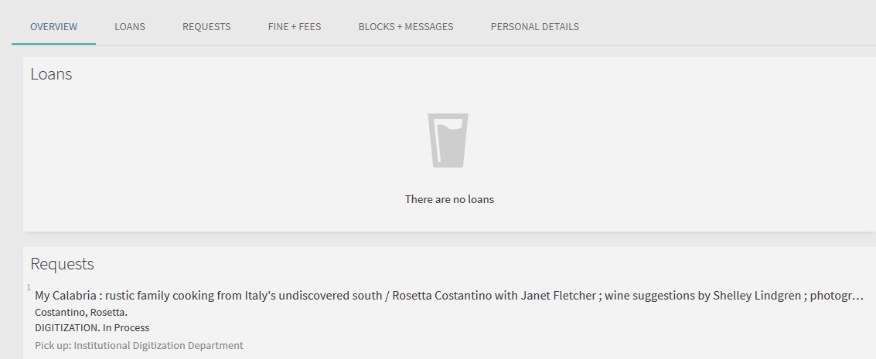
Creating digitization requests
Fourth request
And it will appear in the Library Card of the patron in Primo

Slide 35
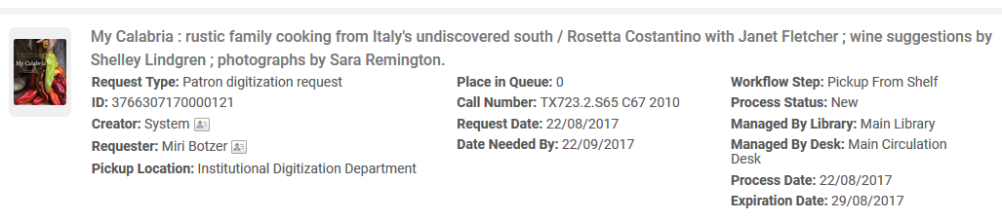
Creating digitization requests
Fourth request
When the request is made via Primo it is considered a Patron Digitization Request
We saw that she has user group ‘Distance Learners’

Slide 36
Creating digitization requests
Summary of the requests we made
First Request: Created in Alma UI for title 'Book of Shanties' for patron who is User Group "Undergraduate Student". It is a patron digitization request and partial. Should use rule 2
Second Request: Created in Alma UI for title 'Antipasti: the little dishes of Italy.' It is a staff digitization request and not partial. Should use rule 1
Third request: Created in Primo by patron who is User Group "Graduate Student" for title 'On top of spaghetti'. It is a patron digitization request and not partial. Should use default rule
Fourth request: Created in Primo by patron who is User Group "Distance Learners" for title 'My Calabria : rustic family cooking from Italy's undiscovered south'. It is a patron digitization request and not partial. Should use rule 3

Slide 37
The Digitization Department
The Digitization profile rules
Creating digitization requests
Processing digitization requests
Reporting on the digitization requests
https://slidemodel.com/templates/animated-rainbow-business-powerpoint-template/
http://image.shutterstock.com/z/stock-photo-business-hand-writing-blank-agenda-list-130255148.jpg

Slide 38
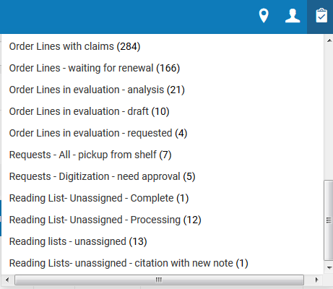
Processing digitization requests
In the task list see the requests waiting for approval

Slide 39
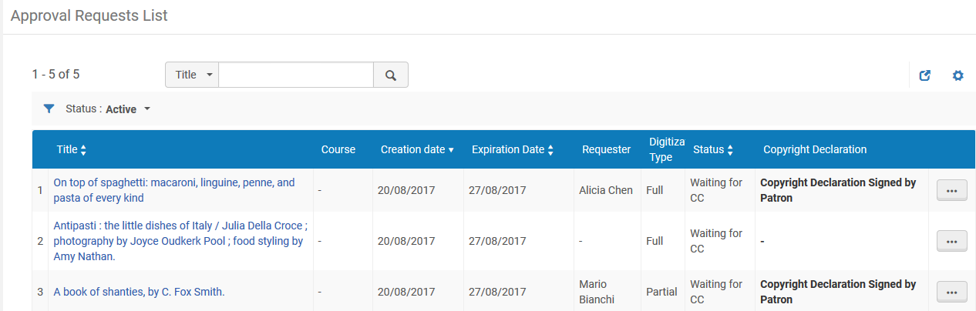
Processing digitization requests
See that requests we made which are in the list are there because the digitation profiles stated that the requests require approval.
The profiles also stated that the requests require copyright clearance.
Title 'My Calabria : rustic family cooking from Italy's undiscovered south‘ uses rule 3 (for User Group ‘Distance Learner’) and does not require approval or copyright clearance and therefore is not in the list.

Slide 40
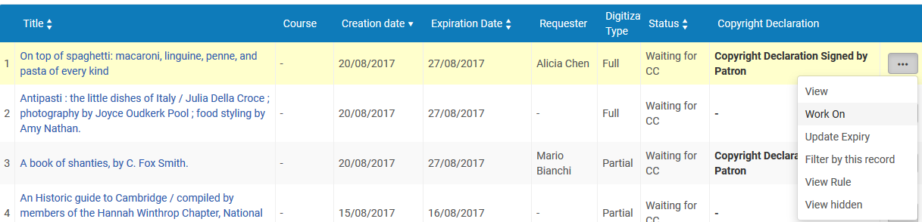
Processing digitization requests
Give them each a CC number and approve it

Slide 41
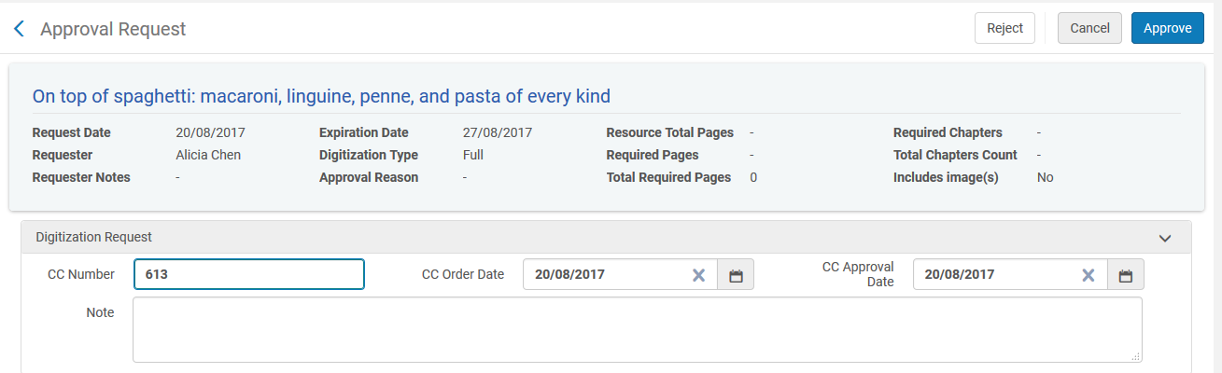
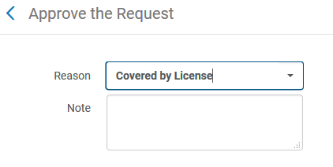
Processing digitization requests
Give them each a CC number and approve it

Slide 42
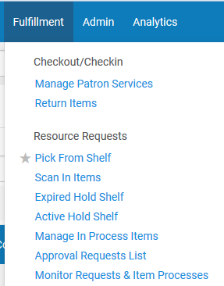
Processing digitization requests
If necessary pick from shelf

Slide 43
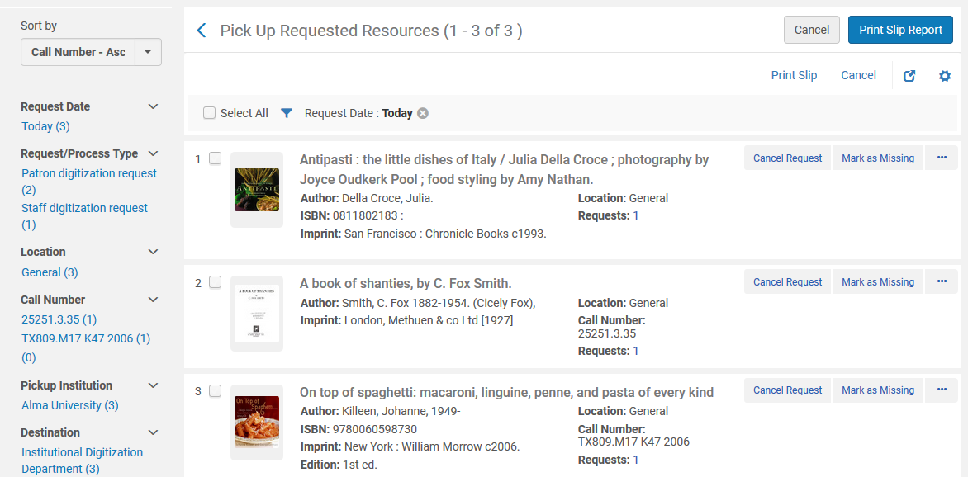
Processing digitization requests
If necessary pick from shelf

Slide 44
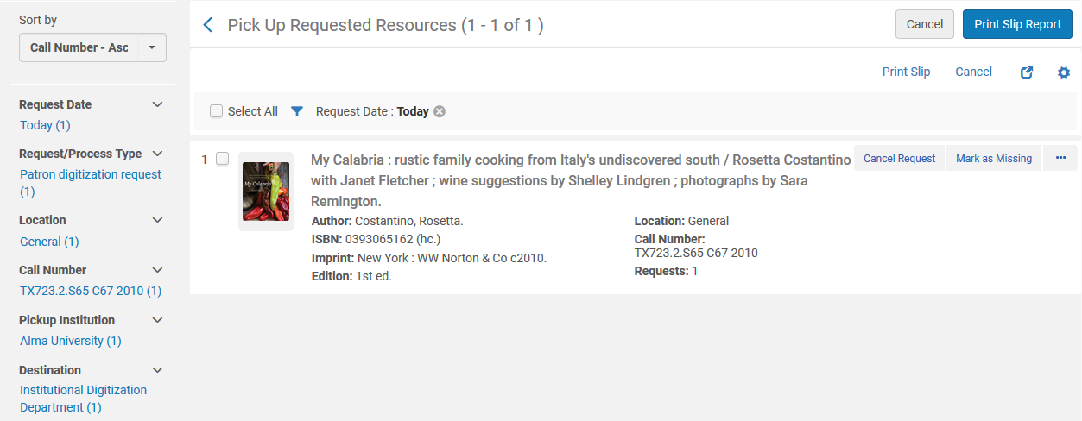
Processing digitization requests
This request was made later by a distance learner via Primo. It does not require approval or copyright clearance but does need to be picked from shelf.

Slide 45

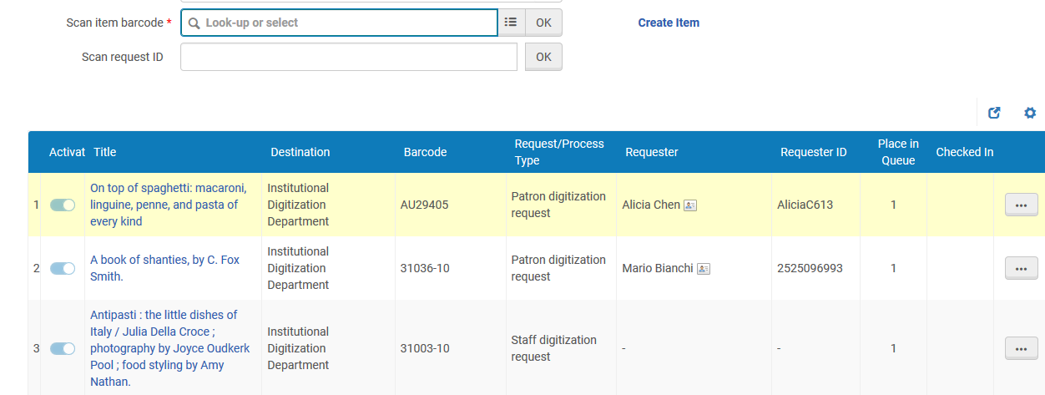
Processing digitization requests
Scan items in at circulation desk and see that they are headed for the digitization dept.

Slide 46
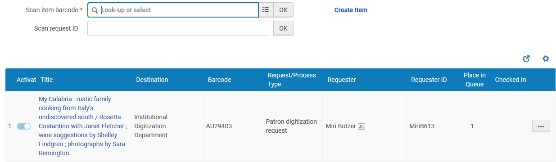
Processing digitization requests
Here is the fourth item scanned in and headed for the digitization dept.

Slide 47
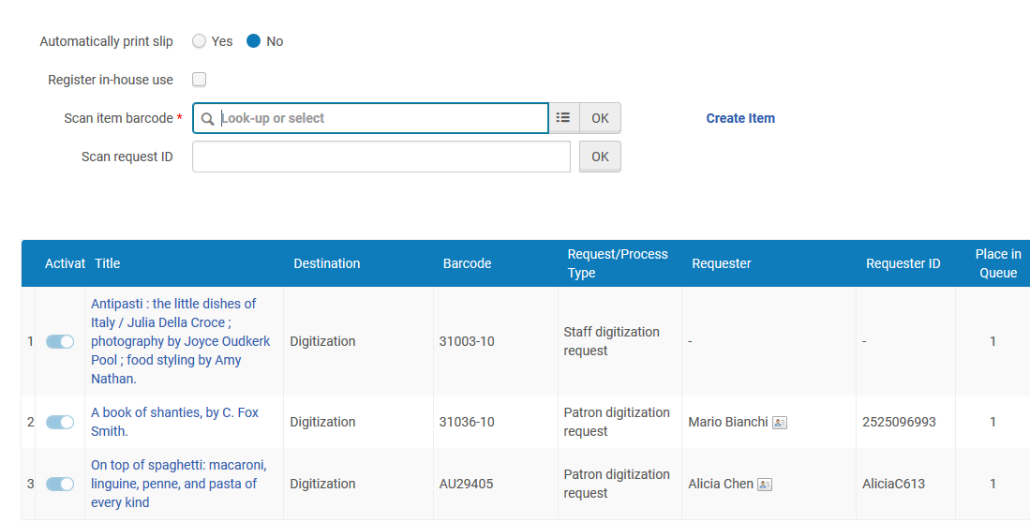

Processing digitization requests
Staff user at Digitation Department scans them in when they arrive to the department

Slide 48
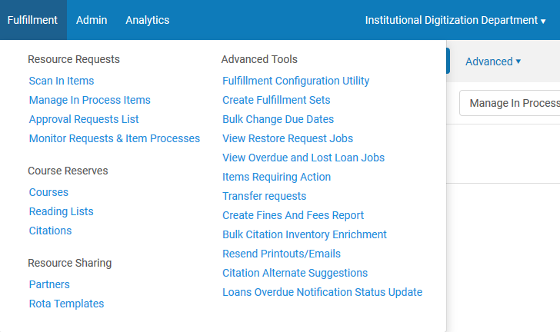
Processing digitization requests
Choose “Manage in process items”

Slide 49
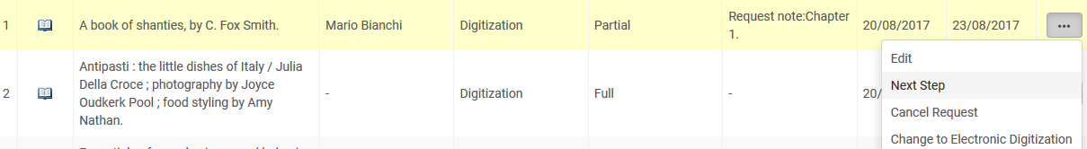
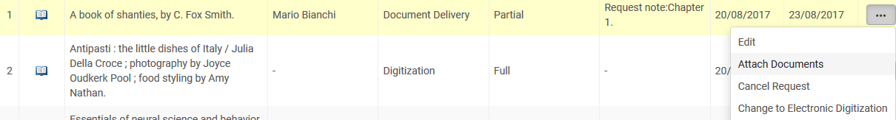
Processing digitization requests
For the partial request choose “Next step” and “Attach documents”

Slide 50
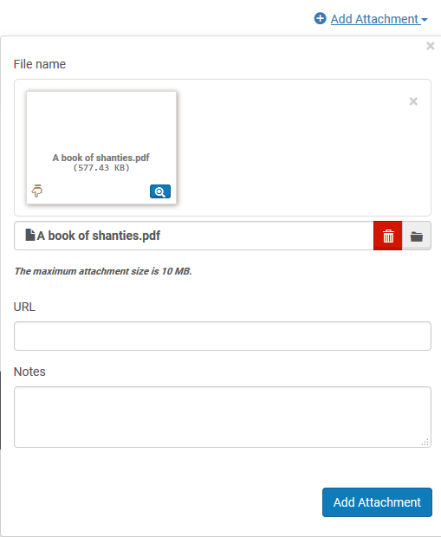
Processing digitization requests
Add the document and click “Done”

Slide 51
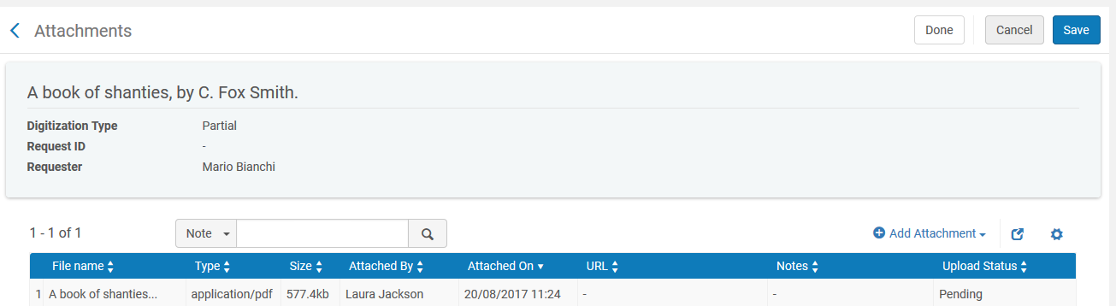
Processing digitization requests
Add the document and click “Done”

Slide 52
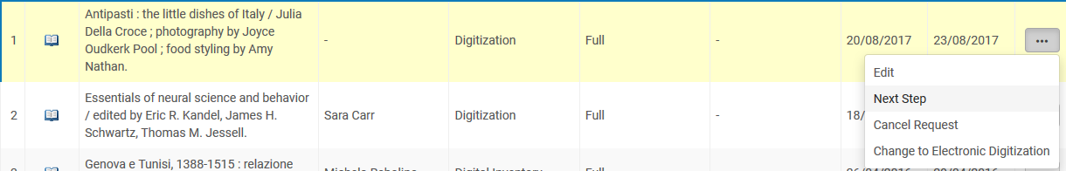
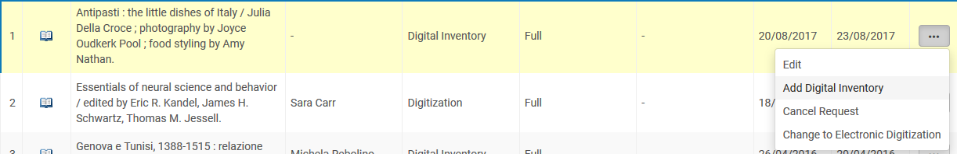
Processing digitization requests
Title ‘Antipasti: the little dishes of Italy’
For the full request with digitization target = digital inventory representation choose “Next step” and “Add digital inventory”

Slide 53
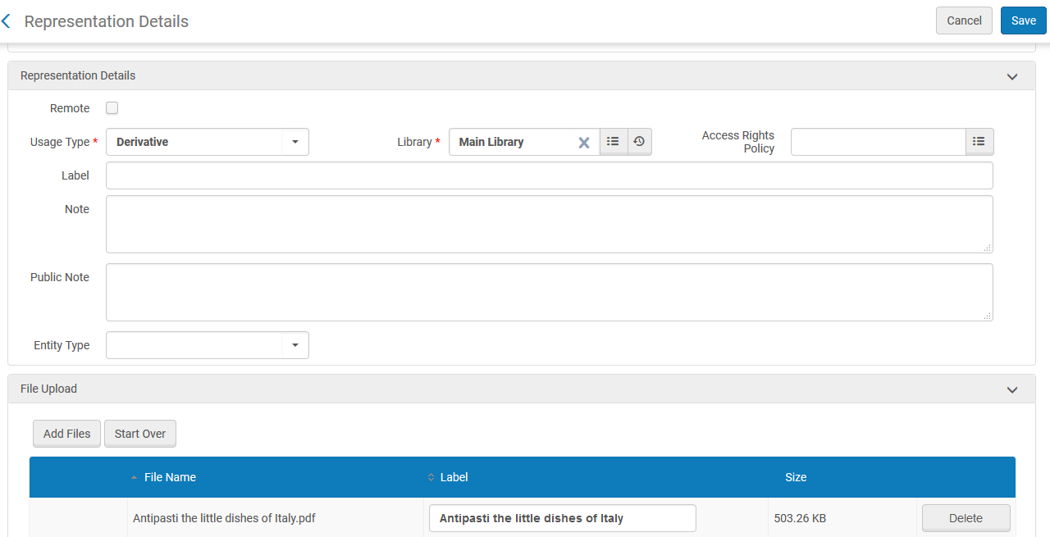
Processing digitization requests
Title ‘Antipasti: the little dishes of Italy’
Add the file and click “Save”

Slide 54
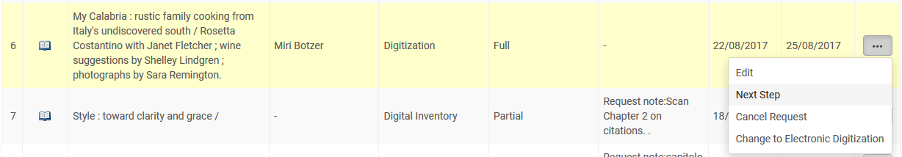
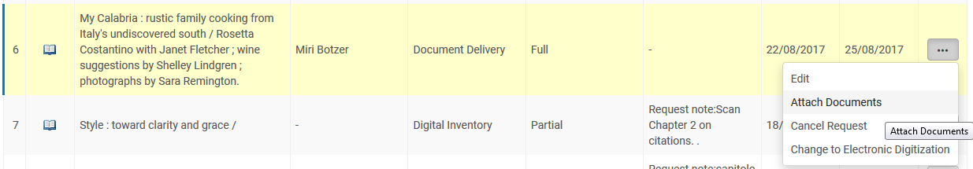
Processing digitization requests
Title ‘My Calibria: rustic family cooking …’
For the full request with digitization target = document delivery link choose “Next step” and “Attach documents”

Slide 55
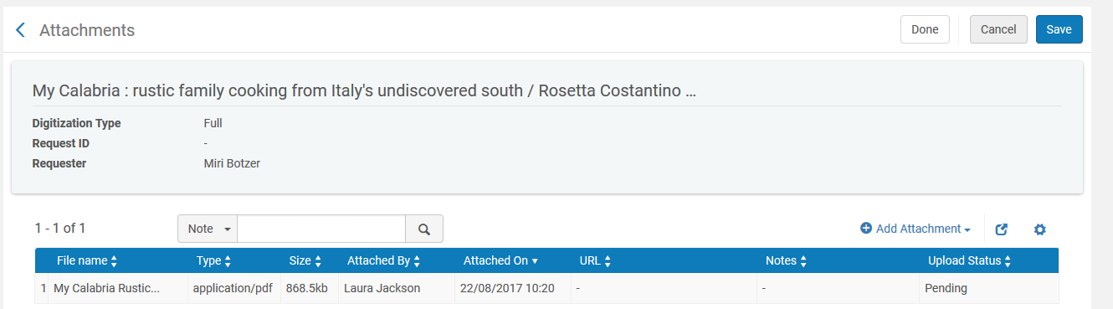
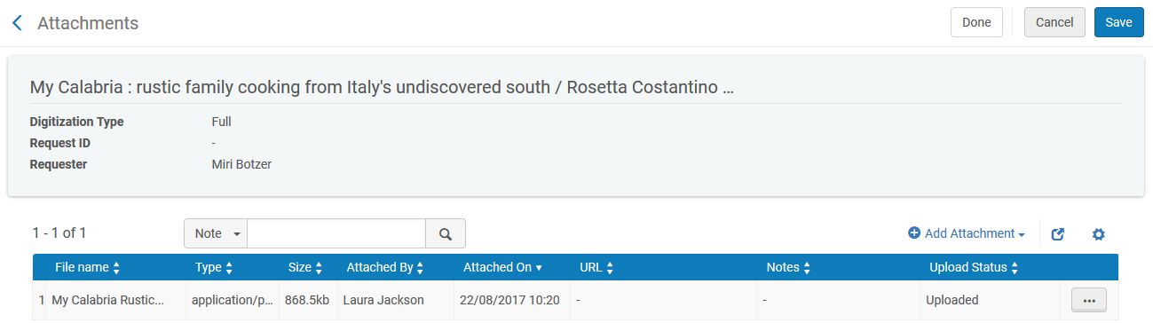
Processing digitization requests
Title ‘My Calibria: rustic family cooking …’
Add the file and click “Save” and “Done”

Slide 56

Processing digitization requests
Finish the process by either
Scanning in the items at the digitization department, which will put them in transit, then scan in again at the owning library circulation desk
Scanning in at owning library circulation desk without first scanning in at the digitization department

Slide 57

Processing digitization requests
All items are back in place

Slide 58


Processing digitization requests
Here we scan in ‘My Calbria’ and it too is in place

Slide 59

Processing digitization requests
Patron who made partial request got the pdf file via mail.
This is because our profile stated ‘if partial digitization = true then digitization target = document delivery attachment’

Slide 60

Processing digitization requests
Patron who made partial request got the pdf file via mail
Email arrived with the pdf

Slide 61


Processing digitization requests
The full digitization request has a digital representation in the repository
This is because our profile stated ‘if partial digitization = false then digitization target = ‘digital inventory representation’ to the ‘central digitized collection’

Slide 62

Processing digitization requests
The full digitization request has a digital representation in the repository

Slide 63

Processing digitization requests

Slide 64

Processing digitization requests
The patron with user group “Distance Learners’ got an email with a link to the file as per rule 3 which stated “digitization target = document delivery link with 3 views”.
We will now click this link

Slide 65

Processing digitization requests
Get prompted to login and then the file downloads

Slide 66

Processing digitization requests
After clicking the link more than the allowed three times the user receives this message:

Slide 67
The Digitization Department
The Digitization profile rules
Creating digitization requests
Processing digitization requests
Reporting on the digitization requests
https://slidemodel.com/templates/animated-rainbow-business-powerpoint-template/
http://image.shutterstock.com/z/stock-photo-business-hand-writing-blank-agenda-list-130255148.jpg

Slide 68
Reporting on the digitization requests
As we have seen all items which require copyright clearance and approval automatically enter the task list and there is no need to manually retrieve them.
Also, all items in the digitization department can be easily retrieved via “Manage in process Items” when at the Digitization Department

Slide 69

Reporting on the digitization requests
It is also possible to use Alma Analytics. Here for example we state that we retrieve all requests which are active and the “request type” is “Digitization”. We display the title, barcode, enumeration a, chronology i and the description

Slide 70

Reporting on the digitization requests
Here is part of the results of the analytics report.

Slide 71

Thank you
Yoel Kortick
Senior Librarian
http://english.bnu.edu.cn/

