Slide 1

campusM Environments
Training Webinar
Notes:
Hello and welcome to this campusM training video
This video will provide you with an overview of your campusM Environments and the components that it consists of.

Slide 2
Learning Objectives
Introduce the campusM Environment Components
Explain the environment types and usage
Highlight the Monthly Release Process
Explain how to access your campusM Environments
Review
Notes:
Over the next few minutes I will summarise the key components that make up each campusM environment.
We will then talk about the different environments that you have access to as part of your campusM deployment, along with their typical usage
Whilst talking about these environments, I will introduce our monthly release cycle and explain how this affects these environments
We will then discussion how you access these environments, both as an app administrators and as an end user.

Slide 3






campusM Environment Components
campusM
App Client
iOS
Android
Web
User
Device
campusM
Cloud Platform
Exlibris
Cloud
App Manager
Web
Customer
Premises
campusM
Connect Layer*
Java
Apache Tomcat
*Optional Component
Notes:
Lets start by talking about what makes up a campusM environment.
Most of your users will experience campusM in the form of its end user client – either on a native mobile device or through the web app using a browser.
The campusM App is available natively for iOS and Android devices – including mobiles and tablets. For all other devices we provide a responsive web app.
These end user apps are powered by the campusM Cloud Platform, hosted regionally within the Ex Libris Cloud. This cloud platform provides the application services and infrastructure in a highly secured and highly available SaaS model
As app administrators, you will have access to a web based configuration tool – App Manager – that allows you to configure your campusM environment and define your end users’ experiences. This also offers access to other services such as App insight Analytics delivered through Oracle Business Intelligence
Finally, some customers may have a locally installed component – the Connect Layer – as part of their deployment. This provides assess to on premise services and data. It will be made clear as part of the implementation wherther the Connect Layer forms part of your campusM Environment.
All of these components come together to form each campusM environment.

Slide 4



campusM Environments
Sandbox
Production
Preview
Monthly
Snapshot
Sandbox Environment used for developing and testing content and experiences before migration to production
Production Environment used by your end users to access campusM
Environment used to Preview the coming month’s release. Snapshot taken of Production a week before the release date and used to populate Preview Enviroment
Native Apps available through App Center. Web App through browser
Native apps available through App Stores. Web App through browser
Native Apps available through App Center. Web App through browser
Shared App Manager instance
Separate App Manager instance
Notes:
Lets now look at the environments you get as part of your campusM deployment.
Typically you will have access to there environments:
Your Sandbox environment, which is used for developing and testing content and experiences before migration to production. Access to this environment will usually be limited to app administrators, developers and testers only
Then you have Your Product App, which is live and in use by your end users
And finally you will have a preview environment, which is used Preview the coming month’s release. This is an important environment as it provides a way to explore the features that are coming to your production environment one month ahead, as part of the monthly release cycle for campusM. Again, access to this environment will usually be limited to app administrators and tester only
Each of these envibroments have their own end user apps, with a shared app manager instance managing your Sandbvox and Prodiction Enviroment whilst a seperate app manager instance is available for your preview environment.

Slide 5
campusM Environments – Monthly Releases
Sandbox
Production
Preview
Monthly
Snapshot
Sandbox Environment used for testing and developing conten and experinces before migration to production
Production Environment used by your end users to access campusM
Environment used to Preview the coming month’s release. Snapshot taken of Production a week before the release date and used to populate Preview Enviroment
Current Release
Next Release
Notes:
Its important at this point to mention the monthly release cycle for campusM
As part of our commitment to ensure your app remains current and engaging, we have an agile development process that is underpinned with monthly releases. These releases are clearly scheduled and are packaged together with comprehensive release notes
To make sure you have good visibility of the monthly changes, we provide you with A preview environment so that you can explore the coming new features a month before they are made available on your Production Environment.
We take a snapshot of your production environment just before the monthly release to provide you with a Preview environment that is as close as possible to your Production Environment. This allows you to explore the new features in a near identical environment to that of you Production

Slide 6






Accessing the Native Apps though App Center
Sandbox App
SB (XX.XX.XX-SB-CAMPUSM-MONTH-YEAR)
Production App (Release Candidate)*
RC (XX.XX.XX-RC-CAMPUSM-MONTH-YEAR)
Preview App
PV (XX.XX.XX-PV-CAMPUSM-MONTH-YEAR)
Apple Devices
Sandbox App
SB (XX.XX.XX-SB-CAMPUSM-MONTH-YEAR)
Production App (Release Candidate)*
RC (XX.XX.XX-RC-CAMPUSM-MONTH-YEAR)
Preview App
PV (XX.XX.XX-PV-CAMPUSM-MONTH-YEAR)
Android Devices
* Current production version available though official App Stores
Notes:
Now let talk about how you access the key components of these different environments. First off, lets discuss access to the end user apps.
Due to the restrictions made by the official app distribution platforms (app store and the play store), we cannot make nonproduction apps available to download through these typical routes. TO this end, we use App Center from Microsoft to enable you to download the Sandbox, Release Candidate and Preview apps for the respective environments.
You will be provided with App Center login details as part of your deployment. From here you can access and download the relevant end user clients for iOS and Android devices.
Note that the release Candidates available for your Product Environment are the Native App versions of the current months release. They may not reflect your current live Production Native App version if you are yet to update. To view your current live native app then download from the relevant App Store.

Slide 7


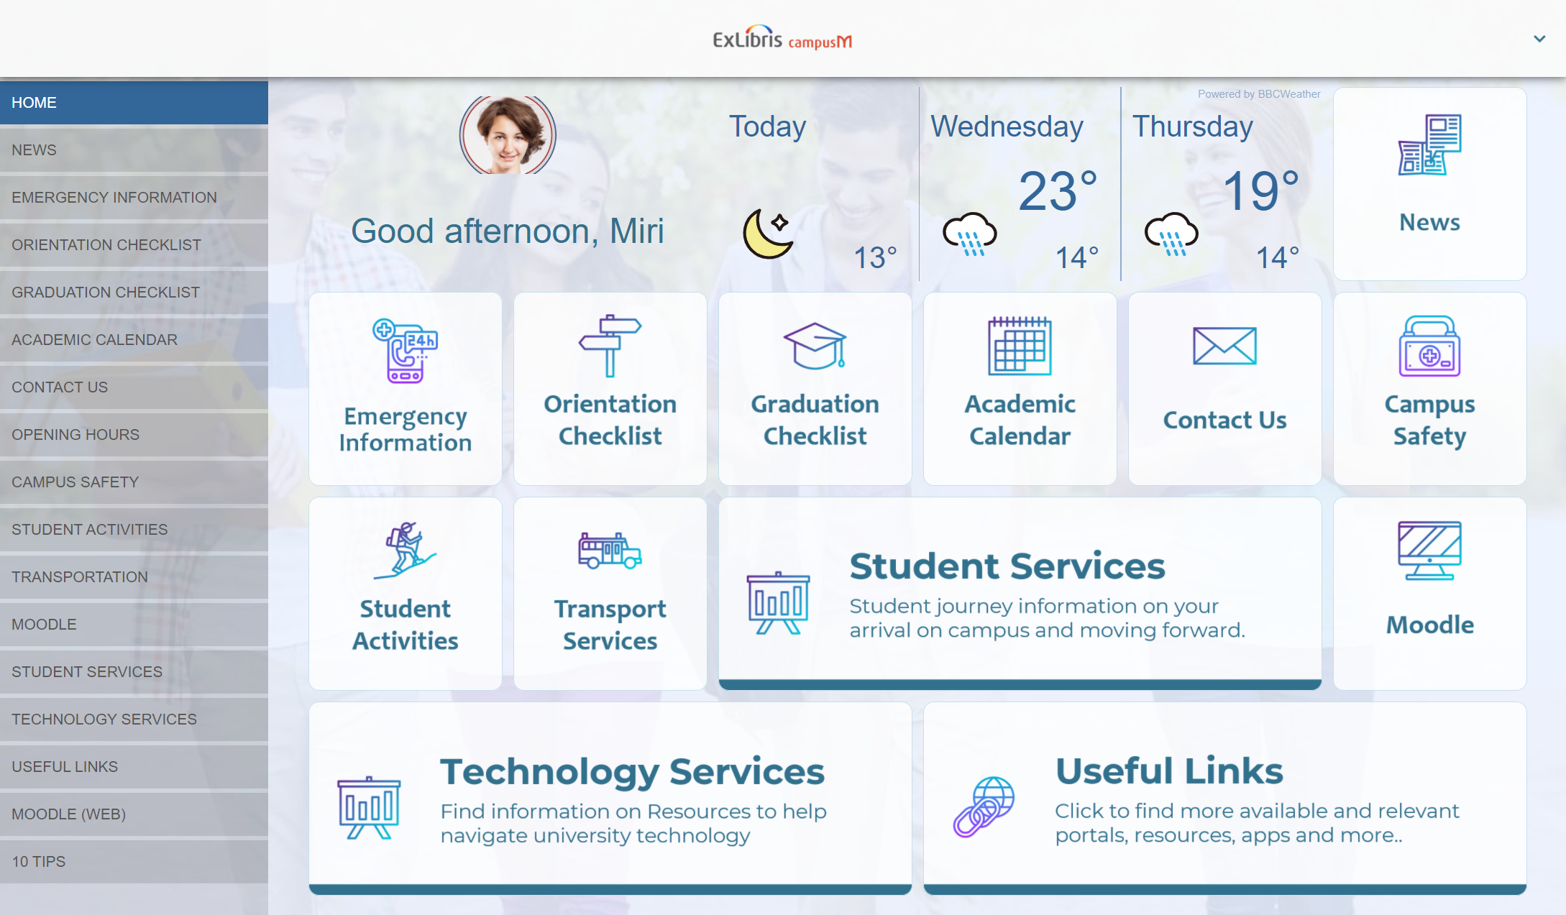


Accessing the Web Apps though a Bowser
Sandbox App
https://CustomerName-sandbox.campusm.exlibrisgroup.com
Production App
https://CustomerVanityURL.com
Preview App
https://CustomerName-preview.campusm.exlibrisgroup.com
Notes:
Accessing the web apps simply requires you to enter the URLS provided to you as part of your implementation. Simply enter these into your browser of choice.

Slide 8
Accessing App Manager
Sandbox
Production
Preview
https://appmanager.ombiel.com/
https://appmanager-eu01-preview.campusm.exlibrisgroup.com/
EMEA
North
America
https://appmanager-na.campusm.exlibrisgroup.com/
https://appmanager-na01-preview.campusm.exlibrisgroup.com/
https://appmanager-ap.campusm.exlibrisgroup.com/
https://appmanager-ap01-preview.campusm.exlibrisgroup.com/
APAC
Notes:
To access App Manager for your environments, you need to use the URLS relevant for your Global region
As already discussed, you have access to a shared app manage environment for your Sandbox and Production Environments, whilst the Preview Environment app manager is accessed through a separate instance. Your will be provided with the URLS for your regional App Manager instances as part of the deployment, and as shown on the screen here.

Slide 9
Summary
Each campusM Environment is composed of
  campusM App Client for Web, iOS and Android
  ExLibris Cloud platform and App Manager
  Optional Connect Layer
Typically customers have 3 environments:
  Sandbox – For testing and development
  Production – For live apps
  Preview – to preview the coming release
A snapshot of production is taken monthly and copied to Preview to aid testing
Sandbox, Preview and Release Candidate native apps can be accessed through App Center
Notes:
Lets summarise
Each campusM Environment is composed of end user clients for Web, iOS and Android, the ExLibris Cloud platform and App Manager. You may also have an optional Connect Layer as part of your deployment
Typically customers have 3 environments: a Sandbox, for development and testing; a Production Environment providing your live apps; and a Preview environment, used to preview the coming release
campusM is developed agilely with monthly releases. To facilitate reviewing the coming release, a snapshot of your production environment is taken each month and deployed to Preview
Your Sandbox, Preview and Release Candidate native apps can be accessed through App Center, whilst the web apps can be accessed through standard web browser

Slide 10
Further Information
Environments Overview
  https://knowledge.exlibrisgroup.com/campusM/Product_Documentation/02_Managing_the_App_Manager_Environment/00_App_Manager_Preview_and_Sandbox_Environments
App Center FAQ
  https://knowledge.exlibrisgroup.com/campusM/Knowledge_Articles/App_Center_FAQ
Release Schedule and Release Notes
  https://knowledge.exlibrisgroup.com/campusM/Release_Notes
Notes:
Further information on the topics discussed can be found on the Ex Libris Knowledge center

Slide 11
Thank you!
Notes:
Thank you for listening

