Slide 1
Systems Administration
Notes:
Hello and welcome to this session on SFX Systems Administration.
This presentation is copyrighted and is the confidential property of Ex Libris Ltd. Information included in this presentation is periodically reviewed and updated. You may shared these training materials within your institution but not beyond.

Slide 2
Copyright Statement
All of the information and material inclusive of text, images, logos, product names is either the property of, or used with permission by Ex Libris Ltd. The information may not be distributed, modified, displayed, reproduced – in whole or in part – without the prior written permission of Ex Libris Ltd.
TRADEMARKS Ex Libris, the Ex Libris logo, Aleph, Alma, SFX, SFXIT, MetaLib, DigiTool, Verde, Primo, Voyager, MetaSearch, MetaIndex and other Ex Libris products and services referenced herein are trademarks of Ex Libris, and may be registered in certain jurisdictions. All other product names, company names, marks and logos referenced may be trademarks of their respective owners.
DISCLAIMER The information contained in this document is compiled from various sources and provided on an "AS IS" basis for general information purposes only without any representations, conditions or warranties whether express or implied, including any implied warranties of satisfactory quality, completeness, accuracy or fitness for a particular purpose.
Ex Libris, its subsidiaries and related corporations ("Ex Libris Group") disclaim any and all liability for all use of this information, including losses, damages, claims or expenses any person may incur as a result of the use of this information, even if advised of the possibility of such loss or damage.
© Ex Libris Ltd., 2014

Slide 3
Agenda
SFX Environment
Backup and Recovery
Security
Testing and Debugging
Server Admin Utility
KB Update
Recommended Maintenance
Summary and Additional Resources
Notes:
In this session:
First, we’ll take a look at the SFX server and see how it’s structured.
Next, we’ll go over how back up and recovery works in SFX and also look at security and how it’s handled.
We’ll also cover how to access and use the log files for testing and debugging, as well as how to use the debugging tool in SFX Admin Center.
We’ll take a close look at the server admin utility, and each of its options.
We’ll also talk about the KB (KnowledgeBase) Update process.
Lastly, we’ll go over the standard recommended maintenance for SFX.
Keep in mind that we’ll just be going over basic systems administration information – all of the information in this session is also covered the Systems Administration Guide. There will be times when I’ll cover a topic, and you’ll be thinking ‘Ok, but how to I actually run a backup, or how do I configure my security settings” – the System Admin guide has step by step instructions on how to perform many of these tasks, so we’ll be focusing on the what and why, rather than the how in this session. Please rest assured that all of the how to’s are documented and available when you need it.

Slide 4

Objectives
How To…
Define SFX environment structure
Backup and recover SFX
Test and debug
Run jobs and perform recommended maintenance
Perform KB updates
Notes:
By the end of this presentation, you will have an understanding for:
how SFX is structured
how backup and recovery works
how to use the log files for troubleshooting and debugging, as well as the Debug Tool in SFX Admin Center
how to use the Server Admin Utility to run jobs, perform maintenance, change passwords, run indices and diagnostics
what you need to do to keep SFX happy and healthy (and up to date!) with KnowledgeBase updates and recommended maintenance tasks

Slide 5
Agenda
SFX Environment
Backup and Recovery
Security
Testing and Debugging
Server Admin Utility
KB Update
Recommended Maintenance
Summary and Additional Resources
Notes:
Let’s first talk about the SFX environment and how it’s structured.

Slide 6
SFX Environment - Instances
SFX Global (sfxglb41)
SFX Test (sfxtst41)
SFX Local (sfxlcl41)
Notes:
Three instances are provided with the basic installation of SFX.
In particular for those who host SFX locally, there are instructions on how to change the name of instances and create additional ones in the System Admin Guide. Keep in mind that you'll need additional license keys for these instances, so you'll need to request them from Ex Libris if you don't have them already.
In general, the Global instance is where everything is updated when you run SFX or KnowledgeBase updates.
The Test instance is used to create your own test area, and the Local instance is where your institution’s resources are activated and customized. The Local instance stores only the data that is specific to you, such as activation status and local data (date coverage/threshold information, linking parameters, local parsers, etc.)

Slide 7
SFX Environment – Symbolic Links
Yes – new file created in local instance
No – file opens in read only mode
Notes:
All files for SFX exist in the global instance, and are symbolically linked to the local instance. The local instance uses the symbolic links to refer back to the files in the global instance.
When editing files in an instance other than global, know that most of the files are really just links to files in the global instance. We recommend that you use vi editor in UNIX as your text editor because it displays a warning when you're editing a file that's actually a link. When you're editing one of those files using vi editor, you'll get this message asking you to break the symbolic link.
If you do break the symbolic link (click), vi editor creates a copy of the file in the local instance and you can edit the file as you wish. For example, if you want to do customizations such as change the colors and fonts in your SFX instance, it may be necessary to break the symbolic link.
If you answer no, (click) vi will open the file in the global instance in read-only mode. We recommend that you do not make any local changes to the files directly in the global instance because these files may be updated without warning during SFX updates.
You can break the symbolic link and reconnect it later on; the instructions are in the Systems Administration Guide.

Slide 8
SFX Environment – Structure
Installation
4_1
Instance
Global
sfxglb41
Instance
Local
sfxlcl41
Institute
(optional)
Institute
(optional)
Instance
Test
sfxtst41
Notes:
With that in mind, let’s look at the SFX structure. (click)The installation level is the complete SFX application - you can actually have more than one installation on a server, which is why we’re seeing the 4 underscore 1 – this is version four, and the installation is in slot 1.
(click) Within each installation, there are instances. There are basically two types of instances:
- the global instance, which has information about objects for all customers and is maintained by Ex Libris
- the local has information relevant only to your specific institution, like activation information, local coverage, and specific linking information. The local information also includes overrides of the global data. In a default installation, you have two local instances - the production environment (lcl) and the test environment (tst).
(click) The institute is a localized subdivision of a local instance. Institutes have their own configuration settings that can be different from the instance defaults.

Slide 9
SFX Environment – File Structure
exlibris/sfxver/sfx4_1
sfxglb41
admin
archive
cgi/core
cgi/public
config
dbs
export
home
lib
logs
sfxadmin
templates
sfxtst41
admin
archive
cgi/core
cgi/public
config
dbs
export
home
lib
logs
sfxadmin
templates
sfxlcl41
admin
archive
cgi/core
cgi/public
config
dbs
export
home
lib
logs
sfxadmin
templates
app
data
proxy
Notes:
Here we’re seeing the file structure -
Besides the global and local instances, there are three other directories in the SFX installation:
App - contains all supporting software required to run SFX (MySQL, Perl, Python, Java, and Apache Web servers, and more
Data - Contains MySQL databases
Proxy - contains reverse proxy apache files
in each instance:
admin - command line tools
archive - statistics archive files
cgi/core - SFX core CGI programs (not editable)
cgi/public - CGI programs required for certain targets (editable)
config - all configuration files
dbs - SQL table definitions and scratch directory
export - export files from KBTools
home - home directory of the instance
lib - perl modules, target parsers, source parsers, and target displayer programs
logs - SFX requests logs when redirection is used; used to see requests sent to the SFX server
sfxadmin - programs for the SFX Admin Center
templates - HTML pages for the SFX menu screen, the HTML electronic journal lists, etc.

Slide 10
Agenda
SFX Environment
Backup and Recovery
Security
Testing and Debugging
Server Admin Utility
KB Update
Recommended Maintenance
Summary and Additional Resources
Notes:
Now that we have covered the server file structure, let’s talk about backup and recovery options.

Slide 11
Backup & Recovery
Direct customers don’t perform backups
Two types of backups
Backup with downtime (weekly)
Backup with no downtime (daily)
Notes:
The first thing to know about backups is that if you’re a direct customer where your SFX instance is hosted on an Ex Libris server, you don’t need to perform backups – Ex Libris provides this service. If you are a Direct customer, note that backups with no downtime will be run for you each day. So you and your users should see no impact in using SFX.
If you host SFX locally on your own server, there are two types of backups; (click) a backup with downtime that we recommend running on a weekly basis, and (click) a backup with no downtime, that we recommend running on a daily basis.

Slide 12
Backup & Recovery – Downtime
Backup includes
SFX files
MySQL databases
Pros/Cons
Pro – fast, easy, straightforward recovery
Con – downtime
To perform a backup with downtime:
csh -f /exlibris/backup/scripts/exec_backup_main s1
Notes:
For customers who host SFX locally, let’s talk briefly about the backup that requires downtime.
The backup with downtime is a .tar archive that includes a backup of the SFX installation, including software files and MySQL databases. This backup can be run every day, but because of the required downtime, this might be inconvenient for you.
(click) Let’s talk pros and cons -
The advantage to running the full backup is that the recovery is fast, easy, and very straightforward.
The disadvantage is, obviously, the downtime - this backup requires shutting down the MySQL and Apache servers. The length of the downtime depends on how long it takes to create the .tar file.
(click) To perform this backup with downtime, log on as the UNIX root user and type:
csh -f /exlibris/backup/scripts/exec_backup_main s1

Slide 13
Backup & Recovery – No Downtime
Backup includes
SFX files
MySQL hot-copy dump of database files
Pros/Cons
Pro – no downtime!
Con – recovery requires manual work
Notes:
Running the backup with no downtime creates a .tar archive of the SFX tree that includes the SFX files and a .tar archive per instance, which is a mySQL hot-copy dump of the database files.
(click) Since there is no downtime with this backup method, it’s more convenient to run this backup daily, but the recovery requires more manual work, since it is based on a binary copy of the MySQL databases.

Slide 14
Backup & Recovery – No Downtime
Three types of backups
Hot backup of MySQL data files
csh -f /exlibris/backup/scripts/exec_backup_main s2
Software excluding MySQL data files
csh -f /exlibris/backup/scripts/exec_backup_main s4
Incremental backup of bin log
csh -f /exlibris/backup/scripts/exec_backup_main s3
Notes:
Again, for local customers only, there are three ways to perform a backup with no downtime. For direct customers, ExLibris runs the backups with no downtime for you.
During a backup with no downtime:
(click)There’s the Hot backup of MySQL data files
(click) You can also backup the Software excluding MySQL data files
(click) and you can also create Incremental backups of the bin (binary) log.
If you’re going to be running any backups, please refer to the System Admin Guide for more detailed information.

Slide 15
Backup & Recovery – Recovery
Database schema
Global (sfxglb41)
Local (sfxlcl41, sfxtst41)
Restoration
Full (all databases)
Cold backup
Single instance
Hot backup
Notes:
In SFX version 4, database information for each local instance is stored in two separate database schemas:
(click) Global or descriptive information such as target, target service, and portfolio information is stored in the global schema.
(click) Local information such as activation, local coverage, and your institution’s specific linking information is stored in the local instance schema.
Only one copy of the global information exists per SFX installation. This global information is maintained by Ex Libris as part of the global KnowledgeBase.
Any locally created descriptive database items (for example, targets, target services, portfolios, and objects) for each of the local instances are stored in the local schema.
Because of this, to recover SFX from a backup, you have two options if you’re a Local customer:
(click)A full restoration, which includes all of the databases in the installation. A full restoration is going to ensure that the global and instance databases are synchronized. You’d perform this restoration when the cold backup was used.
(click) The other option is to recover a single instance, which involves restoring both the instance local database schema and those database records in the global schema that are owned by the local instance. You can only perform this recovery if you are using the hot backup method.
There are step-by-step instructions on how to perform a database recovery in the System Admin Guide. Again, for Direct customers, keep in mind that Ex Libris will be responsible for backups as well as recovery.

Slide 16
Agenda
SFX Environment
Backup and Recovery
Security
Testing and Debugging
Server Admin Utility/Jobs
KB Update
Recommended Maintenance
Summary and Additional Resources
Notes:
I’d briefly like to mention SFX and security at this point…

Slide 17
Security
Support for SSL
Restricting Access to SFX Admin
Restricting Access to SFX Menus
Session Timeout in SFX Admin
XSS Cross-Site Scripting Security Breach
Notes:
(click) SFX has support for SSL – so it’s possible to configure instances so that SFX and the Admin Center are accessible using HTTPS. You’d want to do this if you wanted to make SFX more secure, and/or if you wanted to support the UNIX file manager in the SFX Admin Center.
(click) You can restrict access to the Admin Center based on IP.
(click) You can restrict access to the SFX menus based on IP.
(click) There is a session timeout that you can configure for the Admin Center; right now the default is that SFX Admin Center will timeout after 4 hours of inactivity.
(click) and finally, SFX is set up to handle security breaches called XSS or cross-site scripting. This is a type of breach that could be caused by harmful HTML tags sent through as an OpenURL request. So there is some validation that’s in place to prevent this from happening.
If you’re concerned with security, please refer to the System Admin Guide – there’s an entire section on security that goes into a lot more detail than I have here.

Slide 18
Agenda
SFX Environment
Backup and Recovery
Security
Testing and Debugging
Server Admin Utility
KB Update
Recommended Maintenance
Summary and Additional Resources
Notes:
Let’s now turn our attention to testing and debugging.

Slide 19
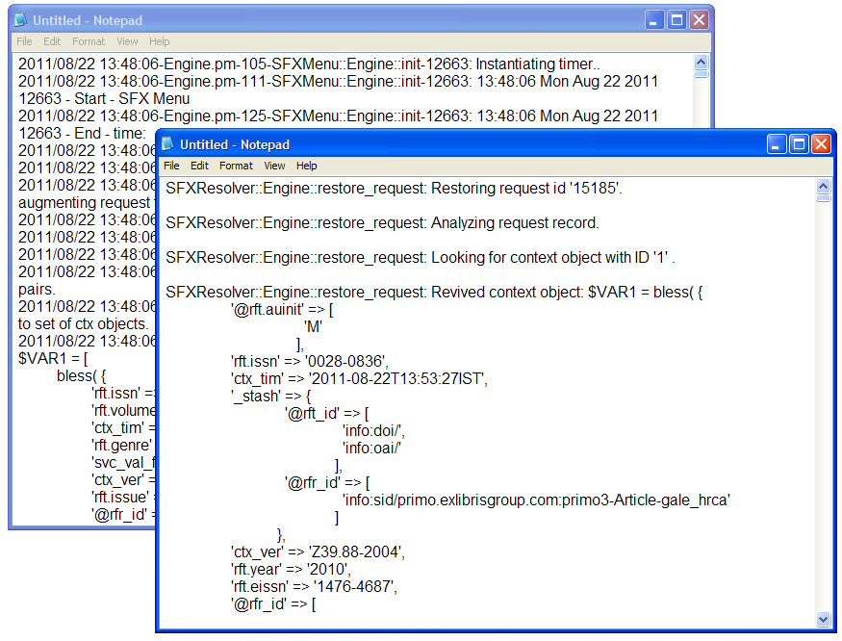
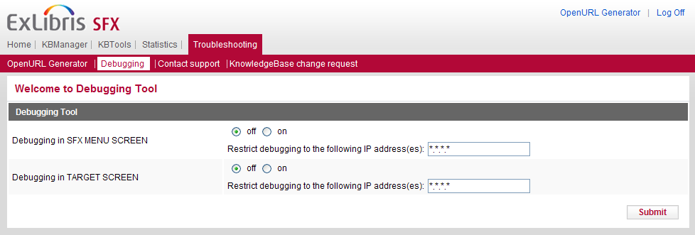
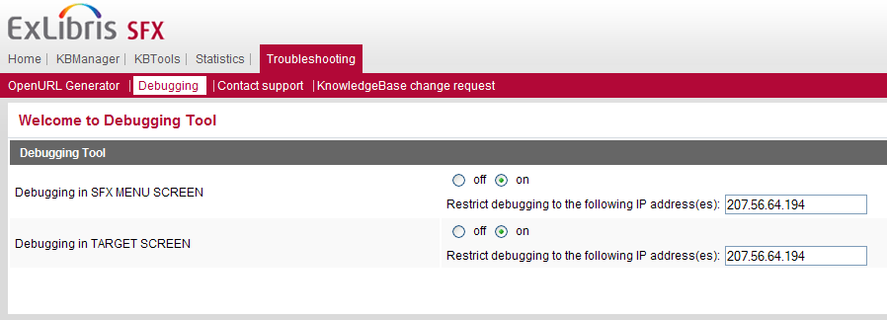
Testing & Debugging – Debug Tool
Notes:
We briefly saw the debugging tool in the Data Management session, but here it is again! This tool allows you to determine the source of errors that may be occurring in the SFX flow, like missing targets from the SFX Menu, corrupted target URLS, proxy problems, and some server errors.
(click) When the debugging tool is on, it’s important to enter your own IP so your users won’t see the debug information.
Now if I’m in my source database, and I have debugging turned on, instead of getting the SFX Menu or Target displayed, I’ll get text – here are a few examples (click)
Turning on debugging in the SFX menu allows you to see if the information being sent through the SFX server passes or fails the thresholds set in the SFX database. This is going to help you determine why an expected target service is not displaying in the SFX Menu.
[Show in SFX Admin Center.]
Turning on debugging in the target window allows you to see if the correct target parser is being used. It also shows the URL that’s created which can help determine if the parser is working properly.
[Show in SFX Admin Center]
There’s more information in the SFX Advanced Users Guide about this tool.

Slide 20
Testing & Debugging – Log Files
error_log
Errors while sending a request to server
access_log
Any access request made to server
Reverse proxy Apache server path
/exlibris/sfx_ver/sfx4_1/proxy/logs
Instance-specific Apache server path
/exlibris/sfx_ver/sfx4_1/<instance>/logs/apache
Notes:
In addition to the Debug tool, Apache log files can be used to debug requests sent to the SFX server.
The log files that the Apache servers create (reverse proxy server and instance‐specific server) are:
(click) error_log – Any error that occurs while sending a request to the server is logged in this file.
(click) access_log – Any access request made to the SFX server is logged in this file.
Both files are located at the following paths:
(click) For the reverse proxy Apache server logs:
/exlibris/sfx_ver/sfx4_1/proxy/logs.
To view these files you log onto the server as the instance user.
(click) For the instance‐specific Apache server logs: /exlibris/sfx_ver/sfx4_1/<instance>/logs/apache
Again, in order to view the content of the files, you must log on to the server as an instance user.

Slide 21
Agenda
SFX Environment
Backup and Recovery
Security
Testing and Debugging
Server Admin Utility
KB Update
Recommended Maintenance
Summary and Additional Resources
Notes:
Let’s now talk about a tool on the server called the Server Admin Utility.

Slide 22
Server Admin Utility – Overview
System Maintenance
Diagnostics
A-Z index, RSI index
Exports
/exlibris/sfx_ver/sfx4_1/<instance>/admin/server_admin_util
Notes:
Each SFX instance has its own admin tool called the Server Admin Utility. With the utility, you can perform various tasks like systems maintenance (click), diagnostics, (click), creating indices (click), and running exports (click)
The full path of the tool is here: (click).

Slide 23
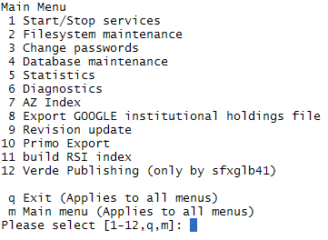
Server Admin Utility – Access
Log onto server as instance user
Type da to move to the admin directory
Type ./server_admin_util
Notes:
To start the Server Admin Utility:
(click) Log on to the SFX server as an instance user (for example, sfxlcl41).
(click) Type da to move to the admin directory.
(click) Type ./server_admin_util
(click) then you’ll see the Server Admin Utility Menu
So let’s walk through each of these options – keep in mind that you’re not really going to be using all of these all of the time, but I’d like to review all of it so that you get an idea for what’s in here. For Direct customers, it’s good to have an understand of the options, but Ex Libris will setup many of these options on your behalf so you won’t need necessarily need to make any updates to them.

Slide 24
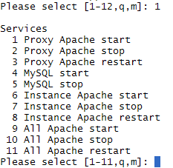
SAU – Start/Stop Services
Use stop/start for config changes
Use restart after cleaning logs
Sfxglb41 user for 1-5 and 9-11
Notes:
The first option is Start/Stop services. This is where you can start and stop MySQL and Apache. You’ll notice that there are options to stop, start, and also restart.
(click) In many cases, you’ll want to use the stop and start command rather than the restart (like when you make changes to reverse proxy configurations or changes to the core SFX programs, because the restart command restarts the main process only. If there are child processes running, they may not be restarted. (click) You can use the restart command after cleaning the apache logs.
(click) To use options 1-5 and 9-11, you need to be logged in as the sfxglb41 user, and for options 9-11 you need to have the UNIX passwords for each of the SFX instance users.

Slide 25
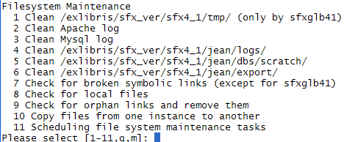
SAU – File Systems Maintenance
Use for file system maintenance tasks such as cleaning logs, checking for broken symbolic links, and scheduling maintenance tasks
Notes:
The second utility focuses on file system maintenance.
The tmp directory has a number of files and subdirectories with files that are generated during various maintenance tasks. We recommend that this directory be cleaned regularly.
2, 3. The Apache and MySQL logs contain messages produced by their respective servers - when these log files get too large, you'd use this option to clear them out.
4. The logs directory contains the log files that are related to the instance you're in.
5. The scratch directory is going to contain the input files loaded using the dataloader, export files from the export tool and the targetmatcher tool, and session files. Note that removing session files that are in use will log off anyone that's working in the SFX Admin center at that time, but the old ones can be removed.
6. The base_export and curr_export directories house temporary files that are used in the creation of the revision update reports.
7. The check for broken symbolic links option does just that - it finds them, then asks if you want to restore them. You need to run that option in the local instance and not the global one.
8. Check for local files is going to report files in an SFX instance that are local - in other words, files that are not symbolically linked to the global instance.
9. Check for and remove orphan links - this is going to look for symbolic links pointing to non-existent files.
10. And copy files from one instance to another allows you to copy files, directories, and symbolic links from one instance to another. Configuration files cannot be copied.
11. Scheduling file system maintenance tasks allows to you set up a recurring cron for any of these options. Note that if you’re a Direct customer, Ex Libris will schedule these tasks for you.

Slide 26

SAU – Change Passwords
Change passwords for UNIX and MySQL and encrypt them for use in the configuration files.
Notes:
This section allows you to change passwords for UNIX and MySQL and encrypt them for use in the configuration files.

Slide 27
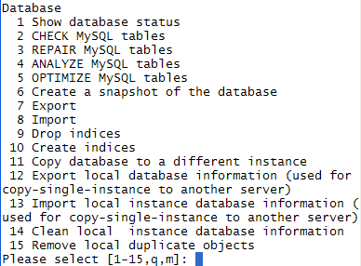
SAU – Database Maintenance
Contact Ex Libris for help with 7,8,9,10
Ex Libris support only – 12, 13
Use #14 with caution – not able to undo!
Notes:
#4 is Database Maintenance.
You can see the database status and database process list in #1
In #2, you can check for errors in the MySQL tables. These errors are usually discrepancies between the binary files, in-memory data, and indices that may be caused by an abrupt server power-off or improper process termination.
Of course after you've found errors, you'll want to repair them by using #3. We do recommend that you back up the database before doing this - the process needs to run uninterrupted until it finishes - if it stops, it will corrupt the database.
in #4, you can analyze the MySQL tables - it will report back status, error, info, or warning messages. If the table wasn't changed since the last time this option was run, it will just say "Table is already up to date"
In #5, you can Optimize the MySQL tables - this is useful if you've deleted large amounts of data from the table. It's like defragmenting your PC - it's going to reclaim unused space, and performs some minor repairs and tidies up the indices.
(click) You can work with the indices in 7,8,9,and 10 - these options aren't required for the regular maintenance of SFX - we suggest that you contact Ex Libris support with any questions about these options.
#11 – Copy database to a different instance this is useful when you're actively using the test instance - you'd be able to copy the test instance over to the production one.
One thing to remember is that while you're copying, the destination instance is going to be down - so everything - the SFX menu, A-Z list, even the SFX Admin are inaccessible.
(click) #12, 13, Export/Import local instance database information - these allow you to export and import all records from the global to the local instance, and vice versa - these options are for Ex Libris support
(click) #14 - Clean local instance database information - this is going to remove all localizations for one specific instance - essentially this is like starting again with a brand new SFX instance. You can't undo this, so be very, very careful with this!
#15 Remove local duplicate objects - In SP 4.1.3, we added step during Revision Update to perform local instance database cleanup for new objects. SFX removes local object duplicates in case a new object was added during the Revision Update which has the same unique identifier (ISSN, ISBN or LCCN) as a locally created object.
This option checks the locally created objects in all the local instances for duplicates. You'd run it as the global instance user, and after you run it, the report will be available in the reports section (HTML/TXT) in the SFX Admin Center.

Slide 28
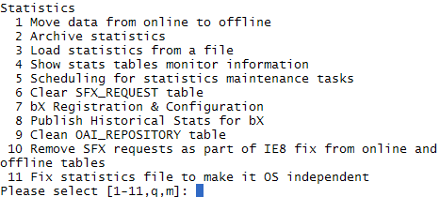
SAU - Statistics
Please select [1-11,q,m]: 4
+----------------+------------+-----------------------+------------+------------+
| Tables | Row count | Disk space (MB) | Min date | Max date |
| | | data/index | | |
+----------------+------------+-----------------------+------------+------------+
| SFX Requests | 79 | 1.17 | 0.01 | | |
| Online Stats | 786 | 1.70 | 0.95 | 2011-06-17 | 2012-04-09 |
| Offline Stats | 145013 | 409.30 | 364.14 | 2010-12-01 | 2011-10-24 |
+----------------+------------+-----------------------+------------+------------+
Need to move statistics offline to query
Need to clean out SFX_REQUEST table
bX options – 7,8,9
Notes:
Statistics…
(click) In order to run statistics queries in SFX Admin Center, the data itself needs to be moved ‘offline’. That’s what the 1st option is for.
Now you can imagine that at some point, you're going to have a lot of data stored in 'offline' - that's where #2 comes in. By archiving the statistics, you can move them to a different server to store them indefinitely. Before you archive, you want to make sure that you've run all of the statistics queries you’re going to need for that timeperiod.
It is possible to load an archive file back into the offline tables - that's done with #3 – load statistics from a file.
You can check to see how big the stats tables are getting with #4, and use that information to determine if or when you need to archive. In general, if the offline table reaches 1 million rows, we recommend you archive it. Each row in the offline table represents 1 SFX request (i.e. one OpenURL that results in the loading of the SFX Menu or DirectLink.)
And with #5, you can schedule these tasks. If you’re a Direct customer, Ex Libris will schedule this for you.
The SFX_REQUEST table stores the data that's used to generate each SFX Menu screen - which means that it's going to need to be cleared out periodically – that also can be scheduled. (click)
If you've purchased bX, (click) you may be interested in the next three options - bX registration & configuration, publish historical stats, and the clean OAI_REPOSITORY table. There's more information about those options in the bX-SFX Configuration Guide.
For those of you who are unfamiliar with bX: bX™ is a recommender service that helps the users to discover relevant literature that they would not have found otherwise. It provides usage-based recommendations - similar to user recommendations at Amazon.com or other websites.
Items #10 and 11 have to do with previous fixes. Remove SFX requests - this was a fix we implemented in a previous Service Pack that takes care of an issue with IE8 that affected SFX usage statistics. If you're running SFX version 4.0.3 (or are in implementation with a new installation) this is already taken care of - if not, you can run this option. And there’s also a fix statistics file option to make it OS independent.

Slide 29
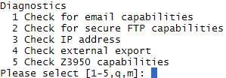
SAU - Diagnostics
Run diagnostics to check if (e.g.) email is functioning properly or FTP is working
Notes:
You can also run a series of diagnostics on SFX.
You can check to see if email is functioning properly - there's an email module that's used for the KnowledgeBase Change Requests area in SFX Admin Center, any local document delivery and feedback targets, etc.
You can check to see if FTP is working properly - FTP is used with MARCit and exporting electronic journals using the External Export program (for MetaLib).
The Check IP address diagnostic is used when you're installing SFX.
If you're using the External Export, you can troubleshoot problems using #4, and you can use #5 to check to see if Z39.50 has access to a particular OPAC.

Slide 30

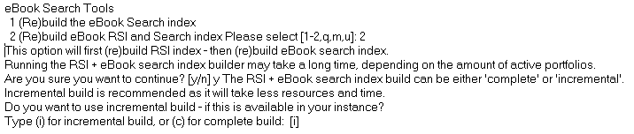
SAU – A-Z Index
Separate A-Z indexing jobs required for eJournals and eBooks
eBooks recommendation: incremental builds after the initial build
RSI job needs to run before the AZ Index job
However, schedule both the A-Z and RSI index jobs for eJournals and eBooks from #7 - AZ Index!
Notes:
A-Z Tools: These are important if you want to use the A-Z List. We mentioned in UI Configuration session that you needed to get onto the server to run the A-Z – well here it is! The A-Z indexing job keeps everything in sync – so for example, if you have activated or deactivated targets, services, or object portfolios, the A-Z indexing job will make sure those changes are reflected in your A-Z list.
From this menu, it’s possible to build or rebuild the list, schedule this to run, and see what you have scheduled. In general, you’ll want to run this daily or weekly, but it really depends on how often you’re making changes to your resources in SFX. If you’re a Direct customer, Ex Libris will schedule this job for you.
(click) I’ll mention this again in a few slides, but the A-Z list uses the information in the RSI job so you’ll need to run the RSI index before the A-Z index.

Slide 31

SAU – Export Google Holdings File
Google Scholar export file is used for Primo Central also.
Notes:
The Google holdings file export can be run and scheduled from here – this export is also used in Primo for the Primo Central database.
This will create your full-text holdings file and export it from SFX, so Google Scholar and/or Primo Central (if applicable to your institution) can pick up the file on a weekly basis.

Slide 32

SAU – Revision Update
Revision update option allows you to:
monitor and clean up the report tables
back up revisions and roll them back as needed
Notes:
The revision update option allows you to monitor and clean up the report tables, and allows you to back up revisions and roll them back.
During an update, everything that's going to be affected is backed up. This allows you to roll back the update.

Slide 33

SAU – Primo Export
Primo Export allows you to export a Primo file, schedule an export, and update and remove scheduled exports.
Notes:
The Primo Export allows you to export a Primo file, schedule an export, and update and remove scheduled exports.
This creates an XML export with active fullText journals and books for import into Primo.
The first time you run it, a full file is created. If an export was already run and there's an output file in the directory, an incremental export file is created.
The export itself is set up in the SFX Admin interface - instructions are in the System Admin Guide.

Slide 34

SAU – Rapid Service Indicator
Used to determine full-text availability for SFX A-Z list, MetaLib, and Primo
RSI job runs before the A-Z Index job!
Recommendation: Use #7 AZ Index from menu to schedule/run both the RSI and AZ Index jobs
Notes:
The RSI, or Rapid Service Indicator, is used to determine full-text availability in SFX - MetaLib uses it, Primo uses it, and most importantly, your A-Z list uses it.
Remember when you schedule this to run, make sure you schedule the RSI before your A-Z list so that your A-Z index will be up to date. Again, if you’re a Direct customer, Ex Libris will schedule this for you.

Slide 35
Agenda
SFX Environment
Backup and Recovery
Security
Testing and Debugging
Server Admin Utility
KB Update
Recommended Maintenance
Summary and Additional Resources
Notes:
Along with the maintenance tasks we just covered, there’s a KnowledgeBase (KB) update that happens on a weekly basis.

Slide 36
KB Update
Consists of software and database updates
Runs on the server
Updates weekly – on Tuesdays
Can apply updates automatically
For Direct Customers: Ex Libris runs for you
Need to review Release Notes
Resources you want to activate
Resources that were deleted
Service Packs manually applied
Notes:
(click) SFX KB updates, or revisions, consist of software updates as well as KB database updates – so these can be anything from a configuration file change to new and updated targets, sources, services, objects, etc. The updates are applied to the global instance and can be applied to your local instance through the use of symbolic links – or in the case of where a symbolic link is broken, you can determine how you want to implement those changes in your local instance.
(click) SFX Updates are run on the server.
(click) The updates are released weekly – every Tuesday, and if you’re a Direct customer, Ex Libris will run the weekly updates for you.
If you’re a Local customer where you host SFX on your own server, it’s up to your individual library to run the updates – you don’t have to run them right away, so if you have your own maintenance window you can run them then. The process takes about a half hour, and there’s no real downtime, though you may want to run it during off-peak hours to make sure it doesn’t slow your users down. Updates are cumulative, so if it makes more sense to run it less often at your institution, that’s possible.
(click) It’s possible to set up a recurring job to apply these updates automatically. Again - for Direct customers, Ex Libris will run the KB updates for you.
(click) For all customers, however: When the weekly updates are applied, you’ll want to review the release notes to see if they included (click) any newly-added resources that you want to activate, or (click) resources that were removed that you may want to know about. We’ll talk more about the release notes in a moment.
(click) Occasionally there will be service packs that Local customers may need to apply – these are not issued on a regular basis anymore, since most of the changes with SFX are being handled in the weekly revision updates.

Slide 37
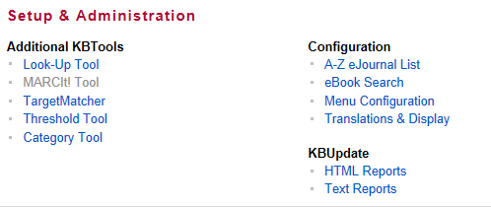
KB Release Notes
Accessed from:
ExLibris Documentation Center
http://www.customercenter.exlibrisgroup.com/
Path: Technical Documentation > Release notes
Admin Center – KBUpdate section
HTML Reports
Text Reports
Note: Weekly updates announced on SFX-L
http://el-una.org/mailing-lists/sfx-mailing-lists/
Notes:
As just mentioned, for all SFX customers, it’s important to review the Release notes for each weekly update to see if there are any targets, services, or objects that were added or removed. If targets, services, or objects were added and you subscribe to them, you may want to activate them in your KnowledgeBase. If any resources were removed, no action is needed on your part – you may just want to be aware that they were removed from the KnowledgeBase.
Release notes can be accessed a couple of different ways:
1) From the Ex Libris Documentation center (URL and path listed here). The Documentation Center will have .pdf and .xls versions of the weekly report.
2) From the KBUpdate area in the SFX Admin Center. The KB Update area allows you to select a weekly update and then see a report in either text or html format of the changes for that update.
Note also that Ex Libris will typically send a message to the SFX-L listserv, indicating that a weekly update is available. This could be helpful just as a reminder to review the release notes. For more information on subscribing to the SFX listserv, see the URL listed here:
http://el-una.org/mailing-lists/sfx-mailing-lists/

Slide 38
Agenda
SFX Environment
Backup and Recovery
Security
Testing and Debugging
Server Admin Utility
KB Update
Recommended Maintenance
Summary and Additional Resources
Notes:
Lastly, let’s talk about recommended maintenance for SFX.

Slide 39
Recommended Maintenance
# | Task | Frequency | Hosted Responsibility
1 | Clean file system | At least monthly | Customer - instance; Ex Libris - global, tmp, app Note: Will be scheduled by Ex Libris
2 | Clean Apache logs | Monthly | Customer - instance; Ex Libris – app Note: Will be scheduled by Ex Libris
3 | Maintaining local files | Ongoing | Customer
4 | MySQL check tables | At least monthly | Ex Libris
5 | MySQL repair tables | When problems are found | Ex Libris
6 | Clear SFX_REQUEST table | Daily | Ex Libris
7 | Move statistics online to offline | Depends | Customer Note: Will be scheduled by Ex Libris
8 | Move statistics offline to archive | Depends | Customer Note: Will be scheduled by Ex Libris
9 | KB Updates | Weekly | Ex Libris applies revision; Customer checks KB reports
10 | RSI Index | As you determine | Customer Note: Will be scheduled by Ex Libris
11 | A-Z List | As you determine | Customer Note: Will be scheduled by Ex Libris
12 | SFX Backups | Daily - no downtime, weekly w/downtime | Ex Libris (daily backups with no downtime)
13 | Google, Pubmed, MARCit exports | As you determine/as needed | Customer
14 | Old revision update report cleanup | Monthly | Ex Libris
15 | eBook Search | Incremental build as you determine (nightly) | Customer Note: Will be scheduled by Ex Libris
Notes:
We have covered a lot of information that you may or may not need to use on a regular basis – so we’ve put together a recommended maintenance list so that that you can keep SFX happy and healthy.
This checklist doesn’t replace all of the information that I’ve given you, but it pretty much covers what you need to know in terms of maintenance tasks that need to be performed. This list is taken from the System Administration Guide, and there’s more detail there on what each task or job does and how each is set up. You’ll want to view the System Administration Guide for any updates to this list.
In the last column, if you’re a Direct customer (i.e. your SFX server is an Ex Libris server), this will tell you if it’s something that we’re doing for you, or if it’s something you need to set up for yourselves. Note that many of these jobs will be scheduled by Ex Libris during your implementation – so you will not need to schedule them on your own. Check with your Ex Libris implementation team for more information on job scheduling.
[Another thing to remember is that if you have set up these cron jobs using the Server Admin Utility, you’ll be able to view them in the utility. You can also see what jobs you have scheduled by using the crontab –l command.]

Slide 40
Agenda
SFX Environment
Backup and Recovery
Security
Testing and Debugging
Server Admin Utility
KB Update
Recommended Maintenance
Summary and Additional Resources
Notes:
This brings us to the end of this session.

Slide 41
Summary
How To…
Define the SFX environment structure
Backup and recover SFX
Test and debug
Run jobs and perform recommended maintenance
Perform KB updates
Notes:
In brief, in this session we covered:
how SFX is structured on the server-side and how back up and recovery works
how to use the log files and the debug tool to troubleshoot and debug issues
how to use the Server Admin Utility to perform maintenance, change passwords, run indices and diagnostics
what you need to do to keep SFX happy and healthy (and up to date!) in terms of running weekly KB updates and recommended maintenance tasks.

Slide 42

Additional Resources
Accessed from Documentation Center:
(http://www.customercenter.exlibrisgroup.com/)
SFX Systems Administration Guide
SFX eBook Search Guide
SFX General User’s Guide
SFX Advanced User’s Guide
bX-SFX Configuration Guide
Notes:
More information on SFX system administration is available in the Ex Libris Documentation Center.
The SFX Systems Administration Guide will be of most help for system administration topics, but the other documents listed may be helpful as well.
Thanks for joining me in this session!

