Slide 1
KB Manager: Activating Resources
Notes:
Hello and welcome to this session on activating resources in SFX.
Please note that this presentation is copyrighted and is the confidential property of Ex Libris Ltd. Information included in this presentation is periodically reviewed and updated. You may share these training materials within your institution but not beyond.

Slide 2
Copyright Statement
All of the information and material inclusive of text, images, logos, product names is either the property of, or used with permission by Ex Libris Ltd. The information may not be distributed, modified, displayed, reproduced – in whole or in part – without the prior written permission of Ex Libris Ltd.
TRADEMARKS Ex Libris, the Ex Libris logo, Aleph, Alma, SFX, SFXIT, MetaLib, DigiTool, Verde, Primo, Voyager, MetaSearch, MetaIndex and other Ex Libris products and services referenced herein are trademarks of Ex Libris, and may be registered in certain jurisdictions. All other product names, company names, marks and logos referenced may be trademarks of their respective owners.
DISCLAIMER The information contained in this document is compiled from various sources and provided on an "AS IS" basis for general information purposes only without any representations, conditions or warranties whether express or implied, including any implied warranties of satisfactory quality, completeness, accuracy or fitness for a particular purpose.
Ex Libris, its subsidiaries and related corporations ("Ex Libris Group") disclaim any and all liability for all use of this information, including losses, damages, claims or expenses any person may incur as a result of the use of this information, even if advised of the possibility of such loss or damage.
© Ex Libris Ltd., 2014

Slide 3
Agenda
Introduction to SFX Admin Center
Sources
Activate Targets, Services, Objects
Add Local Thresholds
Find an Object
Summary and additional resources
Notes:
We’ll be covering several things in this session:
I’ll first talk about the SFX Admin Center which is where most SFX administrative tasks take place.
Then we’ll take a look at the specific areas in the SFX Admin Center where you’ll be managing your resources. In particular we’ll take a look at the areas for sources, targets, services, objects, and thresholds. I’ll do a review of terminology and demonstrations in SFX as we go.
Lastly, we’ll just wrap things up and I’ll give you some additional resources you can use for more information.

Slide 4

Objectives
How To...
Activate targets, services, and objects
Add local thresholds
Add linking parameters
Find an object
Notes:
The key objectives for this session are that you will come away with an understanding of where and how to activate (and deactivate) your resources, add local thresholds to objects, add linking parameters, and be able to search for objects.

Slide 5
Agenda
Introduction to SFX Admin Center
Sources
Activating Targets, Services, Objects
Adding Local Thresholds
Find an Object
Summary and additional resources
Notes:
Let’s first talk about the SFX Admin Center…

Slide 6
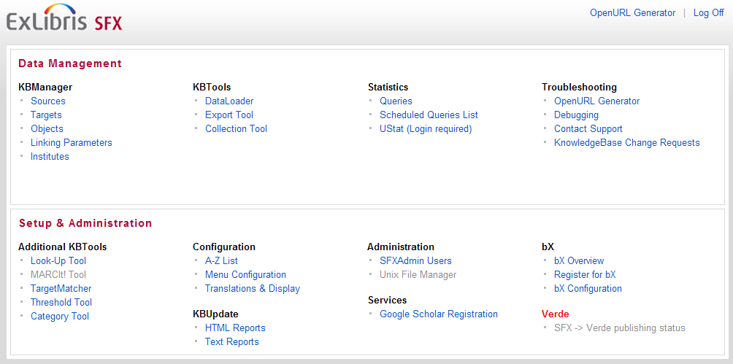
Admin Center
Notes:
SFX Admin Center is a web-based administrative tool that you use to manage SFX. You’ll be given credentials to login to the Admin Center from your Ex Libris project team.
Once you've logged into the Admin center, you'll see two sections of the screen.
The top section is the Data Management section. In this area, you have…
KBManager, which is where you’ll manage your SFX KnowledgeBase and activate and deactivate each of your resources.
KBTools – where you can manage your SFX KnowledgeBase on a collective level by importing data into SFX and exporting data out of SFX, and being able to compare various targets to find out where there may be title overlap
Statistics – the area of the admin center where you can run statistical queries, and
Troubleshooting – the area that allows you to test the setup of the SFX KnowledgeBase, debug problems, contact support and submit change requests.
The bottom section is the Setup & Administration section. In this area, you can find
Additional KB Tools to manage your KnowledgeBase
Configuration – where you configure the user interface, including the A‐Z List and SFX menu
KBUpdate – where you can find reports on what was updated for each weekly KnowledgeBase update
Administration – where you manage the SFX Admin Center users and, if available, you can see the UNIX files
Services – where you record your Google Scholar registration
bX – the tool to generate recommendations based on article usage
Verde – and a section for SFX/Verde interoperability
Features that you do not have access to will be grayed out.
(Click) In this session we’ll be covering the KB Manager section of the Data Management area. This is where we can manage the sources, targets, object, linking parameters, and institutes in SFX. Other areas of SFX Admin Center will be covered in separate sessions.

Slide 7
Agenda
Introduction to SFX Admin Center
Sources
Activating Targets, Services, Objects
Adding Local Thresholds
Find an Object
Summary and additional resources
Notes:
Within the KB Manager section of SFX Admin Center, let’s start with Sources.

Slide 8
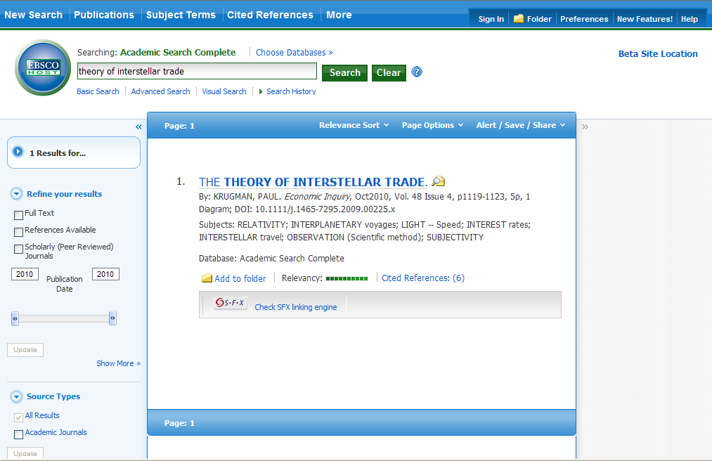
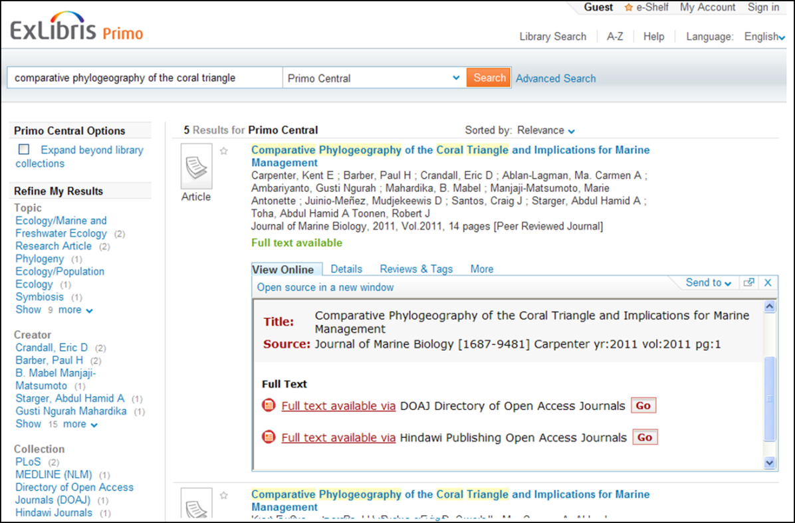
KBManager: Terminology
Source
Database/Discovery system where users start their search
Notes:
You may remember from the SFX Introduction session that the source is where the user starts his/her search. It could be in a database such as Ebscohost Academic Search Complete or a discovery system – for example, Primo.

Slide 9
Admin Center / KB Manager
Notes:
In the SFX Admin Center under KBManager, click on “Sources” to get to the list of configured Sources in SFX.
[Go to SFX for demo.]

Slide 10
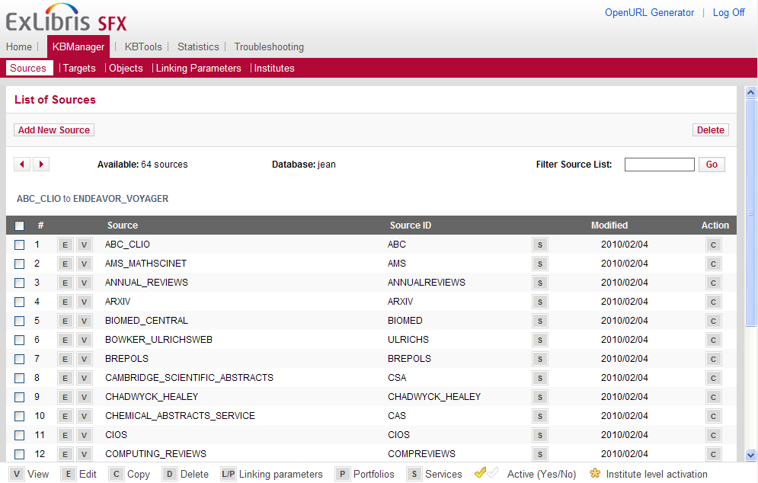
KBManager: Sources
Notes:
[Click Sources link in SFX Admin Center.]
Once you’re in the ‘Sources’ screen, you’ll notice that a navigation bar at the top of the screen will show you where you are within the Admin Center – at the moment, you’re in the KBManager section. From here, you can access other Data Management areas without having to go back to the Admin Center menu, and even go directly to the other screens in the KB Manager in just one click.
The main portion of the screen is devoted to the list of sources that are configured in SFX. Just to be clear, these are databases (Cambridge Scientific Abstracts, Ebsco, etc.) or a discovery system such as Primo where the user can search and the SFX button can be available in the interface so the user can access the SFX menu.
You’ll also see buttons to [E]dit, [V]iew and [C]opy these sources. You’ll see these same icons when we talk about targets. There’s a legend at the bottom of the screen that explains each of the icons used in the list above, as well as some other buttons that we’ll see later on.
Let’s look for Ebsco in our source list. And let’s click on the Edit button. To take you very briefly through these fields:
Each source is assigned a source ID behind the scenes in SFX.
Show Availability and the Local Show Availability fields have to do with if you want the date coverages to appear in the SFX menu in the source. So for example: if Ebsco is a source for your institution, when the user clicks on the SFX button within Ebsco, should the date coverages show for full-text resources that display in the SFX menu?
Internal description is a free text area that will display only to SFX admins who are viewing the source record as we are now.
Additional Details tab shows who created the source, and when it was last updated. Notice this information is not editable.
If I click on the S button, it is possible to see the various services that are associated with each source. If you remember from the SFX Introduction session, services are basically connection information. The source will send an OpenURL to SFX, and the source service is used to help SFX define and interpret the data that’s contained in the OpenURL.
Let’s look at Ebsco’s services (click on Ebsco’s S).

Slide 11
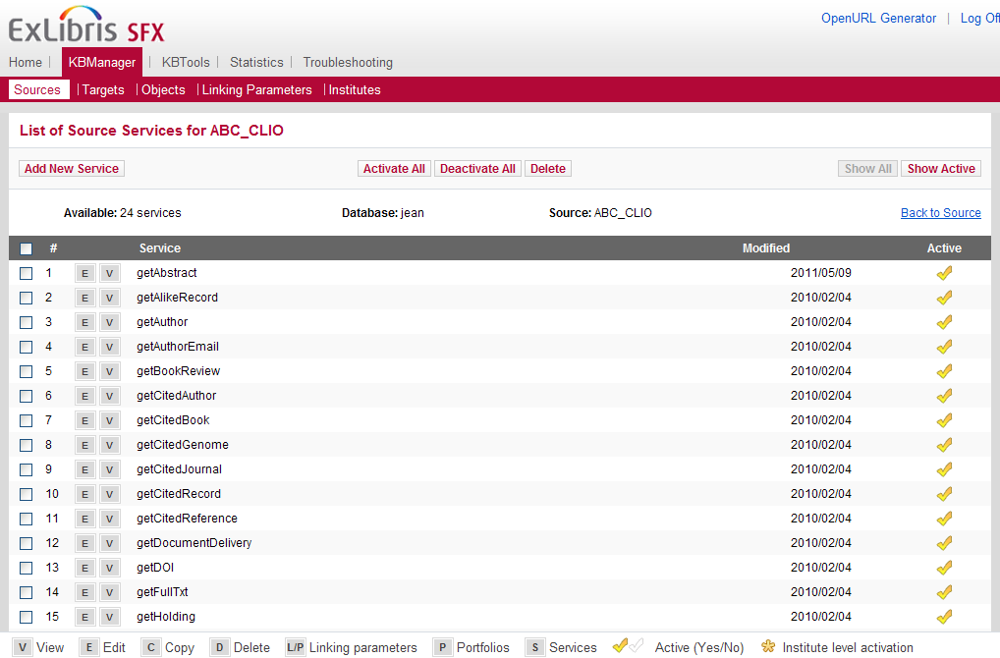
KBManager: Source Services
Notes:
In the source services screen, you’ll see a list of services, the last date that the service was modified, and a yellow checkmark next to each active service. By default, all source services are active in SFX.
Remember that a ‘source’ in SFX is where your user starts their search, so having all services active just enables them for use. It doesn’t mean that the SFX button will automatically appear in your sources. So when you are ready to go live with SFX, you’ll want to contact each of the vendors that you want to use as sources as the vendor may need to do some configuration on their side so the SFX button will appear. The SFX Source Configuration Guide in the Documentation Center will provide you with the information you need to discuss with your vendors. Among the information that the vendor may need to know is your SFX URL.
The bottom line is that because sources and source services are already active, you really won’t need to do much with the sources in SFX other than know that the list is there. Then make sure to contact any vendor that you want to have as a source so that they can do any configuration on their side for the SFX button to display in their interface.

Slide 12
Agenda
Introduction to SFX Admin Center
Sources
Activating Targets, Services, Objects
Adding Local Thresholds
Find an Object
Summary and additional resources
Notes:
Let’s look now at the heart of SFX Admin Center now, which is activating targets, services, and objects.

Slide 13
KBManager: More Terminology
Target
Database that contains what users are searching for
Service
Connection information
Object Portfolio
Collection of objects associated with a target/target service
Object
Serial title or monograph title
Notes:
Just a quick terminology refresher before we go into the details. You may remember this terminology from the SFX Introduction session, but I’d like to recap, and then talk a little more about how targets, services, objects, and object portfolios relate to each other.
The target is the database where users find what they’re looking for.
Services provide the means of communication between SFX and the source and target systems. It’s connection information for what the user is requesting - so they can get to the full-text to an article, get to an article abstract, and so on.
An object portfolio is the collection of e-journals or e-books associated with any given target/target service.
An object in SFX is a serial title or monograph title.

Slide 14
KBManager: How they all relate
Target
EBSCOHost
Academic Search Premier
Target Service
getFulltxt
Object Portfolio
21,732 e-journals
Object
Publisher’s Weekly
ISSN 0000-0019
Notes:
In the SFX Admin Center, the target, service, object, and object portfolio are components of the link resolution process.
To put this into more concrete terms:
The target (click) is where your users will find what they are looking for – in this example, EBSCO’s Academic Search Premier.
The service (click) is what they’re requesting and the connection to it – in this case, they’re requesting the full text.
The object portfolio (click) associated with the target service in this case contains 21,732 e-journals (as of 6/26/2014). And one of those journals is the object (click) Publisher’s Weekly. So Publisher’s Weekly is an object within the object portfolio.
An object is always going to be associated with a target and a service – and it’s possible for an object to exist in more than one target (for example, you can subscribe to Publisher’s Weekly through EBSCO, Gale, and ProQuest to name a few), and/or have more than one service (you could get the abstract, full text, etc.).
You’ll want to think of each of these as a ‘level’ or ‘component’ – and each level/component (target, target service, object/portfolio) needs to be activated in SFX in order for a target to be available in SFX and display in the SFX menu. In this case, if I wanted to activate Publisher’s Weekly, I’d have to activate the EBSCO Academic Search Premier target, the getFullTxt service, and journal (object) itself. So all 3 levels need to be activated in order for the resource to be available in SFX.
We’ll take a look at each of these components in the KBManager in just a moment.

Slide 15
Selective and Aggregator Targets
Selective
Subscribe to individual titles within the package
Examples: Elsevier, Wiley Online, IngentaConnect
Aggregator
Subscribe to entire package of resources
Examples: EBSCO, Gale, ProQuest
Notes:
In the data provider world, there are two ways subscriptions can work, and because of this, there are two different workflows for activating resources in SFX.
The first type is the selective type. In this case, when you subscribed to the resources, you might have agreed on a definitive list of publications, or you may have been able to pick out titles you wanted to subscribe to within the package. Examples of vendors who typically work this way are Elsevier, Wiley Online, and Ingentaconnect.
The second type is the aggregator type. In this case, when you subscribed to the package of resources, you subscribed to the entire bundle, and even though publications may come and go from this bundle, your subscription is to the entire package. Examples of vendors who routinely work this way are EBSCO, Gale, and ProQuest.
It’s important to know the difference when setting up the resources in SFX, because you want to make sure SFX accurately reflects what you’ve subscribed to.
I’ll be showing you an example activating a selective package first in SFX, and then show an example activating an aggregator package.

Slide 16
Activate selective resources: Steps
Go to KBManager > Targets
Search for the target
Click checkmark in Active column
Select S for Services
Click checkmark in Active column
In pop-up window, do not activate all portfolios
Edit Service
Set AutoActive to ‘No’
Check AutoUpdate box
If the resource isn’t free and you use a proxy, check Use Proxy
Click Submit
Select L/P for Linking Parameters
Add value if necessary
Submit
Click P for Portfolio
Click checkmark in Active column to activate individual titles
Notes:
The next couple of slides in your presentation indicate step-by-step instructions for how to activate selective and aggregator packages in SFX.
I’m going to be showing these steps live in SFX.
To activate selective resources:
Go the KB Manager, then choose targets
We search for the target, and then once we find the one we’re looking for,
We click the checkmark in the active column to activate it.
We select S for services, then find the service we want to activate.
We click the checkmark in the active column to activate it, and then we’ll get a pop-up window.
The window will ask us it we want to activate all portfolios, and we choose no.
We want to make sure the auto-update settings are correct by selecting E for Edit on the service we just activated.
We want to set the AutoActive to No, then select the AutoUpdate box.
We want to make sure this will work with our proxy – so if the resource is not free and you use a proxy, check the box next to Use proxy.
Click submit,
Then we go to the linking parameters by clicking LP.
Enter the value or values if necessary, then click submit.
At this point, only the target and service are active – now we want to go ahead and activate individual titles by clicking P for Portfolio,
Then clicking the checkmark in the Active column to activate the individual titles.

Slide 17
Activate aggregator resources: Steps
Go to KBManager > Targets
Search for the target
Click checkmark in Active column
Select S for Services
Click checkmark in Active column
In pop-up window, choose activate all portfolios
Edit Service
Set AutoActive to ‘Yes’
Check AutoUpdate box
If the resource isn’t free and you use a proxy, check Use Proxy
Click Submit
Select L/P for Linking Parameters
Add value if necessary
Submit
Notes:
To activate aggregator resources:
Go the KB Manager, then choose targets
We search for the target, and then once we find the one we’re looking for,
We click the checkmark in the active column to activate it.
We select S for services, then find the service we want to activate.
We click the checkmark in the active column to activate it, and then we’ll get a pop-up window.
The window will ask us it we want to activate all portfolios, and we choose yes.
Then, we want to make sure the auto-update settings are correct by selecting E for Edit on the service we just activated.
We want to set the AutoActive to Yes, then Check the AutoUpdate box.
We want to make sure this will work with our proxy – so if the resource is not free and you use a proxy, check the box next to Use proxy.
Click submit,
Then we go to the linking parameters by clicking LP.
Enter the value or values if necessary, then click submit.
Notice you’re able to activate all of the publications in one click – this is going to be the biggest difference between this aggregator activation workflow and activating selective resources.
Now that we’ve seen how to activate resources, let’s see how we can configure the threshold data.

Slide 18
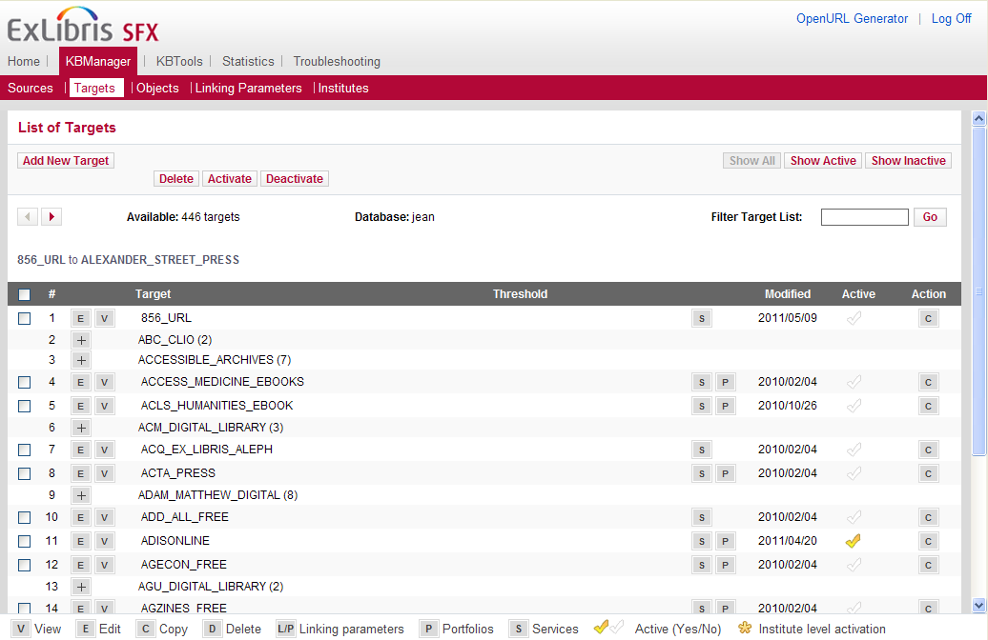
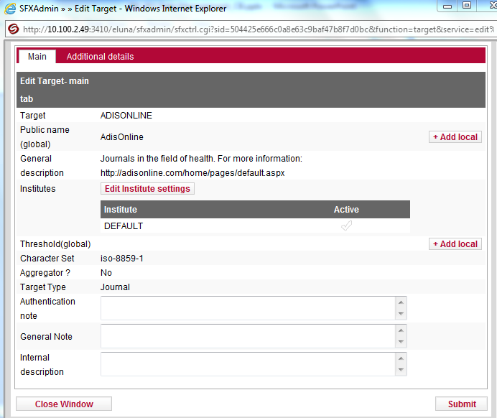
KBManager: Targets
Notes:
In the Targets area of the KB Manager, you’ll find a list of preconfigured targets in SFX. The targets list is similar to the sources list, with a few exceptions: Targets can be active (not just the target service), and by default, they are inactive – if they were active, they would be showing in the user interface. There’s also the option to see the object portfolio (or list of publications) for targets that have them.
While sources are activated at the source service level, remember that targets must be activated at the target level, the target service level, and if applicable, the object level. To activate an inactive target, just click on the white checkmark (click on 856_URL’s checkmark) , and it will turn yellow. If you want to deactivate the target, click on the yellow checkmark (click on 856_URL’s checkmark again) and it will go back to white.
I can view or edit the details of a target by clicking on the E icon (click on Ebsco Academic Search Premier’s E) . Here I can add a local public name, which would change the way this target appeared in the UI. I can also add a local threshold here. There’s a few additional fields that I can add notes to, both for the end users and internal display. (click close window)
Let’s click on ‘S’ to see the target services available for Ebsco’s Academic Search Premier.

Slide 19
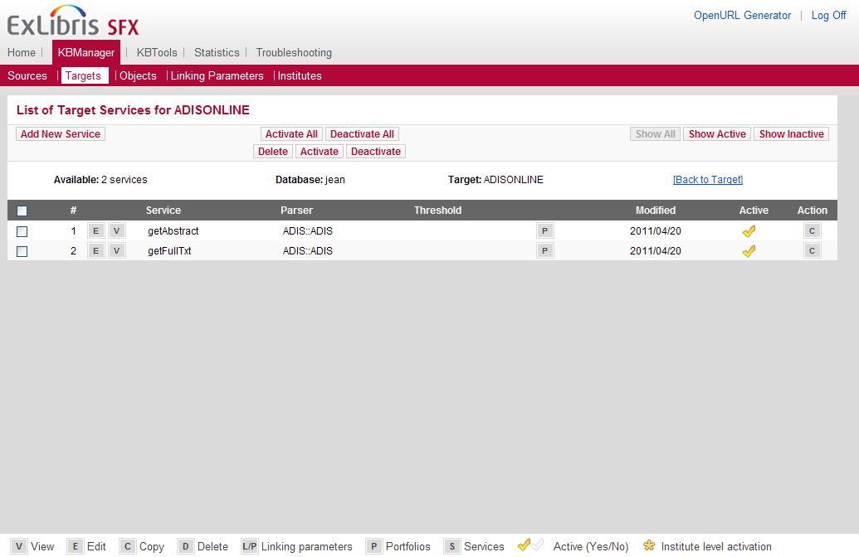
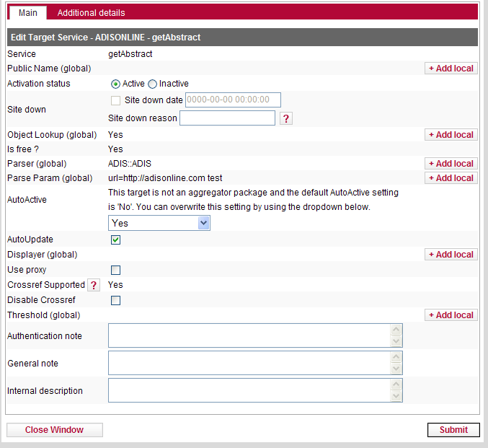
KBManager: Target Services
Notes:
There are two services available for Ebsco’s Academic Search Premier – getAbstract and getFulltext. They’re both active.
I can edit the getAbstract target by clicking on the E (click E on getAbstract). Here, I can see and change various settings and details associated with this service.
There are a few important areas of this screen. The first is AutoActive and AutoUpdate. There are two types of packages – aggregate packages, where you subscribe to the package as a whole and the list of titles in that package might change from time to time, and selective packages, where you’ve hand-picked titles within the package that you subscribe to. The AutoActive and AutoUpdate settings are going to allow you to define which type of package it is, and update it accordingly. We have some knowledge about which type of package the target usually is, and so we make a best guess – that’s why we have the statement “this target is not an aggregator package…” The default setting is ‘aggregator setting’, meaning that it won’t be updated manually – on the screen, we can see that I’ve changed it to ‘Yes’, because it’s a free target, and I want to have it automatically updated.
If you subscribe to individual titles in the package, then you’ll want to make sure this is set to ‘no’, and select the AutoUpdate box. If you subscribe to the entire package, and have access to whatever publications are in that package, set this to ‘yes’ and check the AutoUpdate box.
The only time you may decide not to check the AutoUpdate box is if you have a local target and target service and have written any local parse and parse_param values – because those values may be overwritten with updates. Any other local values such as notes or threshold will not be overwritten. More on local targets, services, and objects a little later in the session.
The second area is ‘Use Proxy’ If this target service is free you won’t have to use your proxy, but if it’s not free, you’re probably going to need to use the proxy for this service. Your proxy is set up in the Configuration area in the Admin Center, and we’ll see how that’s done in the User Interface session, but for now, you would need to make sure the service was set to go through that proxy. Another note here is that if you are in a consortium and more than one institute set up in SFX, this window will look different; it will allow you to specify which institute’s proxy you want to use.
The next area is where you can tell if this service is CrossRef supported. If it is, then you’ll need to register with CrossRef for this service to work properly. It’s free to register with them, and your CrossRef settings are also configured in a different area of the Admin Center. We’ll cover what CrossRef is and how it works in the User Interface session.
The last area I’ll point out is the Threshold. It’s possible to add a local threshold at the service level and at the target and object levels, as well as add notes, just like in the ‘edit target’ screen.
Let’s close this window and go back to the Target Services screen. Before we activate the Target service level by clicking on the checkmark, let’s talk about the Linking Parameter button. Linking parameters are used for primarily authentication types of information, so the user can connect to the full-text, for example. If I click on L/P, I’ll get a pop-up with the linking parameter for this service, and I’ll be able to edit (click) it to input the correct parameters for my library.
From here, I can click (click) on “Go to List of Linking Parameters” to see the entire list. I can also get directly to this screen by choosing Linking Parameters in the KBManager in the navigation menu. Not all targets and services require linking parameters. It will depend on the vendor and the resource. These parameters are authentication credentials, above and beyond your proxy. In some cases, vendors require that credentials be embedded in the targetURL – if they are required, this is where they’re defined.
Let’s now see the object portfolios that are associated with one of these services. When I click P for Portfolio…

Slide 20
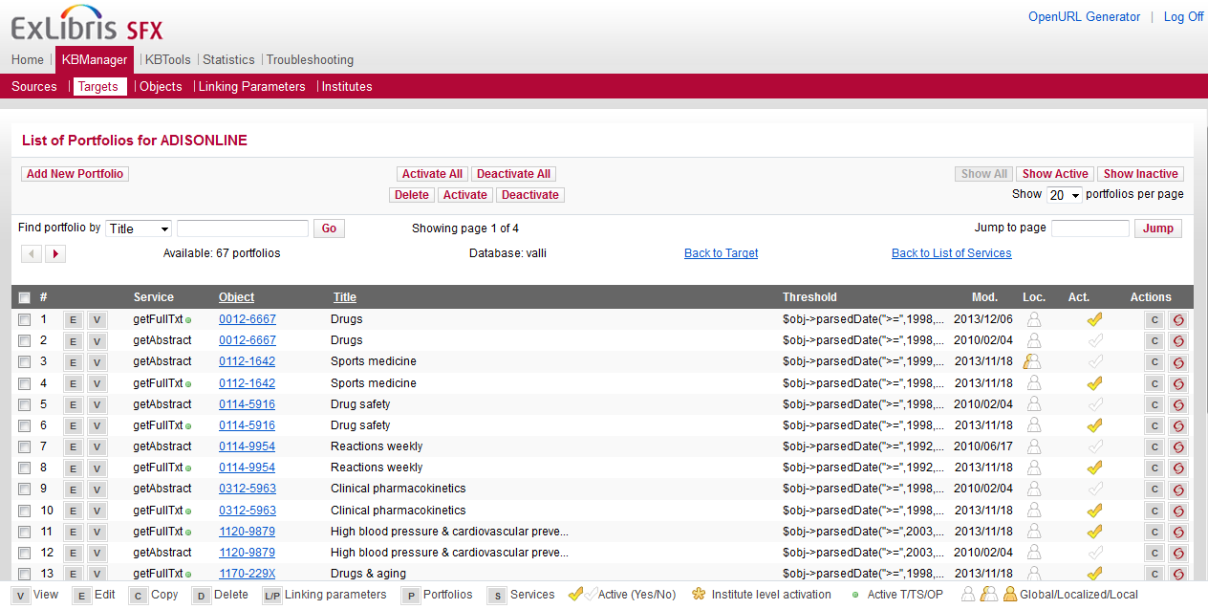
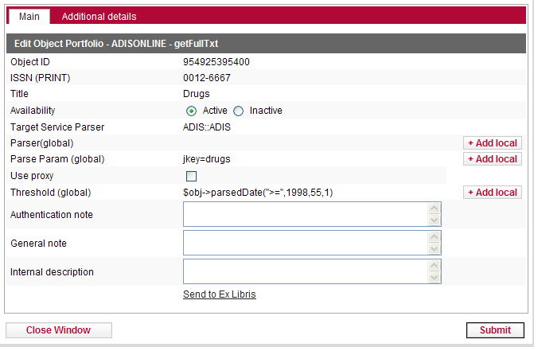
KB Manager: Object Portfolios
Notes:
I’m brought to the Object Portfolios screen. This is where we see the list of objects or publications.
We can see the ISSN of the publication, its title, and its threshold. I’ve already activated all of the objects in this target, but I’m able to activate and deactivate individual objects by click on the check mark, or by using the buttons at the top of the screen.
When I click E (click on Drugs E) for edit I can see a bit more information about the resource, and I can edit the parse parameters and thresholds here as well. Let’s close this window.
Also notice on the Objects screen the little green dots that sometimes display next to the service. The green dots are an indicator that the service is activated. Remember that all 3 levels: target, target service, and the objects have to be activated in order for a resource to display in SFX, so this is just a visual indicator to help you out.
While it’s possible to see a list of objects in an object portfolio, you can also search for objects across all targets and services by going to “Objects” in the navigation menu. (click objects).

Slide 21
Agenda
Introduction to SFX Admin Center
Sources
Activate Targets, Services, Objects
Add Local Thresholds
Find an Object
Summary and additional resources
Notes:
Let’s talk now about how to add local thresholds.

Slide 22
Thresholds
Thresholds
Conditions placed on targets, services, or objects
Global thresholds
Defaults from vendor
Local thresholds
You can customize
Notes:
Remember that SFX (click) uses thresholds, or conditions, on targets, services or object portfolios to ensure that it is available.
Date coverages are a typical kind of threshold, where (for example) you subscribe to a journal title from a package for a particular date range.
Global thresholds (click) are based on the standard packages supplied by the vendors.
If your library’s coverage is different from the default, you can customize these thresholds and make them local.
Local thresholds (click) will override the global ones without replacing them – you can always remove the local and the global will reassert itself.

Slide 23
Define a local threshold
Date Threshold
$obj->parsedDate(">=",1997,undef,undef)
$obj->parsedDate(">=",1997,12,1)
$obj->parsedDate(">=",1989,1,1) && $obj->parsedDate("<=",2005,17,4)
Moving Wall Threshold
$obj->timediff('<','3m')
$obj->timediff('>','1y')
Require an Attribute
$obj->need('ISBN')
$obj->need('@authLast')
Notes:
Thresholds in SFX are written in Perl, though you don’t necessarily need to know perl to read or write them. Here are some examples.
The Date threshold (click) starts with the obj parsed date string, then we can see that it’s greater than or equal to 1997. This means that the available articles in the publication are from 1997 to the present. In the second example, we can see it’s pretty much the same as the first, but now we have some volume and issue information. This threshold would read “everything from 1997 volume 12 issue 1 to the present. The third would read “everything from 1989 volume 1 issue 1 to 2005 volume 17 issue 4.
The Moving Wall Threshold (click)
When you have an embargo or need to specify a time period relative to the current date, the moving wall threshold comes in handy. In the first example, the threshold is making all of the articles in the last three months available. In the second example, this could represent a year-long embargo, where the threshold makes everything that’s a year old or more available.
Require an Attribute (click)
The first example is a threshold that states that the target needs to have an ISBN to resolve; if the citation does not include an ISBN, there will be no link in the SFX menu. The second example is the same principle, with just different data – in this case, the target needs the author’s last name to work.
Now let’s see how we can configure local thresholds in SFX.

Slide 24
Define a local threshold: Steps
Click E to Edit target, service, or object
Select +Add Local next to Threshold
Click Compose
Define threshold
Click Submit
Click Submit to confirm threshold
Click Submit to confirm object edit
Notes:
To define a local threshold,
Click E to Edit target, service, or object
Select +Add Local next to Threshold
Click Compose
Define threshold
Click Submit
Click Submit to confirm threshold
Click Submit to confirm object edit
You can always revert back to the global threshold by editing the target, service or object and selecting ‘clear local’. More detailed information can be found in the SFX General User’s Guide.
You can probably imagine that if you’re trying to configure lots of resources by changing each one individually in the interface, this could get quite tedious very quickly. The KBTools area of the SFX Admin Center will enable you to perform data loading and making changes on a larger scale; we’ll talk about that in a separate session.

Slide 25
Agenda
Introduction to SFX Admin Center
Sources
Activate Targets, Services, Objects
Add Local Thresholds
Find an Object
Summary and additional resources
Notes:
The last activation topic we’ll take a look at is for finding an object.
We’ve been using the workflow where we start with searching for the Target and activate it, drill down to the Service level and activate it, and then drill down to the Object level and activate objects. With Finding an object, we’re going to look at this process basically in reverse – where we search for the object first.
Benefits of this:
We can search for a particular object title to see if it’s been activated – rather than going through the target and service levels first.
We can activate a specific object this way.

Slide 26
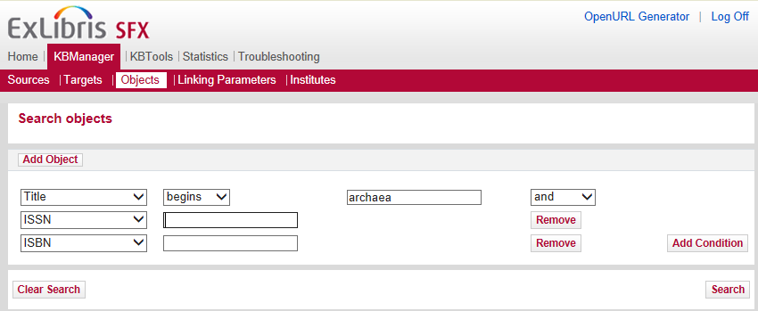
KB Manager: Objects
Notes:
The Objects screen allows you to search for any publication in SFX.
This allows you to do a couple of things – to work backwards to:
1.) Check and see if the object is indeed activated in a particular target (rather than looking up the target first)
2.) From here, activate the object, and in addition to the target and target service if they are not already active and do not require linking parameters.
You can select the field you’d like to search (click on title dropdown), and how the search terms are applied (click on the begins dropdown). It’s also possible to add conditions (click on Add condition) or remove them (click remove to remove the added condition)
Let’s search for Archaea (click once for search term to appear, then click on search)

Slide 27
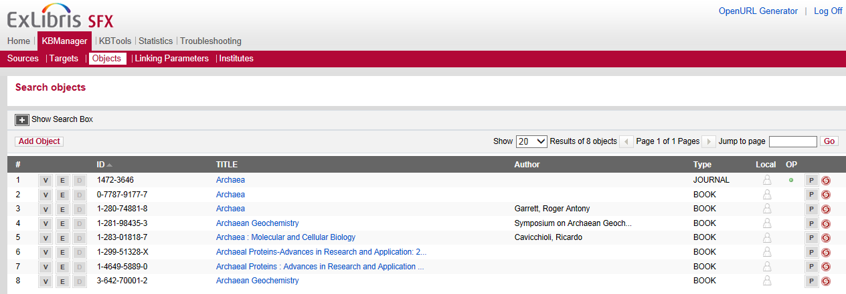
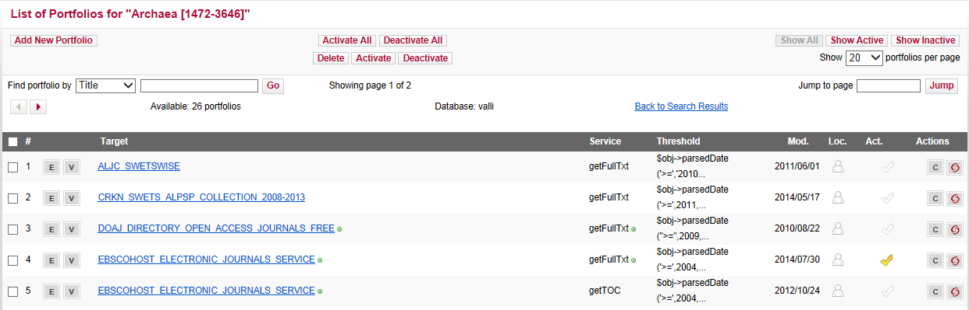
KBManager: Objects – Search Results
Notes:
In the search results, I can see that I have one journal, and a few e-books – right now, I’m interested in the journal. I can edit or view these objects, but you’ll notice I can’t activate them here. The reason for that is the object has to be associated with a target and a target service that also need to be active.
By clicking P for portfolio (click on Archaea P) , I can see that this journal is in more than one portfolio. Archaea is contained in the CEIRC ProQuest 500 International package, the DOAJ package, the EBSCOHost Electronic Journals package, and so on. This is an important concept in SFX – a journal can be supplied by multiple vendors, so it’s important to know which vendor you’re getting the journal from when you’re activating resources in SFX. You’ll notice that there are two lines for EBSCO – this is because there are two different services available – getTOC and getAbstract.
Since I’ve already activated all of the publications in the DOAJ target, I can see the yellow checkmark next to that portfolio. If I scroll down, we can see that it’s also active in the Hindawi Publishing target and PubMed Central Open Access.
I can also use the SFX swirlie to test the connection to the resource. (click the swirlie, then click Go on PubMed Central)
=========================================
Objects Overview
Searching for Objects
Viewing Objects
Editing Object Details
Viewing Object Portfolios
Testing the SFX Menu
Adding an Object

Slide 28
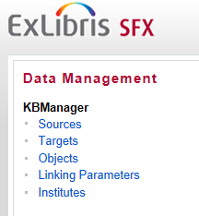
Find an object
Go to KBManager > Objects
Select criteria in dropdown
Enter search term
Add conditions (optional)
Click Search
Notes:
Instructions for how to find an object are listed here.
To find an object in SFX:
Go to Objects under the KB Manager, (click)
Select criteria in the dropdown (click)
Enter your search criteria (click)
Add conditions if necessary (click)
Click Search

Slide 29
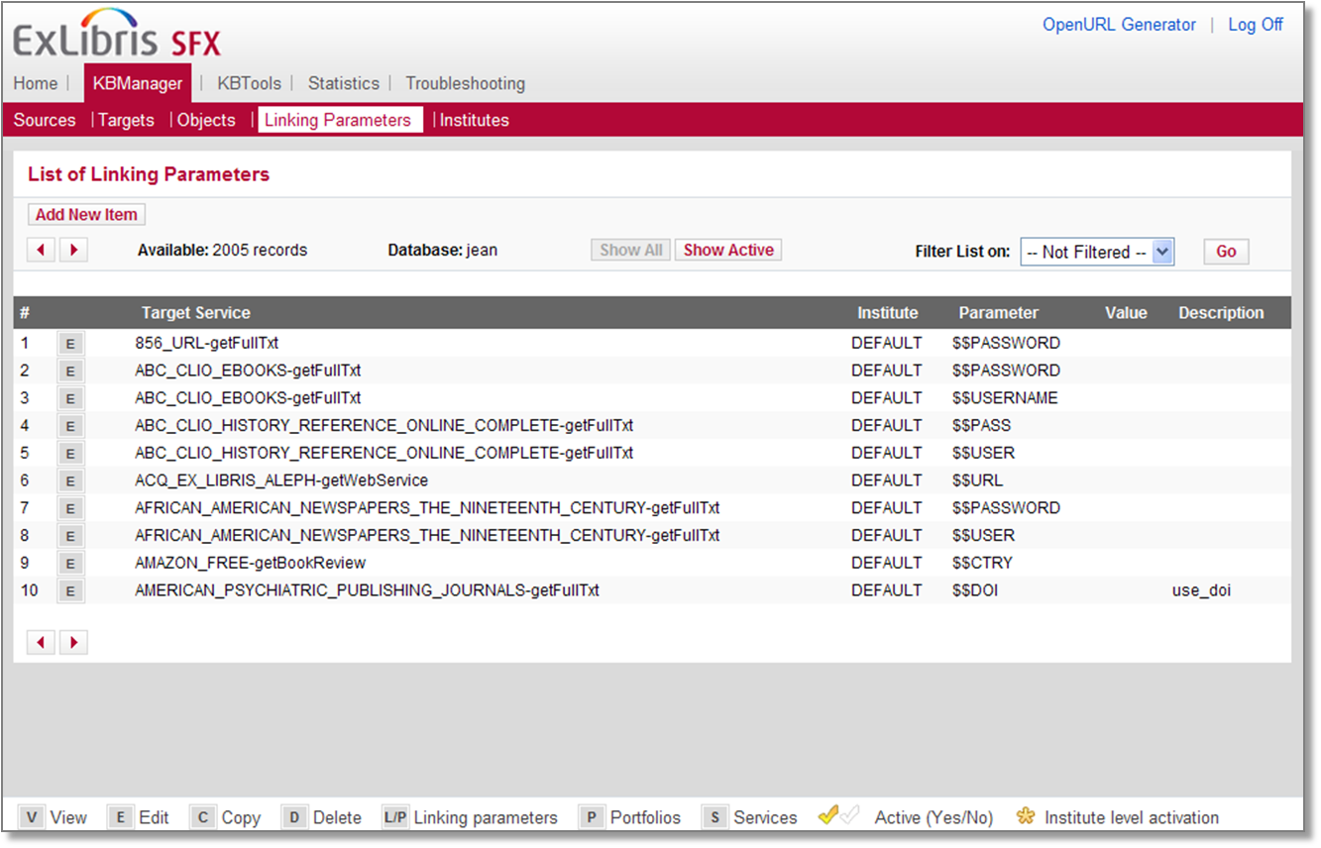
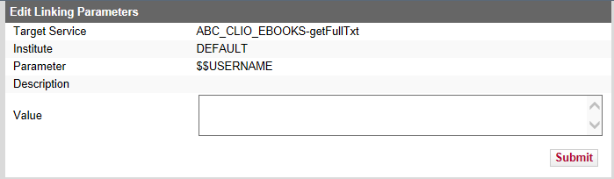
KBManager: Linking Parameters
Notes:
To finish out the Data Management section of the SFX Admin Center…
One way to access and edit linking parameters is from the target service level – as we saw when we activated Ebscohost Academic Search Complete.
Another way to access linking parameters for each target that requires them is from the main SFX admin center menu. The targets that require linking parameters are listed in alphabetical order.
Keep in mind that not all targets and services require linking parameters. It will depend on the vendor and the resource. These parameters are authentication credentials, above and beyond your proxy. In some cases, vendors require that credentials be embedded in the targetURL – so if they are required, this is where they’re defined.

Slide 30
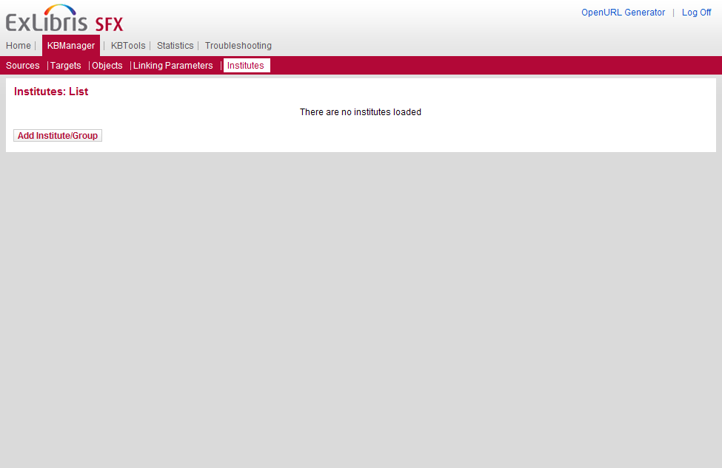
KBManager: Institutes
Notes:
The last area of the KBManager is the Institutes section. I won’t go into too much detail here, but if you’re in a consortium, this is where your institutes would be defined during the implementation. If you’d like more information, please refer to the ‘Using SFX in a Consortium Environment’ guide in the Documentation Center.

Slide 31
KBManager: Additions and Deletions
Can add locally-created resources:
Includes sources, targets, services, object portfolios, and objects
Indicated by _LCL extension in internal name
Recommendation: Request that Ex Libris include it in a future update
Can delete locally-created resources
Only locally created can be deleted
No way to undo deletion – all data is removed
Notes:
As a side note, the SFX KnowledgeBase doesn’t include everything, and you may find that you need to create a new target, service, or object – a good example of this is your library’s OPAC.
You can add all or any of these components to your KnowledgeBase. However, if it’s something that another library would use, we encourage you to request that Ex Libris add it to the general KB – that way others will benefit from the resource as well, and you won’t have to be responsible for updates to it in the future. One way to can request new targets, services, and object portfolios is using the KnowledgeBase Change Requests link in the SFX Admin Center under the Troubleshooting section. Another way to is log a support case. I’ll talk more about the cases in the SFX Troubleshooting session.
If you do create a local resource, it will have a _LCL extension in its internal name. You will need to keep track of new global targets in the KB and if your locally-created resource is added to the KB, then you can delete your local one after the KB update.
As far as deleting (click) things from SFX – most of the time you’re going to want to rely on deactivating it, rather than removing it entirely. And for any resources that are in the SFX knowledgebase, you will not be able to delete them; just deactivate them. However, if you’ve created something locally you will be able to delete it, but there’s no way to undo that deletion.

Slide 32
Agenda
Introduction to SFX Admin Center
Sources
Activate Targets, Services, Objects
Add Local Thresholds
Find an Object
Summary and additional resources
Notes:
This brings us to the end of this session.

Slide 33
Summary
How To...
Activate targets, services, and objects
Add local thresholds
Add linking parameters
Find an object
Notes:
In summary, in this session we looked at how to:
Activate targets, services, and objects (in that order)
Add linking parameters if they are needed
Add local thresholds
Work in reverse to find an object and then activate the object, along with the target and target service levels if they are not already active.

Slide 34

Additional Resources
Accessible from Documentation Center:
(http://www.customercenter.exlibrisgroup.com/)
General User’s Guide
Advanced User’s Guide
SFX Source Configuration Guide
SFX Target Configuration Guide
Using SFX in a Consortium Environment
Notes:
This is a list of documents that will provide more information. These documents can be accessed from the Ex Libris Documentation Center, which, in turn, can be accessed using the Customer Center. The URL is listed here. You’ll need a login to access the Customer Center, so check with your Ex Libris project team if you do not already have access.
Thanks for joining me!

