Slide 1
SFX TotalCare: Activating Resources using SFX Admin Lite
Notes:
Hello and welcome to this session on Activating Resources using SFX Admin Lite.
Please note that this presentation is copyrighted and is the confidential property of Ex Libris Ltd. Information included in this presentation is periodically reviewed and updated. You may share these training materials within your institution but not beyond.

Slide 2
Copyright Statement
All of the information and material inclusive of text, images, logos, product names is either the property of, or used with permission by Ex Libris Ltd. The information may not be distributed, modified, displayed, reproduced – in whole or in part – without the prior written permission of Ex Libris Ltd.
TRADEMARKS Ex Libris, the Ex Libris logo, Alma, Aleph, Voyager, bX, SFX, SFXIT, MetaLib, DigiTool, Verde, Primo, MetaSearch, MetaIndex and other Ex Libris products and services referenced herein are trademarks of Ex Libris, and may be registered in certain jurisdictions. All other product names, company names, marks and logos referenced may be trademarks of their respective owners.
DISCLAIMER The information contained in this document is compiled from various sources and provided on an "AS IS" basis for general information purposes only without any representations, conditions or warranties whether express or implied, including any implied warranties of satisfactory quality, completeness, accuracy or fitness for a particular purpose.
Ex Libris, its subsidiaries and related corporations ("Ex Libris Group") disclaim any and all liability for all use of this information, including losses, damages, claims or expenses any person may incur as a result of the use of this information, even if advised of the possibility of such loss or damage.
© Ex Libris Ltd., 2014

Slide 3
Agenda
Terminology Overview
Introduction to SFX Admin Lite
SFX Resource Management
Find and Activate/Deactivate Objects
Add Local Thresholds
Test SFX Menu
Summary & Additional Resources
Notes:
First we’ll do an overview of SFX terminology, since you will see this terminology throughout the SFX admin interface and the SFX documentation.
Then you will be introduced to the SFX Admin Lite interface which allows you to do management of your SFX resources - such as activating and deactivating resources, adding local thresholds, and testing resources in the SFX menu.

Slide 4

Objectives
How To…
Activate or deactivate objects in the SFX Admin Lite interface
Add local thresholds (date coverages)
Test titles in the SFX menu
Notes:
The key objectives for this session are being able to:
activate objects using the SFX Admin Lite interface
add local thresholds (i.e., date coverages) if you do not use the default thresholds from the vendor
test activated titles in the SFX menu

Slide 5
Agenda
Terminology Overview
Introduction to SFX Admin Lite
SFX Resource Management
Find and Activate/Deactivate Objects
Add Local Thresholds
Test SFX Menu
Summary & Additional Resources
Notes:
So let’s do a review of SFX terminology. You may remember these terms from the SFX Introduction session, but let’s just quickly review them now.

Slide 6
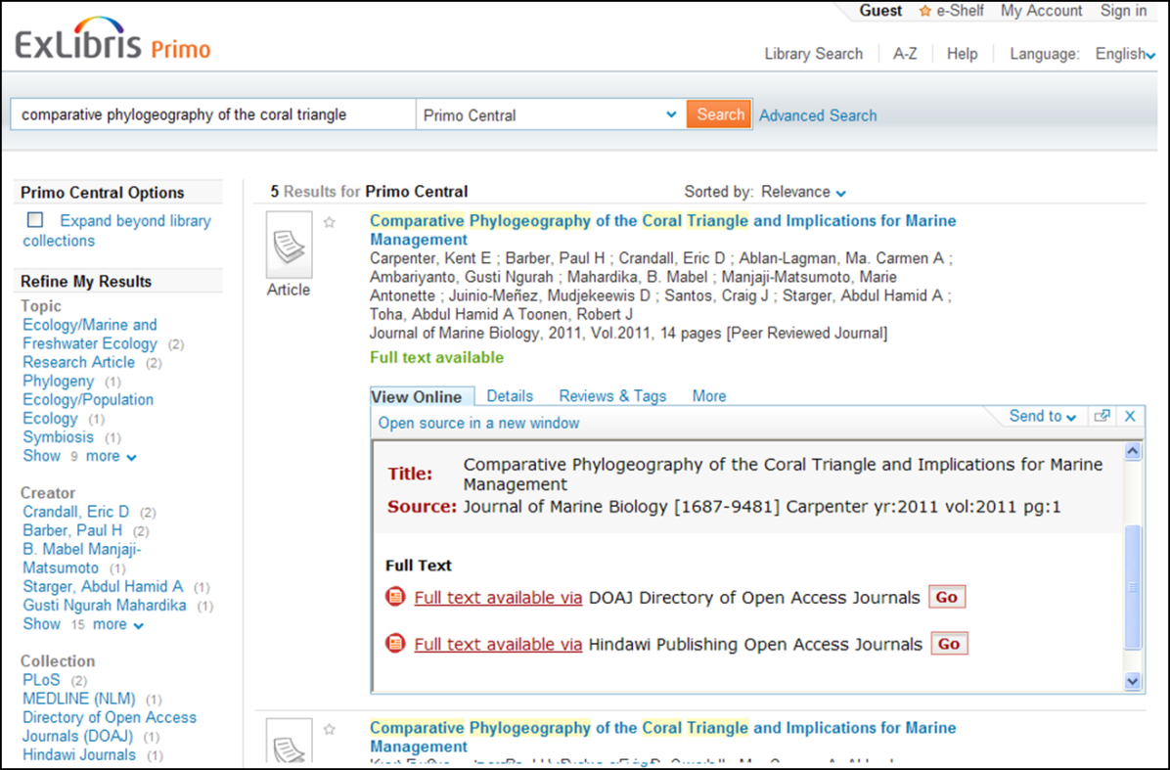
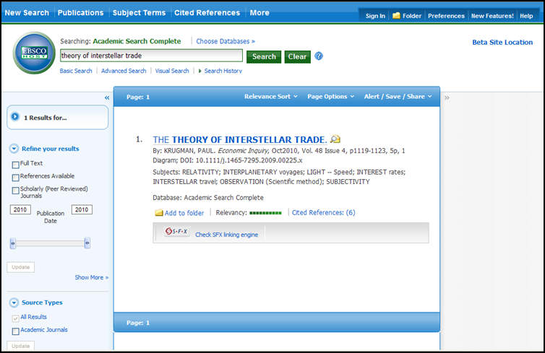
Terminology: Source
Source: Where user starts his/her search
Contact vendor to have SFX button appear in database interface
Source list and information in SFX Source Configuration Guide
Notes:
Remember that a source in SFX is where the user starts his/her search. Let’s look at a couple of examples: Here an Ebscohost database is a source where the user searched and we see the SFX button there. When the user clicks on that button, the SFX menu displays, listing all of the options for finding the full-text (for example) of the article.
(click) Primo can be another example of a source. The user does a search in Primo and then clicks on the View Online tab or the More tab to see the SFX menu display.
When you are ready to go live with SFX, you will want to contact each of the vendors that you want to use as sources. You’ll need to give them information such as your SFX base URL - which will be provided to you by your Ex Libris project team, as well as the image for the SFX button – so the vendor can include the button in their interface.
Your Ex Libris project team and the SFX Source Configuration Guide in the Documentation Center will provide you with a list of vendors that can be used as SFX sources, as well as the information you need to discuss with your vendors.

Slide 7
Terminology: Targets
Target
Database that contains what users are searching for
Service
Connection information
Object Portfolio
Collection of objects associated with a target/target service
Object
Serial or monograph title
Notes:
Let’s talk next about targets – and how targets, services, objects, and object portfolios relate to each other.
The target (click) is the database where your users find what they’re looking for – for example, the database that has the full-text of an article or the database that has the abstract of an article.
Services (click) provide the means of communication between the source and target systems – so the user can get to the fulltext, get to the abstract, get to the table of contents, and so on.
An object portfolio (click) is the collection of e-journals or e-books associated with any given target/target service.
An object (click) in SFX is a serial or monograph title.

Slide 8
Terminology: How they all relate
Target
EBSCOHost
Academic Search Premier
Target Service
getFulltxt
Object Portfolio
21,735 e-journals
Object
Publisher’s Weekly
ISSN 0000-0019
Notes:
In the SFX, the target, service, object, and object portfolio are components of the link resolution process.
The target (click) is where your users will find what their looking for – in this example, EBSCO’s Academic Search Premier. The service (click) is what they’re requesting and the connection to it – in this case, they’re requesting the full text. The object portfolio (click) associated with the target service in this case contains 21,735 e-journals. And one of those journals is the object (click) Publisher’s Weekly.
You can think of these components as levels in SFX: the Target level, the target service level, and the object portfolio level – taking the last 2 areas together.
An object is always going to be associated with a target and a service – and it’s possible for an object to exist in more than one target (for example, you can subscribe to Publisher’s Weekly through EBSCO, Gale, and ProQuest to name a few), and it can exist in more than one service (it’s possible you could get the abstract, table of contents, full text, and so on for Publisher’s Weekly). Because of this, objects are not independent from the target and service – each component (or level) has to be active for the resource to be available in SFX. In this case, if I newly subscribe to Publisher’s Weekly through Academic Search Premier and I, therefore, wanted to activate Publisher’s Weekly, I’d have to make sure all 3 levels are activated: the journal itself (in SFX terms: the object), the getFullTxt service, and the EBSCO Academic Search Premier target.

Slide 9
Agenda
Terminology Overview
Introduction to SFX Admin Lite
SFX Resource Management
Find and Activate/Deactivate Objects
Add Local Thresholds
Test SFX Menu
Summary & Additional Resources
Notes:
I mentioned the SFX Admin Lite interface earlier, so let me introduce you to that.

Slide 10
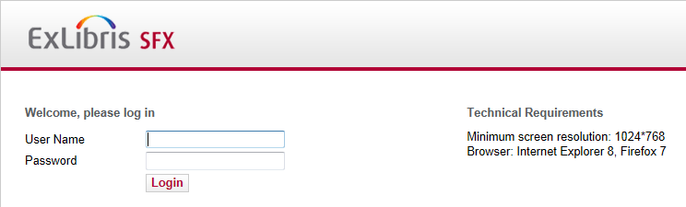
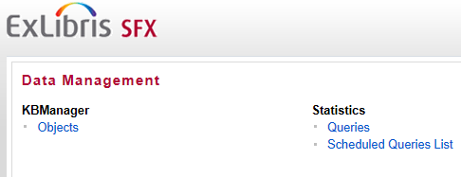
SFX Admin Lite
Notes:
As a TotalCare customer, Ex Libris provides full software and hardware maintenance for SFX. This includes software and hardware updates as well as the maintenance of your KnowledgeBase. During your implementation, we’ll be configuring and customizing SFX for you based on input and feedback we receive during the implementation process. And going forward, we’ll take care of activating new resources that you subscribe to, deactivating resources you no longer subscribe to, and so on. You will want to check your Ex Libris SFX contract to find out the timeframe for how long it takes to do target activations or deactivations, customization changes, and so on.
That said, we also provide a web-based administrative tool called SFX Admin Lite for you to do some management of electronic resources in your SFX Knowledgebase. Now, most of the time you’ll log a support case to have Ex Libris activate or deactivate resources for you in SFX, but in some cases you may want to do your own activations or deactivations.
(click) Your SFX Admin Lite URL and login information will be provided to you by your Ex Libris project team.
Once you log in (click), there are two areas you will have access to within the SFX Admin Lite interface: KB Manager, and Statistics. If you want to activate or deactivate an object (i.e., title) that’s in a package because you subscribed to it or perhaps you no longer subscribe to it, you’d use the KB Manager “Objects” section. If you want to run a statistical report, you would use the Statistics section of the SFX Admin Lite interface. We will talk more about statistics in a separate session. This session will focus on the Objects area.

Slide 11
Agenda
Terminology Overview
Introduction to SFX Admin Lite
SFX Resource Management
Find and Activate/Deactivate Objects
Add Local Thresholds
Test SFX Menu
Summary & Additional Resources
Notes:
Now that we’ve looked at the SFX Admin Lite interface, let’s focus on how to find and activate or deactivate objects using it, as well as add local coverage dates (in other words, local thresholds), and test resources in the SFX menu.

Slide 12
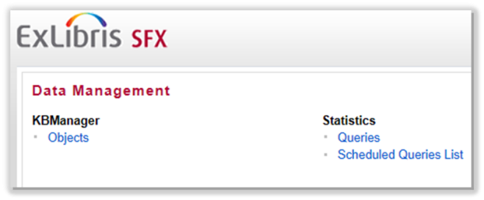
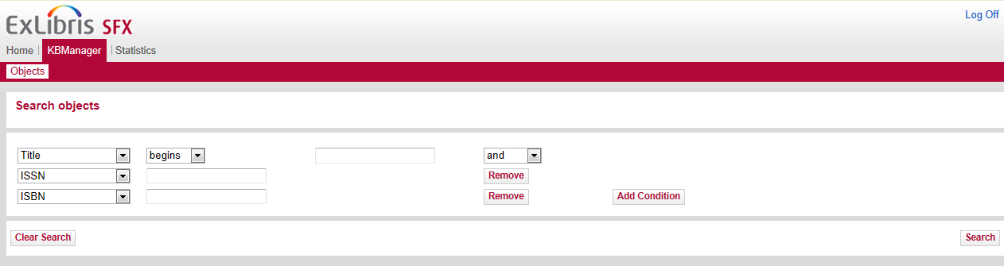
KB Manager: Objects
Search for a publication title in SFX:
Go to KBManager > Objects
Select criteria in dropdown
Enter search term
Add conditions (optional)
Click Search
Notes:
I mentioned previously that most of the time, you will probably log a support case to have the TotalCare Support team do activations or deactivations of resources. Alternatively, you can search for an object (in other words a particular publication title you subscribe to through a package), and activate or deactivate the object in SFX Admin Lite. You’ll click on the “Objects” link in SFX Admin Lite to do this.
Objects search screen allows you to search for any publication title in SFX. You can select the field you’d like to search and how the search terms are applied. It’s also possible to add or remove conditions.
Our scenario here is that we have just subscribed to a new title (Journal of Biochemical Toxicology; ISSN: 0887-2082) within a package. We need to activate that title, or object in SFX terms, so that it will appear in the SFX menu.

Slide 13
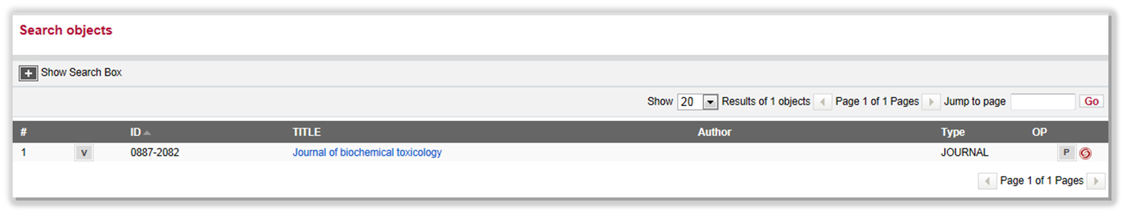
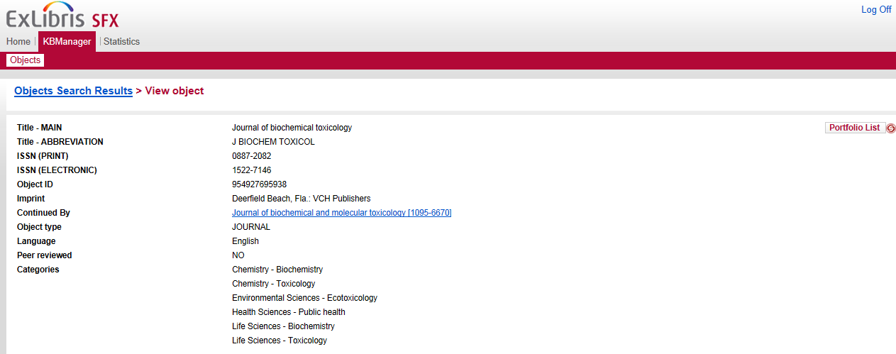
View Object
Notes:
A results list of object titles displays. In some cases, there may be multiple objects listed so you need to decide which is the correct one.
To view the data for an object, you can click on the V button [V for View] so you can confirm that this is indeed the correct object you want to activate or deactivate.
Also notice that you can revise your object search by clicking on the + button to show the search box from here.

Slide 14
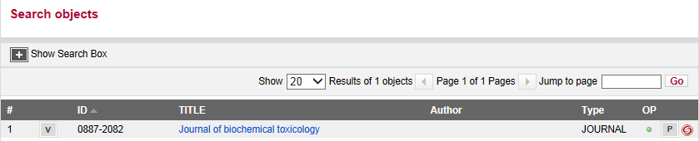
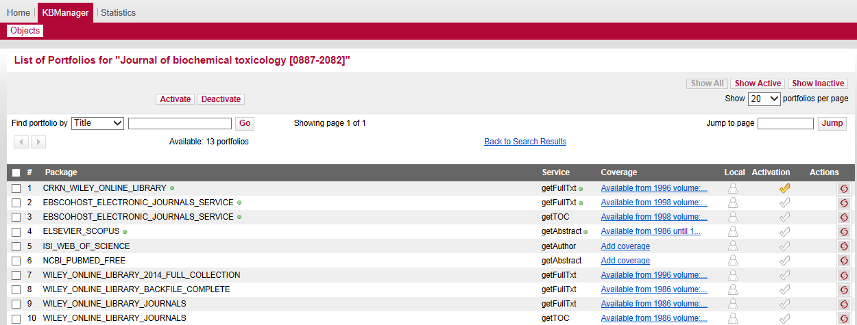
Activate/Deactivate Object
Notes:
Once you have searched for and identified the correct object, you’ll notice a few other things:
If there’s a little green dot in the OP (Object Portfolio) column, that means the object is already activated in a portfolio in SFX. However, at this point, we don’t know which particular package (or target in SFX terms) the object is activated in. You’ll see which target the object is activated in when you click on the P button.
By clicking on the P button, you are taken to a full list of portfolios for targets and target services that the object is included in. This is the screen that we’ll use to activate the title. You’ll look for the correct package (in other words, target) and the correct target service (for example: getFullTxt) that you subscribe to for the object, and then click on the checkmark next to it, turning it yellow, to activate the object in that target and target service. (WILEY_ONLINE_LIBRARY_JOURNAL_BACKFILE_COMPLETE; getFullTxt)
Note the yellow checkmark that already exists for CRKN_WILEY_ONLINE_LIBRARY. This means that the object is already active in this target and target service (getFullTxt). That’s why we saw the green dot in the OP column in the previous screen – because the object was already active in a target in SFX; now we know which target.
You also may remember from a few minutes ago that I mentioned that all 3 levels: the target level, the target service level, and the object portfolio level need to be active in SFX for the resource to display in the SFX menu. Notice the little green dots in the Package column (again, this is the Target) and the Service column. The green dots are visual indicators that the target and target service levels are activated. Again, it’s important to remember that all 3 levels: the target level, the service level, and the object level all need to be active in order for the title to display in the SFX menu. So the green dot by the package/target level means the target-level is activated, the service-level is activated, and the yellow activation checkmark means that the object portfolio level is active also. So this title will display in the SFX menu.
Now when you activate the object, you’ll also be activating the target and target service (full-text) levels if they are not already activated.
e.g., WILEY_ONLINE_LIBRARY_JOURNALS – getFullTxt. Notice it’s listed twice in the list, and that’s because it has 2 different services associated with you. You can choose to activate one or both of those services. In this example, I’ll only activate the getFullTxt service for this target. Notice there currently are no green dots for the target and service levels. When I click on the yellow checkmark, notice that the green dots now appear, so all three levels are now active.
Let’s look at ELSEVIER_SCOPUS: Notice that the target and the service levels already have green dots. This means that I have other objects activated in this target – so the target and service levels are already active. If I wanted to activate this particular object in that target and target service, I just click on the checkmark.
To deactivate a title (for example if you no longer subscribe to it through the package), then simply click the yellow checkmark – which will turn it gray, indicating the title is now inactive. (Example: ELSEVIER_SCOPUS)

Slide 15
Thresholds / Date Coverage
Thresholds
Conditions placed on targets, services, or objects (e.g., date coverage)
Global thresholds
Defaults from vendor
Local thresholds
You can customize
Notes:
You may remember from the SFX Introduction session that SFX uses conditions on targets, services or object portfolios to ensure that it is available. These are called thresholds. Typically these are coverage dates for a database or journal title - or sometimes a database requires a specific attribute like an author’s last name, or volume and issue.
Global thresholds (click) are based on the standard packages supplied by the vendors. Typically, again, this means default coverage dates.
If your library’s coverage is different from the default, you can customize these thresholds and make them local.
Local thresholds (click) will override the global ones without replacing them – you can always remove the local threshold and the global one will become the default again.

Slide 16
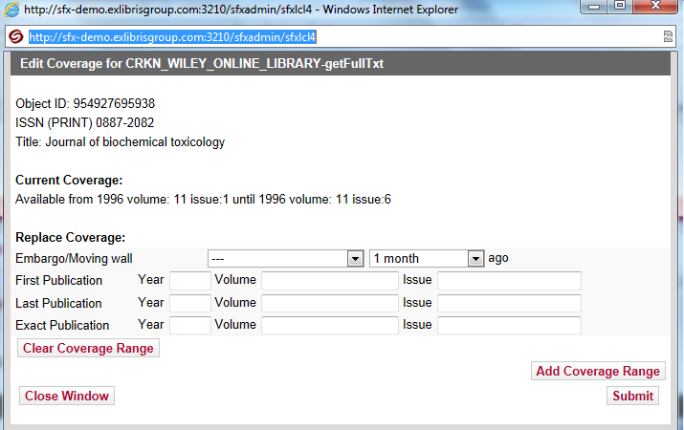
Edit Coverage Information
Notes:
You can edit threshold, or coverage information, by clicking on the Coverage link in the list of portfolios screen after you have searched for an object.
By default, it will indicate the global coverage dates that the vendor supplies. You can set the coverage dates, volumes and issues that you subscribe to, or indicate an embargo if the title is published, but isn’t accessible for a certain amount of time, and then click the Submit button.
If there are multiple date ranges that you have coverage for (where perhaps you subscribed to the title, then canceled the subscription, and then subscribed to it again later on), you can click “Add Coverage Range” to indicate another range of date coverage that you have. Then click the Submit button when you’re finished. Notice that the icon in the Local column will change slightly, as a visual indicator that you now have a local threshold for this title in this particular target and target service.
You can always revert back to the global threshold by editing the object and selecting ‘clear coverage range’.

Slide 17
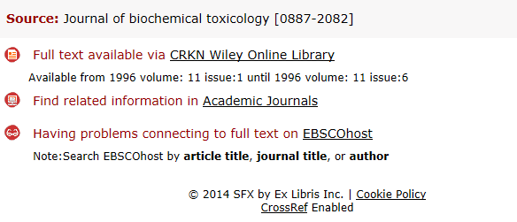
Test SFX Menu
Notes:
You can also do some testing for newly-activated resources.
Click on the little SFX swirlie icon to generate the SFX menu and test the connection to the target.

Slide 18
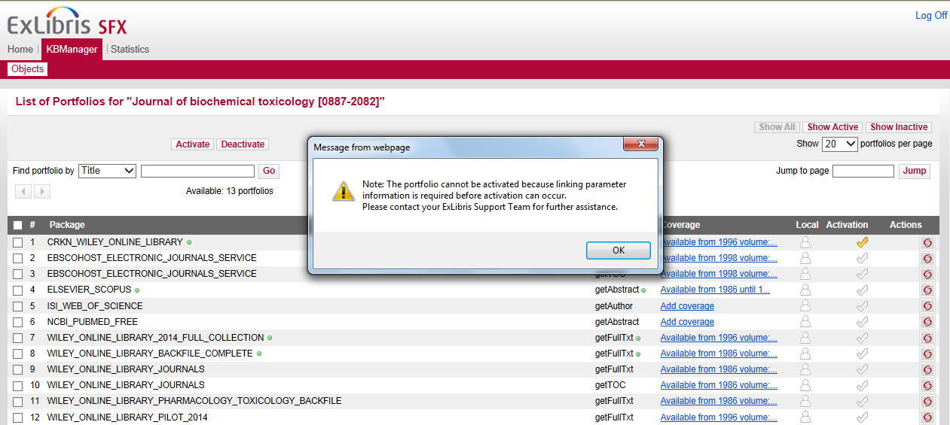
If Linking Parameters Needed…
Notes:
Sometimes when you activate an object where the target and target service levels are not yet activated, you’ll receive this message that the portfolio cannot be activated because linking parameter information is required before activation can occur.
e.g., EBSCOHOST_ELECTRONIC_JOURNALS_SERVICE
Linking parameters are typically authentication information - so for example, username and password information so that the user is able to access the full-text to an article in another database.
If you get this message, log a support case & the Support team will activate this resource on your behalf. You can see what linking parameters are needed for the target in the SFX Target Configuration Guide, and then provide the linking parameters (for example, the username and password for the vendor database) to the Support team. They will activate the resource for you, as well as configure the linking parameters for the target.

Slide 19
Guidelines
When to use the SFX Admin Lite Objects area?
Activating just a few objects in the target / target service
Activating an object within an already-activated target / target service
Example: You have access to a new title in an already-activated selective package
Activating objects in a new target / target service that do not require linking parameters
Example: Activating objects in free targets
Notes:
Let’s talk about some general guidelines for deciding on when to use the SFX Admin Lite Objects area versus when to log a support case to have the support team do activations/deactivations for you.
Generally speaking, most of the time you may probably want to log a support case and ask the Support team to do activations or deactivations for you.
But, if you want to use the Objects area in SFX Admin Lite, there are few things to keep in mind:
(click) It’s best to use the SFX Admin Lite Objects area if you only have a few objects to activate (or deactivate) - because you will be searching for the object titles one-by-one and doing the activations / deactivations manually. So if you have access to a new title within a package that is already activated in SFX, you can use the Objects area to activate the new object.
Also, the target and target service levels need to be already activated (click) (i.e., have little green dots next to them in the List of Portfolios) or (click) it’s the case where they do not require linking parameters. For example, for objects in free targets, or for objects in targets may not require linking parameters.

Slide 20
Guidelines, continued
When to log a support case for activations/deactivations?
If the package is newly-subscribed to and the target/target service may require linking parameters
Example: Subscription to a new aggregator package
If you have many objects in a target/target service to activate or deactivate!
Example: Aggregator packages, or selective packages with many titles
Notes:
Most of the time, you will probably want to log a support case. A few examples, however, are listed here.
Generally speaking, (click) if you have newly subscribed to an aggregator package, you will want to log a support case to have them activate the target, service, and object levels for you - especially since there may be linking parameters required.
(click) The other thing to keep in mind is if there are many objects in a target and target service that need activation…you’ll probably want the support team to this on your behalf.
Note that how to log a support case will be covered in the KB Updates and Basic Troubleshooting session.

Slide 21
Agenda
Terminology Overview
Admin Center (Admin Lite)
Find and Activate/Deactivate Objects
Add Local Thresholds
Test SFX Menu
Summary & Additional Resources
Notes:
This brings us to the end of this session.

Slide 22
Summary
How To…
Activate or deactivate resources in SFX Admin Lite
Add local thresholds (date coverages)
Test titles in the SFX menu
Notes:
In brief, we focused on how to:
activate resources using the SFX Admin Lite interface; Note that you’ll search for the object title and activate or deactivate it from there.
add local thresholds (in other words, date coverages) to objects if you do not use the default threshold from the vendor.
test activated titles in the SFX menu by clicking on the SFX swirlie icon that appears in the list of portfolios when you search for an object.
We also looked at some general guidelines for when to use log a support case for activations and deactivations and when to use the SFX Admin Lite Objects area to manually do the activations or deactivations yourself.

Slide 23

Additional Resources
Accessed from Documentation Center:
(http://www.customercenter.exlibrisgroup.com/)
SFX Source Configuration Guide
SFX Target Configuration Guide
SFX Admin Lite (TotalCare)
Activating objects using Admin Lite interface
SFX General User’s Guide
Resource activation and tools available in SFX Admin Center
Using SFX in a Consortium Environment
Notes:
Listed here are other available resources that will be helpful when activating resources in SFX. These can be accessed from the Ex Libris Documentation Center – which can be accessed from the Ex Libris Customer Center site. The URL is listed, and you will need to login. Check with your Ex Libris project team if you do not already have login credentials.
The document I’ll point out specifically is the SFX Admin Lite guide – which will provide further information about activating objects using the Admin Lite interface.
Thanks for joining me in this session!

