Slide 1
KB Tools
Notes:
Hello and welcome to this session on KB Tools.
Please note that this presentation is copyrighted and is the confidential property of Ex Libris Ltd. Information included in this presentation is periodically reviewed and updated. You may share these training materials within your institution but not beyond.

Slide 2
Copyright Statement
All of the information and material inclusive of text, images, logos, product names is either the property of, or used with permission by Ex Libris Ltd. The information may not be distributed, modified, displayed, reproduced – in whole or in part – without the prior written permission of Ex Libris Ltd.
TRADEMARKS
Ex Libris, the Ex Libris logo, Aleph, Alma, SFX, SFXIT, MetaLib, DigiTool, Verde, Primo, Voyager, MetaSearch, MetaIndex and other Ex Libris products and services referenced herein are trademarks of Ex Libris, and may be registered in certain jurisdictions. All other product names, company names, marks and logos referenced may be trademarks of their respective owners.
DISCLAIMER
The information contained in this document is compiled from various sources and provided on an "AS IS" basis for general information purposes only without any representations, conditions or warranties whether express or implied, including any implied warranties of satisfactory quality, completeness, accuracy or fitness for a particular purpose.
Ex Libris, its subsidiaries and related corporations ("Ex Libris Group") disclaim any and all liability for all use of this information, including losses, damages, claims or expenses any person may incur as a result of the use of this information, even if advised of the possibility of such loss or damage.
© Ex Libris Ltd., 2014

Slide 3
Agenda
KB Tools
  DataLoader
  Export Tool
  Collection Tool
Summary and additional resources
Notes:
In this session, we’ll be looking at an area within the SFX Admin Center called KB Tools, which contains import, export, and collection analysis tools.

Slide 4

Objectives
How To...
Import data to activate resources
Export data from SFX
Run reports to analyze package title overlaps
Notes:
By the end of this presentation, you will know how to:
import data through the use of the DataLoader tool to activate or update resources
export data from SFX
run reports to analyze title overlaps within packages – to help with purchasing and cancellation decisions

Slide 5
Agenda
KB Tools
  DataLoader
  Export Tool
  Collection Tool
Summary and additional resources
Notes:
Let’s take a look at where KB Tools is located in the SFX Admin Center…

Slide 6
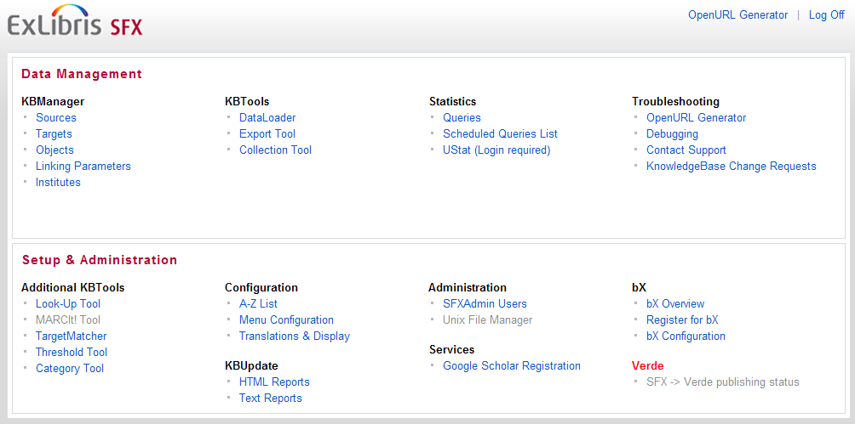
Admin Center
Notes:
KB Tools is the 2nd section under the Data Management area in SFX Admin Center.
I’ll be giving you an introduction to the DataLoader, Export Tool, and Collection Tool.

Slide 7
Agenda
KBTools
  DataLoader
  Export Tool
  Collection Tool
Summary and additional resources
Notes:
Let’s first take a look at the DataLoader tool.

Slide 8
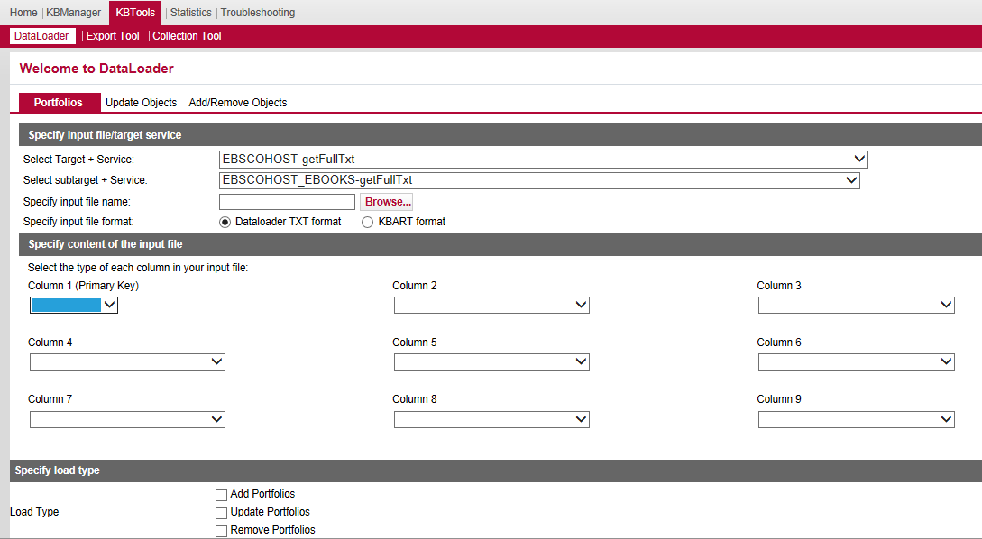


KBTools: DataLoader
Notes:
You may remember in the Activating Resources session that we manually activated (and inactivated) targets, target services, and objects on a one-by-one basis. The DataLoader Tool allows you to make updates, such as activations, in batch for a specific target and target service.
The DataLoader is an import tool to manage and update object portfolios in SFX. Not only can you activate or inactivate titles within a collection, you can also add your library's own subscription coverage dates (threshold data), add local titles (portfolios) to local targets, and much more using the DataLoader.
To use DataLoader, first we need to prepare a file with the information we want to add or update to the SFX KnowledgeBase. We’ll talk more about the input file in a moment.
Then, we define the target and service we want to work with, and select the input file that we want to use.
We then need to tell SFX how the input file is structured, as in what data is contained in which columns:
The first column in the file will act as a primary key, or a unique identifier. This is what we use to match the records in the file with any existing records in the KB.
You can then specify up to 8 other columns that are contained in the file. You can define the column headers using the rest of the dropdowns.
Then, we can choose the type of adjustments we want to make – add, update, or remove portfolios, activate targets, or work in report mode only. Report Mode will simulate the updates, providing a report of what would have updated - without actually doing the updates in SFX.
In any case, when you run the DataLoader import, a log file and report will be generated so you are able to see what successfully updated and if there were any errors.
Let’s briefly go over the other tabs in the Dataloader tool:
Update Objects: Allows you to add local attributes (e.g., local catalog numbers) and local titles (overriding the title that Ex Libris has in the SFX KnowledgeBase) to existing objects already in the KnowledgeBase.
Add/Remove Objects tab allows you to add local objects, or remove local objects from the SFX KnowledgeBase. This is in the case where an object didn’t already exist in the SFX KnowledgeBase, you create and maintain the object locally - on your own.

Slide 9
DataLoader: Input File
Tab-delimited text (.txt) file or KBART format
No spaces in file name
One file per target/target service
1st column = Primary key
If adding local thresholds, need to be written in Perl
  See SFX General User’s Guide: Using Excel to Create Local Thresholds
Notes:
Since putting together the input file itself could be a little time-consuming, a suggestion is that you could use DataLoader for very large selective package activations. An example of an input file is here; it’s an example of a file where I want to activate objects in a particular target and target service, as well as include local thresholds for the objects.
Some things to keep in mind when creating input files:
The file needs to be either in KBART format, or a .txt tab-delimited file with no spaces in the filename; if you keep the header row in the file, just keep that in mind as you’re looking at the log files – it will count that header row as an error.
If you’re activating portfolios, you’ll need 1 file per target/target service - so one input file for Wiley full-text journals, another data file for Ebscohost ebooks, etc.
The first column needs to be the primary key (e.g., usually ISSN or ISBN), but after that, the columns can be in any order – you’ll just need to define what’s in each column in the data loader screen. You can have up to 9 columns in total in the file including the primary key column.
Only 1 primary key type can be used per input file.
If you are activating or inactivating objects using DataLoader, you’ll need to have an Activation Status column in your file with either ACTIVE or INACTIVE as the values in that column. (These are case-sensitive!)
If you want to include local thresholds, the thresholds do need to be written in perl – however, there’s a formula you can use for any local thresholds in the file that you can find in the SFX General User’s Guide.
The SFX General User’s Guide will also provide more detailed information on how to use the tool, the format of the file, and what values each field accepts.

Slide 10
Agenda
KB Tools
  DataLoader
  Export Tool
  Collection Tool
Summary and additional resources
Notes:
We’ve talked about importing data into SFX, so now let’s talk about getting data out of SFX using the Export Tool.

Slide 11
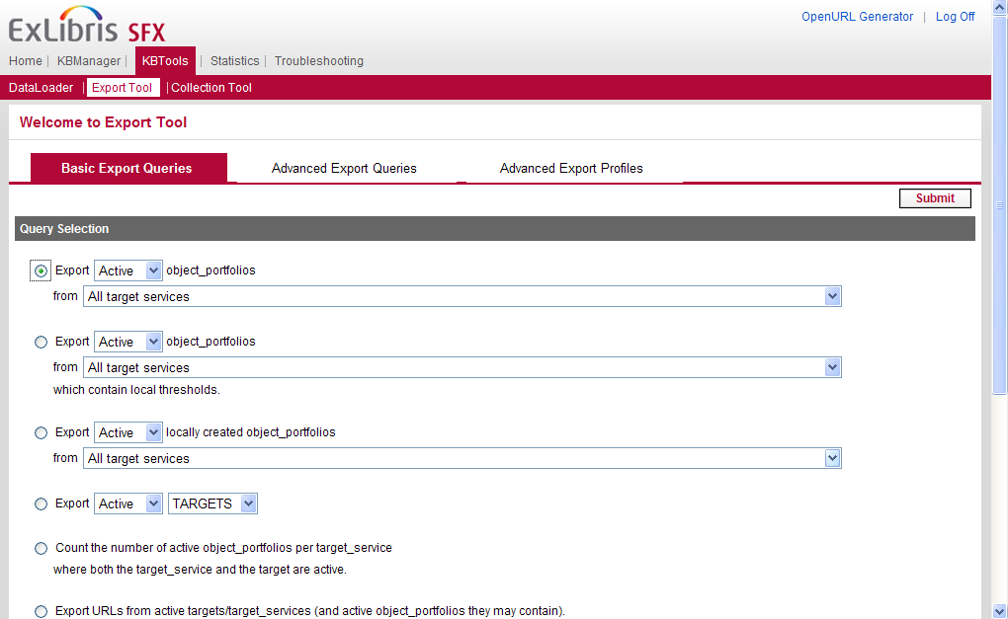
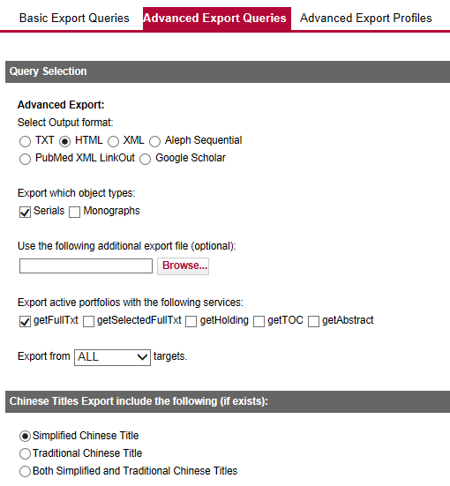

KBTools: Export Tool
Notes:
Export Tool does exactly what it sounds like it does – it exports data from your SFX KnowledgeBase. For example, you could use Export Tool if you want a list of all of your active targets, or a list of active targets, along with objects that are active in the target and threshold information for those objects.
There are a set of basic export queries, advanced export queries, and ways to store your advanced exports by creating export profiles.
The first basic query allows you to export a list of object portfolios from target services. You can work with active, inactive, or both, and you can select one or more target service to analyze. The second query allows you to pull just the ones with local thresholds.
You can also export a list of your locally created object_portfolios. And then there are other options – to export a list of targets, or produce counts of active object_portfolios per active target service. You can also export objects with local attributes, local titles, or local objects. Lastly, you can indicate if there any Chinese titles in the file.
In the advanced queries, you can specify the format of the exported file, whether or not you want to include serials and/or monographs, and what types of services you want to include. You end up getting a lot more data fields in your export file using an advanced export query than you would in a basic query.
You can also define and then save advanced exports in the Advanced Export Profiles section. So you can use your advanced export parameters over and over again, without having to set the advanced export parameters each time you want to run the export.
One thing to note is that while you have the ability to run exports manually from the Admin Center, you can also run exports by setting them up directly on the server, and export can even be scheduled to run on a regular basis. One example of this is the Google Scholar export - where your SFX full-text holdings information can be exported into a file for Google Scholar to pick up on a regular basis. We’ll talk more about running exports on the server in the System Administration session.

Slide 12
Agenda
KB Tools
  DataLoader
  Export Tool
  Collection Tool
Summary and additional resources
Notes:
Let’s talk about the last option in KB Tools, which is the Collection Tool.

Slide 13
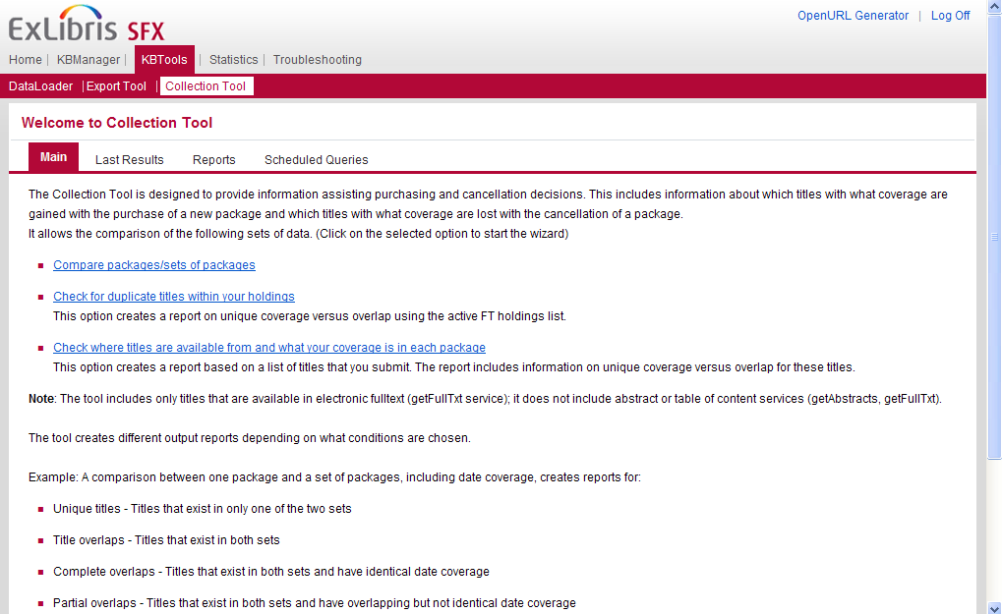
KBTools: Collection Tool
Notes:
The collection tool can give you the information you need to make collection development decisions. You can compare titles that are available in packages or sets of packages, check for duplicate titles within your holdings, and check to see which titles are from which packages, and what your coverage is in each package.
With the collection tool, you can also see what would be gained with a purchase, and what would be lost with a cancellation. This way you can develop your e-resource collections to meet your institution's needs, while making sure that money is spent efficiently.
Each of the links on this page go to a wizard that will walk you through selecting criteria and running the report. When the report has finshed running, you will receive an email notification.
You can always see the results of your latest report that you’ve run in the LastResults tab.
And you can also see the list of reports you’ve run in the past. (Reports) so you can always refer back to them. Notice you have the option to remove reports that you may no longer be interested in.
Finally, you can also schedule a report (ScheduledQueries) to run at a future date (not on a recurring basis, but on a scheduled date/time); we can see a list of these scheduled queries in the last tab.

Slide 14
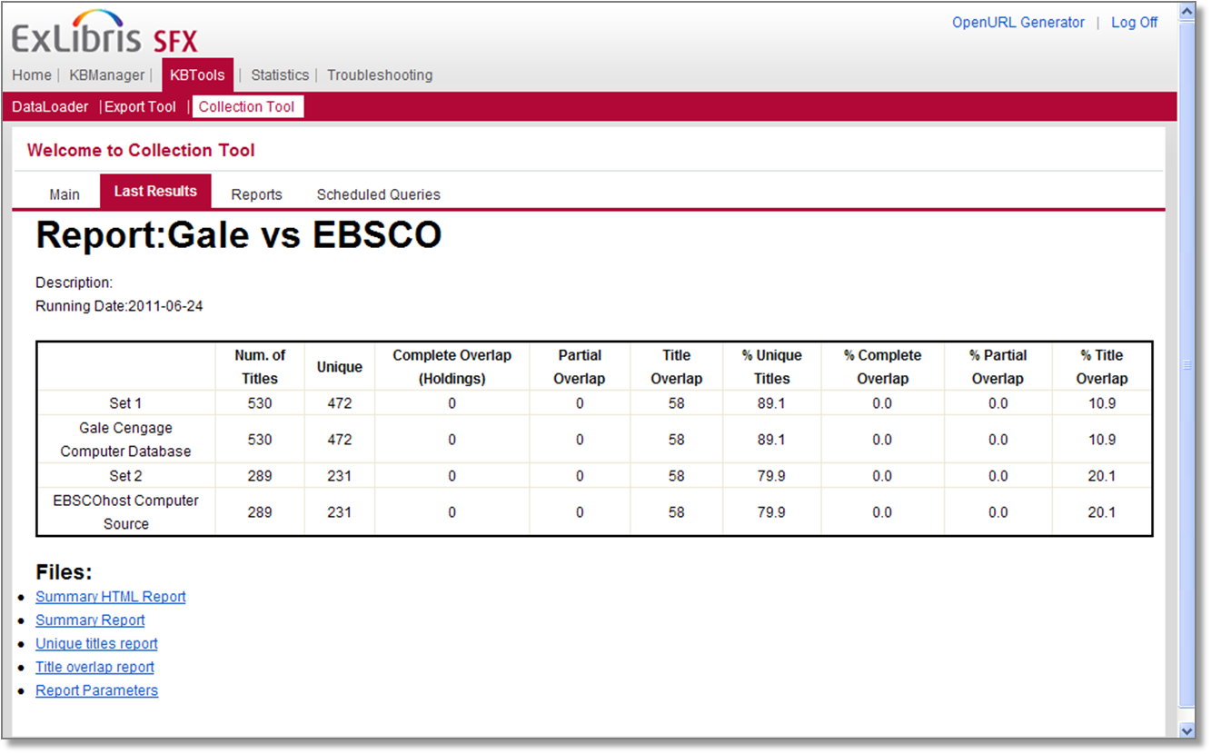
Collection Tool Example Report
Notes:
This is an example of the kind of information you will get from Collection Tool.
Notice we are comparing 2 different packages: Gale Cengage Computer Database and EBSCOhost Computer Source. We can see the number of titles within each package, how many of those titles are unique for each package, as well as what the overlap is between the 2 packages. The overlap is then indicated in percentages.
Complete overlap means titles that are in packages being compared that have identical date coverage.
Partial overlap means titles that exist in the packages being compared that have overlapping– but not identical - date coverage.
Title overlap just means titles themselves that overlap between the packages – it doesn’t take into account the date coverages for the titles.
By clicking on the hyperlinked reports at the bottom of the screen, we’re able to get more details such as the actual titles themselves that are unique and have overlap between the 2 packages.
There’s more information on the Collection Tool in the SFX General User’s Guide.

Slide 15
Agenda
KB Tools
  Dataloader
  Export Tool
  Collection Tool
Summary and additional resources
Notes:
This brings us to the end of our session.

Slide 16
Summary
How To...
Import data to activate resources
Export data from SFX
Run reports to analyze package title overlaps
Notes:
To briefly summarize, we looked at how you can:
import data to activate resources using the Dataloader tool
export data from SFX using the Export tool
run reports to assist in collection development decision-making using the Collection Tool.

Slide 17

Additional Resources
Accessible from Documentation Center:
(http://www.customercenter.exlibrisgroup.com/)
  General User’s Guide
  Advanced User’s Guide
  SFX System Administration Guide
Notes:
Here’s a list of documents that will provide more information on the KB Tools. These can all be found in the Ex Libris Documentation Center.
For DataLoader, Export tool, and Collection tool information, the SFX General User’s Guide will be of most help when using these tools in SFX Admin Center. Note that these tools can also be run from the server as well so the Advanced User’s Guide and the System Administration Guide may be helpful in that case.
Thanks for watching!

