Slide 1
SFX TotalCare: Statistics
Notes:
Hello and welcome to this session on SFX Statistics.
Please note that this presentation is copyrighted and is the confidential property of Ex Libris Ltd. Information included in this presentation is periodically reviewed and updated. You may share these training materials within your institution but not beyond.

Slide 2
Copyright Statement
All of the information and material inclusive of text, images, logos, product names is either the property of, or used with permission by Ex Libris Ltd. The information may not be distributed, modified, displayed, reproduced – in whole or in part – without the prior written permission of Ex Libris Ltd.
TRADEMARKS
Ex Libris, the Ex Libris logo, Aleph, Alma, SFX, SFXIT, MetaLib, DigiTool, Verde, Primo, Voyager, MetaSearch, MetaIndex and other Ex Libris products and services referenced herein are trademarks of Ex Libris, and may be registered in certain jurisdictions. All other product names, company names, marks and logos referenced may be trademarks of their respective owners.
DISCLAIMER
The information contained in this document is compiled from various sources and provided on an "AS IS" basis for general information purposes only without any representations, conditions or warranties whether express or implied, including any implied warranties of satisfactory quality, completeness, accuracy or fitness for a particular purpose.
Ex Libris, its subsidiaries and related corporations ("Ex Libris Group") disclaim any and all liability for all use of this information, including losses, damages, claims or expenses any person may incur as a result of the use of this information, even if advised of the possibility of such loss or damage.
© Ex Libris Ltd., 2014

Slide 3
Agenda
Statistics
  SFX Statistics
  USTAT
Summary & Additional Resources
Notes:
In this session, we’ll be looking at SFX statistics-related tools. There are statistics for analyzing SFX usage, as well as a tool called USTAT that will help you analyze statistics that are provided by your vendors.

Slide 4

Objectives
How To...
Analyze SFX usage through statistics
Access USTAT to analyze vendor-provided usage statistics
Notes:
By the end of this presentation, you will know how to:
analyze SFX usage through statistics that are available in the SFX Admin Lite interface
access USTAT to analyze vendor-provided usage statistics.

Slide 5
Agenda
Statistics
  SFX Statistics
  USTAT
Summary & Additional Resources
Notes:
Let’s look at how to analyze SFX usage.

Slide 6
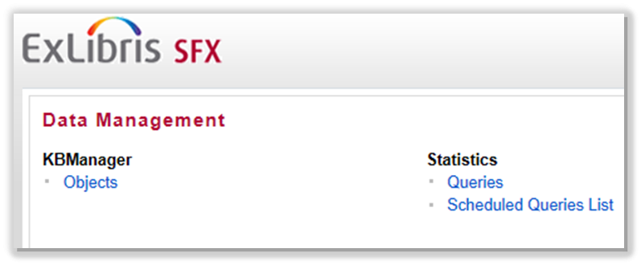
SFX Admin Lite: Statistics
Notes:
From the SFX Admin Lite home page, we’ll working in the Statistics section.

Slide 7
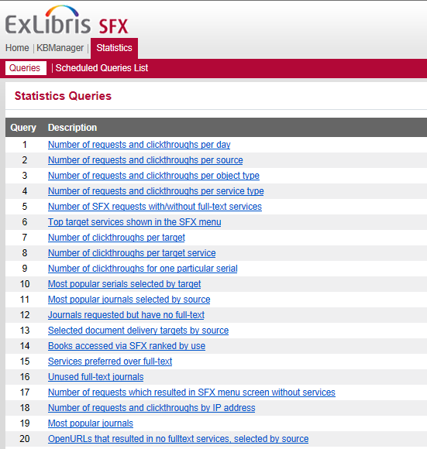
Statistics: Queries
Notes:
SFX has 20 different statistical queries that you can run. You can set certain parameters in each query, so you have a lot of different ways to analyze your e-resource usage, discover new service needs and identify potential collection gaps.
Before I give an overview of what each of these queries does, I’d like to point out a couple of terms that are used: requests and clickthroughs.

Slide 8
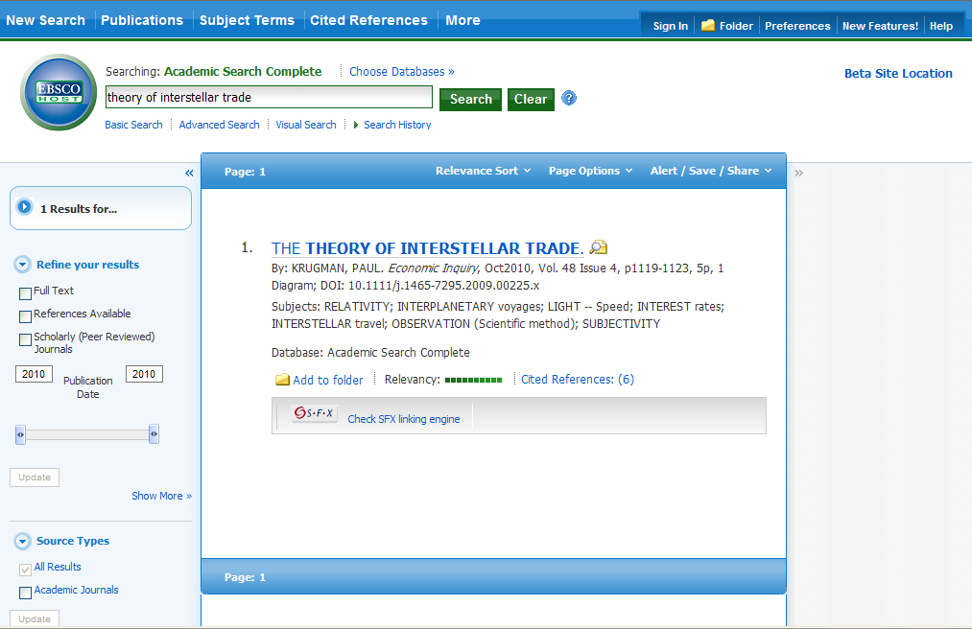
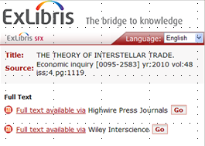
Statistics: Queries
Request: User clicks SFX button in Source
Clickthrough: User clicks on link in SFX Menu
Notes:
SFX measures usage at two different points in the link resolution process –
A request is when a user clicks on the SFX button in the source database (or clicks on the ‘View Online’ tab in Primo)
(click) A clickthrough is when a user clicks on a (target) link in the SFX Menu.
If Directlink is turned on so the user bypasses the SFX menu and goes directly to the full text when they click on the SFX button in the source database or the View Online tab in Primo, it will count as 1 request and 1 clickthrough.

Slide 9
Statistics: Queries List
# | Statistical Query | Description
1 | Number of requests and clickthroughs per day | Overall SFX usage
2 | Number of requests and clickthroughs per source | Usage by source
3 | Number of requests and clickthroughs per object type | Usage by object type (Journal, Newspaper, Book, etc.)
4 | Number of requests and clickthroughs per service type | Usage by service type (getFullTxt, getAbstract, etc.)
5 | Number of SFX requests with/without full-text services | Number of requests that did/did not have full text services.
6 | Top target services shown in the SFX menu | Number of times target services appear in the SFX Menu
7 | Number of clickthroughs per target | Usage by target
8 | Number of clickthroughs per target service | Usage by target service
9 | Number of clickthroughs for one particular serial | Journal usage - one journal, multiple targets
10 | Most popular serials selected by target | Journal usage - all journals within a target
Notes:
The next couple of slides are descriptions of each of the 20 queries that are available in SFX. This same list is in the accompanying presentation for this recording so you can refer to it at any point. For now, I’ll just cover a few of the reports that may be of interest.

Slide 10
Statistics: Queries List
# | Statistical Query | Description
11 | Most popular journals selected by source | Journal usage - all journals within a source
12 | Journals requested but have no full-text | Journals requested that have no full-text
13 | Selected document delivery targets by source | Document delivery usage
14 | Books accessed via SFX ranked by use | E-book usage
15 | Services preferred over full-text | Services preferred over full-text - counts by service
16 | Unused full-text journals | Full-text journals that aren't being used – need to run RSI
17 | Number of requests which resulted in SFX menu screen w/o services | Requests without services - counts grouped by date
18 | Number of requests and clickthroughs by IP address | Usage based on IP
19 | Most popular journals | Most popular journals
20 | OpenURLs that resulted in no full-text services, selected by source | OpenURLs w/o full-text services - counts by source and title
Notes:
Continuation of SFX query descriptions.

Slide 11
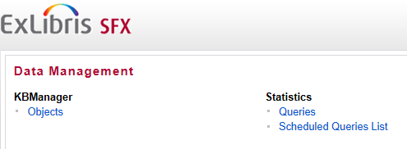
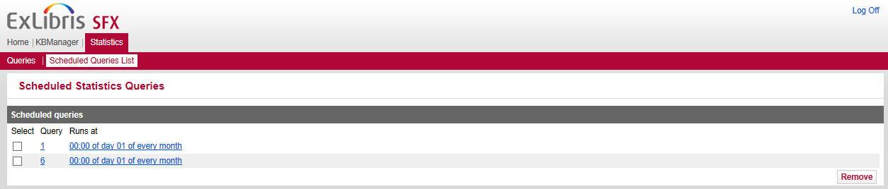
Statistics: Scheduled Queries List
Notes:
It’s also possible to schedule any of these queries to run at a future date, have them run on a recurring basis, and have the results emailed to you.
Note that in order to run statistics in SFX Admin Lite, a job needs to run behind the scenes on the server – and it’s scheduled to run on a regular basis. Your Ex Libris project team will be scheduling this job on your behalf, but just be aware that there may be a slight lag in the data that you are able to query using statistics.

Slide 12
Agenda
Statistics
  SFX Statistics
  USTAT
Summary & Additional Resources
Notes:
Our last statistics-related topic is an application called USTAT, which is available to you through SFX. I’ll just be briefly introducing you to USTAT here, as there is more USTAT information available to you in the Documentation Center.

Slide 13
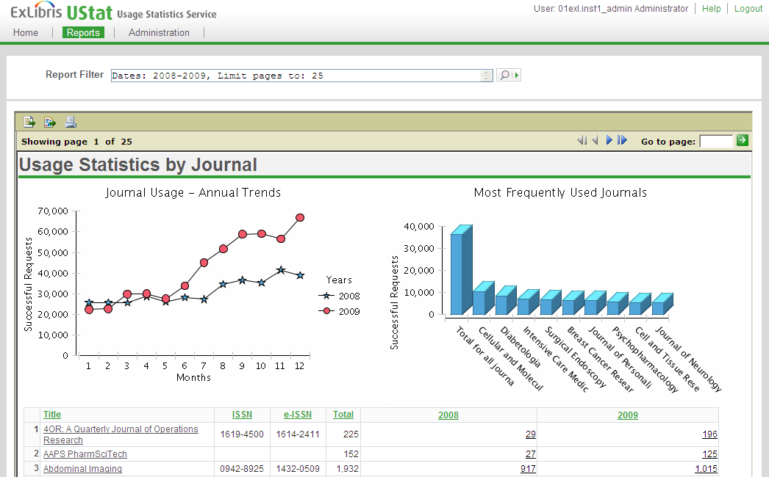
Statistics: UStat
  https://verde‐usage1.hosted.exlibrisgroup.com:8801/usage
Notes:
SFX Statistics provides statistics that rely on SFX transactional data. In addition to this, each of your vendors probably supplies you with usage statistics.
There are standards out there for both the format of the vendor reports, as well as the protocols for gathering and transmitting this information. These standards enabled Ex Libris to create UStat, a usage statistics service that allows the collecting and reporting of usage statistics information supplied by vendors who adhere to these standards. This allows you to consolidate reports from various vendors (who adhere to the standards) into one place where you can do the analysis on all of the reports together. These reports complement the SFX queries that are available in SFX Admin Lite.
UStat comes with your SFX subscription and you can access it from the URL listed here. You can register and request a login using the Registration link on the USTAT login page; it’s a quick registration process where you define your username and password. Once you’ve registered for UStat, you'll be able to log in using the URL listed here and start using the USTAT application.
There is more information in the USTAT User’s Guide that is available in the Documentation Center, and there’s also a USTAT course that’s available in the Learning Center.

Slide 14
Agenda
Statistics
  SFX Statistics
  USTAT
Summary & Additional Resources
Notes:
This brings us to the end of our session.

Slide 15
Summary
How To...
Analyze SFX usage through statistics
Analyze vendor-provided usage statistics through the USTAT application
Notes:
To briefly summarize, we looked at how you can analyze SFX usage through statistics that are available through the SFX Admin Lite interface, and where you can analyze statistics that are provided by vendors by using the USTAT application.

Slide 16

Additional Resources
Accessible from Documentation Center:
(http://www.customercenter.exlibrisgroup.com/)
  SFX Admin Lite
  General User’s Guide
  Advanced User’s Guide
  SFX System Administration Guide
  Using SFX in a Consortium Environment
  UStat User’s Guide
Notes:
Here’s a list of documents that will provide more information on statistics. These can all be found in the Ex Libris Documentation Center.
The best way to learn how the SFX statistics work is to go in, run them, and see what the results are. That said, the SFX Admin Lite guide, as well as the General User’s Guide provide a bit more detail than what I’ve provided in this session. Additionally, since the data behind the statistics is managed on the server, you may want to refer to the Advanced User’s guide and the System Administration Guide for more information.
If you’re in a consortium using SFX, you may want to refer to the Using SFX in a Consortium Environment guide, as it will discuss SFX statistics in a consortium environment.
If you are registered for UStat, you may want to take a look at the UStat User’s Guide. Additionally, the UStat course can be accessed from the Learning Center by using the Customer Center URL listed here.
Thanks for watching!

