Slide 1
SFX TotalCare: User Interface Configuration - A-Z List
Notes:
Hello and welcome to this session on User Interface Configuration for the A-Z List.
This presentation is copyrighted and is the confidential property of Ex Libris Ltd. Information included in this presentation is periodically reviewed and updated. You may shared these training materials within your institution but not beyond.

Slide 2
Copyright Statement
All of the information and material inclusive of text, images, logos, product names is either the property of, or used with permission by Ex Libris Ltd. The information may not be distributed, modified, displayed, reproduced – in whole or in part – without the prior written permission of Ex Libris Ltd.
TRADEMARKS
Ex Libris, the Ex Libris logo, Aleph, Alma, SFX, SFXIT, MetaLib, DigiTool, Verde, Primo, Voyager, MetaSearch, MetaIndex and other Ex Libris products and services referenced herein are trademarks of Ex Libris, and may be registered in certain jurisdictions. All other product names, company names, marks and logos referenced may be trademarks of their respective owners.
DISCLAIMER
The information contained in this document is compiled from various sources and provided on an "AS IS" basis for general information purposes only without any representations, conditions or warranties whether express or implied, including any implied warranties of satisfactory quality, completeness, accuracy or fitness for a particular purpose.
Ex Libris, its subsidiaries and related corporations ("Ex Libris Group") disclaim any and all liability for all use of this information, including losses, damages, claims or expenses any person may incur as a result of the use of this information, even if advised of the possibility of such loss or damage.
© Ex Libris Ltd., 2014

Slide 3
Agenda
A-Z Lists
A-Z List Customizations
Summary & Additional Resources
Notes:
First, we’ll take a ‘tour’ of the A-Z Lists. There’s an A-Z list for ejournals, and an A-Z list for ebooks – so how we’ll look at how each of them looks and works. Then we’ll look at the customization, or configuration, options for the A-Z lists.
Don’t feel like you have to make decisions about each and every one of these options. Keep in mind that in SFX, we already have defaults that are set, and generally speaking, you may not change a lot of them. Keep in mind that I’m just showing you all of the possibilities – and in doing so, educating you a little bit more about how the A-Z user interface works.

Slide 4

Objectives
A-Z List customization options for ejournals and ebooks
Incorporate best practices
Notes:
After this presentation, you’ll know:
what customizations are available for the A-Z Lists for ejournals and ebooks
some general best practices for user interface customization.

Slide 5
Agenda
A-Z Lists
A-Z List Customizations
Summary & Additional Resources
Notes:
Let’s start with how the A-Z lists look and work in general.

Slide 6
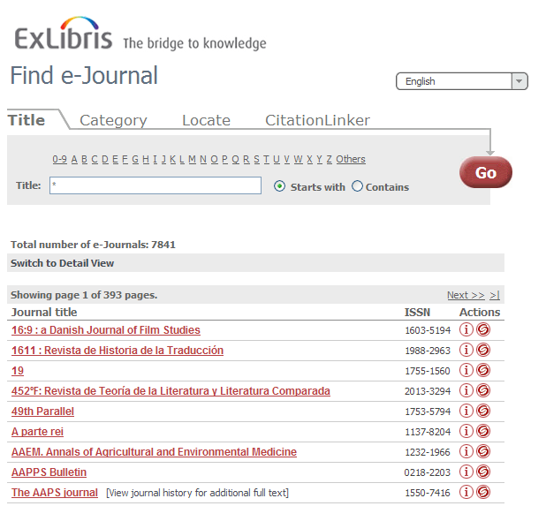
A-Z List: Title
http://hostname:port/instance/az
SFX Base URL
Notes:
Let’s look first at the A-Z list for ejournal titles.
By default, your A-Z list can be accessed by entering your SFX base URL (which your Ex Libris project team will provide to you), along with a /az at the end of the URL. Again, note that this is an A-Z list of all of your eJournal titles.
When we first go to the default A-Z List screen, we’ll see, at the very top of the screen, a header image. By default, we have the Ex Libris logo, but you can replace this with your institution’s logo. You’ll notice that on the right there’s a dropdown menu of languages.
The main portion of the screen defaults to the Title tab, where you can browse or search for ejournals by title.
Here I’ve performed an open search to see all of the journals in a list – the search results default to a brief view, which is called the Table view - where I can see the journal title, the ISSN, and two icons: the Information (I) icon and the SFX swirlie icon, which displays the SFX menu with any active targets and target services that contain the resource.
If I click on the Information (I) icon, I’ll get a pop-up window with additional details, including whether it’s peer-reviewed, the category and subcategory that the title is assigned to in SFX by default, and related object information (e.g., titles that are continued by another title, etc.) All of this information is coming from SFX.
Speaking of related objects, if you look in my list of titles, you’ll see some titles are hyperlinked, while others are not. The hyperlinked titles are the titles you subscribe to and are activated in SFX. The non-hyperlinked titles are related to titles that you have activated. You don’t necessarily subscribe to them and have them activated in SFX, but are related to a title that you do have activated. There are options to remove related titles that we’ll see later.
If I click on the “Switch to Detail View” link, I’ll see the same list with more details – the same information we saw before the brief/table view, but also the services available for the journal, the target or targets it’s in, and the threshold information. You’ll also see the categories and subcategories that the object is assigned to.
Speaking of categories and subcategories, let’s move onto the next tab in the A-Z list interface: Category.

Slide 7
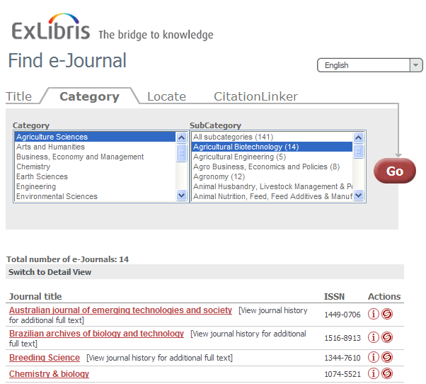
A-Z List: Category
Notes:
The Category tab allows you to browse ejournals by category. The Category information is included in the SFX KnowledgeBase. Each title, or object, in the SFX KnowledgeBase is assigned at least one category and subcategory by default.
If I select a specific category we can see the list of subcategories available. Notice the number in parentheses for each subcategory, which indicates the number of titles within the subcategory. By selecting a subcategory, I can see the list of journals in the view below that meet that criteria. Notice I have the same display options in the results as in the Title tab.
Next…

Slide 8
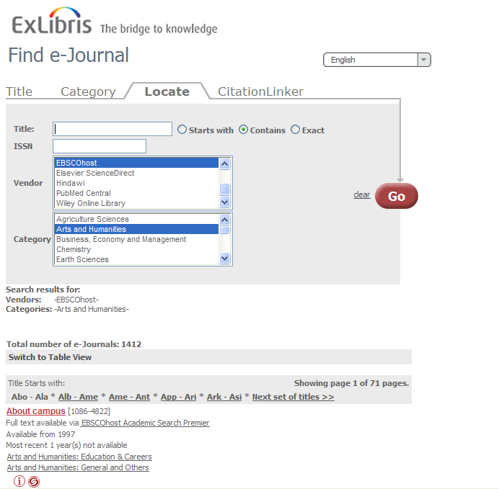
A-Z List: Locate
Notes:
The third tab is the Locate tab. This is where the user can conduct more advanced searches by entering any combination of title keywords, ISSN, Vendors, and or Categories. In this example, I wanted to get a list of Arts and Humanities journals from EBSCOhost.
Again, the display options for the results are the same as in the title and category tabs.

Slide 9
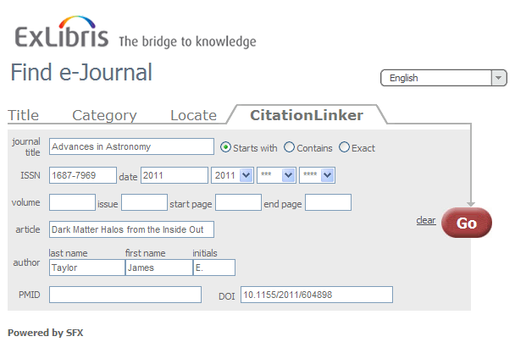
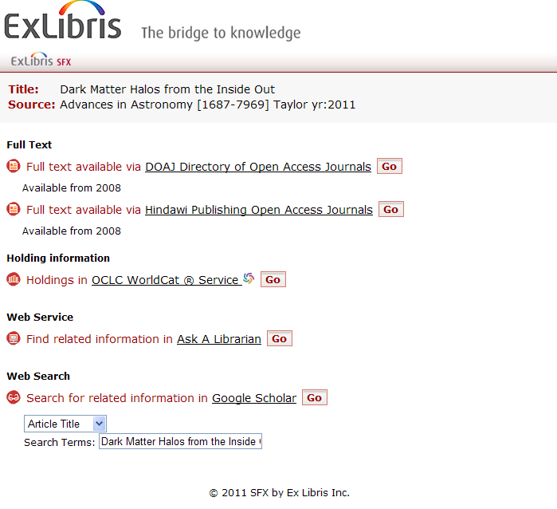
A-Z List: CitationLinker
Notes:
Lastly, we have the CitationLinker tab.
Using the CitationLinker tab, a user with a citation in hand can search for that article using SFX. Essentially the user is manually creating an OpenURL that is then sent to the SFX server.
In this example, I’m searching for the article “Dark Matter halos from the inside out” in Advances in Astronomy. When I click ‘Go’, I get the SFX Menu that provides the links to the full text of this article.
These four tabs make up the standard A-Z list that the user sees.

Slide 10
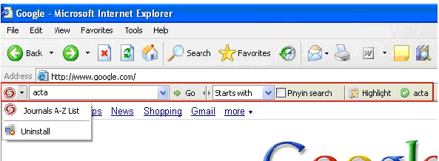

A-Z List: Search Toolbar & Quick Search
Notes:
In addition to the standard A-Z List, the SFX A-Z List browser toolbar is available as an add-on component for Internet Explorer browser only. It allows your end users to quickly search the SFX A-Z List from anywhere on the web.
(click) It’s also possible to generate the html for an embedded search box to allow users to do a quick search of the A-Z list from your library’s home page.

Slide 11
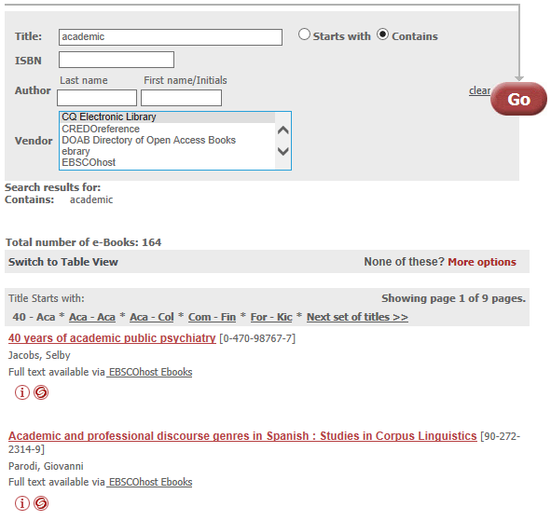
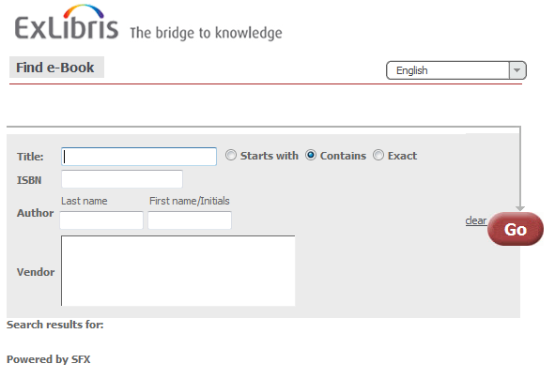
A-Z List: eBook Search
http://hostname:port/instance/azbook
SFX Base URL
Notes:
Now in addition to the eJournals A-Z list, there is also a separate A-Z list for ebooks. Keep in mind they are separate search interfaces.
The default URL for the eBook A-Z list is your SFX base URL including your instance, with /azbook at the end. As a reminder, your SFX Base URL will be given to you by your Ex Libris implementation team.
The eBook search options are similar to the A-Z list options, however ebooks do not have categories and subcategories assigned so you won’t see any category options in the ebook search. The results display will be very similar to the A-Z list journal options that we saw previously.

Slide 12
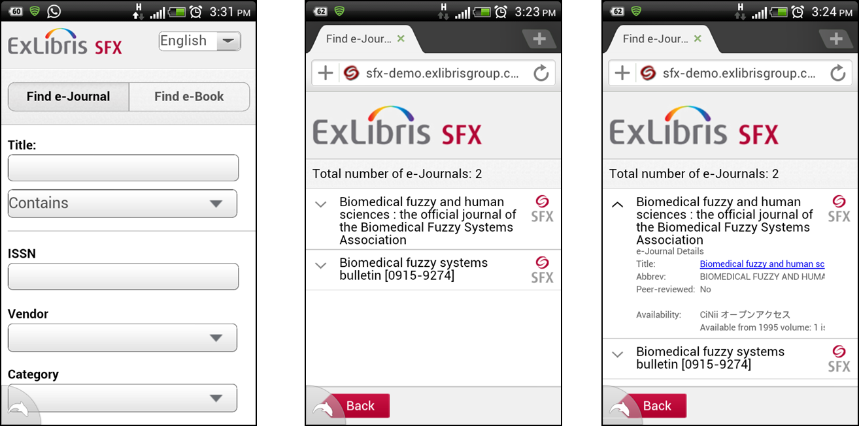
SFX Mobile Search Interface
Available for A-Z lists, SFX Citation Linker, SFX menu
Notes:
Lastly, there’s also a mobile user interface for the A-Z lists and CitationLinker, as well as the SFX menu. Just to be clear, it’s not an app, but a mobile interface. All a user would need to do is type in or access the URL on their mobile device to access the mobile interface screens.
It’s also possible to customize the banner that displays in the mobile interface – so make it your own institution logo, for example.

Slide 13
Agenda
A-Z Lists
A-Z List Customizations
Summary & Additional Resources
Notes:
Let’s talk next about what kinds of A-Z list customizations are available for the ejournal and ebooks A-Z lists. I’ve tried to indicate the defaults in the following examples, so you can decide if you want to stay with the defaults or make changes.
Keep in mind that if you are in the process of SFX implementation, you will want to work with your Ex Libris project team for customization changes. If you are already live with SFX, log a case with Ex Libris Support who will make these changes on your behalf. As TotalCare customers, Ex Libris makes these changes for you. You also may want to review your Ex Libris contract for information on how often changes can be requested.

Slide 14
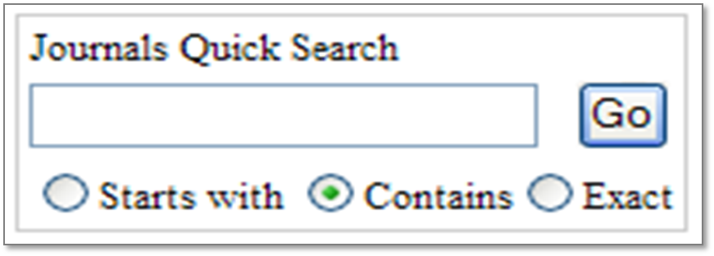
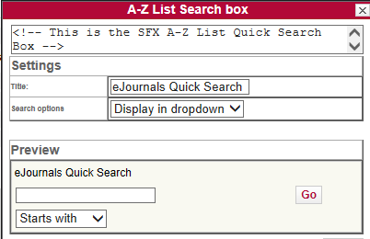
A-Z List: Journals Quick Search
Can change title of search box
Can decide whether to use radio buttons or a drop-down for the search options: starts with, contains, exact
Notes:
The first customization we’ll take a look at is the Journals Quick Search box. As mentioned previously, the Journals Quick Search is the embedded search box that you can add into your library webpages.
Note that the title of the search box can be customized, along with whether you want to use radio buttons, or a drop-down for search options: starts with, contains, or exact.
Once you have a configuration that you’re happy with, the Ex Libris Support team can send you the HTML code, and you can plug the code into your library webpage.

Slide 15
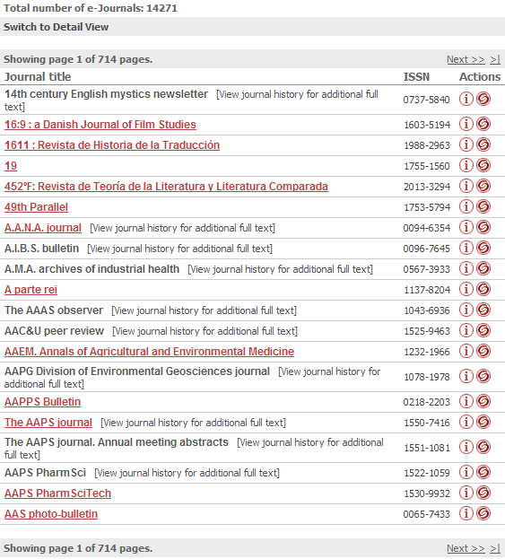
A-Z List Display: Records per page
Default = 20 records per page
Notes:
Let’s focus on some A-Z list display-related options next.
The first option allows you to set the number of records per page. This is the maximum number of search results your users will see before they have to click ‘next’. We do recommend that for best performance this value be set to less than 100 records per page.

Slide 16
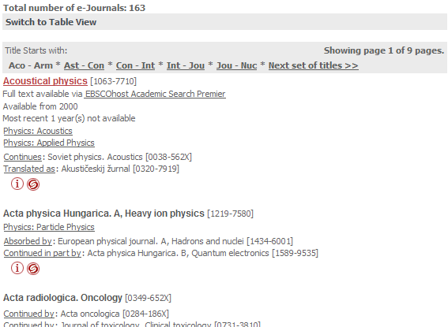
A-Z List Display: Pagination
Default Maximum pagination links = 5 page links per page
Default pagination character length = 3 characters
Notes:
Pagination links affect how your A-Z list search results are divided into pages.
Maximum pagination links and the pagination link character length are two settings that affect how your search results are divided. In this example, the Maximum pagination links is set to 5, and the pagination link character set to 3.
In the user interface this means that we see five alphabetical divisions (Aco – Arm, Ast – Con, etc…) for pages - with the option to see more, and then you’ll notice that each division spans a section defined with three-lettered headers.
You can have the maximum pagination links set to more or less pages, and change the pagination link character length as desired.

Slide 17
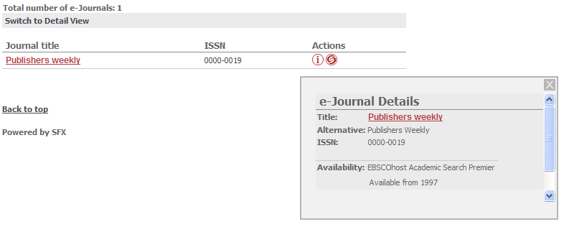
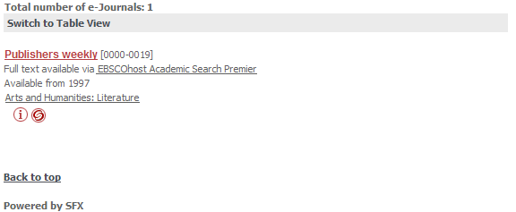
A-Z List Display: Views
Default = Table view
Table View
Detail View
Notes:
The default view defines how much information you want to show the user initially about their search results.
The table view (click to show Table View) shows a brief view – including just the title and ISSN of the journal. The user can click on the ‘I’ icon to show the rest of the information in a pop-up window.
The detail view (click to show Detail View) on the other hand, shows all of the information. Remember that the user is given the option to switch views on their own, but you can determine what the user sees by default.

Slide 18
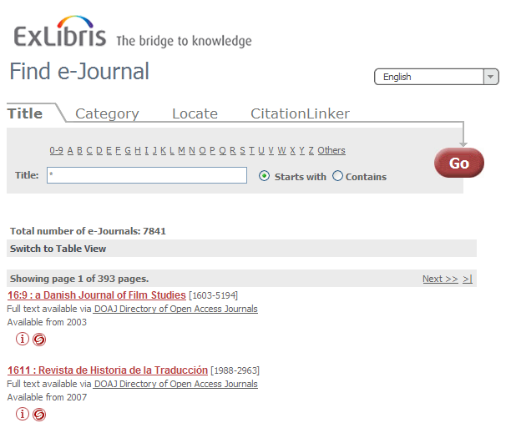
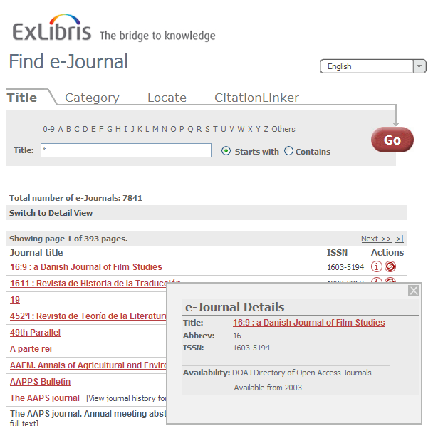
A-Z List Display: Views
Default = “Switch to view” link will display.
“Switch to view” link can be hidden, however.
Notes:
Speaking of the switching views option…
By default, the “Switch to view” link will display to users, so they can decide if they want to see more or less information on their own (i.e., either the table/brief view or the detail view) when they see search results in the A-Z lists.
However, you have the option to hide the “Switch to view” link from users – so they will only see the default view that you set.

Slide 19
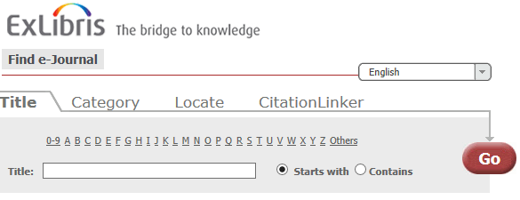
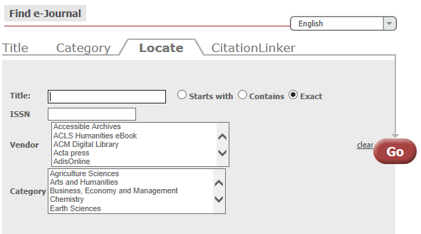
A-Z List Display: Default Search
Default search options: Starts with, Contains, Exact
Default = Contains
Notes:
The next option is the Default search. Here you can define the radio button that’s selected by default (Starts with, Contains, or Exact) when you do a search.
Notice that the A-Z list Title tab does not have an “Exact” option; only the Locate tab has an “Exact” search option. So if you set Exact as the default, it will default to Exact on the Locate tab, but on the Title tab it will default to “Starts with”.

Slide 20
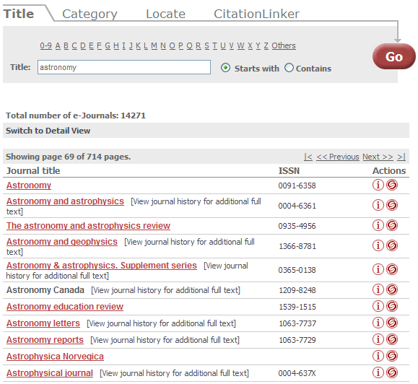
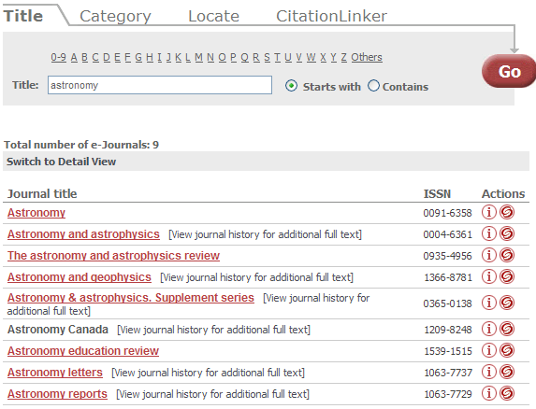
A-Z List Display: Starts With Results
Browse
Search
Notes:
Then there’s the Starts With Results option, which controls how the ‘starts with’ search behaves.
When the starts with results form is set to browse (click) and the user conducts a ‘starts with’ search, they are dropped into an alphabetical list of your journals with their search term acting as the starting point. If the “starts with form” is set to search (click) the user is brought to a list of journals that start with that word.

Slide 21
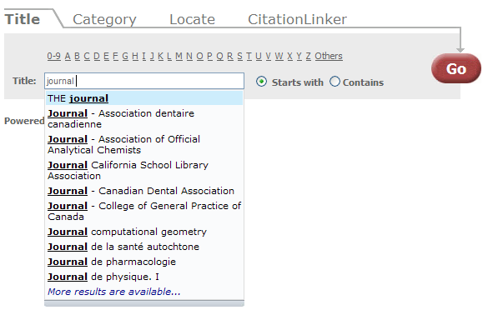
A-Z List Display: AutoComplete (Ajax)
Can enable or disable auto-complete in the A-Z list search boxes
Notes:
There is also an option to enable an auto-complete feature for title searches in the A-Z list. This is called ‘Enable Ajax’ behind the scenes.
If I’m in a “starts with” search, as I start typing a search term, a list of possibilities appears below the search box. As I continue typing, it’s going to automatically refine the list. The auto-complete option can be turned on or off as you wish.

Slide 22
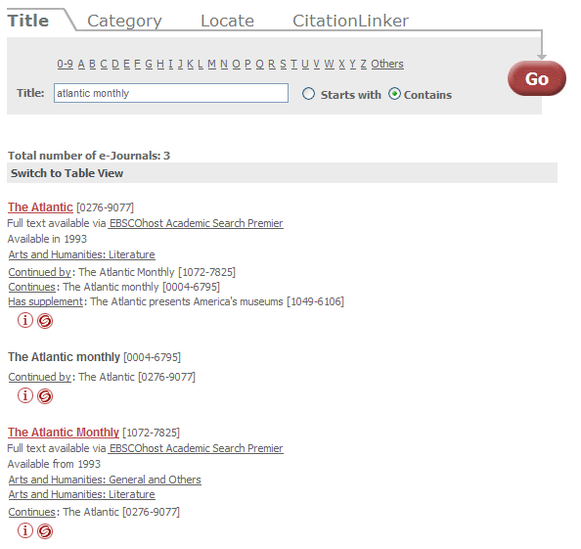
A-Z List Display: Related Objects
Can choose to not display related objects
Notes:
There is also an option of whether or not you want to include related object information in the A-Z list.
The SFX KnowledgeBase has information about related objects. For example, if a journal ceases publication and is continued by another journal, the two journals are considered related. Another example would be a journal and its supplements.
With this option turned on, your users can benefit from this information and see related journals in the results list. In first example (click), we can see the various iterations of The Atlantic, and we can also see a supplement indicated in the first result. If it might b confusing or not useful to users, then related object information can be hidden from the A-Z list.
Looking at the 2nd example, note also that you can decide if you want any related journals that don’t have any active services to display in the A-Z list if they are related to journals that do have active services. In this example, we do not subscribe to this title; it’s not activated in our SFX (the title is not hyperlinked), but it is displayed in the A-Z list because it is related to a title that IS active in SFX. You can decide if you want not-active related titles to display in the A-Z list or not.

Slide 23
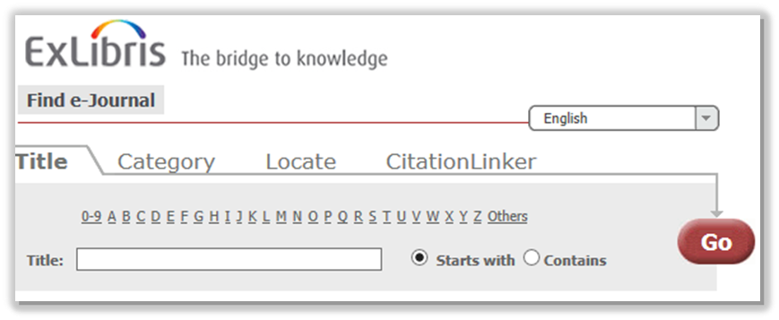
A-Z List Display: Hide Citation Linker
Can choose to hide the Citation Linker tab in the A-Z list
Notes:
We talked about the Citation Linker tab as being part of the standard A-Z list interface. If Citation Linker will not be useful to your users, you can choose to hide the CitationLinker tab altogether – so it won’t display to users when they access the A-Z list.

Slide 24

A-Z List Display: MetaLib
Can give users the ability to push journal information to their MetaLib My e-journals list; link will appear as an icon next to the SFX swirlie icon
Notes:
If you have MetaLib as well as SFX, you can decide whether or not you want to give your users the ability to push journal information from the SFX A-Z list to their MetaLib My e-journals list. If you do, the MetaLib icon appears next to the SFX swirlie. If users click on the MetaLib icon, it will push the journal information to their MetaLib My e-journals list.

Slide 25
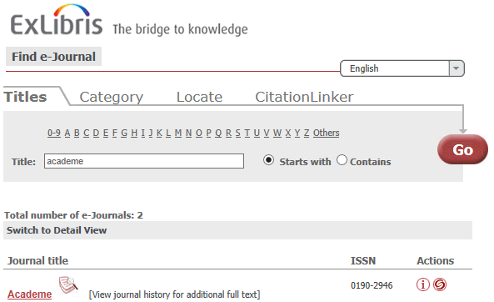
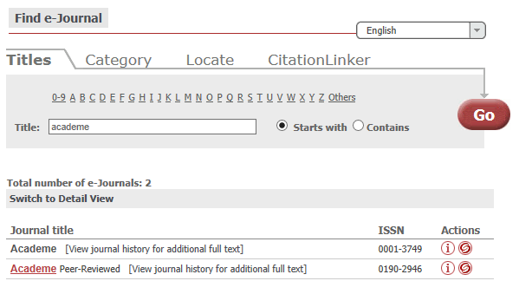
A-Z List Display: Peer Review
Visual indicator for peer-reviewed journals: no visual indicator, image, or text
Notes:
The last display option is whether you want a visual indicator to display to users if a title is peer-reviewed.
You can choose to not have any visual indicator in the results list, or if you want a visual indicator, you can choose from an image that displays next to the title, or (click) text that displays next to the title in the A-Z list.
Note that the peer review information will always appear when you click on the Information button.

Slide 26

A-Z List: Advanced Customizations
Header image
Colors and fonts
Notes:
Just a note that there are a few display-related changes that involve changing files directly on the server. For example, the header image in the A-Z List, and colors or fonts that display in the A-Z list.
More information on these kinds of server-related changes can be found in the Advanced User’s Guide. Again, you will want to refer to your Ex Libris SFX contract for specifically what types of changes can be made, and how often changes can be requested.

Slide 27

A-Z List: Content
Can choose which services users should see in the A-Z list: getAbstract, getTOC, getFullTxt, getSelectedFullTxt
Can decide to exclude services from specific targets
Notes:
We have been talking about display-related customizations for the A-Z lists. Let’s talk about content that can be included in the A-Z list.
You can decide which services you’d like to display or hide in the A-Z list menu, and you can even choose to exclude targets from view. Here’s a detailed view of a journal – by default, I can see the full text services, and I can see both of the targets that have this journal. If I wanted to exclude the DOAJ from the A-Z list view, Ex Libris Support can add it to your excluded target list. This won’t deactivate the target itself, it will still function and perform its link resolution duties, but it just won’t be visible in the A-Z list.

Slide 28

A-Z List: Content
Choose to remove any of the following elements from the A-Z list view:
ISSN
LCCN
Coden
Categories
Availability Information
SFX button
Note
Authentication
Notes:
You can also decide to remove certain elements from the A-Z list view – if, for example, they may be confusing or not useful to your users.
Any of these items listed here can be removed from the A-Z list user interface and when you click on the Information button. So for example, if categories is not useful to have displayed in the A-Z list and when you click on the Information button, it can be removed from the display.

Slide 29
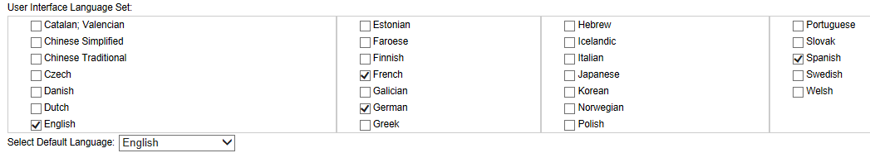
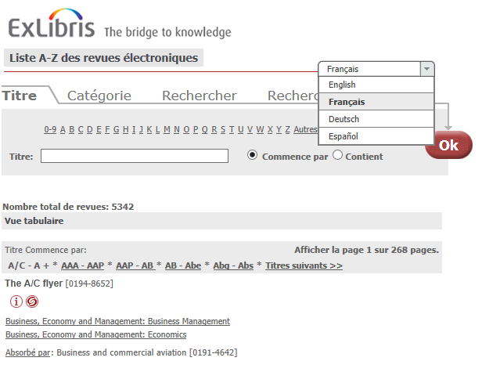
A-Z List: Language
Notes:
For A-Z list user interface languages, you can define the user interface language set – this is the list of languages that appear in the dropdown menu in the A-Z List.
(click) You’ll notice that in the A-Z list user interface, the language options appear in their native language. So if I choose to view the A-Z list in French, you’ll notice that the language in the tabs is translated, and some of the text in the search results below, but not all. This is because some of the information in the search results is derived from the object, target and category names that are defined in the KnowledgeBase – these are not translated automatically.
You can also select the default language for when a user first comes to the A-Z list. In this case, English is our default language.

Slide 30
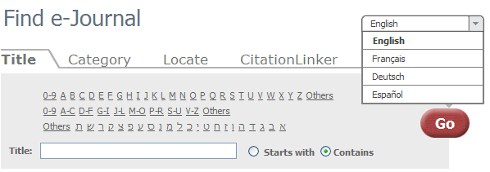
A-Z List: Language
Decide on Title tab header(s) to use – for example:
Standard: 0-9, A, B, C, D…
Small: 0-9, A-C, D-F, G-I….
Hebrew
Notes:
You can also define one or more headers to show in the A-Z list. Headers are the letters you can click on the Title tab to find titles starting with a particular letter.
You can have 1 header, or multiple headers, and some examples of the types of headers are listed here. Refer to the SFX General Users Guide for more information on the types of headers that are available.
In this example, I have 3 headers: I’ve added the standard header, the small header, and the Hebrew header. But typically, you may only have 1 header.

Slide 31
eBook Search: A-Z List
Very similar to A-Z List customizations
Can copy A-Z ejournal list customizations to eBook A-Z customizations
Notes:
We’ve been talking through the customizations available for the A-Z journals list, but there are also customizations available for the eBook A-Z list.
The customization options are actually very similar to the A-Z ejournal list customizations. And if you want to use the same customizations in both the ejournal and ebook A-Z lists, once you have the A-Z ejournal customizations configured they way you want, it’s very easy for Ex Libris to copy the A-Z ejournal list customizations to the A-Z ebook list.

Slide 32
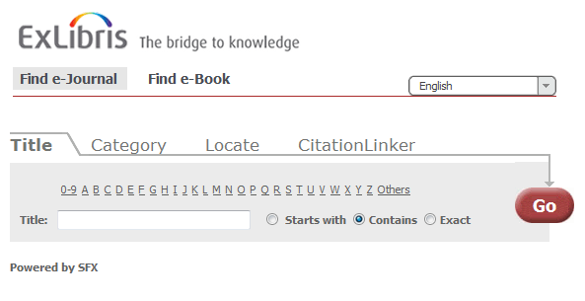
eBook Search: Combine A-Z Links
Can choose to combine Find e-Journal and Find e-Books into 1 screen.
They are separate searches, however.
Notes:
There are a couple of unique options, however, for the eBook A-Z list that we’ll cover.
One of these options is being able to display links between the eBook Search and A-Z eJournals end user interfaces. The eJournals A-Z list and the eBook A-Z list are typically separate URLs as we saw earlier. However, you can combine the two searches into 1 URL. They are still separate searches on separate tabs, but both can be accessed from the same A-Z URL.

Slide 33
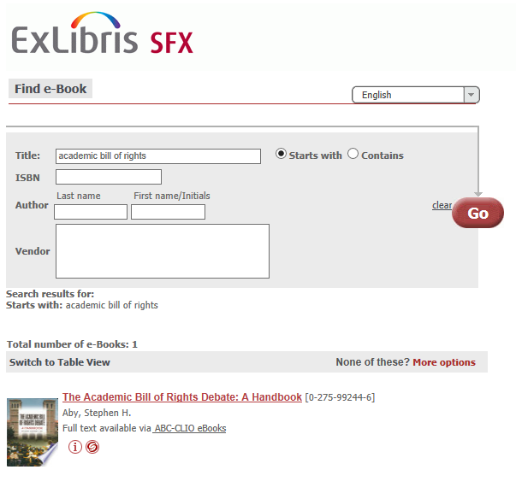
eBook Search: Thumbnails
Can display/not display book thumbnails
If displaying thumbnails, can decide if they come from Google Books or Amazon
Notes:
The second unique option for the A-Z ebook list is you have the option to display book thumbnails in the A-Z ebook results list.
The images can come from either Google Books or Amazon – your choice – based on ISBN.

Slide 34
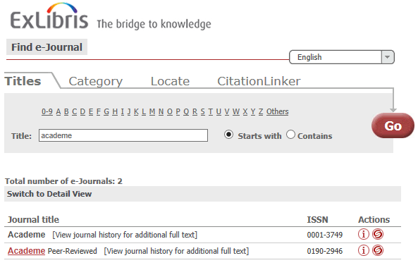
A-Z List Label Changes
A-Z list text labels can be changed
Notes:
Another option you have with both the ejournal and ebook A-Z lists is you can customize the wording for all text elements that are used in your SFX A-Z lists. This can apply to one or more of the languages that you want to make available to your users.
The example here just shows a very small portion of the labels that can be changed. So if you don’t like what a field label is called, you can ask your Ex Libris project team or the Support team to change it for you.

Slide 35
A-Z List: Seeing Changes
New, updated, deactivated targets, services, and objects display in the A-Z list after the A-Z list indexing job runs.
Most UI changes display immediately.
Note: a few UI changes require A-Z and/or RSI indexing jobs to run first; Support team will confirm when changes are completed.
Notes:
In terms of how long it will take to see changes:
(Click) Any changes to your targets or objects in your Knowledge Base – for example activating a new target or a new object in your KnowledgeBase - will appear in the A-Z list after an A-Z list indexing job runs. This indexing job typically runs on a daily basis, and your Ex Libris SFX project team will be scheduling this job for you. Just be aware that it may take a day or so before you see updates in your A-Z list.
(Click) For user interface customization changes, most of the changes that we covered in this session can actually be seen immediately in the A-Z list after they are made.
(Click) There are, however, a few types of user interface customization changes that require indexing jobs to run first before they display.
Your Ex Libris project team, or the Support team will do these user interface changes on your behalf, and will confirm when the changes are completed so you can view them.

Slide 36

A-Z List: Best Practices
Defaults are good!
Keep your resources in mind
Keep your users in mind
Notes:
So that covers possible customizations that you can make to the A-Z List. Let’s just briefly sum up some best practices…
(click) Defaults are good – it’s okay to leave everything to its default and change only what drives you or your users crazy, as opposed to approaching each option as a decision you have to make.
(click) Decide on the pagination or the number of records per page based on your own resources – there’s no rule that’s going to apply to everyone in every situation because your resources are unique.
(click) Last but not least, keep your users in mind – when you’re customizing your views and configuring how search behaves, you’ll want to make sure these are set up to be friendly to your users. If you support multiple languages, you’ll want to make sure SFX can do the same.

Slide 37
Agenda
A-Z Lists
A-Z List Customizations
Summary & Additional Resources
Notes:
This brings us to the end of this session.

Slide 38
Summary
A-Z List customization options for ejournals and ebooks
Incorporate best practices
Notes:
To briefly summarize, we talked about:
customization options for the ejournal and ebook A-Z lists
some best practices for user interface customization for the A-Z lists.

Slide 39

Additional Resources
Accessible from Documentation Center:
(http://www.customercenter.exlibrisgroup.com/)
  General User’s Guide
  Advanced User’s Guide
  eBook Search Guide
  SFX System Administration Guide
Notes:
Here’s a list of documents that will provide more information on A-Z list customizations. These can all be found in the Ex Libris Documentation Center.
The General User’s Guide will have more details on many of the A-Z list customizations we talked about in this session.
The eBook A-Z list has its own guide - the eBook Search Guide - which will explain customizations that can be made for the eBook A-Z list.
The Advanced User’s Guide will have information on making A-Z list customization changes on the server - such as for color or font changes, and changing the A-Z list header to be your institution’s own logo.
For the A-Z list indexing job that was mentioned in this session, your Ex Libris project team will be setting up this job and scheduling it for you, but if you are interested in further information about the job, it can be found in the System Administration Guide.
Thanks for joining me!

