Slide 1
Basic Troubleshooting
Notes:
Hello and welcome to this session on SFX Basic Troubleshooting.
This presentation is copyrighted and is the confidential property of Ex Libris Ltd. Information included in this presentation is periodically reviewed and updated. You may shared these training materials within your institution but not beyond.

Slide 2
Copyright Statement
All of the information and material inclusive of text, images, logos, product names is either the property of, or used with permission by Ex Libris Ltd. The information may not be distributed, modified, displayed, reproduced – in whole or in part – without the prior written permission of Ex Libris Ltd.
TRADEMARKS
Ex Libris, the Ex Libris logo, Aleph, Alma, SFX, SFXIT, MetaLib, DigiTool, Verde, Primo, Voyager, MetaSearch, MetaIndex and other Ex Libris products and services referenced herein are trademarks of Ex Libris, and may be registered in certain jurisdictions. All other product names, company names, marks and logos referenced may be trademarks of their respective owners.
DISCLAIMER
The information contained in this document is compiled from various sources and provided on an "AS IS" basis for general information purposes only without any representations, conditions or warranties whether express or implied, including any implied warranties of satisfactory quality, completeness, accuracy or fitness for a particular purpose.
Ex Libris, its subsidiaries and related corporations ("Ex Libris Group") disclaim any and all liability for all use of this information, including losses, damages, claims or expenses any person may incur as a result of the use of this information, even if advised of the possibility of such loss or damage.
© Ex Libris Ltd., 2014

Slide 3
Agenda
Introduction
OpenURL Generator
Missing and broken links
Debugging issues
Reporting issues to Support
Summary and additional resources
Notes:
In this session, we’ll first do a brief review of the SFX process that happens behind-the-scenes – in particular, how the OpenURL factors into that process and where issues can arise.
We’ll then cover the OpenURL generator tool that’s available in the SFX Admin Center, how to troubleshoot missing and broken links, debug issues, and how to report issues to support.

Slide 4

Objectives
How To...
Troubleshoot errors
Debug issues
Log a support case
Notes:
By the end of this presentation, you will have an understanding for how to:
troubleshoot errors such as missing target links in the SFX menu, or broken links
debug issues using the SFX debug tool
log a support case for any issues - and know what information to include in the case that will be helpful to the Support team.

Slide 5
Agenda
Introduction
OpenURL Generator
Missing and broken links
Debugging issues
Reporting issues to Support
Summary and additional resources
Notes:
Before we dive into the details, let’s briefly talk about a couple of general things that will be helpful to know for this session.

Slide 6
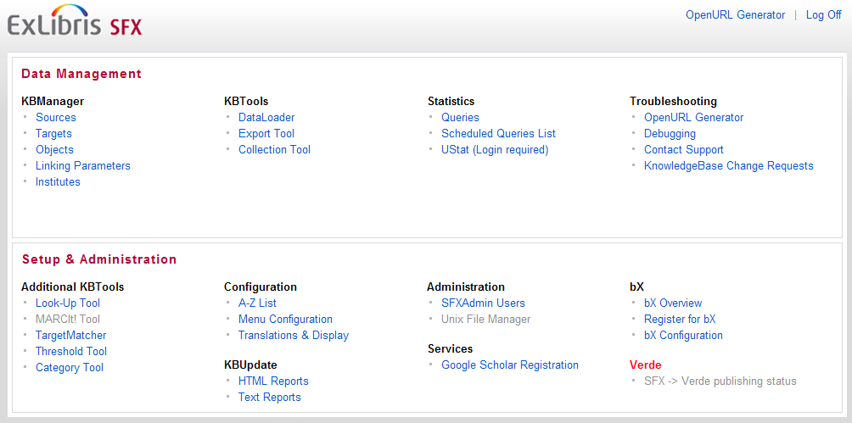
Admin Center
Notes:
The tools that we’ll talk about in this session can be found in the SFX Admin Center – in the Troubleshooting area of the menu.
While we go over the tools in the Admin Center that focus on troubleshooting, I’d also like to go over the link resolution process and some issues you may see from time-to-time.

Slide 7



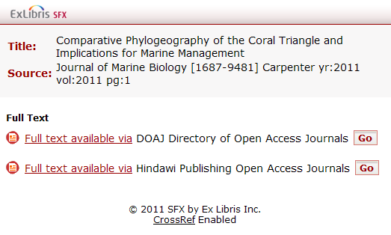

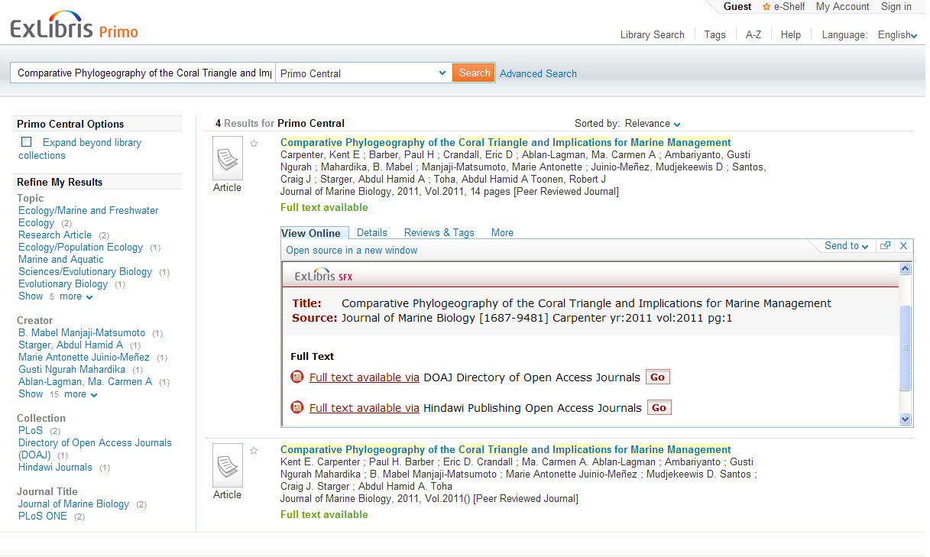

Target
Source
Target URL
OpenURL
SFX
Menu
SFX
Thresholds
Context
Object
Services
Notes:
You may remember this slide on the link resolution process from the SFX Introduction presentation – but this time, let’s take a look at each point to see where things can possibly break down.
When the source generates (click) an OpenURL, SFX relies on that OpenURL to continue on. In some cases when SFX fails to resolve the link, it’s because the source passed SFX an OpenURL that was either constructed incorrectly, OR didn’t have enough information in it to identify the article/object.
That OpenURL is sent (click) to the SFX server where the data from the OpenURL is augmented with information. SFX gathers this metadata and generates (click) a context object. Using that object, SFX looks up (click) the services that are available. It doesn’t happen often, but the information that is augmented may be outdated. SFX trusts the information the source gives it – it’s not validating the citation data in this process, just adding to it if it can.
Once SFX has identified potential providers, it then uses (click) the thresholds to determine whether or not the article itself is available. Remember that the thresholds determine what’s available – so if they are configured incorrectly, they are going to affect what’s displayed in the SFX menu. (click)
When the user clicks (click) on one of the links in this menu, a target URL is generated and the user is brought (click) to the full text article. Remember that this target OpenURL is different than the source OpenURL; it contains the additional augmented data, and can also contain your institution’s authentication information. If you’re able to see the link in the menu, but the link doesn’t work, there may be an issue with the way the target URL is constructed or your linking parameters. It could also be that, though the vendor reported to us that they had the content initially, for some reason it’s no longer on their site, or there’s another issue with the vendor’s content. If your user is off site, another issue might be with your proxy configuration.

Slide 8
Agenda
Introduction
OpenURL Generator
Missing and broken links
Debugging issues
Reporting issues to Support
Summary and additional resources
Notes:
Now let’s talk about OpenURLs and the OpenURL Generator tool that’s available in the SFX Admin Center.

Slide 9
Troubleshooting: OpenURL
OpenURL
  A standard type of URL that contains resource metadata designed to support linking from information resources (e.g. bibliographic record) to library services (e.g. full-text information)
NISO maintains the OpenURL standard
    sections of the OpenURL are vendor-specific
Source and Target links are OpenURLs
Notes:
(click) The openURL is essentially a URL that’s used to transfer metadata (article, journal, or ebook information, for example) from one information provider to another.
(click) National Information Standards Organization maintains the OpenURL standard, allowing communication between different data providers, but (click) there are sections of the OpenURL that are vendor-specific.
(click) SFX handles two types of OpenURLs – the Source OpenURL, which is from the vendor, and the Target URL, which SFX generates. We’ve worked with vendors to make sure we interpret their OpenURL correctly. We use the data in the Source OpenURL to generate the target OpenURL which makes the request from the target (for full-text, for an abstract, etc.)

Slide 10
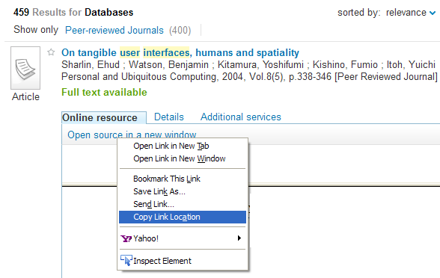
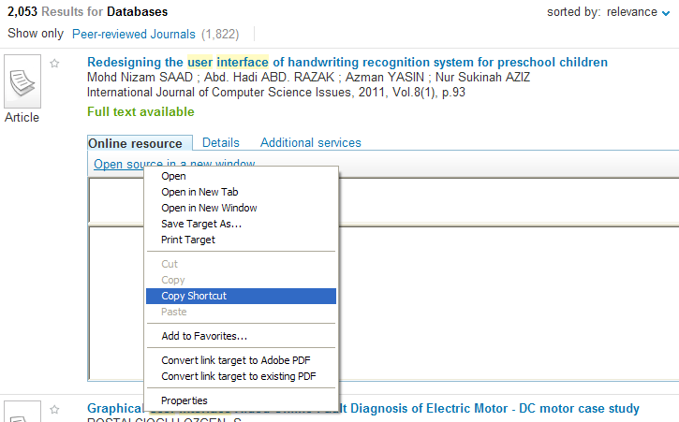
How to see the OpenURL
Notes:
Let’s look at a couple of ways for how you can see the OpenURL that is being sent.
One way to see the OpenURL is in the address/URL field in your browser. However, by the time you’ve clicked on the link, you might have been redirected through your proxy, so taking the link from the URL bar in the browser doesn’t always work.
Using an example of Primo as the source, another way to see the OpenURL is…
Using Internet Explorer, you can right-click on the “Open Source in New Window” link and click copy shortcut, then paste into an email or text editor. If you’re viewing the SFX menu in Internet Explorer, you can right-click and select “Properties” to view the OpenURL and copy it from there.
OR
(click) Using Firefox you can right-click on the link and click copy link location.
Other ways to view the OpenURL are listed in the SFX General User’s Guide in the section on Troubleshooting .

Slide 11
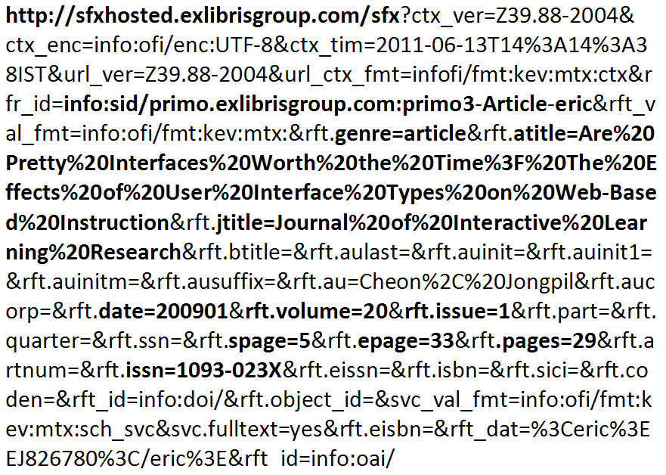
Example OpenURL
Notes:
This is what one of our OpenURLs looks like. I’m not going to explain every piece of it, just point out a few things. You’ll notice that it starts with the SFX base URL (so this is a target URL), and also contains the information from the source system, in this case Primo. It helps the database on the receiving end interpret the OpenURL. Other important fields here are the genre, the article title, the journal title, author, the date of the publication, the volume and issue, pagination information, and the ISSN. All of this information needs to be correct in order for this OpenURL to work.
When it’s not working the way it should, try taking a quick look at the OpenURL to see if it has the correct information in it. Don’t worry too much about if it’s formed properly or spend time looking at what should be in every field – the key is to not be intimidated by this giant link. Just check to see if the obvious information makes sense and looks correct. Also, if you’re already authenticated, you can take this link and put it directly into a new browser window – you should get the same result as the original link.

Slide 12
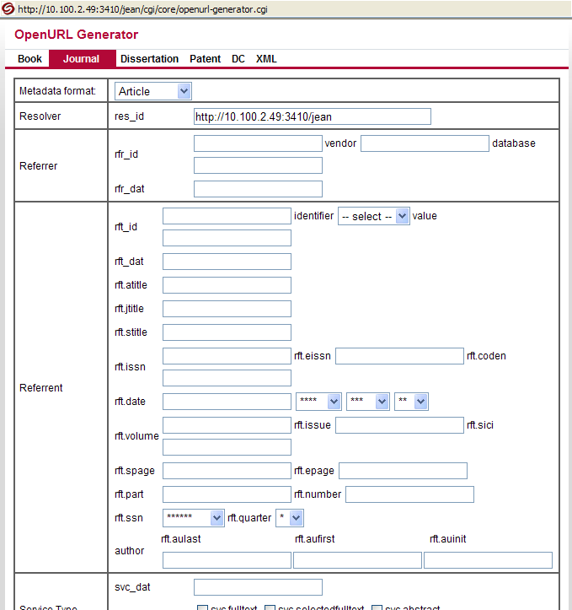
Troubleshooting: OpenURL Generator
Notes:
In the SFX Admin Center, we have an OpenURL generator - which opens up in a separate pop-up window.
You can use this to reconstruct an OpenURL based on the information that you have. When you look at the OpenURL that’s constructed, it may also help you identify issues or things that need to be corrected in the OpenURL. For example, perhaps there is important metadata such as an ISSN or article page number that is missing from the OpenURL or incorrect in the OpenURL.
Example:
Dark Matter Halos
Taylor, James
2011
Advances in Astronomy
ISSN: 1687-7969

Slide 13
Agenda
Introduction
OpenURL Generator
Missing and broken links
Debugging issues
Reporting issues to Support
Summary and additional resources
Notes:
Let’s look at some issues that may come up from time-to-time – in particular, missing or broken links in the SFX Menu.

Slide 14
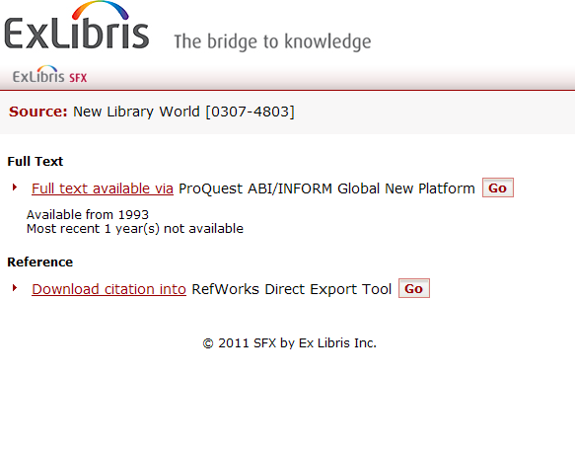
Troubleshooting: No Link
Don’t we get this from EBSCO, too?
Notes:
The first issue we’ll look at is there may be a target link that is not displaying in the SFX menu.
For example, you know that you subscribe to the journal in EBSCO (click) and you expect to have an Ebsco link to the full text display in the SFX menu, but it’s not there.

Slide 15
Why you don’t see it & what to do
Threshold filtering it out
  Check publication details in A-Z list and/or object thresholds in SFX Admin Center
Target / service / object not active
  Check SFX Admin Center & make changes/corrections as needed
Article not available on vendor’s site
  Check vendor site
Submit support case as needed
Notes:
So what are some possibilities for why we don’t we see an EBSCO link in the SFX menu?
(click) The threshold may be filtering it out – maybe the article is from 1998, and your EBSCO coverage doesn’t go back that far, and your threshold is actually configured correctly. Or maybe 1998 is covered in your subscription, but the threshold in SFX needs to be adjusted to match your institution’s subscription.
To check the threshold for the object, you can search for the object directly in the SFX Admin Center, or you can look for the publication in the SFX A-Z list. (We’ll talk more about the A-Z list in a separate session.) In the A-Z list, you can see all of the publications that are active, and also see the threshold dates for the publication, so it’s a great way to check to see if SFX has the correct information to work with. If it doesn’t, then you can update the threshold in the Admin Center.
(click) Another possibility is that the target, service, or object isn’t active for some reason. So you can search for the target or object in SFX Admin Center, and ensure that all 3 levels (the target, target service, and object portfolio levels) are activated as needed.
Or, (click) the article may not be available on the vendor’s site – this can happen for a variety of reasons. Remember that SFX works at the journal level, so if the journal is available and the article is within the coverage dates, SFX is going to assume that that specific article is there.
One of the first steps to take is to search for the article with information you have on the vendors site, and confirm that it’s there. If it’s not, SFX won’t be able to find it. Then you can ask the vendor directly why it’s not there.
(click) At this point, if you still can’t identify what’s wrong, you can at any point log a support case and ask us for help. Near the end of the presentation I’ll go over the information to include in those requests.

Slide 16
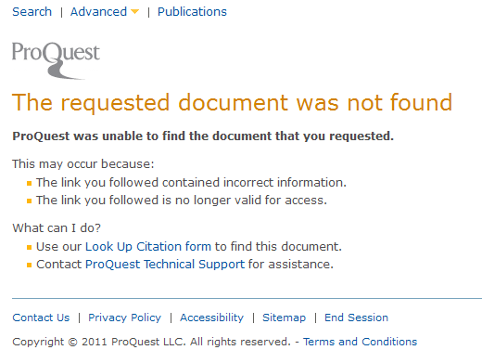
Troubleshooting: Link is broken
Notes:
The other type of issue we sometimes see is that everything looks good in the SFX Menu - target links appear as they should in the menu - but when you click on a link, you don’t get the article you’re looking for or perhaps get a message indicating that the article wasn’t found.

Slide 17
Why it’s broken & what to do
Vendor site down or article not available on vendor’s site
  Check vendor site
Linking parameters configured incorrectly
  Review linking parameters in SFX Admin Center for target/target service
OpenURL incorrect or incomplete
  Review data in OpenURL and use that data to search in vendor site to see if it’s correct/incorrect
  Log support case as needed
Notes:
Why is the link broken?
(click) The most common causes for this situation are the vendor site (click) may be down, or the article may not be available on vendor’s site. Occasionally we see an error like in the last slide because we have the complete citation information for the vendor’s holdings, but the vendor may be in the process of moving all of the content on the new platform so not all of the content is there yet on the vendor’s new platform.
So it may be worth checking the vendor site to make sure the site is up and running, and search for the article there to make sure it’s really available on the vendor’s site. You can look at the data in the OpenURL and try to search for the publication using just that information. If you can’t find the article with the information provided in the OpenURL, see if providing additional information for the article will do the trick.
(click) Something that’s much less common is that the linking parameters may be configured incorrectly. If this is the case, you’re going to notice that nothing works from that vendor. This is usually more common during implementation when we’re just getting everything set up – as vendors don’t usually like to change login information on you. You’ll want to review the linking parameters that you have included for the target/target service in SFX Admin Center, and talk to your vendor if there’s an issue.
Another possibility (click) is that the OpenURL coming from the source doesn’t have the correct information, or it doesn’t have enough metadata in it to find the article. Remember that SFX relies on the source to provide the information it needs to create a link to the target, it doesn’t validate it. And usually the information we use to augment the data depends on the correctness of key elements in the source OpenURL.
So again, check the vendor site and use the data that’s in the OpenURL to try to search for the publication using just that information. If you can’t find it, see if providing additional information will work to find the article.
If the article doesn’t display in the vendor site when you search for it, you can contact the vendor directly to ask why the article is missing from their site.
If the article is in the vendor site when you search for it there, you can try to see if there’s something incorrect in the OpenURL (e.g., perhaps there’s an incorrect page number for the article in the OpenURL), or if more information needs to be added to the OpenURL.
If the information in the Source OpenURL is incorrect or incomplete, contact the vendor as there may be changes they need to make on their side.
If the information in the Source OpenURL is correct and complete, contact Ex Libris Support as we may need to make some changes on our side.

Slide 18
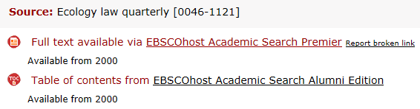
Troubleshooting: Report Broken Link
Displays in SFX menu for full text, abstract, and table of contents services - if Go button or target link is clicked
Reports broken target links to Ex Libris and to any e‐mail address you configure
Notes:
Users also have the option to report a broken link when they use the SFX menu.
If the user clicks on a target link or on the Go button for a target that has either full-text, abstracts, or table of contents in the SFX menu, the Report Broken Link link will then display next to the target. If the target link is broken, the user can click on the Report Broken Link link to report it.
When users click Report Broken Link, the information about the target and target URL is sent to Ex Libris and used to analyze and improve target linking. Additionally, you can configure SFX to send a copy of the report to a pre‐defined e‐mail address so you or your library is aware when the link is clicked.
By default, the Report Broken Link option is active in the SFX menu, but it’s possible to disable it via a configuration file on the server for each local instance. More information is in the SFX General User’s Guide.

Slide 19
Agenda
Introduction
OpenURL Generator
Missing and broken links
Debugging issues
Reporting issues to Support
Summary and additional resources
Notes:
Let’s shift gears and talk a little about debugging in SFX.

Slide 20
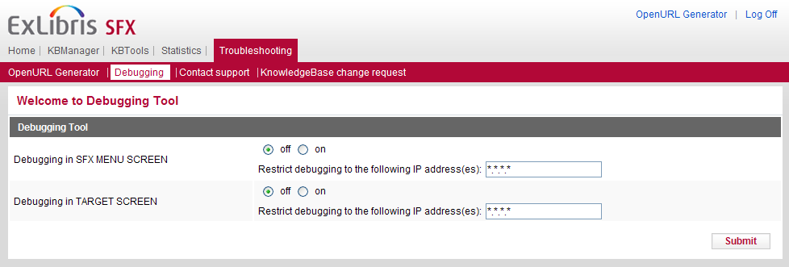
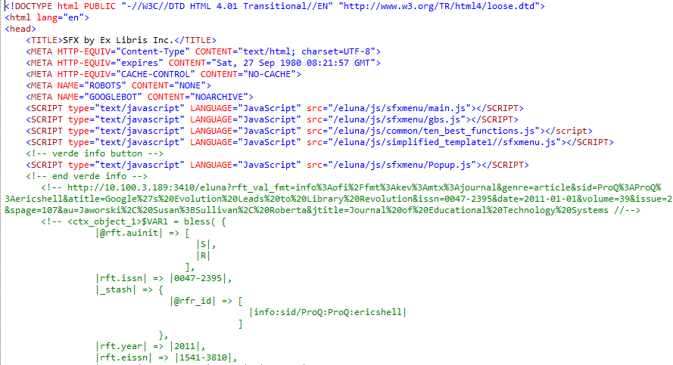
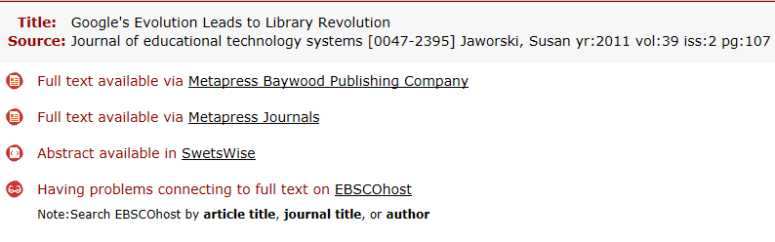
Troubleshooting: Debugging
Notes:
SFX comes with a debugging tool – this is more advanced functionality but we’ll cover it a little more in-depth in the System Administration session. For now, I’ll just point out that it’s here.
When the debugging tool is turned on, it allows you to see the information that’s being sent – basically you’ll see the code and text for everything that happens behind the scenes. (click) In this example, if debug is turned on, I can see behind the scenes all of the activity that’s going on for the SFX menu.
You will want to restrict debugging to your own IP, so you can test in your live environment without affecting what your users see – in particular so they won’t see the debug information when they use the SFX menu.
There’s more information on the Debug Tool in the SFX Advanced User’s Guide.

Slide 21
Agenda
Introduction
OpenURL Generator
Missing and broken links
Debugging issues
Reporting issues to Support
Summary and additional resources
Notes:
If you are seeing any issues, you can report them to the Support team at any point.

Slide 22
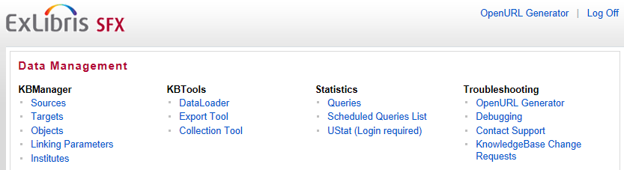
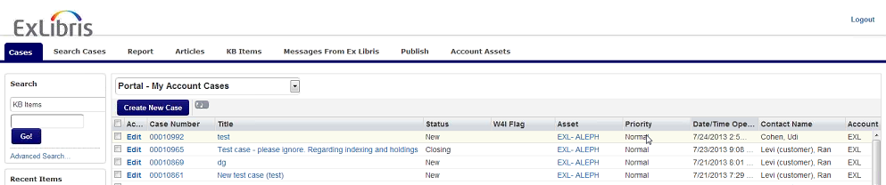
Troubleshooting: Contact Support
Notes:
There is a “Contact Support” link from the SFX Admin Center so that you can easily log a support case from there.
Before you’re transitioned to support you’ll be guided through the process of using the Ex Libris Support Portal to create support cases.

Slide 23
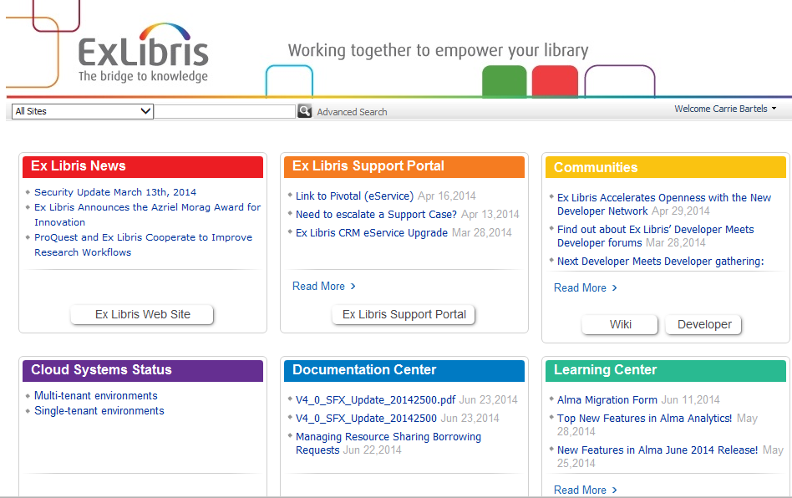
Troubleshooting: Contact Support
Other ways to access ExLibris Support Portal:
Customer Center: http://www.customercenter.exlibrisgroup.com
Directly via: http://support.exlibrisgroup.com
Notes:
Another way to access the ExLibris Support Portal is through the Customer Center, or by using the direct Support Portal link, which is listed here.

Slide 24
Troubleshooting: Reporting issues
Steps to reproduce
Expected behavior vs. what’s happening
Article Name (if applicable)
Journal/Book Name (if applicable)
ISSN/ISBN (if applicable)
Date of the object’s publication
Vendor/Provider Names of Source and Target
Your coverage of the publication (check A-Z List)
OpenURLs of the Source and Target (if applicable)
URL of the SFX Menu
Screenshots of the SFX Menu & Error Message
  PC - PrtSc + paste into Paint; Mac Command Shift 3
Include 1 issue per support case
Notes:
When you log a support case, there’s some information that you’ll want to include which will be helpful to the Support team.
It may take a few more minutes to put this information together, but it’s really information that should be readily accessible. If you think about how things can go wrong, you can see that everything we’re asking for is helping us find out what’s gone wrong, and will also help us fix it quickly if we can without a lot of back and forth.
In the support case, it will be helpful to include:
Steps to reproduce, expected behavior vs. what’s happening – you don’t have to go into a lot of detail, but if we know what you’re trying to do, it gives us some context.
Article name, journal / book name, ISSN/ISBN, date – this is all information that should be available in the citation you’re looking at – don’t worry about digging around for this information if it’s not there.
Vendor names of the source and target, so where you’re starting from and where you’re trying to go.
Your coverage of the publication – should be available in the A-Z list or in the object details using SFX Admin Center.
The Source and Target OpenURLs and the URL of the SFX Menu – if you provide the debugging text, it will contain this information.
Screenshots if it helps describe what you’re seeing – a picture is worth a thousand words, and it’s especially helpful if the Support team is unable to reproduce the issue.
Additionally, it’s helpful to include only 1 issue per support case. It’s tempting to include several issues in 1 support case, but in actuality, they may be very different issues that need to go to different teams to resolve. So it’s better to have each issue in a separate support case in case they do end up being very different issues.

Slide 25
Troubleshooting: Reporting issues
Steps to reproduce | Log in to URL here Search for search term Go to the identified record result and click ‘View Online’ Select the ProQuest result in the SFX Menu
Expected behavior vs what’s happening | I expect to be brought to the full text in ProQuest, but it’s not available
Article Name | London’s Book Fair 2011: Books that Made a Splash
Journal Name | Publisher’s Weekly
ISBN/ISSN | 0000-0019
Date of the object’s publication | 5/24/2011
Vendor/Provider Name | ProQuest
Your coverage of the publication | 1999-current
OpenURLs | http://sfxhosted.exlibrisgroup.com/sfx?ctx_ver=Z39.88-2004&ctx_enc=info:ofi/enc:UTF-8...
URL of SFX Menu | http://sfxhosted.exlibrisgroup.com/sfx?ctx_ver=Z39.88-2004&ctx_enc=info:ofi/enc:UTF-8...
Notes:
This is an example of the information you would include in a support case. You can see that the steps to reproduce are brief - I went here, I clicked this, I didn’t get that. The expected behavior can be just a simple statement, and so on.
I won’t go into this slide in detail, but it’s available for your reference in the slide presentation that accompanies this recording.

Slide 26
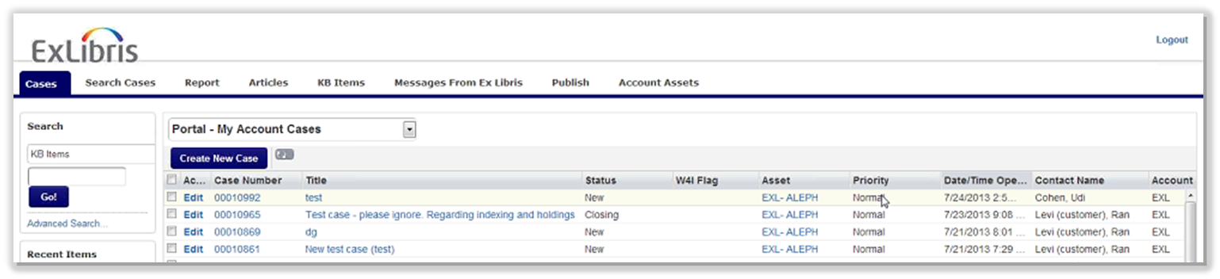
Requests for New Targets
Support Portal - KB Items: Customer requests for new targets and target services
  Click on “Promote” to vote “me too” for the target.
If not in KB Items list, submit support case or use KnowledgeBase Change Requests link in SFX Admin Center
Notes:
While we’re on the topic of creating support cases… in addition to logging support cases for any issues that you’re experiencing, you can also log a support case to request that a new target, target service, or object be added to the SFX KnowledgeBase.
Before you submit a case for a new target, however, we recommend that you first search to see if it’s already been requested by another customer. To do this: in the Support Portal click on KB Items which will display a list of targets that have been requested by customers.
You can click ‘Promote’ for any targets that you too would like to see added to the SFX KnowledgeBase.
If you’re not able to find your requested new target in the KB Items list, then submit a support case.
Note that you can also use the KnowledgeBase Change Requests link in the SFX Admin Center to request a new target, target service, or object.
The type of information the KnowledgeBase team would like to receive for new target requests:
Name of requested target/collection
Provider/vendor
Type of material that’s contained in the target (Journals/Books/Other)
Description of the target
Link to vendor's website
Link to title list for the target

Slide 27
Agenda
Introduction
OpenURL Generator
Missing and broken links
Debugging issues
Reporting issues to Support
Summary and additional resources
Notes:
This brings us to the end of this session.

Slide 28
Summary
How To...
Troubleshoot errors
Debug issues
Log a support case
Notes:
In this session, we covered how to:
troubleshoot issues such as missing or broken target links in the SFX menu and how to use the OpenURL generator tool to see the metadata in the OpenURL – in particular to see if any metadata might be missing or incorrect in the OpenURL
debug issues using the SFX debug tool
log a support case for any issues or for new target requests - and what information to include in the case that will be helpful to the support team.

Slide 29

Additional Resources
Accessible from Documentation Center:
(http://www.customercenter.exlibrisgroup.com/)
Path: SFX > Technical Documentation
  General User’s Guide
  Advanced User’s Guide
  SFX Source Configuration Guide
  SFX Target Configuration Guide
Path: Cross Product > Support
  Support Portal Documentation
Notes:
Here’s a list of documents that will provide more information on the topics we covered today. All are accessible on the Ex Libris Documentation Center. The paths to access the documentation in Documentation Center are listed here.
More detailed troubleshooting information, including how to use the OpenURL Generator tool and the Debugging Tool, can be found in the General User’s Guide and the Advanced User’s Guide.
If you’re interested in the OpenURL structure for targets or what metadata elements are included in the OpenURL that are passed by sources, both the Source and Target Configuration Guides will be helpful.
Lastly, for more information on the Support Portal and how to log a support case, there is documentation the Cross Product area of the Documentation Center. The path to find that documentation is listed here.
Thanks for joining me!

