Slide 1
User Interface Configuration: A-Z List
Notes:
Hello and welcome to this session on User Interface Configuration for the A-Z List.
This presentation is copyrighted and is the confidential property of Ex Libris Ltd. Information included in this presentation is periodically reviewed and updated. You may shared these training materials within your institution but not beyond.

Slide 2
Copyright Statement
All of the information and material inclusive of text, images, logos, product names is either the property of, or used with permission by Ex Libris Ltd. The information may not be distributed, modified, displayed, reproduced – in whole or in part – without the prior written permission of Ex Libris Ltd.
TRADEMARKS
Ex Libris, the Ex Libris logo, Aleph, Alma, SFX, SFXIT, MetaLib, DigiTool, Verde, Primo, Voyager, MetaSearch, MetaIndex and other Ex Libris products and services referenced herein are trademarks of Ex Libris, and may be registered in certain jurisdictions. All other product names, company names, marks and logos referenced may be trademarks of their respective owners.
DISCLAIMER
The information contained in this document is compiled from various sources and provided on an "AS IS" basis for general information purposes only without any representations, conditions or warranties whether express or implied, including any implied warranties of satisfactory quality, completeness, accuracy or fitness for a particular purpose.
Ex Libris, its subsidiaries and related corporations ("Ex Libris Group") disclaim any and all liability for all use of this information, including losses, damages, claims or expenses any person may incur as a result of the use of this information, even if advised of the possibility of such loss or damage.
© Ex Libris Ltd., 2014

Slide 3
Agenda
A-Z List
A-Z List Customizations
Translation and Display
Summary & Additional Resources
Notes:
First, we’ll take a ‘tour’ of the A-Z List itself – how it looks and how it works.
Then we’ll look at how to customize it in the SFX Admin Center.
Lastly, we’ll take a look at where you can customize language and text labels in these A-Z list interface.
I’ll mention at this point that this session may seem like an overwhelmingly long list of choices that you need to make decisions about. That’s not really the case. In SFX, we already have defaults that are set, and generally speaking, you’re probably not going to change a lot of them. Keep in mind that I’m just showing you all of the possibilities – and in doing so, educating you a little bit more about how the A-Z user interface works. The best approach to User Interface design is really testing and seeing what needs to be changed to make the best possible experience for your users.

Slide 4

Objectives
How To…
Customize the A-Z List
Implement translations & display customizations
Incorporate best practices
Notes:
After this presentation, you’ll know:
where and how to customize A-Z Lists and what customizations are available
where to customize the Translation and Language display if there are text elements you want to change in the A-Z list user interface
general best practices for User Interface customizations

Slide 5
Agenda
A-Z List
A-Z List Customizations
Translation and Display
Summary & Additional Resources
Notes:
Let’s start with how the A-Z list looks and works in general.

Slide 6
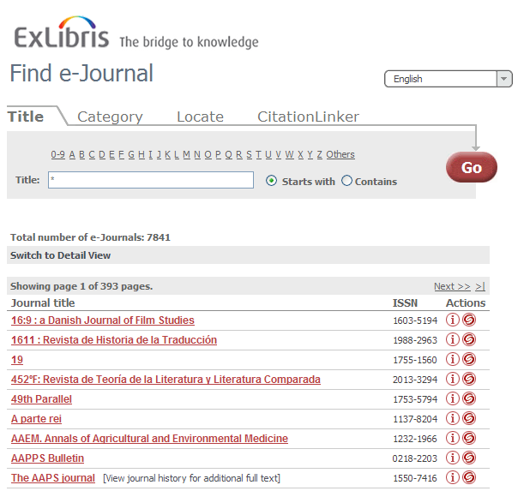
A-Z List: Title
http://hostname:port/instance/az
SFX Base URL
Notes:
By default, your A-Z list can be accessed by entering your SFX base URL, along with a /az at the end of the URL.
Note that this is an A-Z list of all of your eJournal titles.
When we first go to the default A-Z List screen, we’ll see, at the very top of the screen, a header image. By default, we have the Ex Libris logo, but you can replace this with your institution’s logo. You’ll notice that on the right there’s a dropdown menu of languages.
The main portion of the screen defaults to the Title tab, where you can browse or search for journals by title.
Here I’ve performed an open search to see all of the journals in a list – the search results default to a brief view, which is called the Table view - where I can see the journal title, the ISSN, and two icons: the Information (I) icon and the SFX swirlie icon, which displays the SFX menu with any active targets and target services that contain the resource.
If I click on the Information (I) icon, I’ll get a pop-up window with additional details, including whether it’s peer-reviewed, the category and subcategory that the title is assigned to in SFX by default, and related object information (e.g., titles that are continued by another title, etc.)
Speaking of related objects, if you look in my list of titles, you’ll see some titles are hyperlinked, while others are not. The hyperlinked titles are the titles you subscribe to and are activated in SFX. The non-hyperlinked titles are related to titles that you have activated. You don’t necessarily subscribe to them and have them activated in SFX, but are related to a title that you do have activated. There are options to remove related titles that we’ll see later.
If I click on the “Switch to Detail View” link, I’ll see the same list with more details – the same information we saw before the brief/table view, but also the services available for the journal, the target or targets it’s in, and the threshold information. You’ll also see the categories and subcategories that the object is assigned to.
Speaking of categories and subcategories, let’s move onto the next tab in the A-Z list interface: Category.

Slide 7
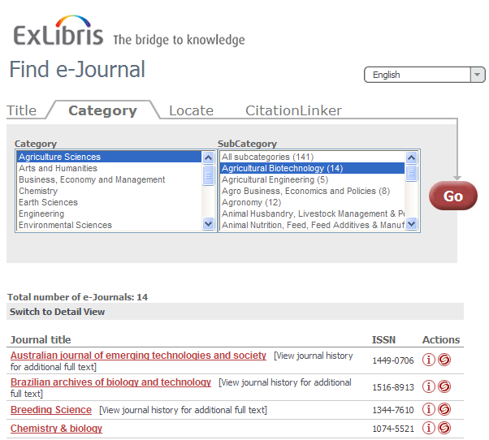
A-Z List: Category
Notes:
The Category tab allows you to browse ejournals by category. The Category information is included in the SFX KnowledgeBase. Each title, or object, in the SFX KnowledgeBase is assigned at least one category and subcategory by default.
If I select a specific category we can see the list of subcategories available. Notice the number in parentheses for each subcategory, which indicates the number of titles within the subcategory. By selecting a subcategory, I can see the list of journals in the view below that meet that criteria. Notice I have the same display options in the results as in the Title tab.
Next…

Slide 8
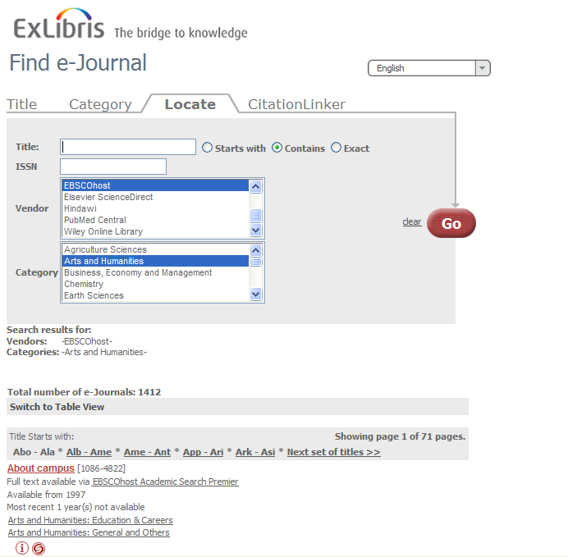
A-Z List: Locate
Notes:
The third tab is the Locate tab. This is where the user can conduct more advanced searches by entering any combination of title keywords, ISSN, Vendors, and or Categories. In this example, I wanted to get a list of Arts and Humanities journals from EBSCOhost.
Again, the display options for the results are the same as in the title and category tabs.

Slide 9
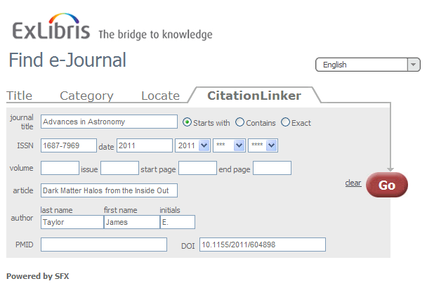
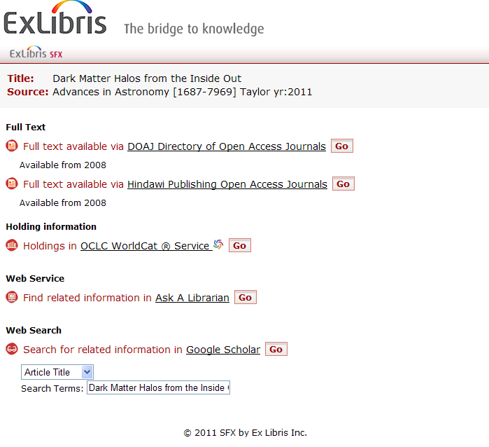
A-Z List: CitationLinker
Notes:
Lastly, we have the CitationLinker tab.
Using the CitationLinker tab, a user with a citation in hand can search for that article using SFX. Essentially the user is manually creating an OpenURL that is then sent to the SFX server.
In this example, I’m searching for the article “Dark Matter from the inside out” in Advances in Astronomy. When I click ‘Go’, I get the SFX Menu that provides the links to the full text of this article.
These four tabs make up the standard A-Z list that the user sees.

Slide 10
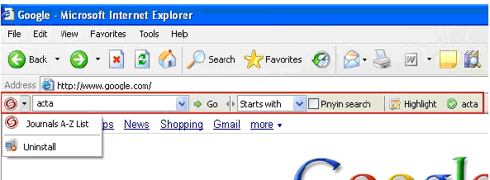

A-Z List: Search Toolbar & Quick Search
Notes:
In addition to the standard A-Z List, the SFX A-Z List browser toolbar is available as an add-on component for Internet Explorer browser only. It allows your end users to quickly search the SFX A-Z List from anywhere on the web.
(click) It’s also possible to generate the html for an embedded search box to allow users to do a quick search of the A-Z list from your library’s home page.

Slide 11
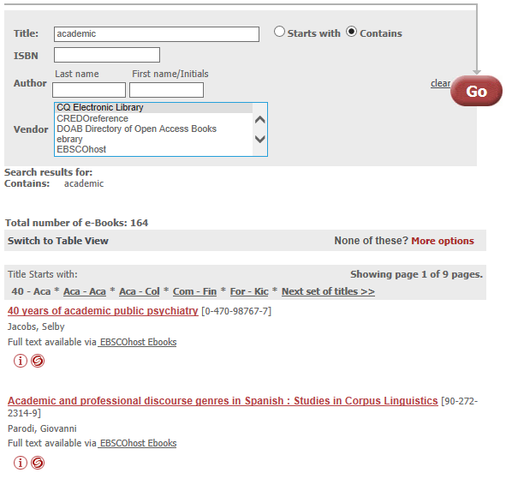
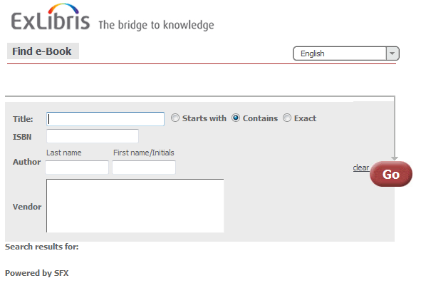
A-Z List: eBook Search
http://hostname:port/instance/azbook
SFX Base URL
Notes:
In addition to the eJournals A-Z list, there is also a separate A-Z list for ebooks. Keep in mind they are separate search interfaces.
The default URL for the eBook A-Z list is your SFX base URL including your instance, with /azbook at the end.
The eBook search options are similar to the A-Z list options, however ebooks do not have categories and subcategories assigned so you won’t see any category options in the ebook search. The results display will be very similar to the A-Z list journal options that we saw previously.

Slide 12
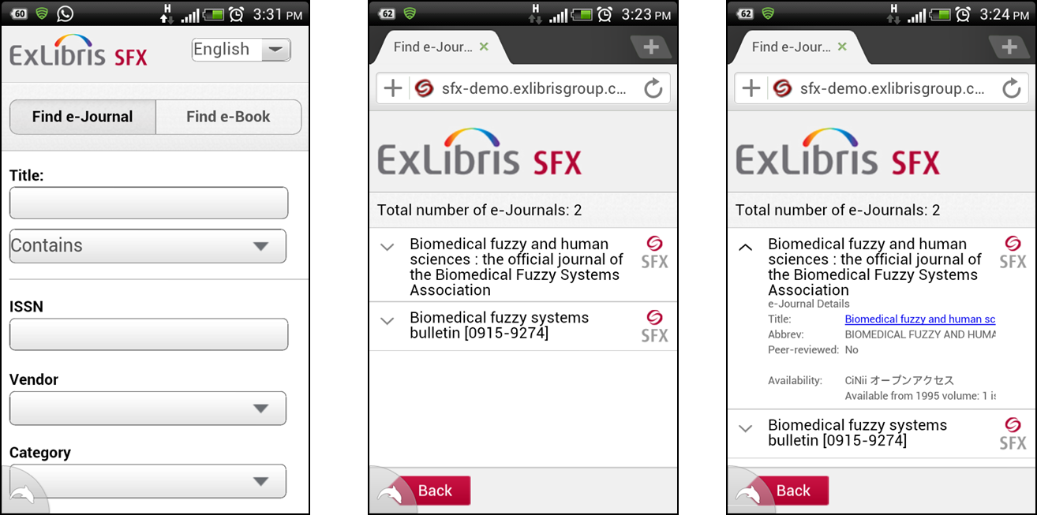
SFX Mobile Search Interface
Available for A-Z lists, SFX Citation Linker, SFX menu
Notes:
Lastly, there’s also a mobile user interface for the A-Z lists and CitationLinker, as well as the SFX menu. Just to be clear, it’s not an app, but a mobile interface. All a user would need to do is type in or access the URL on their mobile device to access the mobile interface screens.
Can also customize the banner that displays in the mobile interface – we’ll cover that a little later.

Slide 13
Agenda
A-Z List
A-Z List Customizations
SFX Menu
SFX Menu Customizations
Translation and Display
Summary & Additional Resources
Notes:
Let’s talk next about what kinds of A-Z list customizations are available, as well as where and how to make the changes.

Slide 14
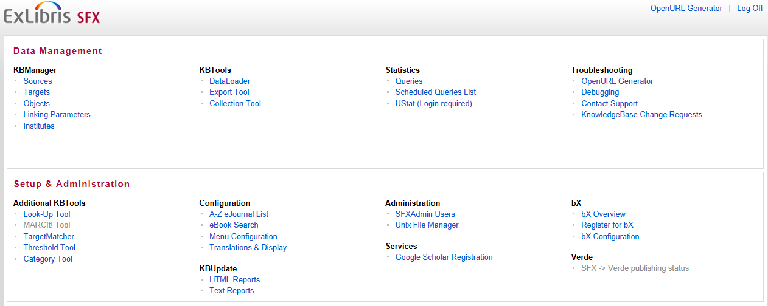
Admin Center: Configuration
Notes:
In the SFX Admin Center, the ejournal and ebook A-Z lists can be customized by going to ‘A-Z eJournal List’ and ‘eBook Search’, respectively, in the Setup & Administration area, under the Configuration section.

Slide 15
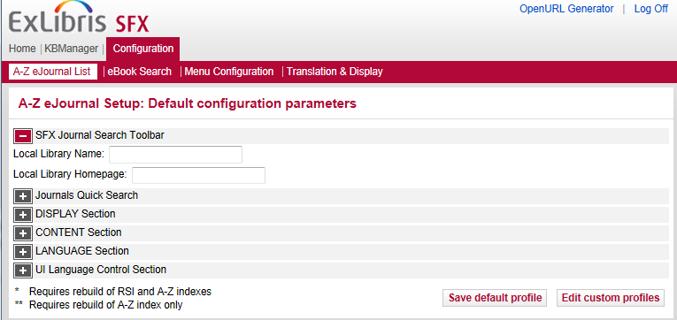
A-Z List: SFX Journal Search Toolbar
Notes:
We’ll talk about A-Z ejournal list customizations first.
You’ll notice that in the A-Z List screen, there is a list of sections- SFX Journal Search Toolbar, Journal Quick Search, Display, Content, Language, and UI Language Control.
Each of these sections are collapsed, and can be expanded by clicking on the plus sign next to the header. Let’s go through each of the sections.
The first is the SFX Journal Search Toolbar; in the Admin Center, we have a place to enter the Local Library Name, and the Local Library Homepage. If you want to implement the Internet Explorer browser add-on, you’d also need to enable it on the server in a configuration file. To release it to your users, you’d then provide them with a link they could follow that would initiate the download and installation of the add-on.
The SFX Advanced User's Guide provides more detailed instructions on this, so I won’t go into more detail here.

Slide 16
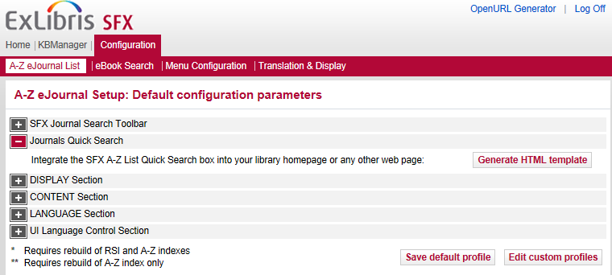
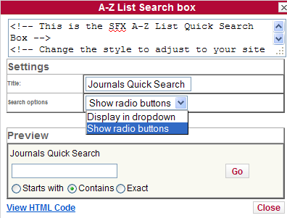
A-Z List: Journals Quick Search
Notes:
The next section is the Journals Quick Search – this is the embedded search box you can generate.
When you click on the ‘Generate HTML template’, (click) a pop-up window opens and you can configure the search box. You can give it a title, and choose between a dropdown or radio buttons. There’s a preview window that shows you what it will look like. Once you’ve found a configuration that you’re happy with, you can click ‘View HTML Code’, and the code will be updated in the top section of the pop-up. You can copy the code and then paste it into the web page you want the search box embedded into.

Slide 17
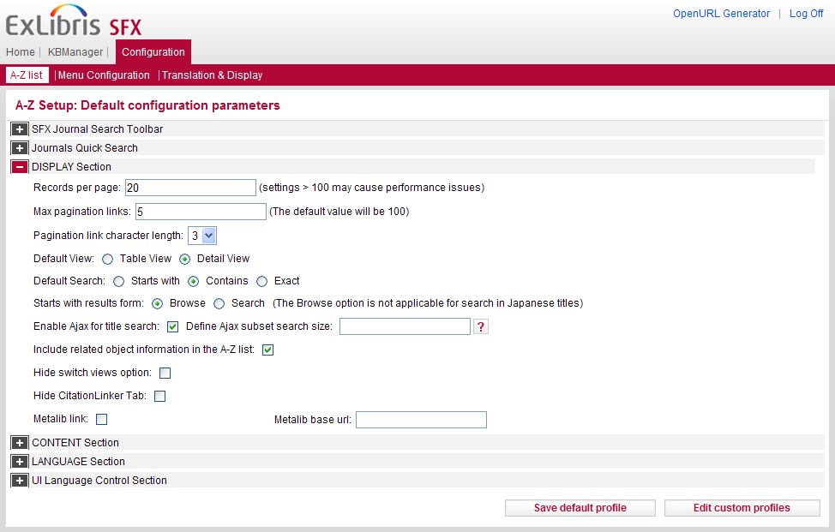
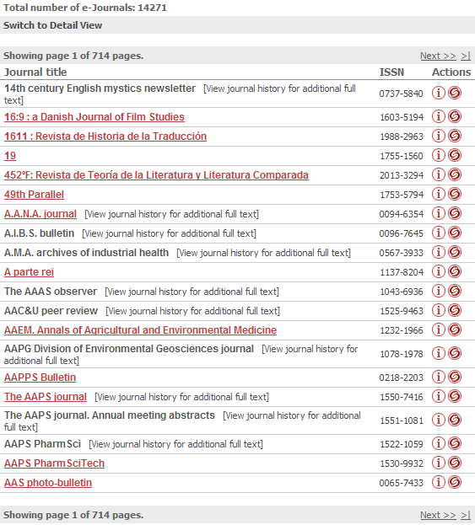
A-Z List: Display: Records per page
Notes:
While the first two sections focused on creating additional access points for your users, the rest of the sections focus on the changes you can make to the A-Z list’s appearance and function.
The Display section contains the bulk of the changes you can make to the A-Z List. In this section, the first option allows you to set the number of records per page (click to show UI) – this is the maximum number of search results your users will see before they have to click ‘next’. We do recommend that for best performance you set this value to less than 100.

Slide 18
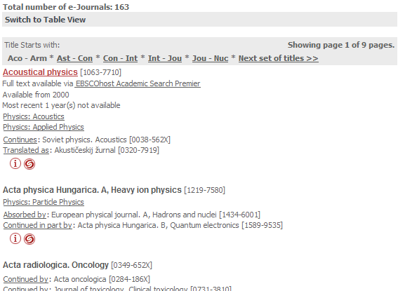
A-Z List: Display: Pagination
Notes:
Max pagination links and the pagination link character length – these two settings affect how your search results are divided. For example, I’ve got the Max pagination links set to 5, and the pagination link character set to three. In the user interface (click to show UI) this means that we see five alphabetical divisions (Aco – Arm, Ast – Con, etc…) with the option to see more, and then you’ll notice that each division spans a section defined with three-lettered headers. So, max pagination is 5, and the pagination link character is 3 in this example.

Slide 19
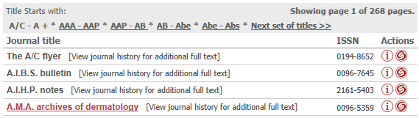
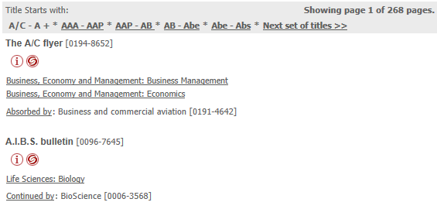
A-Z List: Display: Views
Table View
Detail View
Notes:
The default view defines how much information you want to show the user initially about their search results. The table view (click to show Table View) shows the title and ISSN of the journal, and the user can click on the ‘I’ icon to show the rest of the information in a pop-up window. The detail view (click to show Detail View) on the other hand, shows all of the information. Remember that the user is given the option to switch views on their own, but you can determine what the user sees by default when they first see the results.

Slide 20
A-Z List: Display: Default Search
Notes:
The next option is the Default search, – here you can define the radio button that’s selected by default (Starts with, Contains, or Exact) when you do a search.
Notice that the A-Z list Title tab does not have an “Exact” option; only the Locate tab has an “Exact” search option. So if you set Exact as the default, it will be the default to Exact on the Locate tab, but on the Title tab it will default to “Starts with”.

Slide 21
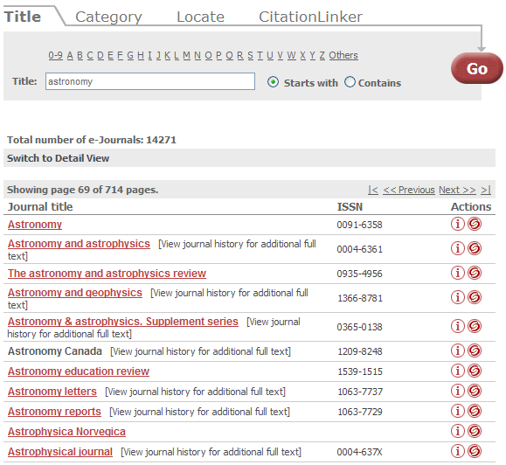
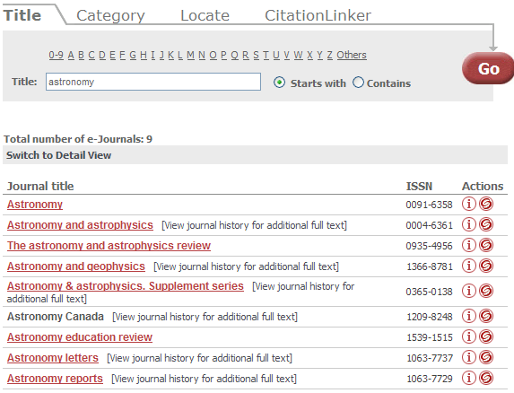
A-Z List: Display: Starts With Results
Browse
Search
Notes:
And then there’s the Starts with results form, which controls how the ‘starts with’ search behaves. When the starts with results form is set to browse (click to show browse option in UI) and the user conducts a ‘starts with’ search, they are dropped into an alphabetical list of your journals with their search term acting as the starting point. If you have the starts with form set to search (click to show search option in UI) the user is brought to a specific list of journals that start with that word.

Slide 22
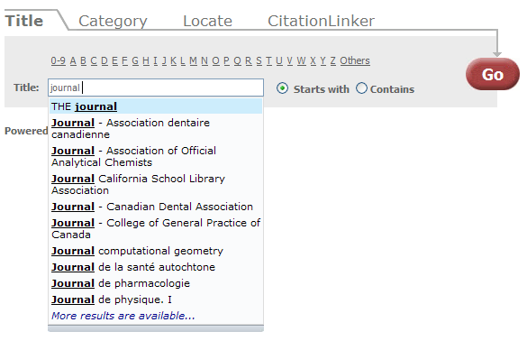
A-Z List: Display: AutoComplete (Ajax)
Notes:
Enable Ajax for title search – this option enables an auto-complete feature. (click to show UI)
We can see here that I’m in a starts with search, and as I start typing a search term, a list of possibilities appears below the search box. As I continue typing, it’s going to automatically refine the list.
(click to show admin interface)
When you enter a value in the ‘define Ajax subset search size’ box, you can reduce the search set that is retrieved and sorted to a smaller list for performance reasons. By default, this text box is empty, which means no set value is currently being used.

Slide 23
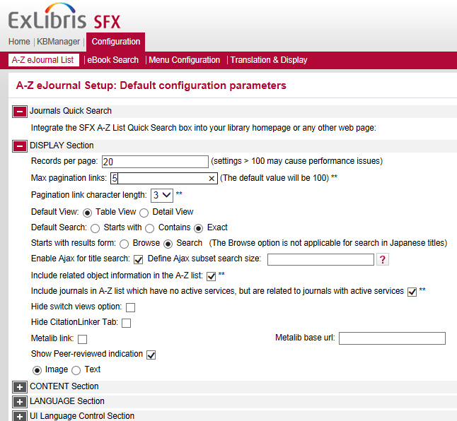
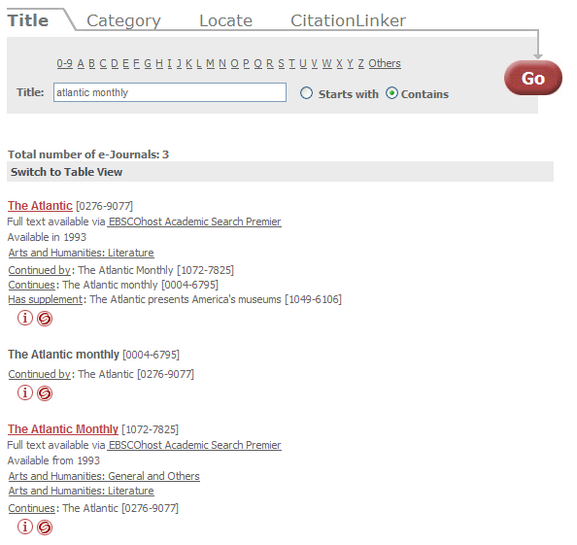
A-Z List: Display: Related Objects
Notes:
Next up, including related object information in the A-Z list.
The SFX KnowledgeBase has information about related objects. For example, if a journal ceases publication and is continued by another journal, the two journals are considered related. Another example would be a journal and its supplements.
With this option checked, your users can benefit from this information and see related journals information. In this example, we can see the various iterations of The Atlantic, and we can also see a supplement indicated in the first result.
Also note that you can decide if you want any related journals that don’t have any active services to display in the A-Z list if they are related to journals that do have active services.

Slide 24
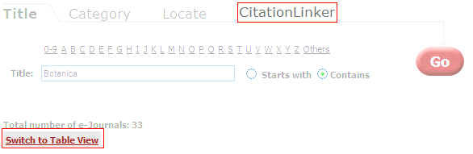
A-Z List: Display: Hide Options
Notes:
There are a couple of things that you can choose to hide in the user interface – the switch views option, and you can also choose to hide the CitationLinker tab altogether.

Slide 25

A-Z List: Display: MetaLib
Notes:
Another choice in this section is whether or not you want to give your users the ability to push journal information to their MetaLib My e-journals list. If you do, this link appears as an icon next to the SFX swirlie.
(show Admin UI again)
Once you’ve finished making display configurations, you can click on ‘Save default profile’ to save your changes.
Note that if you’re in a consortium, custom profiles can be used to customize views for individual libraries in the consortium. You would click on the ‘Edit custom profiles’ button to add or edit a profile and customize it.

Slide 26
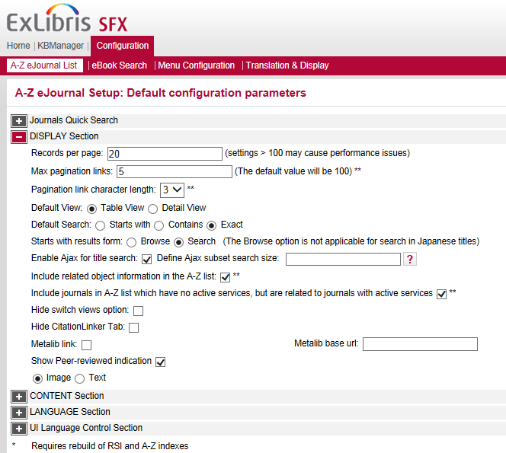
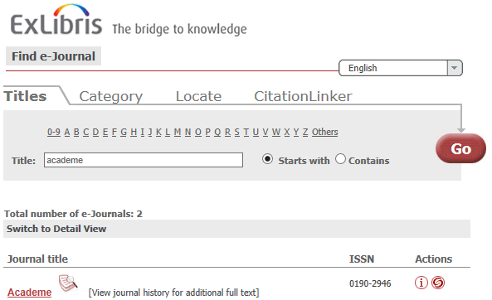
A-Z List: Display: Peer Review
Notes:
The last option in this section is whether you want a visual indicator to display to users if a title is peer-reviewed. You can choose from an image that displays next to the title, or text that displays next to the title in the A-Z list.
Note that the peer review information will also appear when you click on the Information button.

Slide 27

A-Z List: Advanced Customizations
Header image
Colors and fonts
Notes:
Even though there are quite a few options to customize the A-Z list display in the Admin Center, there are a few display-related changes you might want to make that involve changing files directly on the server. For example, the header image in the A-Z List, and colors or fonts that display in the A-Z list.
More information on these kinds of server-related changes can be found in the Advanced User’s Guide.

Slide 28
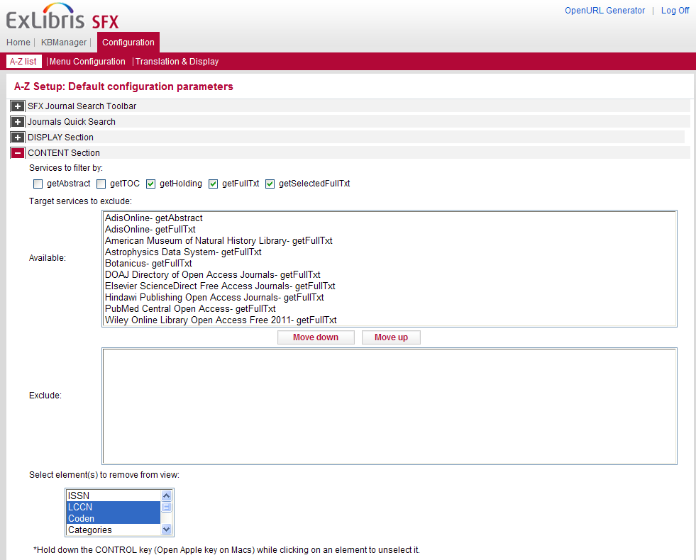

A-Z List: Content
Notes:
The next section is the Content section. Here you can decide which services you’d like to display or hide in the A-Z list menu, and you can even choose to exclude targets from the A-Z list. (click to show UI) Here’s a detailed view of a journal – by default, I can see the full text services, and I can see both of the targets that have this journal. If I wanted to exclude the DOAJ from view, I would add it to the Excluded target list. This won’t deactivate the target itself, it will still function and will still perform its link resolution duties, but it just won’t be visible in the A-Z list. (click to show admin interface)
You can also select which elements you want to remove from the view. It will also remove those elements when you click on the Information button – here I’ve selected the LCCN and the Coden, two standard identifiers.

Slide 29
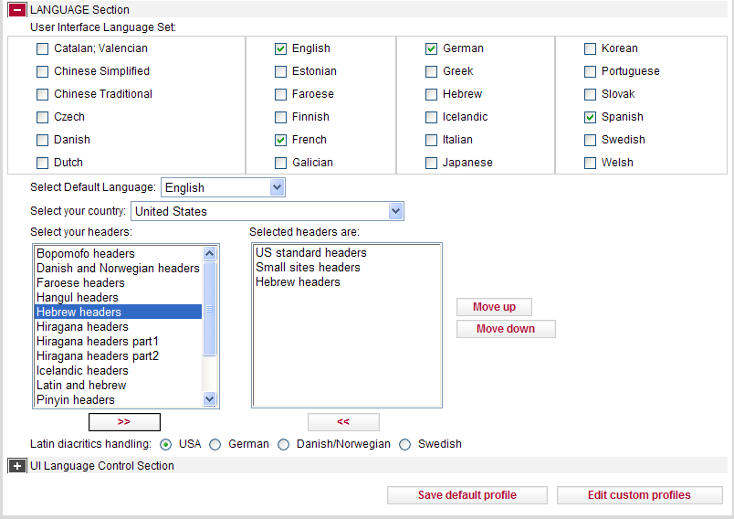
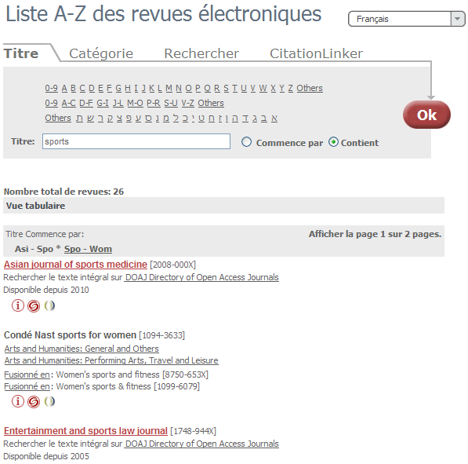
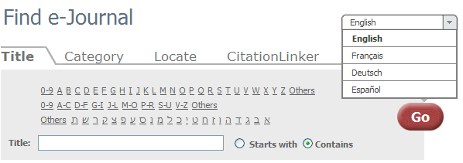
A-Z List: Language
Notes:
In the Language section, I can define the user interface language set – this is the list of languages that appear in the dropdown menu in the A-Z List. You’ll notice that in the UI, the language options appear in their native language.
If I choose to view the A-Z list in French, you’ll notice that the language in the tabs is translated, and some of the text in the search results below, but not all. This is because some of the information in the search results is derived from the object (titles), target and category names that are defined in the KnowledgeBase – these are not translated automatically.
You can also select the default language, in this case English, and your country, in this case, the United States.
Under ‘Select Headers’, you can define one or more headers to show in the A-Z list. In this case, I’ve added the standard and small versions of the header, and the Hebrew header. With all three active, it looks like this: (click).
The last language option here defines how Latin diacritics are handled. In the SFX General User’s Guide, there’s more detail on how each of these options are rendered.

Slide 30
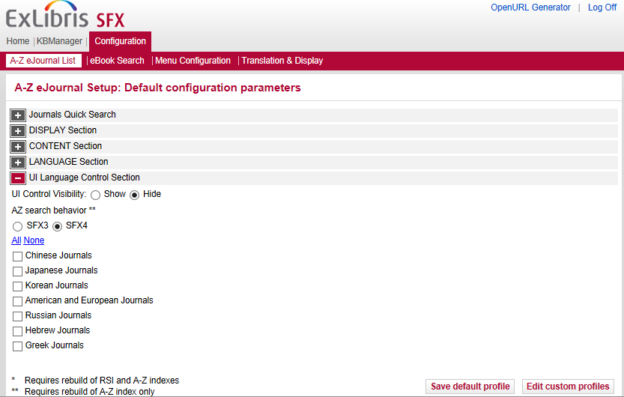
A-Z List: UI Language Control
Notes:
There are a few ways you can control the UI language in the A-Z List – by deciding whether or not you’d like to give your users the ability to limit search results based on the journal’s written system language – for example Chinese, Russian, Hebrew, etc.
If this is something you’re interested in, there is more detail in the SFX General User’s Guide.

Slide 31
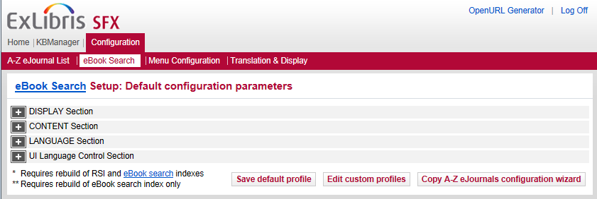
eBook Search: A-Z List
Very similar to A-Z List customizations
Can copy A-Z List customizations to eBook A-Z customizations
Notes:
We’ve been talking through the customizations available for the A-Z journals list. There are also customizations available for the eBook A-Z list.
They’re accessible from SFX Admin Center > Configuration menu, in the eBook Search area.
They are actually very similar to the A-Z ejournal list customizations, and once you have the A-Z ejournal customizations configured, in the eBook Search area you can simply click the button “Copy A-Z eJournal configuration wizard” to have the same customizations in the eBook A-Z list.

Slide 32
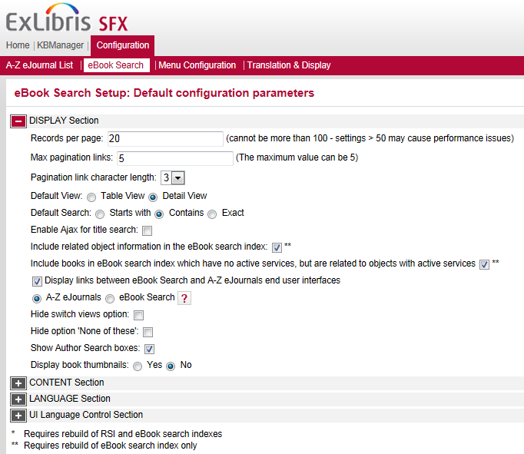
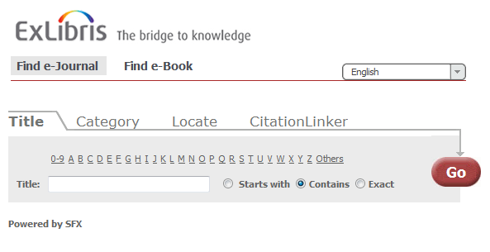
eBook Search: Combine A-Z Links
Notes:
One option that is unique, however, in the eBook search customizations is the ‘Display links between eBook Search and A-Z eJournals end user interfaces’. The eJournals A-Z list and the eBook A-Z list are typically separate URLs as we saw earlier. However, you can combine the two searches into 1 URL. They are still separate searches on separate tabs, but both can be accessed from the same URL.
Note that you also have the option to display book thumbnails in the A-Z results list for an ebook search.

Slide 33
A-Z List: Building the A-Z List
Initial Setup
  Define Country and Headers (Languages section)
  Run RSI (Rapid Service Indicator)
  Run A-Z Index
Updating
  Schedule the RSI to run first
  Schedule the A-Z List Index
Notes:
So we’ve covered what you need to know to customize the A-Z Lists, but let’s back up a moment. In order to see your own A-Z List, you’re going to have to build it first.
(click) The first step in this process is making sure you’ve got the country and headers defined in the Languages section. If you don’t, you’re going to get an error message in the next steps.
(click) Next, you’ll need to get on the server to run 2 jobs: RSI and A-Z List Index. RSI is used by other applications such as Primo and MetaLib; it offers an interface for querying the SFX KnowledgeBase for the availability of specific journals and books identified by their ISSN, ISBN, etc. - and it’s also used to generate the A-Z list. The A-Z indexing process looks at your KnowledgeBase to determine what resources should appear in the A-Z List. We’ll talk further about these 2 jobs in the SFX Systems Administration session, so I won’t demonstrate it at this point.
(click) Now you can imagine that if the indexing process needs to be run to reflect what’s in the KnowledgeBase, you’re also going to need to run it again, every time you make changes to the KB. (click) The indexing process can be set up to run automatically, and we recommend that it runs daily – or rather nightly.
(click) You’ll need to schedule the RSI to run before the A-Z List. Again, this will all be covered in the System Administration session.

Slide 34
A-Z List: Seeing Changes
New/updated/deactivated targets, services, and object portfolios display in A-Z list after the A-Z indexing job runs
Most A-Z list UI changes are immediate
UI changes that require RSI and/or A-Z jobs to run first will be asterisked (*) in configuration menu
Notes:
When you’re making changes, sometimes you’ll need to build the A-Z list to see the changes to the list, other times the changes will appears just after you make them in the SFX Admin Center.
(Click) Any changes to your KnowledgeBase– such as activating or deactivating targets, services, and object portfolios will depend on the rebuild. So the A-Z list indexing job will need to run first in order to see the changes in the A-Z list.
(Click) However, for many of the changes that we saw in this session – these can actually be seen immediately after you save them, which is nice when you’re just starting out and want to test the configurations a bit to see which ones you prefer.
The exception is for any A-Z list customizations that are identified with an asterisk (or two asterisks) indicating that the A-Z list indexing job and/or the RSI job needs to be run before the changes will display in the A-Z list user interface. An example is related objects – if you opt to show or hide this, you’ll need to re-index the A-Z list for the change to take effect.

Slide 35

A-Z List: Best Practices
Defaults are good!
Keep your resources in mind
Keep your users in mind
Notes:
So that covers the possible customizations that you can make to the A-Z List – let’s just briefly sum up some best practices.
Defaults are good – it’s okay to leave everything to its default and change only what drives you or your users crazy, as opposed to approaching each option as a decision you have to make.
Configure the pagination/number of records per page based on your own resources – there’s no rule that’s going to apply to everyone in every situation because your resources are unique.
Keep your users in mind – when you’re customizing your views and configuring how search behaves, you’ll want to make sure these are set up to be friendly to your users. If you support multiple languages, you’ll want to make sure SFX can do the same.

Slide 36
Agenda
A-Z List
A-Z List Customizations
Translation and Display
Summary & Additional Resources
Notes:
Let’s turn out attention now to translation and text labels in the ejournal and ebook A-Z lists.

Slide 37
Admin Center: Configuration
Notes:
To do this, we’ll be working in the Translation & Display area of the SFX Admin Center.

Slide 38
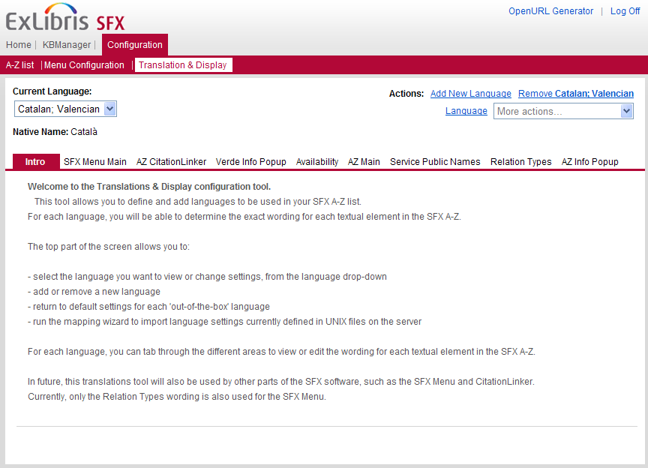
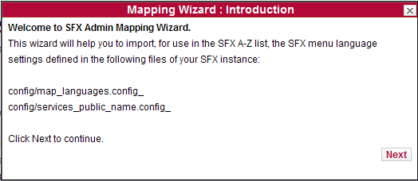
Translations and Display
Notes:
The translation and display area allows you to customize the wording for all text elements that are used in your SFX A-Z lists and the SFX Menu. This can apply to one or more of the languages that you want to make available to your users.
This tool allows you to change all text elements in the language of your choice, return to the default settings, add or remove a language, and run the mapping wizard to import existing configurations. (click) The first time you access this tool, the SFX Admin mapping wizard appears. This wizard will import your existing menu language settings as defined in the configuration files on the server.

Slide 39
Agenda
A-Z List
A-Z List Customizations
Translation and Display
Summary & Additional Resources
Notes:
This brings us to the end of this session.

Slide 40
Summary
How To…
Customize the A-Z List
Implement translations & display customizations
Incorporate best practices
Notes:
To briefly summarize, we talked about:
where and how to customize the ejournal and ebook A-Z lists
where to customize the Translation and Language display if you want to change any of the text labels in the A-Z lists or the SFX menu
some best practices for UI customization for the A-Z List

Slide 41

Additional Resources
Accessible from Documentation Center:
(http://www.customercenter.exlibrisgroup.com/)
  General User’s Guide
  Advanced User’s Guide
  eBook Search Guide
  SFX System Administration Guide
Notes:
Here’s a list of documents that will provide more information on A-Z list customizations. These can all be found in the Ex Libris Documentation Center.
The General User’s Guide will have more details on many of the A-Z list customizations we talked about in this session.
The eBook A-Z list has its own guide - the eBook Search Guide - which will explain customizations that can be made for the eBook A-Z list.
The Advanced User’s Guide will have information on making A-Z list customization changes on the server - such as for color or font changes, and changing the A-Z list header to be your institution’s own logo.
Additionally, the System Administration Guide will have more information about the RSI and A-Z indexing jobs that were mentioned in this session. We’ll discuss them more in the System Administration session.
Thanks for joining me!

