Slide 1
SFX-Primo Interoperability
Notes:
Hello and welcome to this session on SFX and Primo Interoperability.
This presentation is copyrighted and is the confidential property of Ex Libris Ltd. Information included in this presentation is periodically reviewed and updated. You may shared these training materials within your institution but not beyond.

Slide 2
Copyright Statement
All of the information and material inclusive of text, images, logos, product names is either the property of, or used with permission by Ex Libris Ltd. The information may not be distributed, modified, displayed, reproduced – in whole or in part – without the prior written permission of Ex Libris Ltd.
TRADEMARKS
Ex Libris, the Ex Libris logo, Aleph, Alma, SFX, SFXIT, MetaLib, DigiTool, Verde, Primo, Voyager, MetaSearch, MetaIndex and other Ex Libris products and services referenced herein are trademarks of Ex Libris, and may be registered in certain jurisdictions. All other product names, company names, marks and logos referenced may be trademarks of their respective owners.
DISCLAIMER
The information contained in this document is compiled from various sources and provided on an "AS IS" basis for general information purposes only without any representations, conditions or warranties whether express or implied, including any implied warranties of satisfactory quality, completeness, accuracy or fitness for a particular purpose.
Ex Libris, its subsidiaries and related corporations ("Ex Libris Group") disclaim any and all liability for all use of this information, including losses, damages, claims or expenses any person may incur as a result of the use of this information, even if advised of the possibility of such loss or damage.
© Ex Libris Ltd., 2014

Slide 3
Agenda
Introduction
SFX Linking via Primo
SFX2Primo Export
SFX4Primo Central
Troubleshooting
Summary & Additional Resources
Notes:
In this session, we’re going to cover how SFX & Primo are integrated, or how they communicate, with each other – focusing more on the ‘what’ and ‘why’, rather than the step-by-step ‘how’ because much of that is covered in previous SFX sessions & documentation, as well as Primo training & documentation. In many cases, these configurations (especially in Primo) will be set up for you during implementation so this will just be background information for you.
We’ll cover the Linking integration points first – showing where SFX linking happens in Primo & the configurations that relate to linking.
Then we’ll shift gears a bit & talk about exporting data from SFX. We’ll go through the processes & configurations in order for (1) SFX to export data to Primo and for (2) SFX to export data for Primo Central.
Lastly, we’ll cover some troubleshooting steps that you can take and what information the Support team will need if you log a support case.

Slide 4

Objectives
How SFX interacts with Primo through the user interface and important background processes
Configurations on both sides for Primo and SFX to work together
Process for exporting SFX data into Primo
Process for exporting Full Text availability information into Primo Central
Troubleshooting steps for linking issues and how to report issues to Support
Notes:
The key points for this session are understanding:
how SFX interacts with Primo through the user interface and through some behind-the-scenes processes
configurations needed in order for the applications to work together
the process for exporting data from SFX to Primo
the process for exporting Full Text availability information into Primo Central
troubleshooting steps for linking issues and how to report issues to Support

Slide 5

Main purpose of SFX in Primo?
Access to Full Text
Notes:
The main purpose of integrating SFX with Primo is, among other things, to access to full-text. Now SFX can also provide access to table of contents, abstracts, and holdings information among other things, but when integrated with Primo, it’s used mostly to access full-text in Primo – which is what users are primarily looking for.

Slide 6
Primo/Primo Central/SFX
Primo: Front-end user interface in which users search – for example:
  Your local catalog
  Your digital repository (if applicable)
  Primo Central
Primo Central: Digital repository of metadata
  Includes:
    ebooks and articles
    full-text metadata
SFX: Identifies what your library has access to
Notes:
To explain further:
Primo itself is the front-end user interface which allows users to search. It creates its own index of your local sources – so your users can search, for example, your ILS or your digital repository if that’s applicable. And users can also search Primo Central using Primo.
Primo Central is a huge digital repository of metadata that is searched using Primo – and it includes full-text metadata. Think of Primo Central as an index of a collection of resources (e.g., articles and ebooks). It’s 1 index, all in 1 place so it’s faster to access and bring back search results. However…even though users are searching this index that contains full-text, vendors may not allow the full-text to display because your library may not subscribe to it.
That’s why we need SFX with Primo: SFX is needed to identify what your users have access to or what your library subscribes to.
So if a user is in Primo looking for the full-text of an article and it’s available in a Gale resource, the full text will display to the user in Primo because in SFX we activated that Gale resource target, getFullText target service, and associated object portfolios.

Slide 7
Agenda
Introduction
SFX Linking via Primo
SFX2Primo Export
SFX4Primo Central
Troubleshooting
Summary & Additional Resources
Notes:
Let’s look at where the integration points are between SFX and Primo, as well as some of the associated configurations.

Slide 8
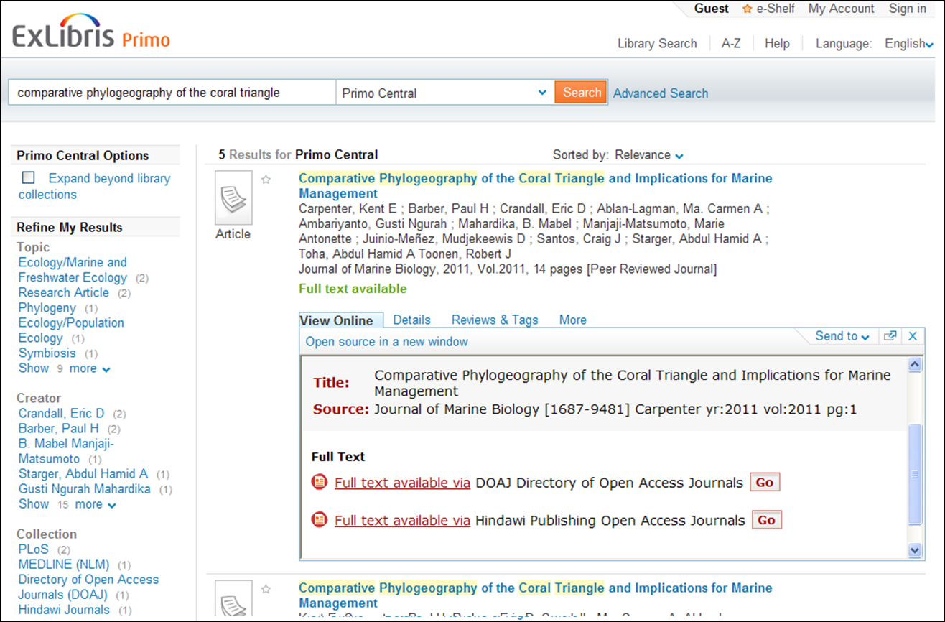
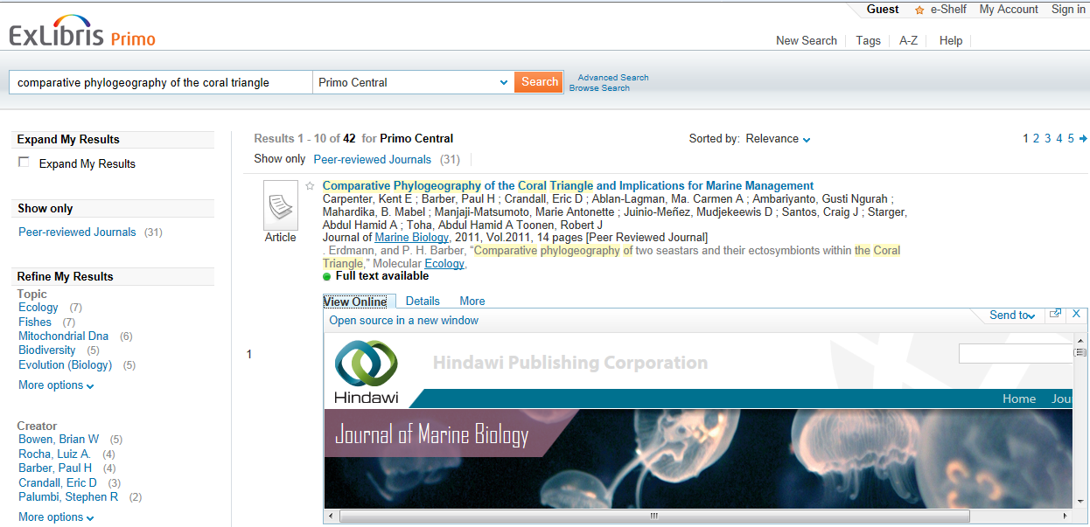
SFX Linking via Primo – View Online tab
View Online (GetIt1):
Displays full text targets in SFX Menu or
Direct links to journal, article, or ebook
Notes:
Let’s take a look at where data from SFX displays in Primo.
In Primo, there are typically 3 tabs: View Online, Details which has bibliographic information, and the More tab. Now, you can change the text labels for these tabs, so the labels may be different for your library. And keep in mind that behind the scenes - in Primo Back Office and in the Primo documentation, the View Online tab is called GetIt1.
When integrated with SFX, if full-text is available, the View Online tab will display one of two things:
the SFX Menu with full text targets – this tab will just display full-text targets only if full-text is available
OR
2) (click) if direct linking is turned on, the user can direct link to the full-text of a journal, article, or ebook in the View Online tab. If direct linking is not available depending on the situation, then the tab will just display any full-text targets.

Slide 9
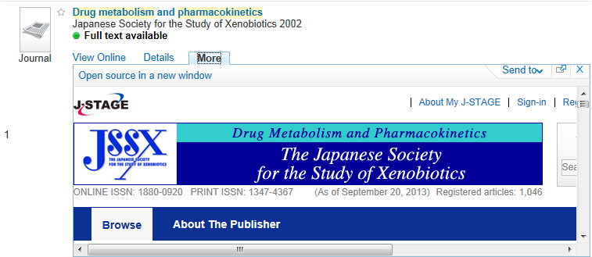
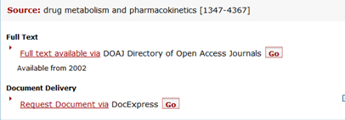
SFX Linking via Primo – More tab
More (GetIt2):
Displays all target services in SFX Menu: Full text, Table of Contents, Abstracts, Holdings, Web Services (ILL, Ask a Librarian), etc.
Notes:
The ‘More’ tab (which behind the scenes in Primo Back Office is called GetIt2) contains ALL active target services in the SFX menu that are applicable for the citation. So not only will it display full-text targets, but also any applicable Abstracts targets, Table of Contents, holdings information, and web services like Interlibrary Loan or “Ask a Librarian” services.

Slide 10
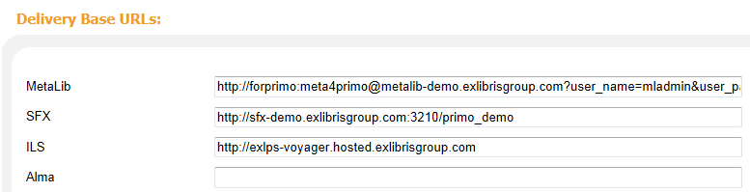
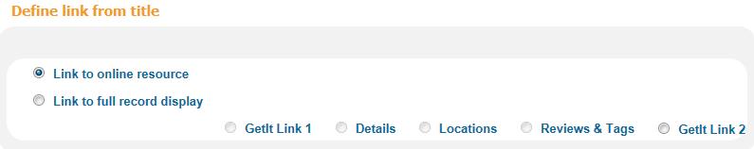
Primo: BackOffice UI Configuration
Institution Wizard: SFX Base URL
Views Wizard: Define link from title in results
Notes:
Let’s look behind the scenes in Primo Back Office.
For the initial integration setup, Primo needs to know your SFX Base URL (hostname:port/instance name) - so Primo knows where SFX is located so it can reach out to it. This is defined in the Institution Wizard in the Primo Backoffice.
Also in the Primo Back Office, you can determine what happens when you click on a title link in the Primo results list. When users click on the hyperlinked title in Primo, do you want them to:
-Go to the list of full-text targets (which is basically the View Online tab/GetIt1?)
-Go to the list of all target services that are available for the citation (which is basically the More tab/GetIt2?)
-Go to the Details tab, which contains bibliographic information about the article/ebook?
Common choices are GetIt1 (View online) or Details when you click on a hyperlinked title in Primo, but you have the choice here.

Slide 11
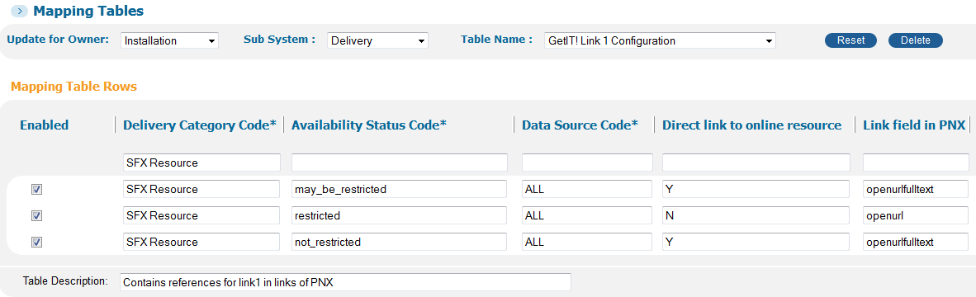
Primo: OpenURL Templates
Different default OpenURL templates for each tab…
Notes:
We had talked in previous sessions that OpenURLs are sent to & from SFX. In Primo, it’s the same situation. Each time the user clicks on the View Online tab or the More tab, Primo sends SFX an OpenURL containing metadata for what article or ebook the user is looking for.
In Primo Back Office, there are OpenURL templates that are used to provide data to SFX – basically telling SFX to what do, and in particular whether to provide full-text or not. Primo uses these OpenURL templates and plugs in the metadata for the citation into the template and then sends it to SFX.
There can be different delivery scenarios – and in some cases, Primo will be able to tell whether the article or ebook will be restricted to the user, or not restricted to the user (as in the case of a free resource), but in other cases, Primo may not be sure.
If it knows the resource is restricted, it sends an OpenURL template called openurl to SFX.
If it knows that the resource is not restricted, it sends an OpenURL template called OpenURLFullText.

Slide 12
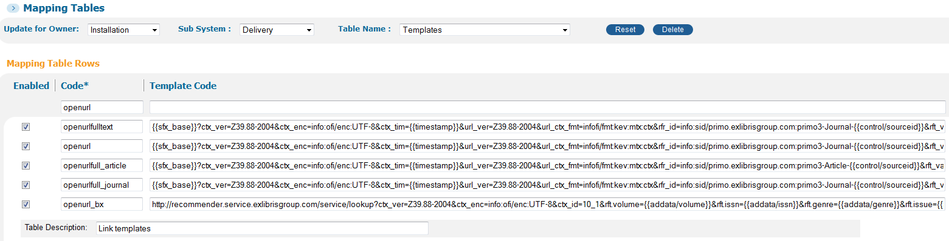
Primo: OpenURL Templates
Inside the OpenURL templates…
Notes:
Now let’s look inside the OpenURL templates – which are in the Primo Back Office templates table.
If the resource is not restricted, and we want the full-text to be sent, that OpenURL is listed here & you can see that parameters would be plugged into the OpenURL before it’s sent to SFX. If we could see the entire OpenURL template here, we would see that there would be a parameter called full-text and there would be a “Yes” plugged in to indicate to SFX to yes, send the full-text.
If the resource is restricted, that OpenURL template is listed here also & you can see the parameters that would be plugged into the OpenURL.

Slide 13
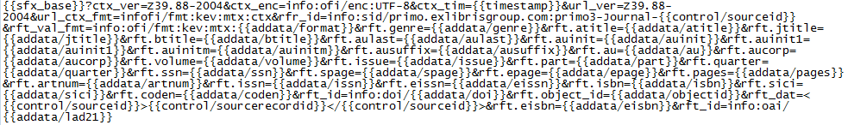
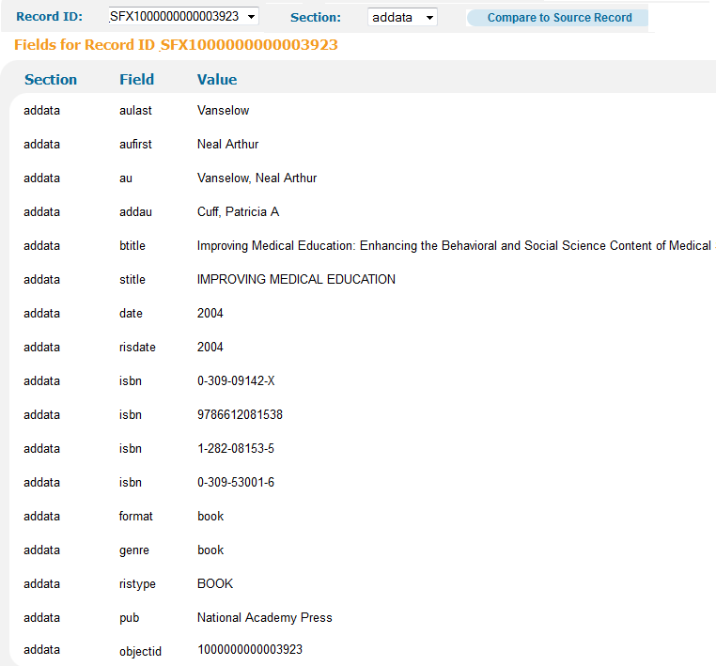
Primo: OpenURL Templates/PNX
Notes:
Here’s a full example of an OpenURL that Primo sends to SFX. This is an example using the openurl template for a restricted resource; we know this because we don’t see a fulltext = yes parameter in the openURL. If there was a parameter for fulltext=yes in the OpenURL, it would be an example using the openurlfulltext template which is for a non-restricted resource.
We see a PNX (Primo Normalized XML) record below for the citation the user is interested in. The AddData sections are specially formatted for link resolvers. The information from the PNX record will be plugged into the OpenURL when Primo sends it to SFX.
So for example, we see the parts that are highlighted in green and red in the PNX record correspond to the OpenURL above.
For troubleshooting purposes, if SFX is not able to find any results to display in Primo, it’s possible that perhaps the metadata in the Primo PNX record may be incorrect – so it may be worth looking at the PNX record to make sure the metadata is correct. If it’s not correct, log a support case.
So this is how the metadata for the OpenURL is generated from Primo and sent to SFX.

Slide 14
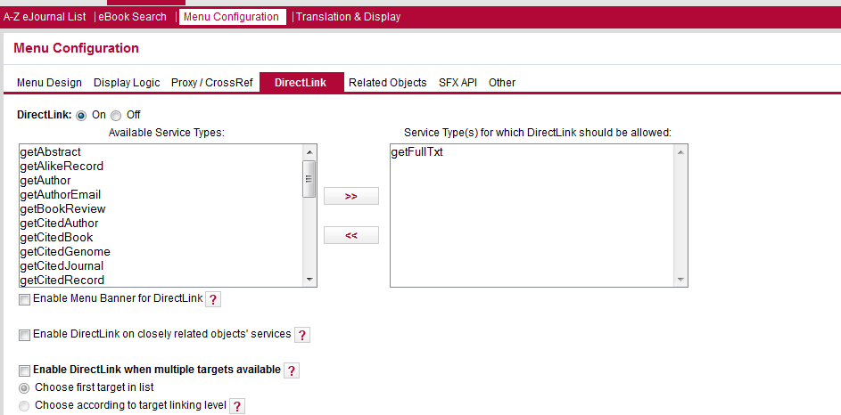
SFX: Direct Link
Used for Primo “View Online” tab
Turn Direct Link on to go directly to journal/ article in “View Online” tab
Use Source Filtering to restrict DirectLink to Primo only
Notes:
Now we’ll take a look at the SFX side of things. There are several SFX menu configurations that can impact how linking works in Primo.
The first is Direct Link. If Direct Link is not turned on in SFX, it will not be turned on in Primo. Then you’ll need to determine what types of services you would want to use with direct linking. Typically you will just select getFullText because it may not make sense to have the other available services use direct linking.
We covered the direct linking configuration in the SFX menu user interface configuration session, so I won’t go over all of the options here. That said – just to put out a couple of options, you can determine if you want direct linking enabled if there are multiple targets that have the full-text. If the 1st target in the list is (for example) a newspaper database, it may not provide an article-linking level. You may want the full-text to come from the next target in list which would have article-level linking. So it may make sense to choose “Choose according to target linking level.”
You can decide if you want your SFX banner image to display if direct linking is turned on.
Also, you can use source filtering to restrict direct linking only to Primo.

Slide 15
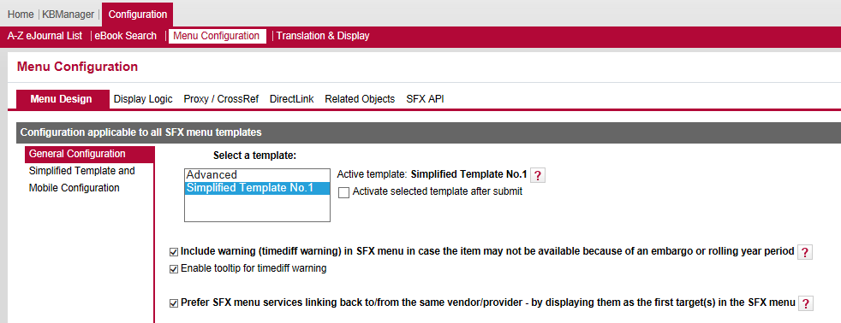
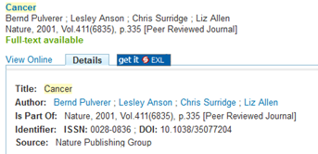
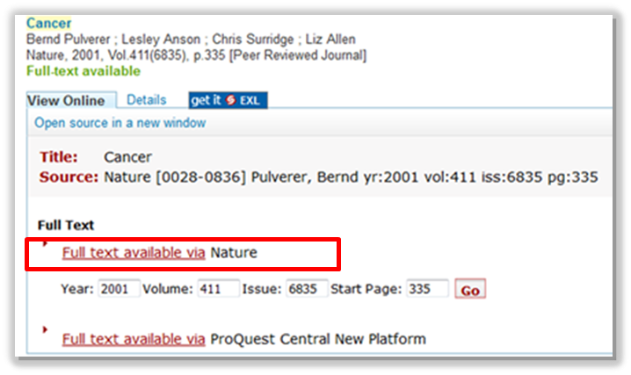
SFX: Source-to-Target Preference
Sorts targets from same vendor as incoming Primo Central citations at top of SFX Menu
Turned on automatically in SFX Admin Center
Notes:
Within in the SFX General area within the Menu Design section, there are some linking preferences. One of those preferences is the Source-to-Target preference – and it’s checked by default.
This essentially gives preference to the original source – and will display that as the first target in the SFX menu since we assume that would be the best record.
Putting it into Primo Central terms: when linking from Primo Central (so Primo Central sends the OpenURL to SFX), it takes the source of the record into account & would display that as the first target in the list.
For example, when an OpenURL is sent to SFX by Primo Central for a record that originated from Nature (click), then Nature targets (if you’ve activated them in SFX) are presented at the top of the SFX menu list of targets (click).
Note that this functionality does override any SFX target precedence options you may have configured – but does not interfere with display logic rules.
Also while on this screen, note that there is an option to remove the SFX banner image whenever the user is viewing the SFX menu in Primo – so only a list of targets would display; no banner image.

Slide 16
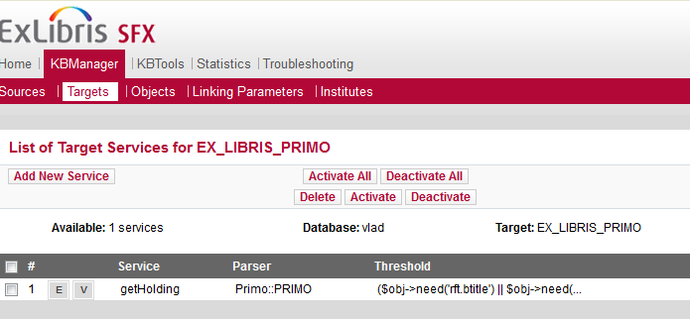
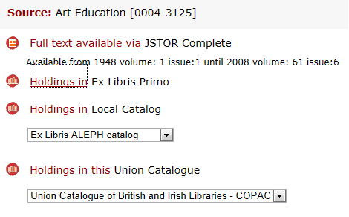
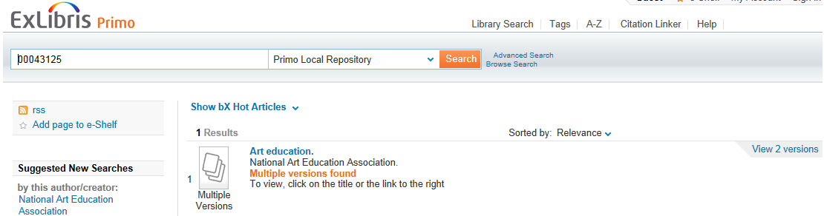
SFX: EX_LIBRIS_PRIMO Target
Notes:
Lastly - optionally, you can activate the Primo target in SFX so Primo would appear in the SFX menu if you were searching within a different source and wanted to link out to see holdings in Primo. The only target service available for the Primo target is ‘getHolding’ – and it would perform a Primo search of either the Title (journal or book title), or ISSN and ISBN.

Slide 17

SFX: Rapid Service Indicator Index
Displays full text availability in Primo
Scheduled via server_admin_util during SFX implementation
Runs at regular intervals, no extra Primo configuration required
Notes:
Within SFX, there’s also an RSI indexing job that runs from the server. It’s a scheduled process and we talked about it during the Systems Administration session.
That RSI job is needed for the “full-text available” message that displays in Primo. In the case of no full text, a message “No Full Text” will display. The RSI job is also used for e-journals & ebook ILS records that are normalized in Primo as Electronic Resources.
This process is scheduled using the SFX server_admin_utility during your implementation – so there’s no extra Primo configuration required for this.

Slide 18
Agenda
Introduction
SFX Linking via Primo
SFX2Primo Export
SFX4Primo Central
Troubleshooting
Summary & Additional Resources
Notes:
We have just covered linking configurations – so let’s now talk about the processes and configurations needed to get data exported from SFX to Primo. There are 2 export processes we’ll talk through – the first of which is for Primo itself.

Slide 19

SFX2Primo Export
Harvests active SFX KB Object records for Primo (MARC21 format)
Brief records contain title, ISSN/ISBN, subject (category)
Searchable by Title, not Article metadata
Notes:
The SFX2Primo Export process harvests your active KnowledgeBase object records & sends that information to Primo.
The export harvests active object (i.e., titles) records that are in your SFX KB. Keep in mind that this process harvests brief MARC records – which will contain titles, ISSN/ISBNs, and subject (or category). The objects are then searchable by title in Primo.
The export isn’t used to display full-text, but it’s a pointer towards full-text availability. We’ll talk about full-text availability a little later on.

Slide 20
SFX: Set up Primo Export (Complete)
One-time process for complete harvesting, then incremental harvesting
Create Advanced Export profile using SFX Admin Center’s Export Tool:
    Output = XML
    Object Type = Serials and/or Monographs
    Services = getFullTxt
    Select Fresh Export
    Optional = prefix, author info recommended for books
Notes:
The very first time you run the SFX export to Primo, it’s set up to do complete harvesting – so all of your SFX active objects exported to Primo. Going forward, you’ll do incremental harvesting to get just the updates exported to Primo. Note that your SFX implementation team will have most likely set this up for you, so this is probably just going to be background information.
The parameters for a full export are listed here. The export file format must be an XML for Primo. You can choose to include serials and/or monographs. Note that you can do one or the other or both - but the export shouldn’t be run separately for each of them because Primo can’t distinguish between 2 SFX loads. Keep in mind that if you are activating ebook packages in Primo Central, you may not want to include your ebooks in this export because there can be duplicate records then.
We’ll look at the full (complete) export process first, and then the incremental process.

Slide 21
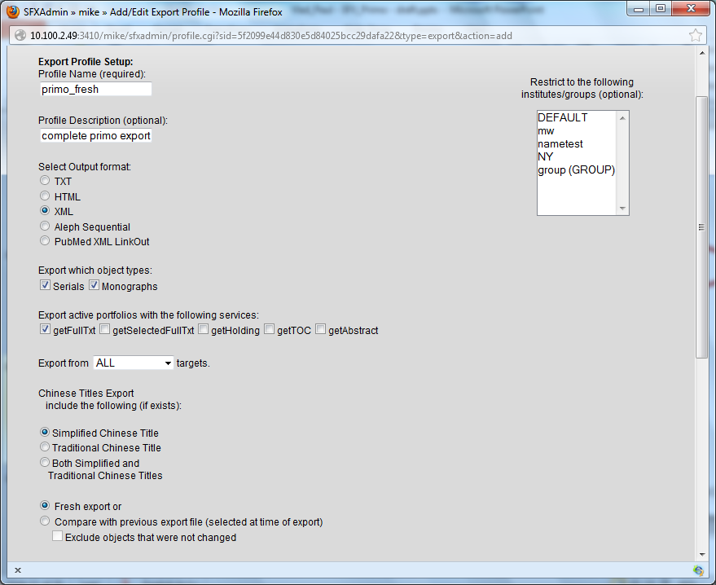
SFX: Advanced Export Profile (Complete)
List size per page (keep under 100)
Enable Ajax for Autocomplete option
Notes:
This is the SFX Advanced Export Profile – this is how it would look for a Complete harvesting for ALL SFX records to Primo.
Output format needs to be XML for Primo exports.
Export object types: This is where you indicate if you want to include serials, monographs, or both.
Select from which services you would want object portfolios to be included in the export file.
Export from field: You could select to export information from all of your active targets, or perhaps exclude your free targets.
If Chinese titles are in the file, you could include that information.
Select ‘Fresh export’ to do a complete harvesting.
‘Compare with previous export file’ is used for an Incremental export that we’ll talk about next - and would typically exclude objects that were not changed
You also have some other options that you could include for each of the object records in the export file…
Prefix: You can add a prefix to the export file if that’s easier to find the file on the server later on.
Base link: Include a 256 link to your proxy to add to the target URL
Title 245 $h: [Electronic resource]
Add categories to 860 field.
Add local attributes 901 $1
Include Author info – may be important to include if you’re including eBooks.

Slide 22
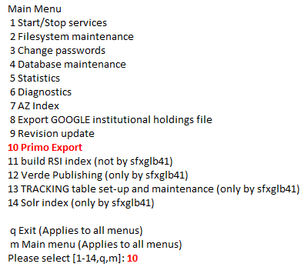
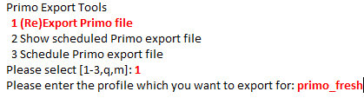
SFX: Run Primo Export (Complete)
Run export process via server_admin_util
Export file is created, tarred and placed in:
  /exlibris/sfx_ver/sfx4_1/<instance>/export/sfx2primo_export
Primo pipe (i.e., import process) picks up file
Notes:
So as we just saw, the advanced export profile that’s going to be used for the complete export is created in the Export Tool in SFX Admin Center.
Then on the SFX server, the server_admin_utility is used to run the export job and create the export file using option #10 from the server admin utility menu, and entering the name of the export profile that you want to use.
The export process creates the file, tars/archives it and places it on the SFX server. If you have access to the SFX server, the path to the file is listed here.
At that point, Primo can pick up the file from the SFX server and import it into Primo. Primo uses a data import process called a Primo pipe to pick up the file from SFX. It brings the data into Primo with transformation – so normalization rules are part of the pipe.
There’s more explanation of Primo pipes in Primo training.
Speaking in general terms, the maximum file size should be no more than 314 MB to not impact performance while loading to Primo – this is the raw file size; not zipped. If you suspect the file size will be larger, contact Support for details on how to split the file.
Again, typically all of this will already be taken care of for you during your implementation.

Slide 23
SFX: Set up Primo Export (Incremental)
Create incremental export profile after fresh (full/complete) export is harvested
Same parameters, except:
  Compare with previous export file (selected at time of export)
  Exclude objects that were not changed
Compares with most recent file in
/exlibris/sfx_ver/sfx4_1/instance/dbs/scratch/e_collection_update
Notes:
After the fresh (or complete) export is run, then we set up the SFX profile for an incremental job & we schedule the incremental job to run on a regular basis. Using this incremental process, it will have the parameters as we had in the complete export, but this time the export file going forward will only contain any changes since the last export – e.g., any new object portfolios that you have activated or object portfolios that you may have inactivated since the last export.
It will automatically compare against the most recent export file. If you have decided to add a prefix to the export file through the export profile, it will not take the prefix into consideration when it does the comparison. For those who have access to the SFX server, the directory where the most recent file will be is listed here.
For those who are using MARCit, it will not compare against MARCit exports, so these two processes can run without interference.

Slide 24
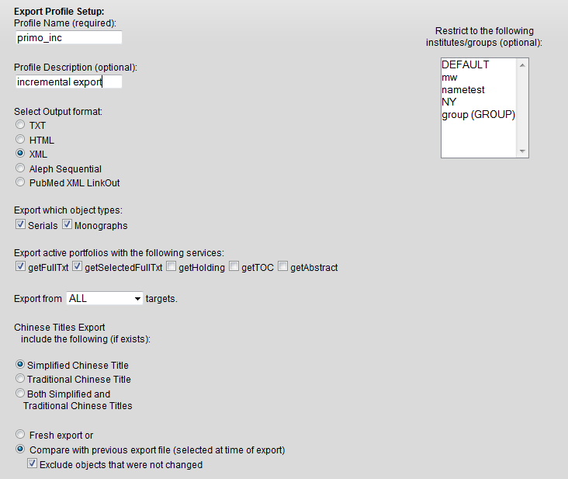

SFX: Advanced Export Profile (Incremental)
List size per page (keep under 100)
Enable Ajax for Autocomplete option
Notes:
Basically an identical advanced export profile is created, but this time for an Incremental export, rather than a fresh (complete) export.
A different profile name is used with the same parameters we selected for the Fresh/Complete export. But instead of a fresh export, we select ‘Compare with previous export file’, and check the box for exclude objects that were not changed.
Again, what this will do is export any new objects that you may have activated since the last export, or remove any objects you have deactivated since the last export. Anything that has not changed since the last export will be excluded from the export file.

Slide 25
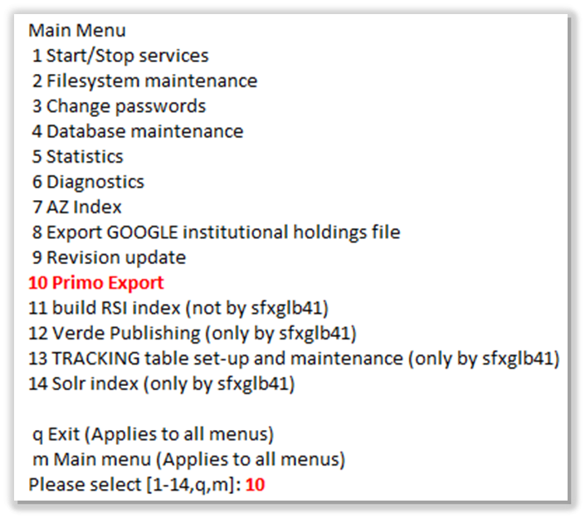
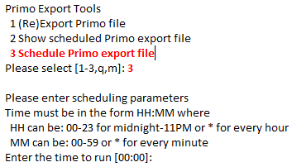
SFX: Schedule Incremental Export
Incremental export scheduled weekly using SFX Server_Admin_Util
Export file is created, tarred, placed in:
/exlibris/sfx_ver/sfx4_1/<instance>/export/sfx2primo_export
Primo picks up the file (2nd Primo pipe is set up for ongoing harvesting)
Notes:
Once the Incremental export profile has been created in SFX, then the incremental job is scheduled to run typically on a weekly basis.
The export file is created, tarred/archived, and placed on the SFX server so it’s ready for pickup by Primo. For those who have access to the SFX server, the path to the export file is listed here.
Primo then picks up the file for import into Primo. A 2nd Primo pipe (data import process) is set up to specifically for the ongoing harvesting of SFX incremental records.
We’ll look at the Primo pipe configuration next…

Slide 26
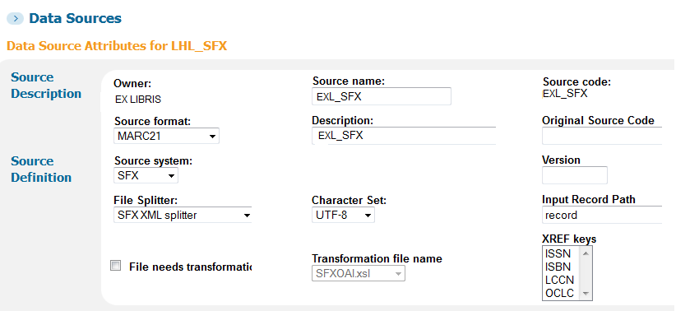
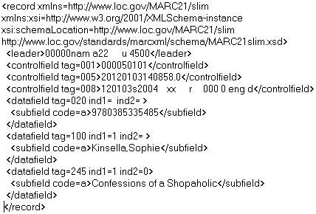
Primo: Pipe Configuration (1)
Notes:
We’re back in the Primo Back Office area – and this is the default setup for the Primo pipe. Again, this is the Primo process that imports the SFX data file.
It first indicates the data source information – so Primo knows where information is being taken from. For example, the source system for the export file is SFX, and it also includes what character sets are being used for the file.
Primo also needs to know how the file from SFX is structured, or formatted, so it can map fields correctly. It uses a ‘file splitter’ that’s specifically for SFX to determine this. The File splitter actually works inside in the XML – it determines what are the fields in the XML file and how Primo should split up, or apply, the fields. In other words, it’s how the fields in the XML records map to Primo fields.
The Input Record Path is highest point of the XML hierarchical structure – the start of the path. So in this case, each XML record in the SFX file starts out with a <record> tag. So Primo knows where each record in the file begins.

Slide 27
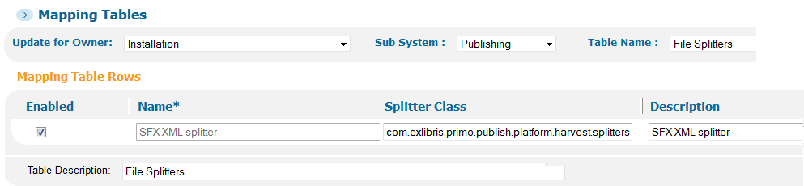
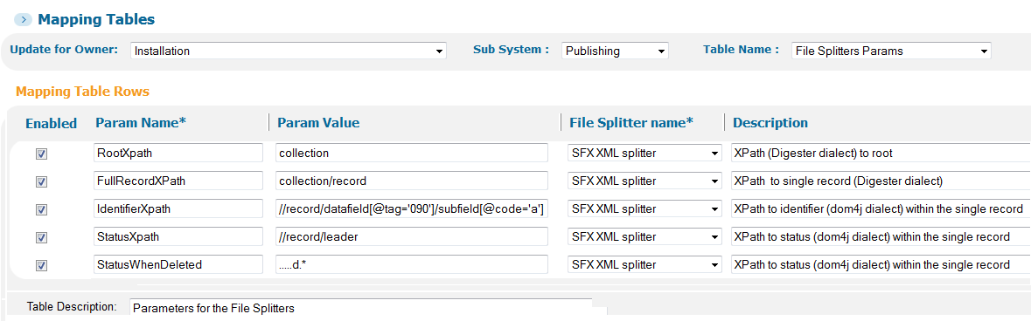
Primo: Pipe Configuration (2)
Notes:
So the file splitter tells Primo how to read the content of the SFX export file.
This file splitter parameters table is where the mapping of fields from the SFX file to Primo fields happens. It indicates at a high level how Primo needs to break up the file so that Primo normalization rules can be applied.
No set-up is needed by you; this is only background information. You really won’t need to do anything with this table, but if you want to see the fields and if you have access to the Primo Back Office, it’s in the Primo BackOffice mapping tables.

Slide 28
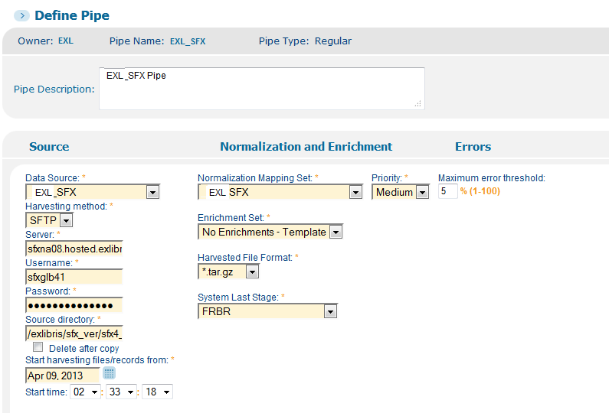
Primo: Pipe Configuration (3)
Notes:
In addition to telling Primo how the file is structured and how to split it apart, the actual Primo pipe itself needs to be setup and scheduled.
This indicates where the data is coming from (in this case, SFX) and how to access the export file. It uses the SFX server information, username and password to be able to access the SFX server, and also knows which directory on the SFX server that the file is contained in. We also tell Primo what normalization rules to use for the file. And notice we can also tell Primo when to start harvesting the records.

Slide 29

Primo & SFX: Scheduling Jobs
SFX KB weekly update scheduled/runs
SFX incremental export scheduled/runs
Primo’s SFX ongoing pipe scheduled/runs
Warning: If SFX export contains many ebooks, best to schedule Primo pipe when no other pipes are running/low usage time
Notes:
There are a lot of jobs we’ve talked about, so let’s talk about the order in which they should be scheduled to run. Again, this is just background information for you as these jobs are typically set up for you during your implementation process.
The SFX KnowledgeBase weekly update should be scheduled to run first. The idea is that you’ll then possibly be activating any new targets, target services, or objects from that update.
Then the SFX weekly incremental export should be scheduled to run.
Lastly, the Primo pipe should be scheduled to run to grab the SFX incremental export file and bring it into Primo.
Just a note that if eBooks are included in the SFX export file, the Primo pipe will be scheduled to run at a low usage time. This is to prevent any performance impacts because ebooks will typically contain a lot of metadata in the export file.

Slide 30

Primo: Additional Export Option
MARCit! service enriches SFX objects with CONSER records, harvested into ILS system
Optional export of detailed MARCit!-enhanced records from SFX via ILS
If loading MARCit! Records: Must enable adddata/objectid field in ILS Normalization Rule set
Load MARCit records directly to Primo
Notes:
If you use MARCit, you may be interested in this export option instead of the SFX2Primo export we just talked covered.
As background for those who may not be familiar with MARCit: MARCit! enriches SFX ejournal objects with CONSER records - and that data is then harvested into your ILS system. From your ILS, you have the option of exporting the MARCit records to Primo - instead of exporting the information from SFX.
If you want to load MARCit records, you’ll need to enable the adddata/objectid field in your ILS Normalization Rule set in Primo.
Then you can load MARCit records directly into Primo from your ILS.

Slide 31

Primo: Dedup with SFX Data
Dedup preferred record:
Based on delivery category and record with the most fields in Display section
Default priority:
  SFX resource
  Online resource
  Metalib resource
  Physical item
  Microform
Notes:
If you’re using dedup in Primo, the SFX resource will be the preferred record that will be used. This is because SFX records are maintained by Ex Libris and the idea is that it will be the most up-to-date record.
For example: If you have a journal title from SFX and the same journal title from your ILS, the SFX resource will be the preferred record. However, there are configurations and standards in place to make sure that you don’t lose any important fields from your ILS record.

Slide 32
Agenda
Introduction
SFX Linking via Primo
SFX2Primo Export
SFX4Primo Central
Troubleshooting
Summary & Additional Resources
Notes:
The second type of export we’ll talk about is the SFX export for Primo Central.

Slide 33

SFX: Export for Primo Central
Provides Full Text availability for Primo Central
Uses Google Scholar XML export file format
Exports ISSN/ISBN, threshold (coverage), title & other information
File saved as:
/exlibris/sfx_ver/sfx4_x/<instance>/export/institutional_holding.xml
View in browser:
http://<server>:<port>/<instance>/cgi/public/get_file.cgi?file=institutional_holding.xml
Notes:
This export provides full text availability for Primo Central. So if a user searches Primo Central, they’ll see a “Full Text Available” message or a “No Full Text” message for results that display. [Remember that the SFX RSI job also helps with providing full text availability.]
You may remember from the System Administration session that SFX has an export process to create an XML file for Google Scholar - if you have registered with Google Scholar. For this SFX export for Primo Central, we actually use the export process that is used to create the Google Scholar XML file. That’s because both Primo Central and Google Scholar can use the same file format - but there are just different end results: Google Scholar uses the information to create links to SFX, while Primo Central uses the information to provide full-text availability information.
The process primarily exports ISSNs/ISBNs, titles, and threshold information in addition to some other data. And once exported from SFX, the file is placed on the SFX server. If you have access to the SFX server, the path is listed here in order to view the file and see the contents.
If the file is not too large, you may be able to view the file via HTTP in your browser instead of navigating on the server. The URL is here. If the file is very large (especially in the case of ebooks being in the file!), or if there are security limitations on your server or browser, you may not be able to use a browser to view the file. Another alternative is instead of viewing a very large file in the browser, you could create an HTML file with the link in it, display that file in your browser, and right-click download (in IE: save target as) to get a copy of the file from the server if you want to examine the contents.

Slide 34
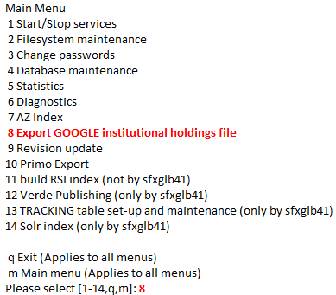

SFX: Google Scholar Export Setup
Scheduled via SFX server_admin_util
Schedule export to run by 10am ET Thursdays for Primo Central
Re-run, if desired, for Google Scholar
  Institute: Skip if institutes not used
  Use Compression: Select Y
Notes:
For exporting to Google Scholar & to Primo Central, they both use the same process in SFX server_admin_utility - #8 called Export GOOGLE Institutional holdings file. This process can be scheduled, and will most likely be set up for you during implementation.
We recommend that this export process is scheduled to run no later than Thursdays at 10am Eastern Time.
There’s a Primo Central Indexing job that will pick up your export file between Thursday/Friday and runs it over the weekend. So note that it will take a few days (typically around Tuesday of the following week) before you see any changes made in SFX reflected in Primo Central.
Google Scholar typically picks up the export files on Sunday nights, so the same file that is generated by Thursday 10am for Primo Central can also be used for Google Scholar. Or you can re-run the job on Sunday nights specifically for Google Scholar.
Again, this will typically be scheduled for you during implementation, but if you are running the job on your own from the server_admin_utility, you’ll be asked to select an Institute. Just skip this if you do not have institutes in SFX. You’ll also want to select “Yes” for the question about if you want to use compression.

Slide 35
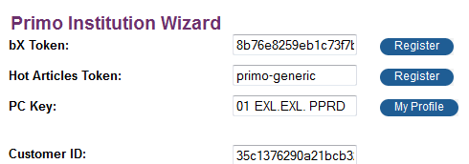
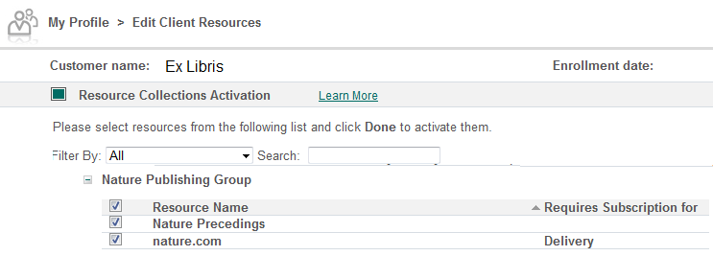
Primo: Primo Central Activations
Notes:
In terms of Primo Central set-up from the Primo Back Office, there’s a Primo Central profile where you would activate resources that you want to be searchable in Primo and update any activations as needed.
The Primo Central Indexing process that runs over the weekend looks at items you’ve activated in Primo Central, plus your institution’s holdings from the SFX export – and that determines availability in the Primo Results list. So the SFX export job determines the full text available/no full text available messaging in the Primo results.

Slide 36
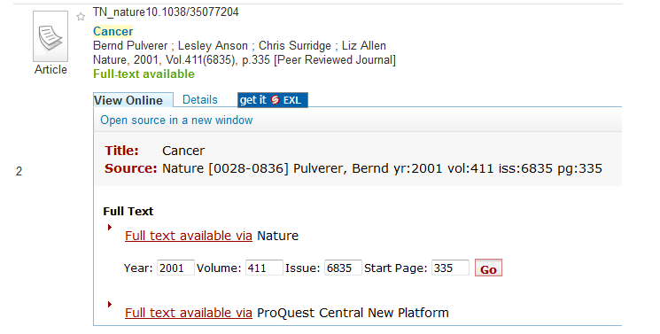
SFX/PrimoCentral/Primo Interoperability
Included in Search Results because a Primo Central Collection containing this citation is Active
Included because the listed Targets offering this title (Nature) are Active in SFX
Generated from the Google-Scholar-format holdings file exported from SFX
(updated weekly in Primo Central)
Notes:
Let’s look at how this all fits together using a result in Primo & where each piece comes into play in a Primo record. In this example, the user has been searching Primo Central.
1.) The fact there is a result displaying means the resource is activated in Primo Central. This refers back to the Primo Central activation we saw on the previous slide.
2.) The fact that full text links are available in the View Online tab means the target & full-text target service & object is activated in SFX. This refers back to SFX activations that we talked about in the SFX Resource Activation session.
3.) The Full-Text available message means the holdings file exists (with a positive holdings response), 2001 is inside the threshold/date coverage range, and the RSI indexing has run in the background. (This refers back to the Primo Central Indexing availability process)
This is one way you can troubleshoot – determining whether the issue might be SFX related or Primo Central related:
If a target isn’t displaying in the View Online or Get It tabs, it will most likely be SFX-related where a target, target service and object haven’t been activated or threshold information is incorrect.
If the full-text available messaging isn’t correct, it may be due to the SFX Google Scholar export process, which is the same process used to create the file for Primo Central, or perhaps the RSI indexing job hasn’t run.
If a citation isn’t displaying in the Primo Central search results, it’s possible that the resource or collection hasn’t been activated in the Primo Central Profile activation area.

Slide 37
Agenda
Introduction
SFX Linking via Primo
SFX2Primo Export
SFX4Primo Central
Troubleshooting
Summary & Additional Resources
Notes:
Our last topic is how to troubleshoot when things go wrong and what information the Support team will need to know when you log a case.

Slide 38

File Access & Firewall Issues
Include required Primo Central IP addresses in SFX file: get_file_restriction.config_
Re-link .config_ file to /sfxglb41 if not localized
If local server, add Primo Central IPs to server firewall
Notes:
For file access or firewall issues – for example, if Primo Central can’t get to the SFX server to pick up the file, if you can’t access the URL, or if Google Scholar can’t access the export file, check these things if you have access to the SFX server:
1. In SFX, the get_file_restriction.config file is where you set up your IP to use the URL.
Everything is restricted unless it’s added to this file. It adds permissions for (for example) Google Scholar see the file, etc.
2. If you’ve localized the get_file_restriction.config file, the symbolic link will be broken. If symbolic link is broken, and you don’t have any local IPs in that file, can just relink to the global instance. Instructions on how to relink the file to the global instance can be found in the SFX Advanced User Guide.
3. If you have a local server, make sure to add the Primo Central IPs to your server firewall. If you’re hosted on one of our servers, the Primo Central IPs should already be there.

Slide 39

Primo-SFX linking problems
Open case with detailed scenario for product:
  Primo or SFX
What went wrong?
  Short, clear title & description of problem
  Example: Link to Ebsco Academic Search Premier results in “document not found” error
How did it happen?
  Sequence of events in description field
Notes:
When you have linking problems, don’t hesitate to open a case for ExLibris support to address.
Do the best you can with which product the issue is with. If you’re seeing the problem in Primo, feel free to log it as a Primo case. It may not be a Primo issue, but we’ll re-assign it as needed.

Slide 40
Examples of Linking Problem Reports
I searched Primo for “candidate and party strategies.” Record # 1 was... {copy/paste the article citation from the Primo search results}
  Candidate and Party Strategies in Two-Stage Elections Beginning with a Primary. (Report)
  Adams, James ; Merrill, Samuel
  American Journal of Political Science, April, 2008, Vol.52(2), p.344(16)
I clicked {tab name} tab in Primo to access Full Text, then clicked on Ebsco Academic Search Premier link in SFX Menu. Copy/paste article citation from SFX search results. (Primo link and results helpful also.)
EBSCO displayed error: Provide a screenshot of the error in the Case (error message, vendor search box, if PDF for wrong article, etc.)
Notes:
Here are some examples of cases that have been logged for issues and the type of information the Support team would ideally like to have. You can’t give too much detail.
Know that some issues are a result of vendor practice, so the Primo Central Indexing team can request that vendor fix it. However, ExLibris may ask the customer to contact the vendor also - because as the paying customer, you may have a little more power. The Primo Central Indexing team will typically fix any OpenURL issues or can contact the vendor to correct any citation metadata.

Slide 41

Helpful Information for Support
Include in case:
Screenshots along with issue description
Proxy information for ExLibris Support access
One issue per case
Primo search term & result citation
URLs:
  SFX Menu URL, if possible
    Note: If using DirectLink [with Direct Link Banner] to bypass SFX Menu, find “Click Here for More Options” link at top of Direct Link Banner & right-click to copy URL address
  Primo URL
Notes:
In the interest of getting the issue resolved quicker, the following information is very helpful to Support…
Please don’t just describe what you see. Screenshots are very helpful – especially if Support can’t reproduce it because it can prove that you saw the error.
If you’re using proxy, please provide the Proxy information in the case so Ex Libris can access it. Our Support Portal, SalesForce, is a secure environment – so it’s more secure than sending email.
Please only include 1 issue per 1 case. If exactly the same thing is happening multiple times, you can put it in the same case, but it may in actuality be separate, different issues.
URLs are very helpful also. If SFX menu is opened in a separate window, can get the URL. If not sure how to get this, no worries.
Nice to have for all options. Most important is the Primo URL so we can get to it.

Slide 42
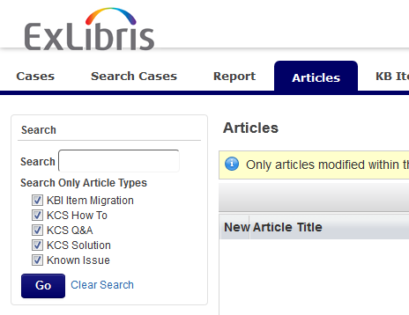
Access Support Portal
Access Support Portal from Customer Center: http://www.customercenter.exlibrisgroup.com
Directly via: http://support.exlibrisgroup.com
In Support Portal, click Articles tab to search for articles on a particular topic or issue
Notes:
To access the Support Portal, you can log into the Customer Center and access it from there, or log in directly to the Support Portal using the direct URL.
Keep in mind that in the Support Portal, you can search our KCS (Knowledge-Centered Support) database for articles that you may be able to use to resolve the issue. Also - as you are logging a case, there may be an article that’s recommended to you that may possibly help you resolve the issue so you don’t need to log a case.

Slide 43
Agenda
Introduction
SFX Linking via Primo
SFX2Primo Export
SFX4Primo Central
Troubleshooting
Summary & Additional Resources
Notes:
This brings us to the end of this session…

Slide 44

Summary
How to…
set up full-text linking between Primo & SFX
export active objects from SFX and harvest them into Primo
explain full-text availability in Primo Central
troubleshoot and report SFX/Primo issues
Notes:
In summary, in this session we…
reviewed the integrations and configurations for linking between Primo & SFX.
demonstrated how to export active objects from SFX and how they are harvested into Primo.
explained how full-text availability works for Primo Central.
provided options for troubleshooting and how to report SFX-Primo issues.

Slide 45

Additional Resources
Accessible from Documentation Center: http://www.customercenter.exlibrisgroup.com
Primo Interoperability Guide
  Harvest SFX data
  Configuring SFX and Primo
SFX System Administration Guide
  Export Google institutional holdings file
  Primo Export
SFX General Users Guide
  Google Scholar file format
Notes:
For more information on SFX and Primo interoperability, please feel free to refer to these documents:
The Primo Interoperability Guide can be found on the Ex Libris Documentation Center – under the Primo set of documents. It will have information about Configuring SFX and Primo, as well as Harvesting SFX data.
The SFX System Administration Guide can be found within the SFX set of documents on the Documentation Center. It will have information on the Export of the Google Scholar format - which is the same export used for Primo Central.
The SFX General Users guide has information on the Google Scholar file format.

Slide 46
Questions?
Share and discuss your own Primo/SFX experiences!
SFX Discussion List
SFX-DISCUSS-L@LISTSERV.ND.EDU
Information at:
http://el-una.org/mailing-lists/sfx-mailing-lists/
Primo Discussion List
PRIMO-DISCUSS-L@LISTSERV.ND.EDU
Information at:
http://el-una.org/mailing-lists/primo-mailing-lists/
EL Commons:
http://www.exlibrisgroup.org
Notes:
Lastly, feel free to share and discuss your own Primo and SFX experience using the listservs here, as well as using the EL Commons website.
Thanks for joining me!

