Slide 1
User Interface Configuration: SFX Menu
Notes:
Hello and welcome to this session on User Interface Configuration for the SFX Menu.
This presentation is copyrighted and is the confidential property of Ex Libris Ltd. Information included in this presentation is periodically reviewed and updated. You may shared these training materials within your institution but not beyond.

Slide 2
Copyright Statement
All of the information and material inclusive of text, images, logos, product names is either the property of, or used with permission by Ex Libris Ltd. The information may not be distributed, modified, displayed, reproduced – in whole or in part – without the prior written permission of Ex Libris Ltd.
TRADEMARKS Ex Libris, the Ex Libris logo, Aleph, Alma, SFX, SFXIT, MetaLib, DigiTool, Verde, Primo, Voyager, MetaSearch, MetaIndex and other Ex Libris products and services referenced herein are trademarks of Ex Libris, and may be registered in certain jurisdictions. All other product names, company names, marks and logos referenced may be trademarks of their respective owners.
DISCLAIMER The information contained in this document is compiled from various sources and provided on an "AS IS" basis for general information purposes only without any representations, conditions or warranties whether express or implied, including any implied warranties of satisfactory quality, completeness, accuracy or fitness for a particular purpose.
Ex Libris, its subsidiaries and related corporations ("Ex Libris Group") disclaim any and all liability for all use of this information, including losses, damages, claims or expenses any person may incur as a result of the use of this information, even if advised of the possibility of such loss or damage.
© Ex Libris Ltd., 2014

Slide 3
Agenda
SFX Menu
SFX Menu Customizations
Translation and Display
Summary & Additional Resources
Notes:
During this session, we’ll be focusing on the SFX Menu. I’ll be showing the possibilities for customization in the SFX menu and how to make those configuration changes. Then, we’ll take a look at where you can customize language and terminology that appear in the SFX menu.
As mentioned in the A-Z list configuration session, keep in mind that defaults are set for the customizations, and the best approach to user interface design is testing and seeing what needs to be changed to make the best possible experience for your users.

Slide 4

Objectives
How To…
Customize the SFX Menu
Implement translations & display customizations
Incorporate best practices
Notes:
After this presentation, you’ll know
where and how to customize the SFX Menu, and what customizations are available
where to customize the Translation and Language display for text label changes to the SFX menu
some best practices for UI customizations for the SFX menu.

Slide 5
Agenda
SFX Menu
SFX Menu Customizations
Translation and Display
Summary & Additional Resources
Notes:
So let’s take a look at the SFX menu itself.

Slide 6
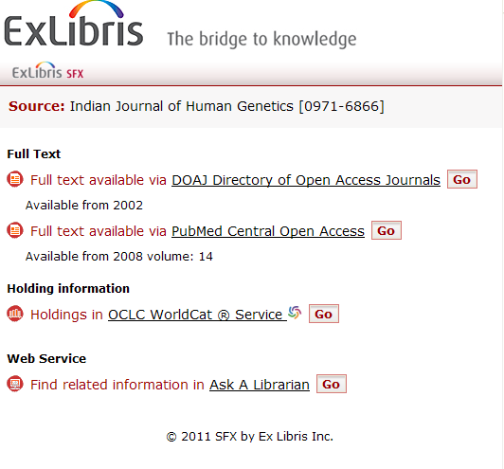
SFX Menu
http://hostname:port/instance?&rft_val_fmt=info....
SFX Base URL
Notes:
The URL for the SFX menu consists of your SFX Base URL, in addition to metadata from the OpenURL.
Note that the SFX menu won’t have anything displayed in it unless it has metadata from an OpenURL, which then allows the menu to show applicable targets and target services.
Because the SFX Menu is generally produced as a result of clicking on the SFX button in a source database, the content itself is going to vary quite a bit.
In terms of content, the Menu shows a summary of the object, then a list of basic and extended services that are available. It contains the names of targets and descriptions of different services. Note that targets with the same services can be grouped together. All of these items and the order in which they appear can be customized.

Slide 7
Agenda
SFX Menu
SFX Menu Customizations
Translation and Display
Summary & Additional Resources
Notes:
Let’s talk now about the kinds of customizations that are available, along with how to make configuration changes for the SFX menu.

Slide 8
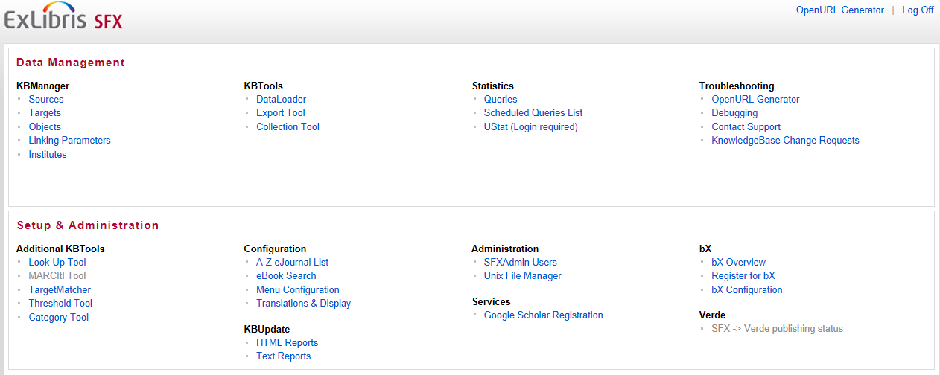
Admin Center: Configuration
Notes:
SFX Menu configuration can be accessed in the Admin Center in the Setup & Administration section, under Configuration.

Slide 9
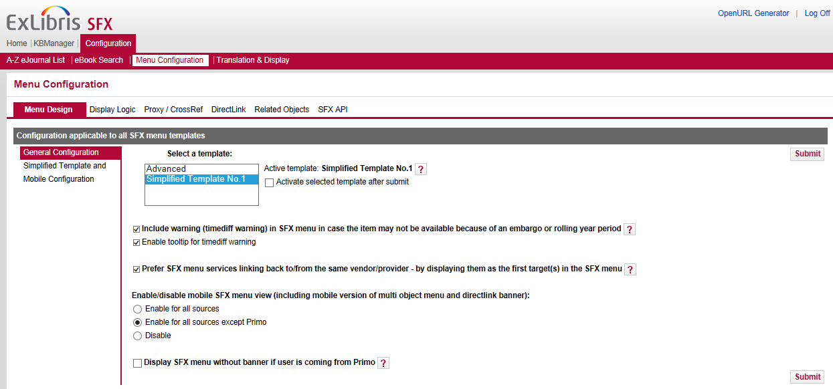
Menu Configuration: Menu Design
Notes:
The Menu Configuration area is organized a bit differently than the A-Z List configurations we saw in the A-Z list customization session.
[DEMO]
There are tabs that cover different areas – the menu design itself, Display Logic, Proxy and CrossRef configurations, DirectLink, Related Objects, and SFX API for other settings.
Let’s start with the Menu Design. There are two templates here – Advanced and the Simplified Template No. 1.
You would select the template you want to use for the SFX menu in the list box, select the “Activate selected template after submit” checkbox to confirm your choice and then click the Submit button.
Let’s talk about the differences between the 2 templates:
The advanced template has all of the possible configuration options available, but the configurations and translations are made directly in the HTML template files and UNIX configuration files. The SFX Advanced User’s Guide has more information on the advanced menu template.
For today, we’re going to be focusing on the Simplified template. All configuration and language changes for the SFX menu can easily be made in the SFX Admin Center using this simplified template. Note that most changes (unless noted) made in the simplified template will apply to the SFX Menu as well as the SFX mobile menu interface.
We’ll cover the other options available on this tab in a few minutes.

Slide 10
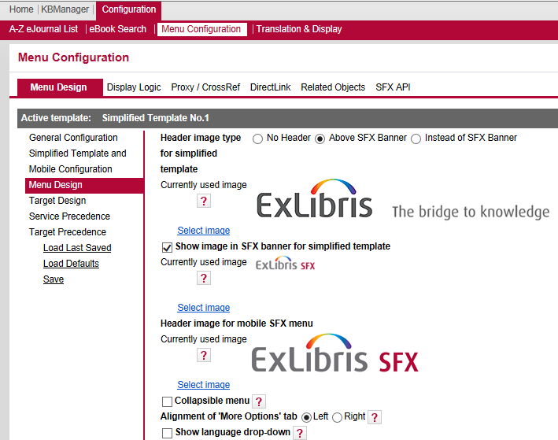
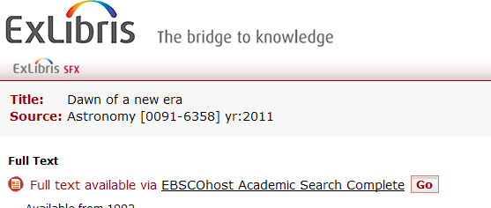

Menu Configuration: Menu Design
Notes:
The Menu design area is where you can control the header and banner images, determine whether or not you want to use the collapsible menu, the alignment of the more options tab, and whether or not you want to show the language dropdown.
Let’s take a look at the images first. Notice there is a header image and a banner image that can be used in the SFX menu. Each of these are optional, and you can upload your image of choice – perhaps your institution’s logo. Notice that you can also choose a header image that can appear in the SFX menu mobile interface. The Header, in this example, is our large Ex Libris logo, and we’re using the smaller SFX logo in the banner.
You can also choose to have no header, or have it replace the banner area. Uploading images is very straightforward – you click on the select image link, and it will walk you through uploading the image you want to use. Note also that if there is a question mark icon, you can mouse-over the question mark to get more details about the configuration.
(click) In the SFX Menu, these two images are going to appear at the top of the menu. The header is the first image.
The banner area is just below the header; note that the banner includes the short summary, and it can also include the language options as we’ll see in a moment.
We recommend that the header image be no wider than 455-700 px, and though there isn’t a restriction on how tall the image is, keep in mind that the SFX menu will be in a pop-up window or embedded in another application, like Primo, so screen real estate may be of concern.

Slide 11
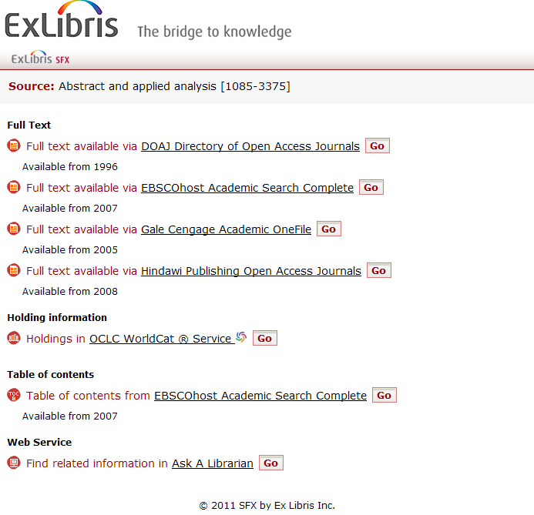
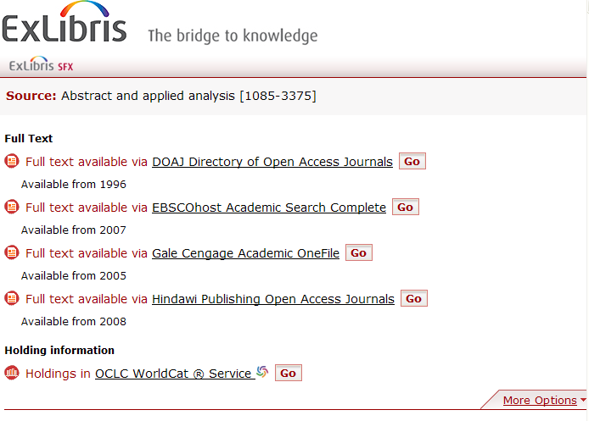
Menu Configuration: Menu Design
Collapsible Menu Unchecked
Collapsible Menu Checked
Notes:
It’s also possible to have a collapsed menu, showing only the basic services in the menu (what you feel are the most important services to display to users), and then have a more options tab, which when clicked will display the other services that are available in addition to the basic services – so basically all services will display when the More options tab is clicked. If you decide that you want the menu collapsed, you can also choose which side you want the more options tab to appear on.
When the collapsible menu box is not checked, we can see all of the services available (click). Notice that the full text links are listed first, then the holdings information, table of contents, and web services. If there was a target that provided abstract information, it would be below the full text as well. Now if I had checked the ‘collapsible menu’ checkbox, the menu would look like this (click). Now there’s only full text and holdings information viewable – the user could click on the More Options to see the rest.

Slide 12
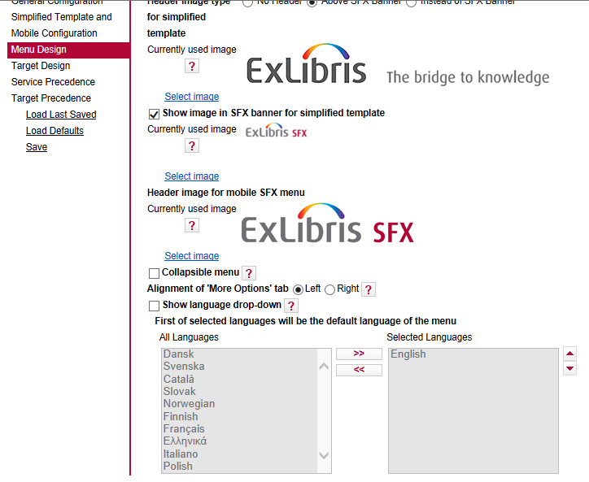
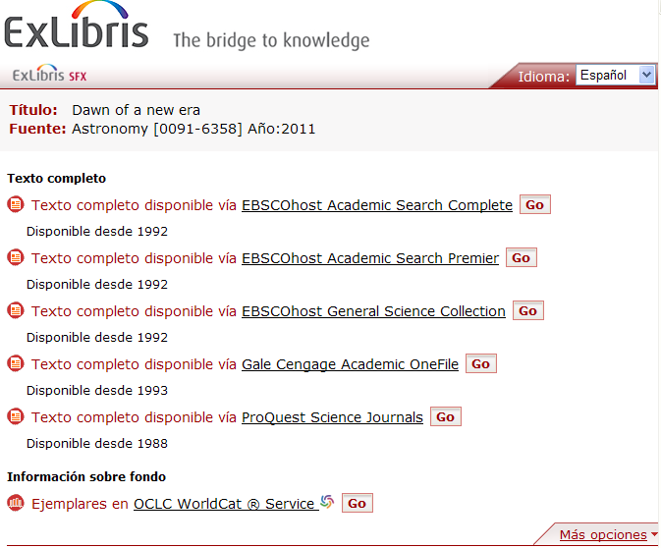
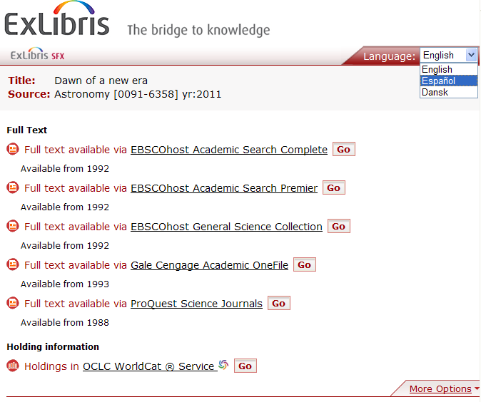
Menu Configuration: Menu Design
Notes:
Like the A-Z List, you can show a language dropdown, and you can choose the languages you’d like to appear in the dropdown. (click)
Also like the A-Z list, if you select a different language (click), the labels in the menu are translated, but the information that comes from the KnowledgeBase (such as journal titles) remains the same.

Slide 13
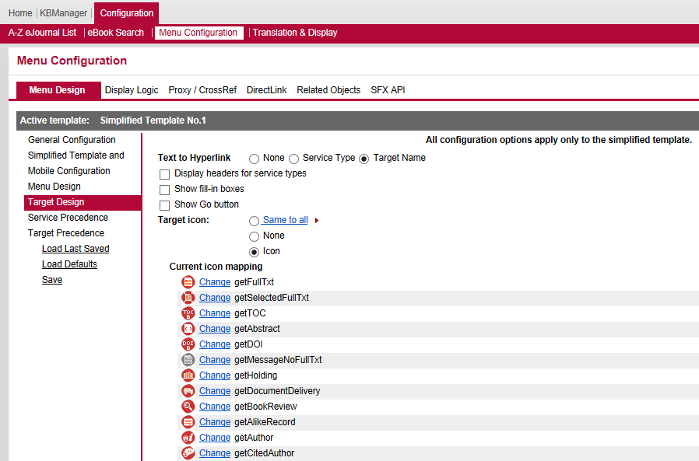
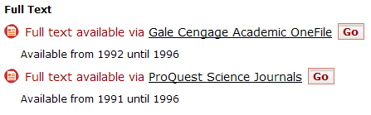
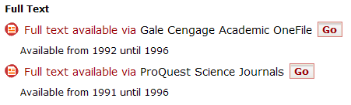
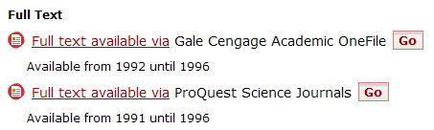
Menu Configuration: Target Design
Target Name
None
Service Name
Notes:
Let’s go on to the Target Design area.
The first option in the Target Design is where you want to place the hyperlink.
(click) By default, the target name links to the full text in this example.
(click) If you chose to have no linked text, it would look like this. The user could still get to the full text using the ‘Go’ button.
(click) And lastly, this is what it would look like if you decided to use the service name to link to the full text.

Slide 14
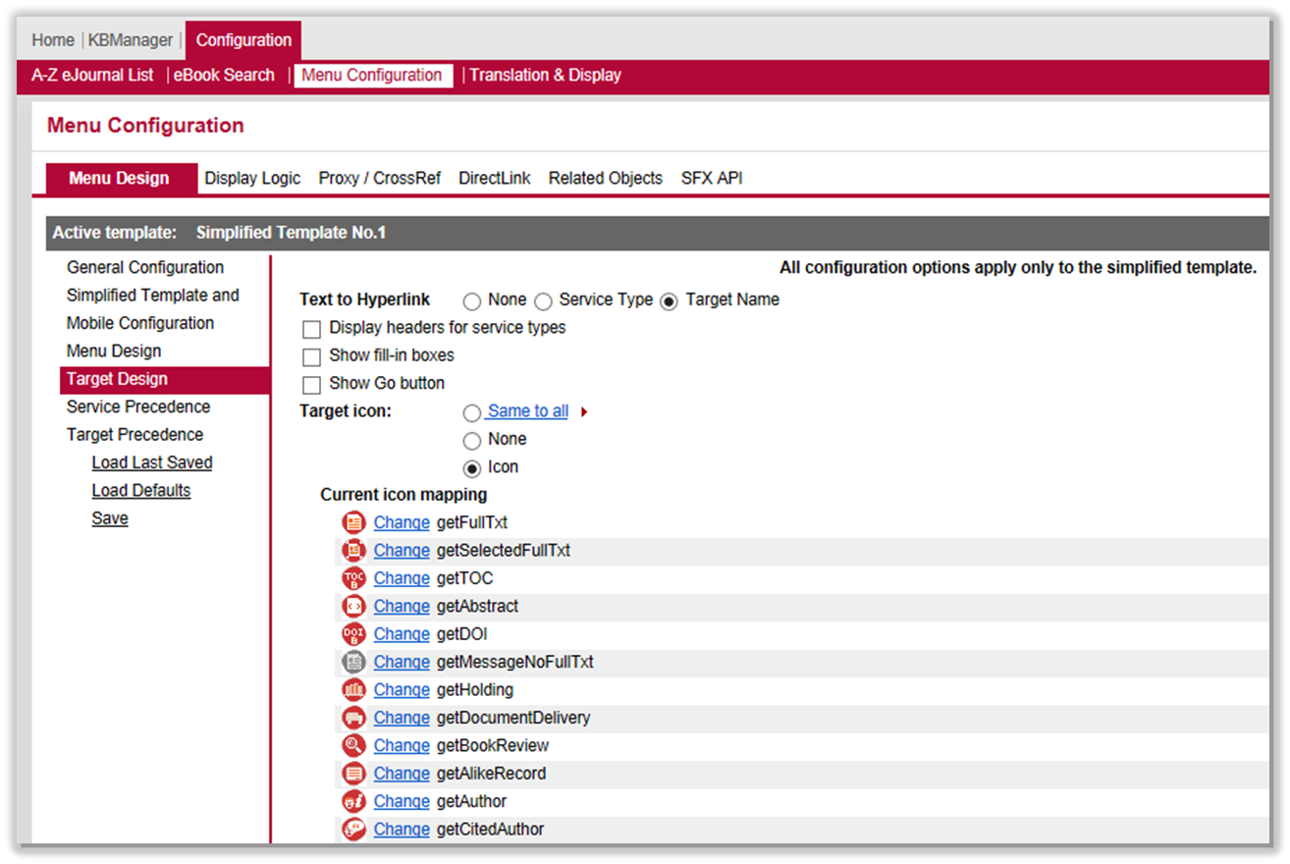
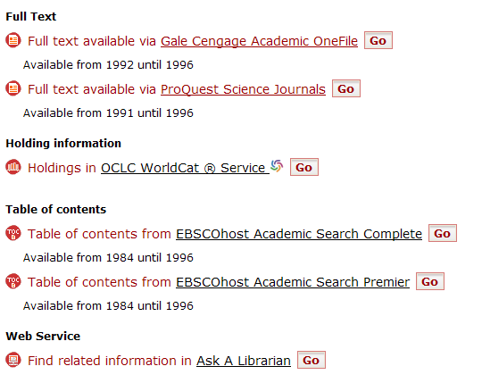
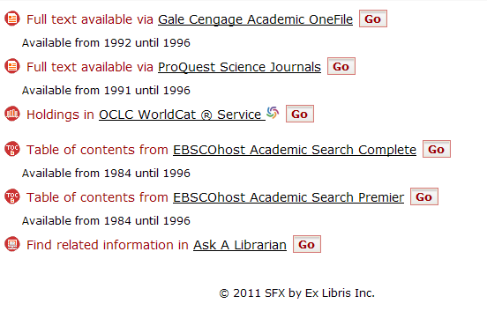
Menu Configuration: Target Design
Display Headers Checked
Display Headers Unchecked
Notes:
The next option is to display or hide the headers.
If the Display headers check box is selected (click), then you’ll see section headers appear in the SFX menu for each type of service.
If the Display headers check box is not selected (click), then you will not see any section headers, but targets will still be grouped together. Notice in this example that full-text targets are listed together, and table of contents targets are listed together, but there are no section headers displayed.

Slide 15
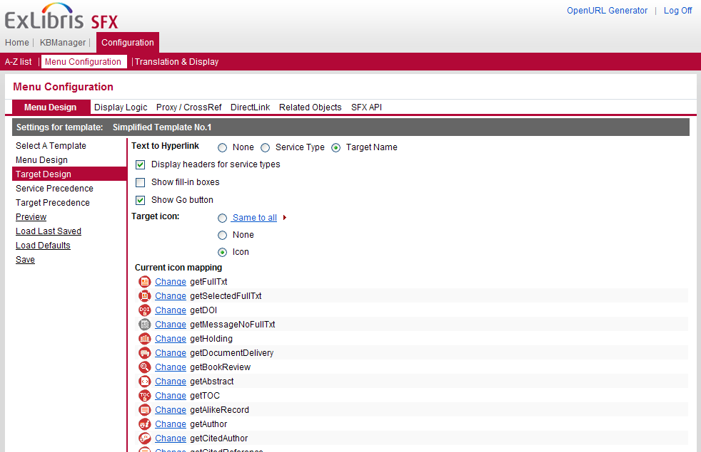
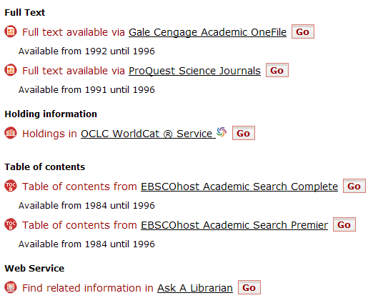
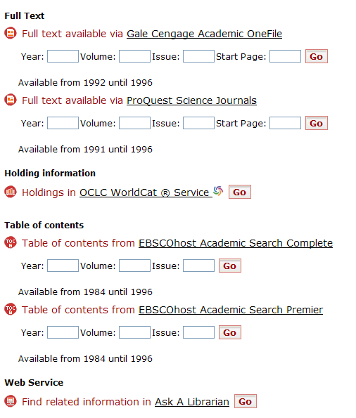
Menu Configuration: Target Design
Show Fill Boxes Unchecked
Show Fill Boxes Checked
Notes:
The ‘Show Fill-in Boxes’ option allows the user to input their own year, volume, issue, and start page information into the menu.
(click) Here’s the Menu with the box unchecked, so we don’t see them,
(click) and with the box checked

Slide 16
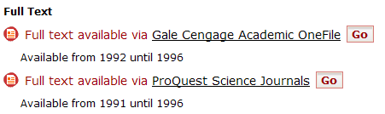
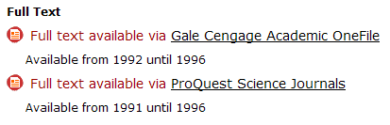
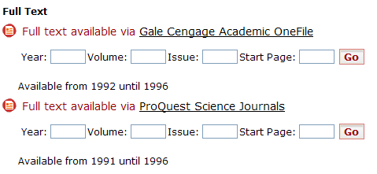
Menu Configuration: Target Design
Show Go button checked
Show Go Button Unchecked
Keep the Go Button
if you decide to
show the fill-in boxes!
Notes:
The ‘Show Go button’ – if you decide that you don’t want to show the go button, that’s possible too.
(click) Here’s what it looks like checked,
(click) and unchecked. Obviously if you decided not to make any of the text hyperlinked, you’d want to keep the go button.
(click) Another thing to keep in mind is that if you decide to show the fill-in boxes, you’ll also want to keep the Go button. Otherwise it’s not clear how to submit the changed year/volume/issue information. It’s possible (you can hit enter while your cursor is in one of the text boxes), but it’s really not that intuitive.

Slide 17
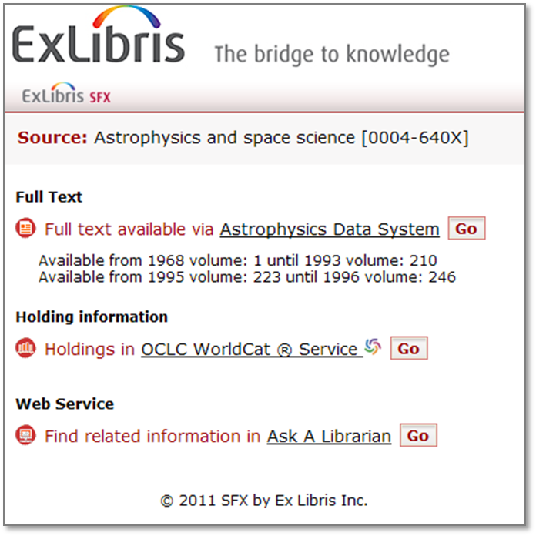
Menu Configuration: Target Design
Notes:
It’s also possible to customize the icons that appear next to each link in the menu. (click) You can choose to make them all the same, remove them completely, or customize individual icons and upload them. You could also choose to reassign the icons.

Slide 18
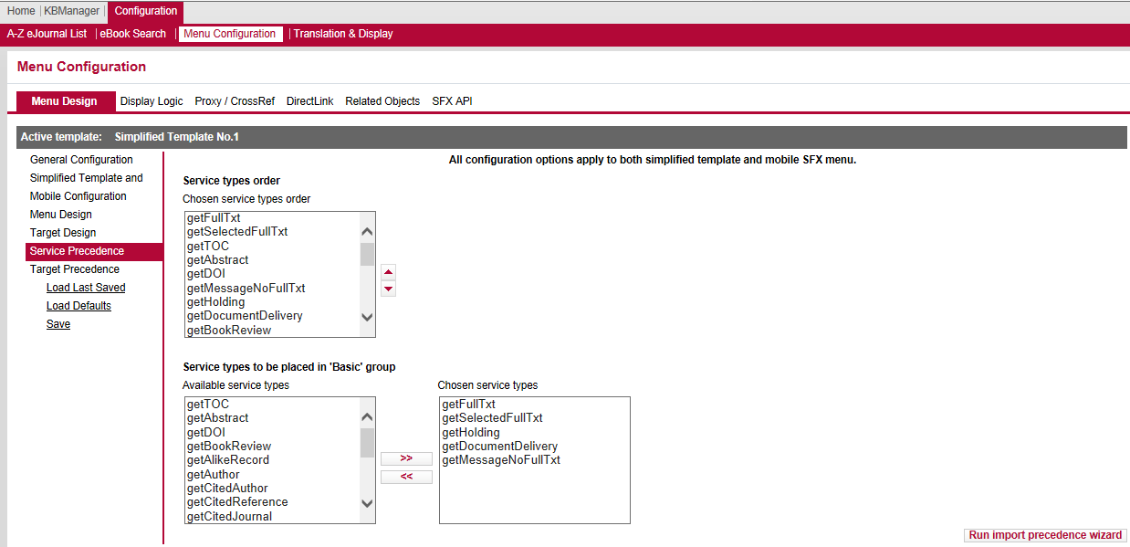
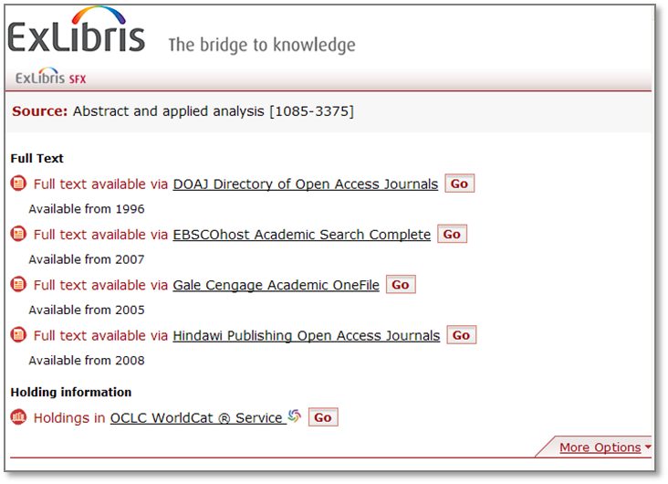
Menu Configuration: Service Precedence
Notes:
That covers many of the design elements available in the SFX menu. Now let’s talk about service precedence.
Basically, it’s possible to control the order of the services that we see in the menu, in order of priority. We can also decide what should be included in the basic services that we talked about with using a collapsible menu.
(click) In my example, I’ve chosen make getFullTxt the top service – so any full-text services will appear first in the SFX menu if full-text is available, then any getselectedfulltxt services if applicable, etc.
I’ve also defined the basic group to include full text, selected full text, holdings, document delivery, and if applicable, a message if there’s no full text. Remember that this configuration is going to be important if you decide to have the collapsible menu.
If you have previously used the advanced SFX menu template to define service precedence, then clicking on the Run import precedence wizard button will import that current configuration for service precedence into this screen.

Slide 19
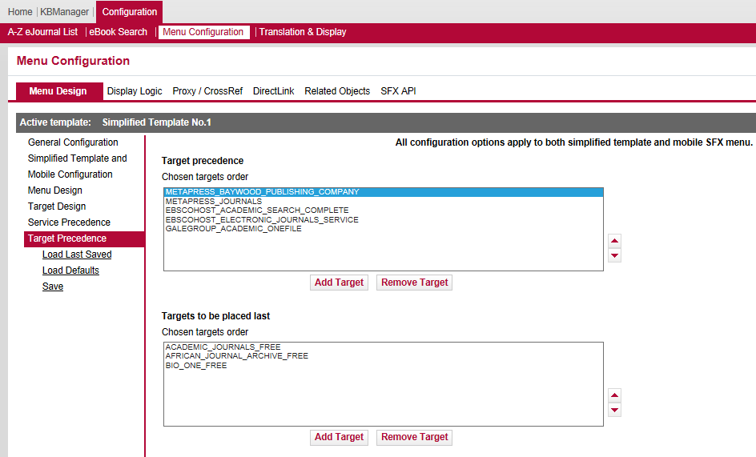
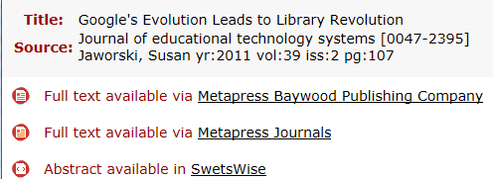
Menu Configuration: Target Precedence
Notes:
In a similar way, you can also define the target precedence. By default, they’re going to display in alphabetical order. In reality, most likely your users are going to use the first link in the list.
So for example, if you have full text available from Metapress Baywood Publishing Company and Metapress Journal, they’re going to be using the Metapress Baywood Publishing Company full text link first. Remember this when you’re running usage statistics.
If you wanted to showcase your subscription resources first, you could opt to put all of your free targets in the ‘Targets to be placed last’ section.

Slide 20
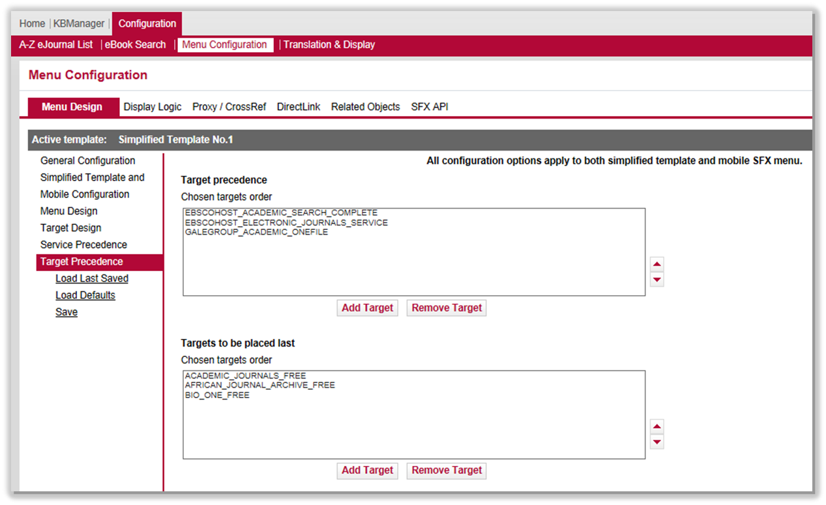
Menu Configuration: Save Changes
Notes:
Once you’ve made any changes in the Menu Design area, you can save them by clicking on Save in the left menu.
Notice you also have the option to load the defaults, and load your last saved changes.

Slide 21
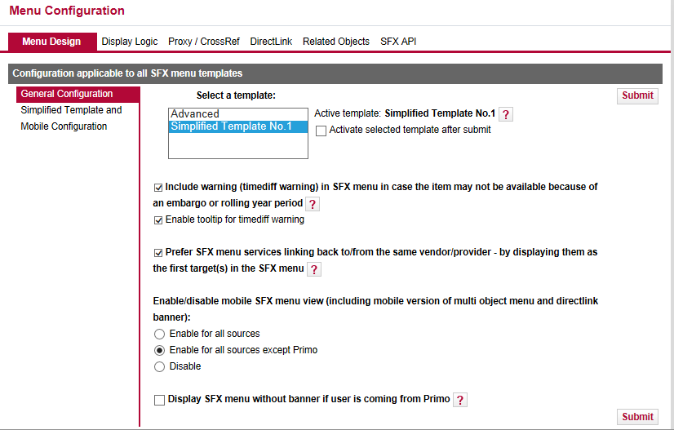
Menu Configuration: Other Settings
Notes:
Before we leave the Menu Design tab, let’s look at the other options that are available from the General Configuration area.
This tab allows you to configure several things – and by default a couple of these options are turned on:
You can decide whether you want to give users a warning in the SFX menu if the item may not be available because of embargos or a rolling year period.
If the source for an article (for example, the publisher who originally published the article) is also an active target, you can have that target display first in the SFX menu. The idea is that that target will probably be the best target to use because the article originated there.
You are also able to enable or disable the mobile user interface SFX menu. We talked briefly about the Mobile user interface in the A-Z List user interface configuration session. Note that if the SFX menu mobile interface is disabled, the A-Z list mobile interface is still enabled.
Lastly, you’re able to decide if you want to turn off the SFX banner in the SFX menu if the user is in Primo and views the SFX menu. Only target services will be shown in the SFX menu from Primo if this option is selected.

Slide 22
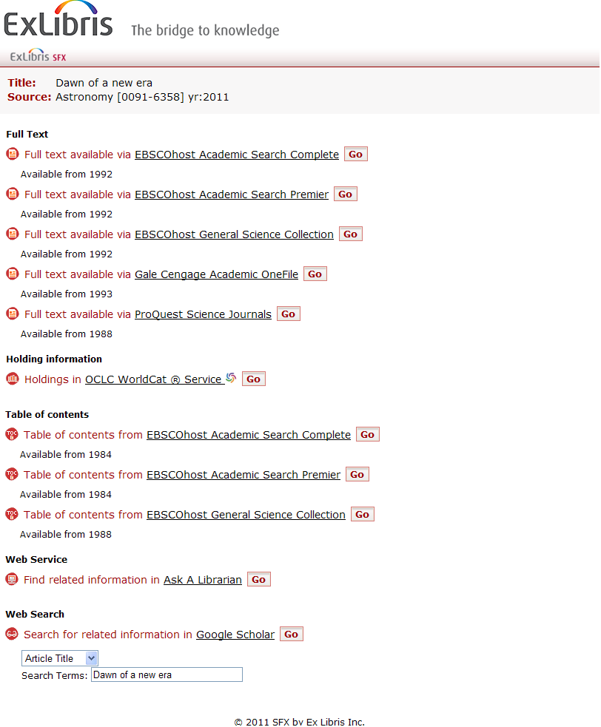
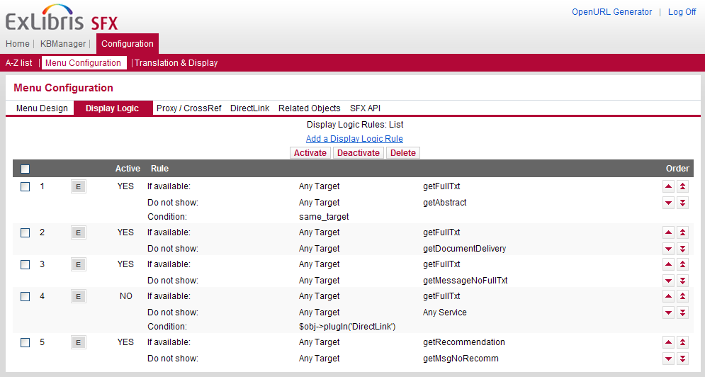
Menu Configuration: Display Logic
Notes:
Display logic – here’s a fun one to play with.
You may have noticed earlier in some of the examples I gave that the full text was available through multiple targets, or full text and TOC information was available in the same menu. Well, you may not want to give all of those options to your users – you really want a nice clean menu without a lot of extraneous information in it.
Here’s a great example. (click)
We can see here that the full text is available from three EBSCO databases, not to mention that it’s also available from two other vendors, Gale and ProQuest. The table of contents is also available for this article, again, from three EBSCO databases. You may decide that you really just want to display a full text link from each vendor, and you want to suppress the Table of Contents services in this case, because you’re already providing links to the full text.
Now, it's possible to shut one or more of these services off or inactivate the services, but you may not want to do that - because it could be that with another article the full text isn't available, and you'd want to make sure that at least you gave your users the option to get to the Table of Contents.
So Display Logic allows you to think about conditions you want to apply to the services that are displayed. (click)
Some of the default rules here can help you do just that. This first rule, which I have active already, is saying that if the full text is available from a target, don't show the abstract. There's a condition - if I'm getting the full text from a target, I only want to suppress the abstract from the same target. The next rule states that if full text is available, I want to suppress document delivery.
And so on - you can actually get very specific with these logic rules, and this will help you create a clutter-free SFX Menu.

Slide 23
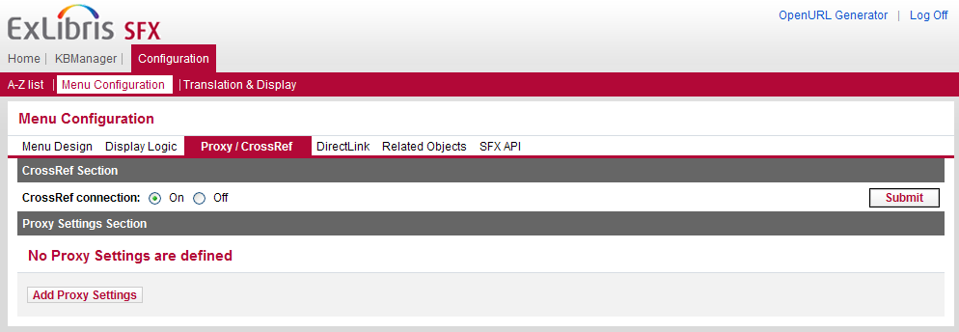
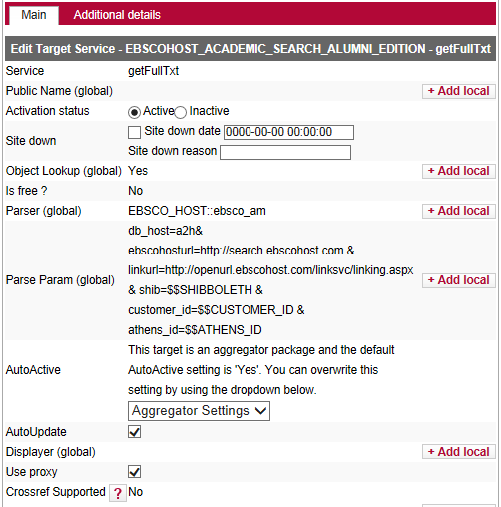
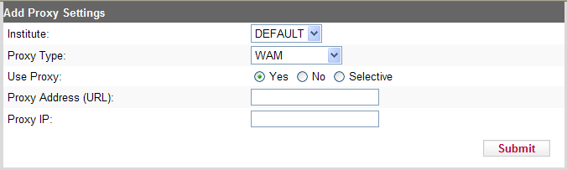
Menu Configuration: Proxy
Notes:
Proxy and CrossRef – In this area, you can enter and configure your Proxy details and enable CrossRef. Let’s talk about your proxy first.
When creating target URLs, SFX can direct end users to go through your proxy server. The proxy server determines the IP address of the user and checks to see whether the user on campus or off campus. If the user is on campus, they go straight to the to the target. If the user is off campus, they’re asked to log into the proxy server. The proxy then goes out to the databases to get the web pages and send them back to the user. Since your proxy is on the library’s network, the database vendors recognize the IP address as belonging to your institution.
SFX supports EZProxy, Innovative WAM, LIBPROXY, and WEB_PROXY.
You’d set up your proxy to work here. When I click on ‘Add Proxy Settings, I get a pop-up window (click). If I’m in a consortium, I select my institute – in this case, I’m just going to use the default. I select my proxy type, then decide when I want to invoke the proxy. If I select Yes, my proxy will be used for all targets. If I select No, the proxy won’t be used for any targets. If I choose ‘selective’, I can control whether or not I want to use the proxy at the target level. (click) The Selective option is handy if you find that your having technical issues with a particular database, or if you have a lot of free targets active – there’s no need to proxy a free target, and you can save your proxy server some traffic.

Slide 24
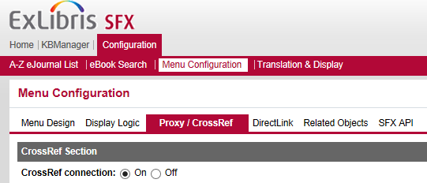
Menu Configuration: CrossRef
CrossRef: Official DOI registration agency for scholarly and professional publications
http://www.crossref.org/
DOI (Digital Object Identifier) example:
10.1103/PhysRevE.62.1457
Notes:
For CrossRef, see just a radio button choice here, asking you if you want enable the CrossRef connection or not. By default, it’s on.
To give you a little background, CrossRef is the official DOI registration agency for scholarly and professional publications – DOI stands for Digital Object Identifier – it’s a standard identifier for articles and other digital objects that allows you to link directly to them based on the DOI itself. Using the DOI example here, the 10.1103 typically represents the publisher. The other information seen in the DOI represents title of the journal, the volume and the page number.
During your implementation, you’ll be asked to register with CrossRef as a library affiliate. You'll need to add your CrossRef affiliate user name and password to a configuration file on the server. The Advanced Users Guide provides more detailed instructions, but this is something that we’re most likely setting up for you during implementation.
There are a number of reasons why we ask you to register with CrossRef…

Slide 25
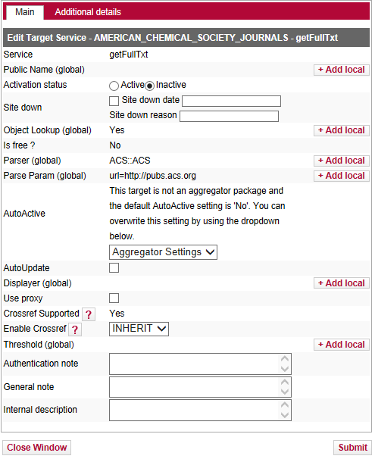
Menu Configuration: CrossRef
Enables article level linking
if target requires a DOI, SFX can reach out to CrossRef to retrieve the DOI
Enhances SFX services
if source sends DOI through the OpenURL, SFX can reach out to CrossRef to retrieve other metadata about the article
Ensures CrossRefs/DOIs link to appropriate copy
provides other alternatives to access full-text
Notes:
The first reason why we ask you to register with CrossRef is to enable article-level linking. Also during your implementation, you’ll probably be activating the DOI target - when the SFX server receives a DOI, DOI linking can be provided. In other cases SFX targets may require a DOI to create an article level link. However, the SFX source doesn't always send the DOI as metadata in the OpenURL. When it's not there, SFX can retrieve the DOI from the CrossRef database.
The targets that use DOI Linking contain a field called 'CrossRef Supported with a 'yes' value in the View and Edit windows of the target service – you may remember this from the Activating Resources session.
(click) Another reason to register with CrossRef is that sometimes an SFX source sends a DOI through the OpenURL, but doesn't send any other metadata. SFX can use the CrossRef database to augment the OpenURL so that the targets will have more information to work with.
(click) And lastly, CrossRef can ensure that your users are linking to the appropriate copy: By default, when your users click on a CrossRef or DOI link in a source, they're going to be linked to the full text at the publisher's Web site. However, this may not be the link you want - for example, you may host the journal locally, or subscribe to the journal through an aggregator. As a CrossRef library affiliate, you can ensure that when your users click on a CrossRef or DOI link, they're going to go to your SFX server, and not directly to the publisher’s site.
So that’s an awful lot of information surrounding this one little radio button!

Slide 26
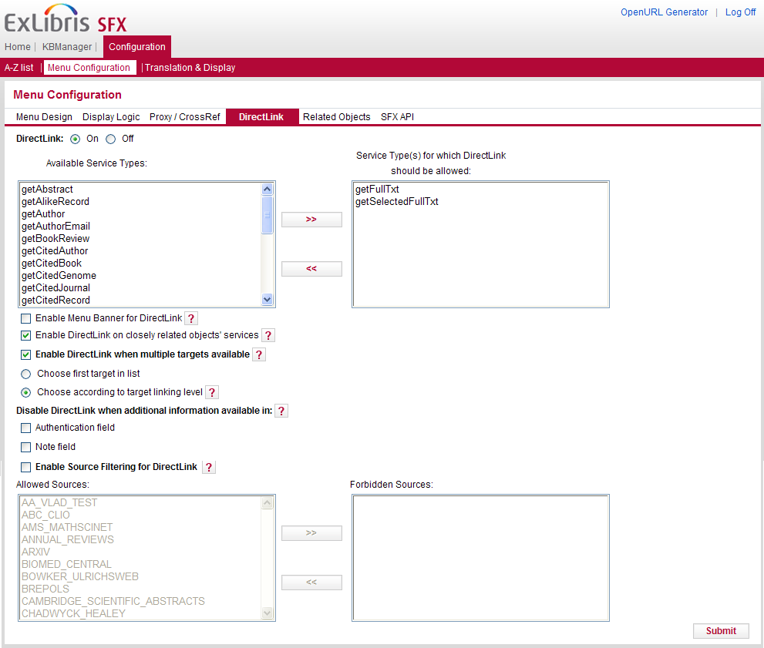
Menu Configuration: DirectLink
Notes:
Our next menu configuration option is DirectLink. In short, when DirectLink is enabled, the user can click on the SFX button in the source system and be passed directly to the full text, bypassing the SFX Menu completely.
There are several decisions you’ll need to make if you decide to enable directlink. You’ll notice in this screen, I have Directlink On. If it was set to off, all of these options would be grayed out.
Let’s assume for the moment that we want to use DirectLink. In the top portion, you can choose which services you want to direct link – I have getFulltext and getSelectedFulltext here. This means that if only an abstract or table of contents is available, I’m still going to get the SFX menu.
You can opt to keep the SFX banner at the top when you go to the source, and use the direct link services for related objects.
In the event that the full text is available from more than one target, you can choose which target you want users to link directly to. If you decide to enable direct linking when multiple full-text targets are available, you have an option to display the full-text from the first target that would display in the list (this will take into account target precedence if you have that configured) - or you can choose to have the full-text display from a target according to linking level priority. You may remember linking levels from the Activating Resources session, but in brief, if this option is selected, a target that is able to link to the article-level will be used over a target that can only link to the volume or journal-level.
You can also choose to disable directlink under certain circumstances – for example, if you’ve entered a note in the Authentication or Note fields for the target perhaps you want the user to see the SFX menu rather than have them link directly to full text,
Lastly, you can restrict certain sources from direct linking when the user clicks on the SFX button in those sources.

Slide 27
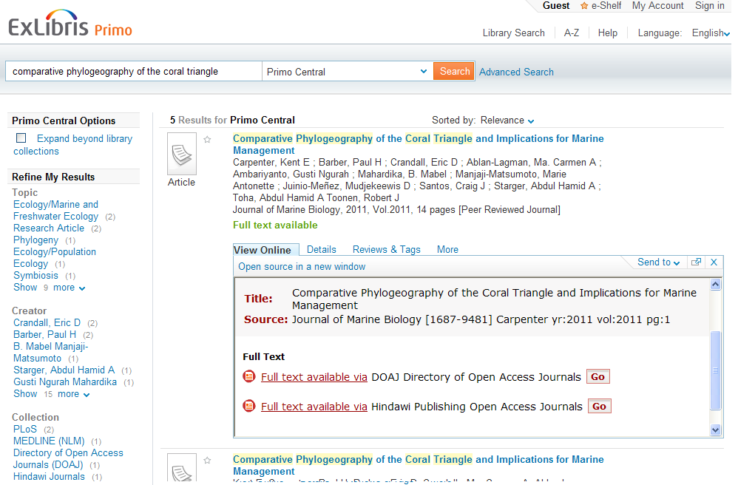

Menu Configuration: DirectLink OFF
Notes:
To show you the difference between DirectLink turned on vs. off, let’s use an example of Primo as a source where the user starts his/her search.
With DirectLink off, when the user clicks on the View Online tab in Primo – or if they click on the SFX button in other sources - they will always see the SFX Menu as an intermediate step between the source and the target databases. Generally speaking, with DirectLink off, the user will have the ability to choose which target they want to use, or take advantage of any additional services shown in the menu.

Slide 28
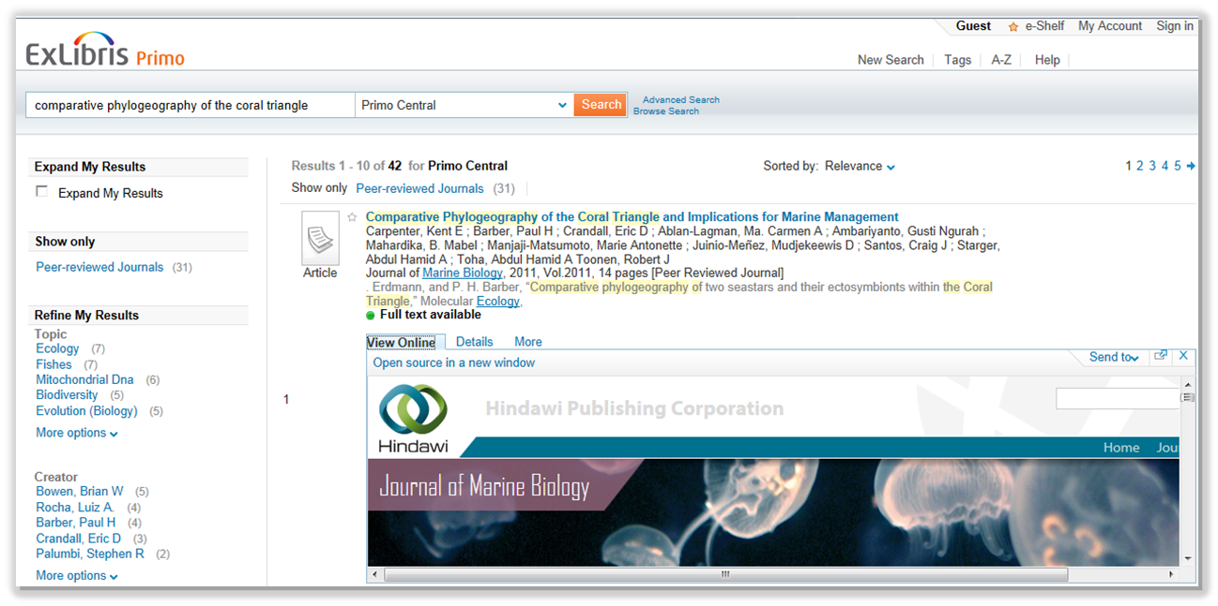
Menu Configuration: DirectLink ON
DirectLink bypasses the SFX menu, and takes the user directly to article full-text
Notes:
However, with DirectLink on, the user will be taken directly to full-text when they click on the SFX button in the source (or in Primo, the View Online tab.) They will not see the SFX menu when full text is available.
With DirectLink on, the user no longer need to make an extra decision and an extra click, and they’re brought directly to the full text – bypassing the SFX menu.

Slide 29
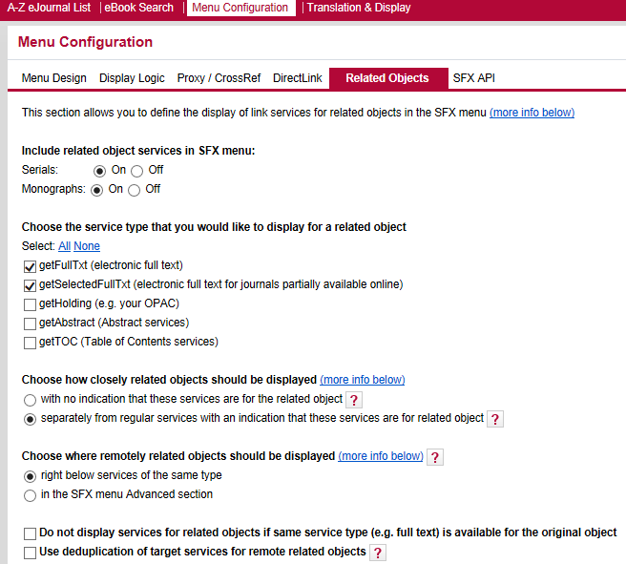
Menu Configuration: Related Objects
Notes:
The last two tabs here I’m just going to sum up very briefly – the Related Objects tab relates to how you want to display related journals and books in the SFX menu. More information on related objects can be found by scrolling down to the bottom of the screen.

Slide 30
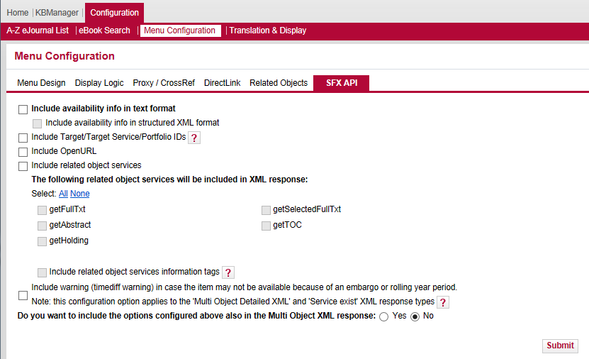
Menu Configuration: SFX API
Notes:
The SFX API tab has to do with writing APIs for SFX.
For information concerning the SFX API tab, please see the EL Commons Web site. I’ll give you the URL for EL Commons in the Additional Resources slide.

Slide 31

SFX Menu Configuration: Best Practices
Defaults are good
Keep it simple
Will affect usage
Therefore, will affect usage statistics
Notes:
When you start thinking about how to customize the SFX Menu, remember that in general, (click) defaults are good! Start from there, and as you start testing and becoming more familiar with SFX, you’re going to start to notice things you want to change.
(click) Next, remember to keep it simple. You want to make sure your users know exactly what they need to click on to get to the full text, holdings information, or document delivery. But you don’t want to necessarily hide options that are going to be useful to your users.
(click) Remember also that the choices you make in regard to target and service precedence, display logic and direct linking are going to affect how your users gain access to your electronic resources. (click) Therefore, they’re going to affect your usage statistics. An example is if you’ve implemented target precedence. Users may have a tendency to click on the first link they see in the SFX menu, so that first target and service that displays may get a lot of use which you’ll notice in your usage statistics.

Slide 32
Agenda
SFX Menu
SFX Menu Customizations
Translation and Display
Summary & Additional Resources
Notes:
We’re nearing the end of the presentation, but before we end, I would like to briefly show you the Translation & Display area of the SFX Admin Center, which is where you can change text labels and translations for fields that display in the SFX menu.

Slide 33
Admin Center: Configuration
Notes:
The Translation and Display area is in the Configuration section of the SFX Admin Center. It’s the same area we looked at in the A-Z list configuration session, but this time we’ll focus on where to make changes for the SFX menu.

Slide 34
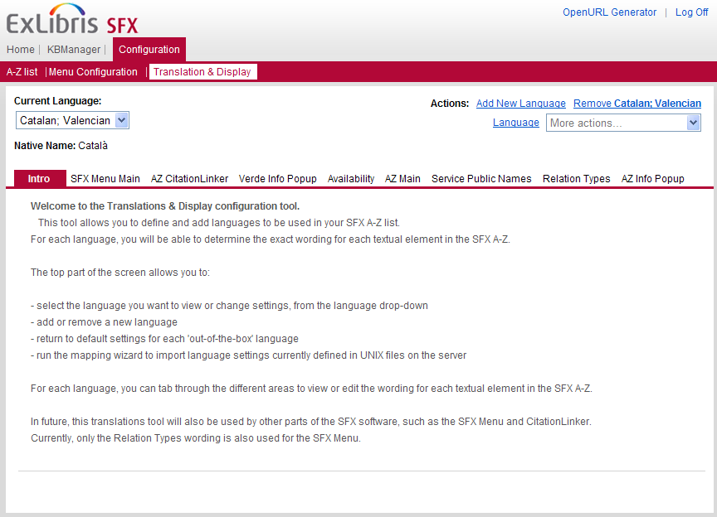
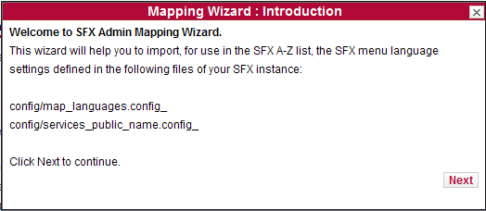
Translations and Display
Notes:
Just as a refresher, the Translation and Display area allows you to customize the wording for all text elements that are used in your SFX A-Z list and the SFX Menu. This can apply to one or more of the languages that you want to make available to your users.
This tool allows you to change all text elements in the language of your choice, return to the default settings, add or remove a language, and run the mapping wizard to import existing configurations. The areas that pertain to the SFX menu are outlined here.
(click) The first time you access this tool, the SFX Admin mapping wizard appears. This wizard will import your existing menu language settings as defined in the configuration files on the server.

Slide 35
Agenda
SFX Menu
SFX Menu Customizations
Translation and Display
Summary & Additional Resources
Notes:
This brings us to the end of this session.

Slide 36
Summary
How To…
Customize the SFX Menu
Implement translations & display customizations
Incorporate best practices
Notes:
To summarize, we talked about:
SFX menu customization possibilities and how to make configuration changes for the SFX Menu
where to customize the translation and language display for text labels in the SFX menu
some best practices for UI customizations

Slide 37

Additional Resources
Accessible from Documentation Center:
(http://www.customercenter.exlibrisgroup.com/)
General User’s Guide
Advanced User’s Guide
EL Commons Website
http://www.exlibrisgroup.org
Notes:
Here’s a list of documents that will provide more information on SFX menu configurations. These can all be found in the Ex Libris Documentation Center.
The General User’s Guide will have more details on the SFX menu customizations we talked about in this session.
The Advanced User’s Guide will have information on making SFX menu customization changes on the server using the Advanced SFX Menu template
Additionally, the EL Commons website is where customers can share APIs and other information.
Thanks for watching!

