Slide 1
Introduction to Voyager 9
Notes:
Welcome to our session: Introduction to Voyager 9

Slide 2
Copyright Statement and Disclaimer
All of the information and material, including text, images, logos and product names, is either the property of, or used with permission by, Ex Libris (USA), Inc. The information may not be distributed, modified, displayed or reproduced – in whole or in part – without the prior written permission of Ex Libris (USA), Inc.
TRADEMARKS Ex Libris, the Ex Libris logo, Aleph, SFX, MarcIT, MetaLib, DigiTool, Verde, Primo, Voyager, MetaSearch, MetaIndex and other Ex Libris products and services referenced herein are trademarks of Ex Libris, and may be registered in certain jurisdictions. All other product names, company names, marks and logos referenced may be trademarks of their respective owners.
DISCLAIMER The information contained in this document is provided on an "AS IS" basis for general information purposes only without any representations or warranties, whether express or implied, including any implied warranties of satisfactory quality, completeness, accuracy or fitness for a particular purpose.
Ex Libris, and its subsidiaries and related corporations disclaim any and all liability for use of this information, even if advised of the possibility that loss, damage or expenses may arise.
© Ex Libris, Inc., 2014

Slide 3




Agenda
Batch Update features
Circulation
Primo / OPAC
Cataloging
Acquisitions
Other
Notes:
“Big Bang” project in Voyager 9
Enrich batch update features
Additional highlights in this release:
Improve service to users
Fulfill customer requests
Increase support for standards
Enhance stability and system performance
Release announced 18 March 2014

Slide 4
Agenda
Batch Update features
Bulk Import
Pick and Scan
GDC
Circulation
Primo / OPAC
Cataloging
Acquisitions
Other

Slide 5
Bulk Import Enhancements in v9
Bulk Import
Option to NOT create an 035 tag upon import
Option to check for 035 upon import/replace
New –C parameter (note case)
Says to check for 035 and if one is found, do not create a new one
Change Default Setting to –X NOKEY
Keyword indexes off by default for imports
Use –K ADDKEY now to index, instead of –X NOKEY
Applies to command-line imports and when using WebAdmin (also default in GDC)

Slide 6


Introducing Voyager Pick & Scan 2.0
Pick and Scan
More update/delete options
Options to delete empty holdings and bibs
Input by Item Barcode, Item ID, MFHD ID, or Bib ID
Ability to change related records
Preview changes
New logging options
Manage logs via the clients

Slide 7
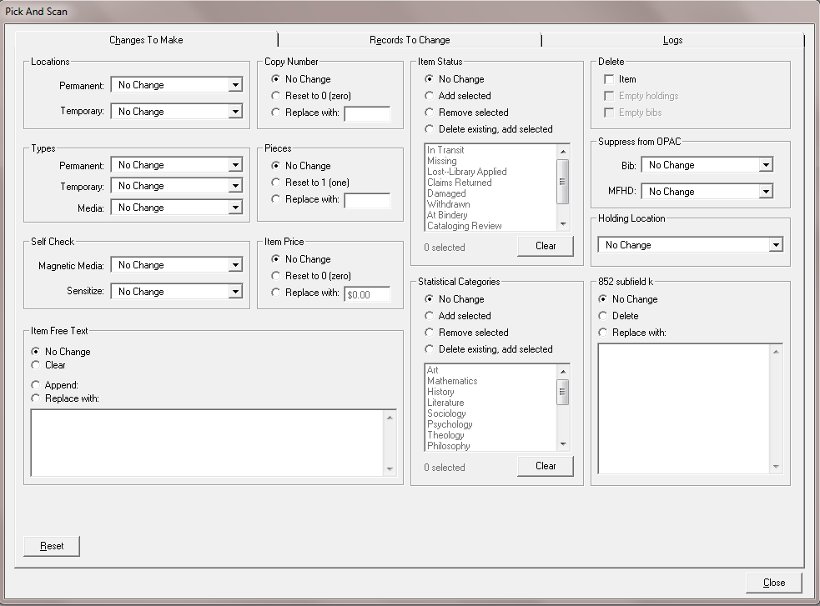
Introducing Pick & Scan 2.0
New update/delete options, new layout, new tabs

Slide 8

Security for Pick & Scan 2.0
Cataloging and Circulation operators need to be able to:
Add/update item records
Set/change item status (sep. in Circ only)
Delete item records
Update holdings records
Delete holdings records
Delete bibliographic records
Pick & Scan will check permissions to know what the user can do and display options accordingly

Slide 9


Pick & Scan 2.0
Some new features require new settings in Sys Admin > Security for Circulation operators
Pre-9.0:
9.0 +:

Slide 10
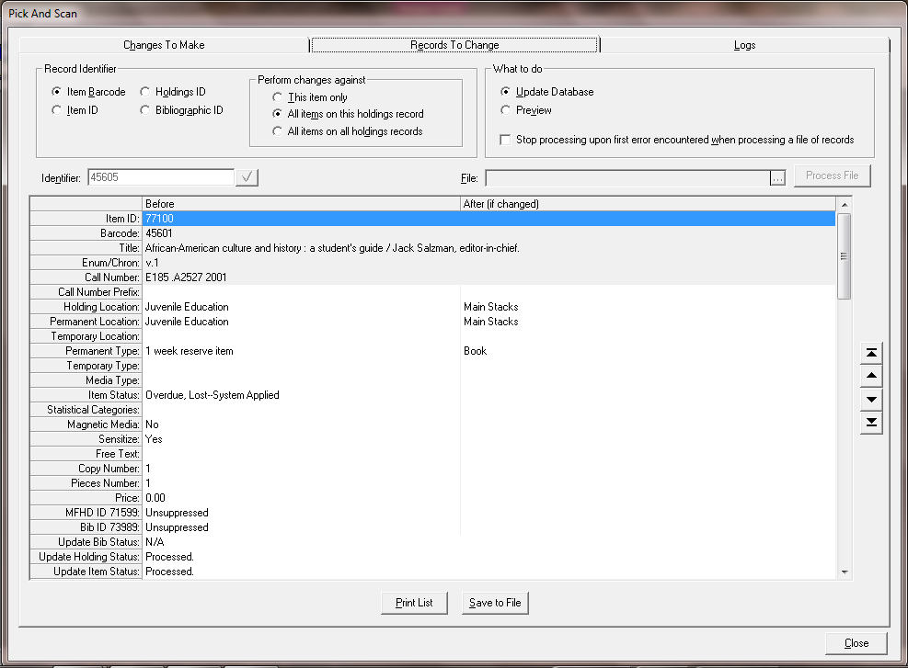
Great Power in Pick & Scan 2.0
Use different inputs, Change related records, Preview, and “Stop processing on error”

Slide 11
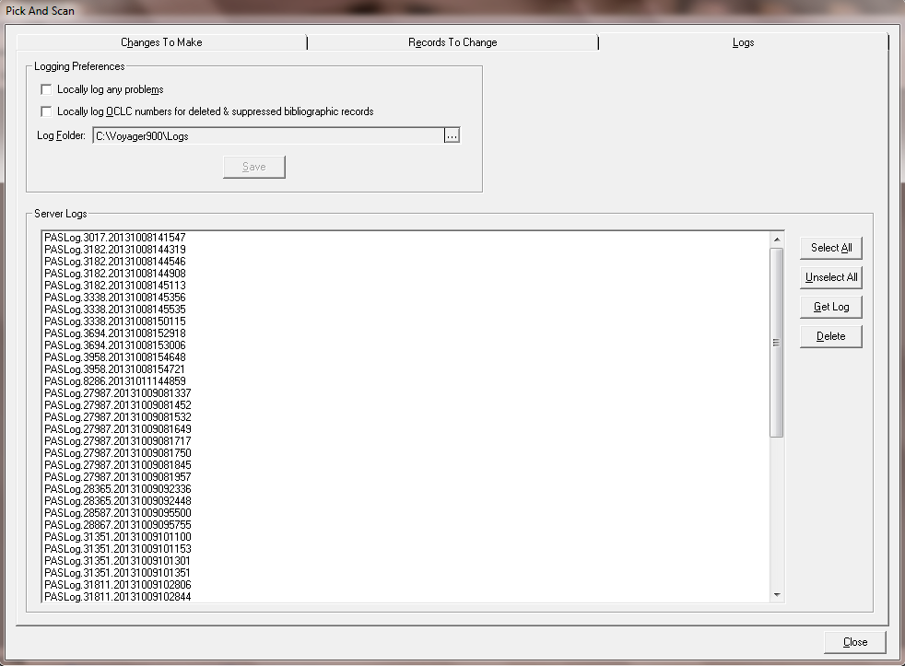
New Logging in Pick & Scan 2.0

Slide 12

Global Data Change
Global Data Change enhancements
New record set creation options
Improvements in record delete
Options to suppress/unsuppress bibs and holdings
Export record sets and MARC files

Slide 13
Create Record Sets Using GDC
Record selection criteria currently includes:
Select records by create and update date
Select records by create and update operator
Select records by record number range
Select records by call number prefix (MFHD 852$k)
Select records by MFHD location (852$b)
Select records by record type and bibliographic level
Select records by call number type based on indicator value
Select records by headings values
And many others…

Slide 14
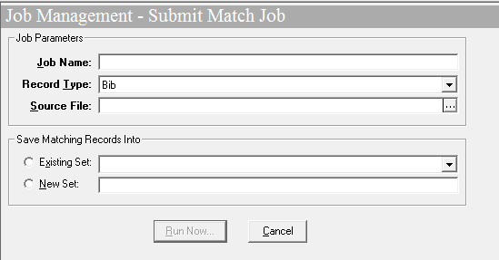
New Ways to Create Record Sets Using GDC
Create record set by matching external MARC file
Useful when working with vendor-supplied files
Record set will be created for all matches found, even if there are duplicate records in the db

Slide 15
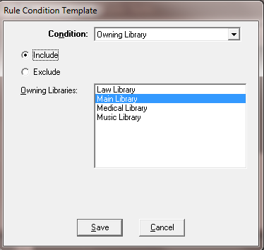
New Ways to Create Record Sets Using GDC
New ‘Scan’ options to create record sets by specifying owning library criteria
Owning library
Bib
MFHD
Use criteria to include or exclude records from record sets

Slide 16
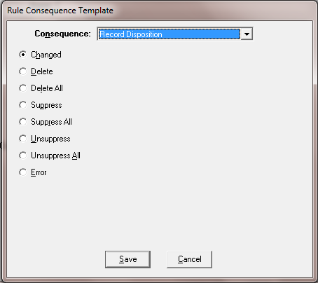
New Delete, Suppress, Unsuppress in GDC
New options for rule consequences
Possible to delete hierarchies of records
Records that can’t be deleted will automatically be suppressed

Slide 17
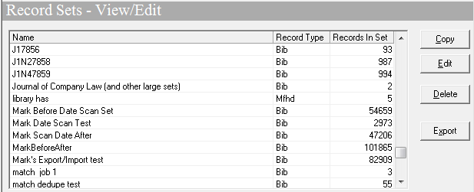
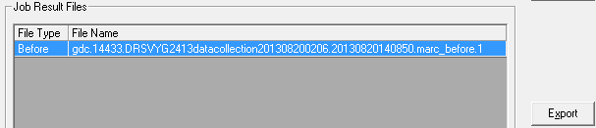
Export Records from GDC to Use Elsewhere
Export Record Sets or MARC records – or both

Slide 18
Agenda
Batch Update features
Circulation
Patron Requests
Circ matrix settings
Lost Fines & Fees
Patron notifications
Historical Browse
Primo / OPAC
Cataloging
Acquisitions
Other

Slide 19

Improving Service: Patron Requests
Projects to improve the management and processing of patron requests
Limit # of hold requests
Limit hold request types (title vs. copy)
Block holds for lost & missing items
Block charging of items on hold for other users
Cancel “duplicate” requests for items in transit
Emphasize patron’s last name on hold slips

Slide 20
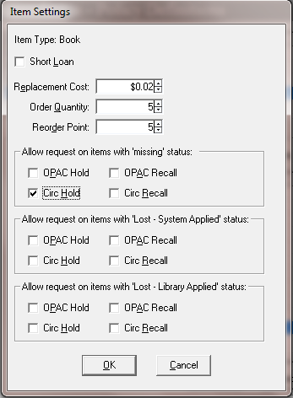
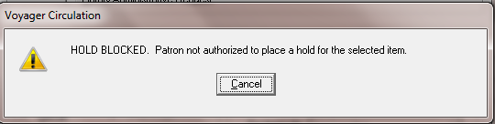
Block Holds on Missing/Lost Items

Slide 21
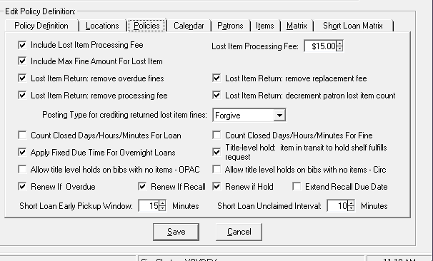
Block Holds on Missing/Lost Items
New circulation policy group decisions for bibs with no items

Slide 22
Block Holds on Missing/Lost Items
“missing” error message remains the same
New and modified error messages in webvoyage.properties and vxws.properties:
page.patronRequests.message.requestblocked5=The item has a lost status.
(existing msg) For Lost-System Applied
page.patronRequests.message.requestblocked13=The item has a lost status.
(new msg) For Lost-Library Applied

Slide 23
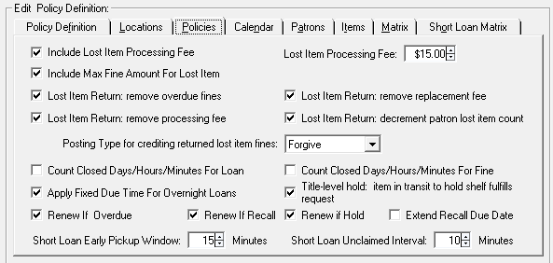
Cancel ‘Duplicate’ Requests When Item In Transit

Slide 24
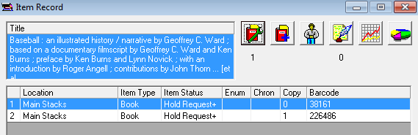
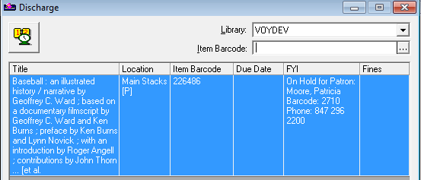
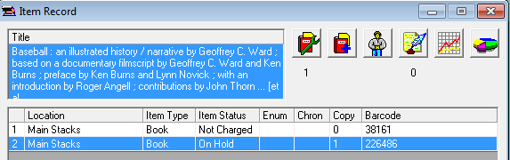
Prevents Extra Items From Being Trapped

Slide 25
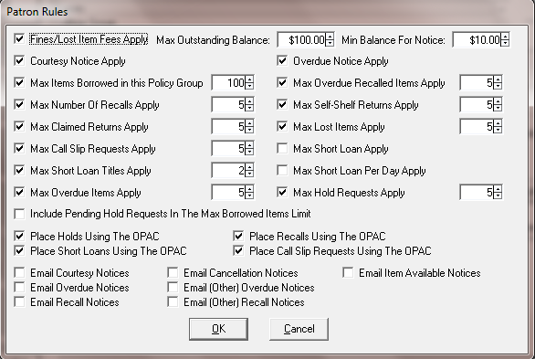
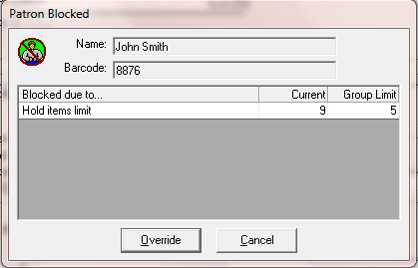
Limit Number Of Holds

Slide 26
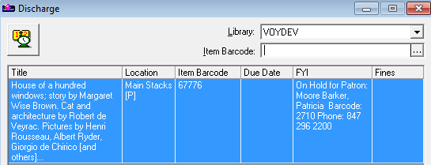

Make Patron’s LN Obvious in FYI/on Hold Slip
Patron’s name is Patricia Moore Barker

Slide 27
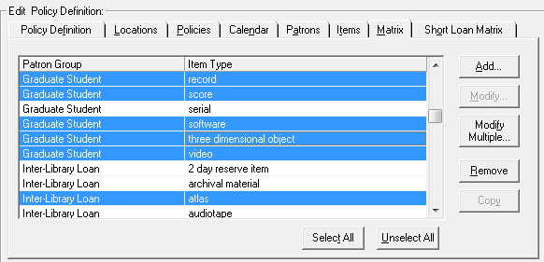
Edit Multiple Circulation Policy Matrix Settings

Slide 28
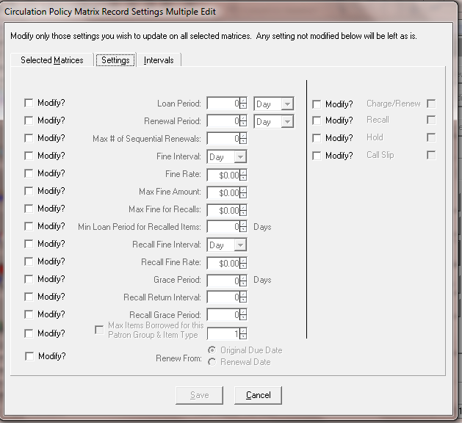
Edit Multiple Circulation Policy Matrix Settings

Slide 29
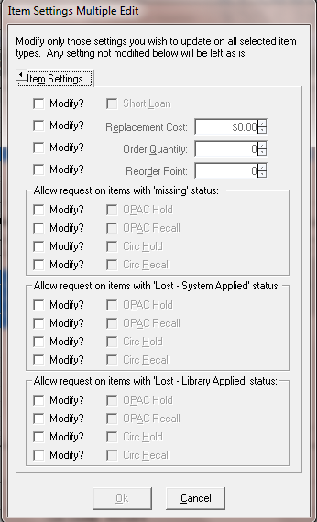
Edit Multiple Item Settings

Slide 30
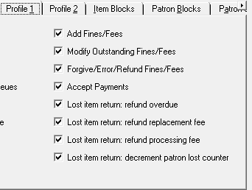
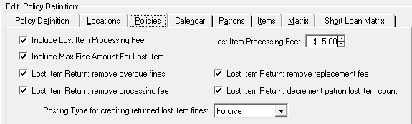
Automatically Remove Lost Fines & Fees
Set Circulation operator profile privileges for the staff profile
And define policies for the Circulation Policy Group

Slide 31
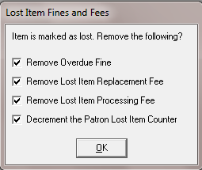
Returning Lost Items Made Easy

Slide 32
Automatically Remove Lost Fines & Fees
Exceptions are logged if the circ policy group says that we SHOULD remove the fines, but the operator did not have permission
If the circ policy group says we should remove the fines, and the operator had the choice, we do not log an exception because the operator already made the decision.
When the circ policy group says we should not remove the fines, no exceptions are logged.
56 Overdue Fine Not Removed
57 Processing Fee Not Removed
Replacement Fee Not Removed
59 Patron Counter Not Decremented
60 Lost Item Return – Historical Fines Present
61 Lost Item Return – Lost Status not removed

Slide 33
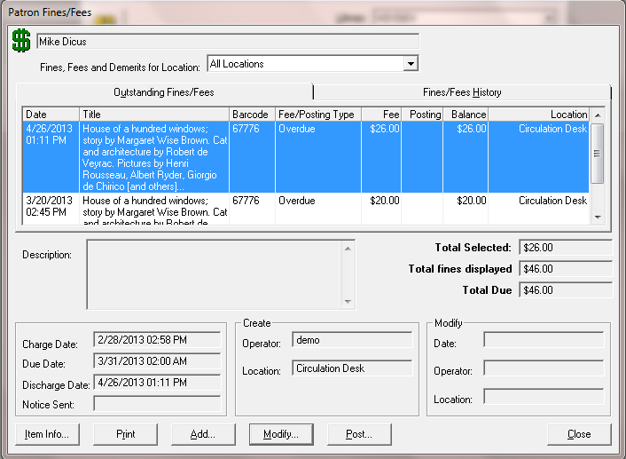
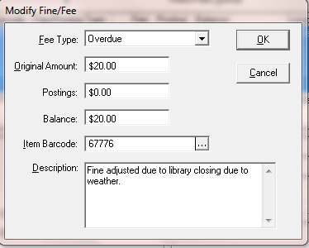
Option to Edit Fine/Fee Information

Slide 34
Message For Patron Whose Card Is Expiring
Webvoyage.properties:
page.myAccount.expireNotify=Y
page.myAccount.expireNotifyLead=30
page.myAccount.expireNotifyMsg=Your patron account will expire in \\d days.
page.myAccount.expireNotifyMsgWithin24Hrs=Your patron account will expire in \\h Hours \\m Minutes \\s Seconds
page.myAccount.viewPersonalInfo.hasExpiredMsg=Your patron account has expired.
page.myAccount.viewPersonalInfo.expireNotifyMsg=Your patron account will expire in \\d days. Please contact your circulation desk for assistance.
page.myAccount.viewPersonalInfo.expireNotifyMsgWithin24Hrs=Your patron account will expire in \\h Hours \\m Minutes \\s Seconds. Please contact your circulation desk for assistance.

Slide 35
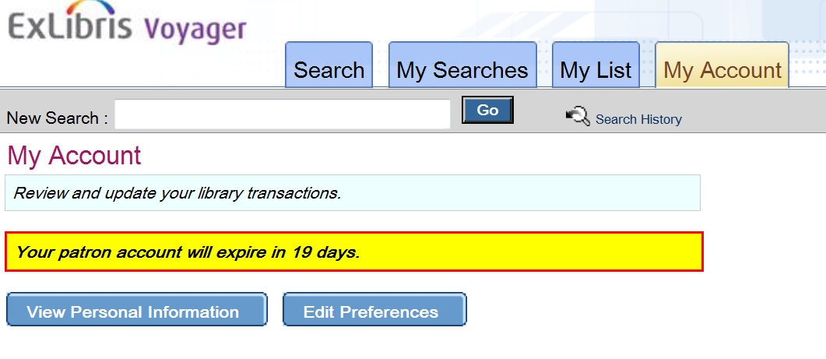
Message For Patron Whose Card Is Expiring

Slide 36
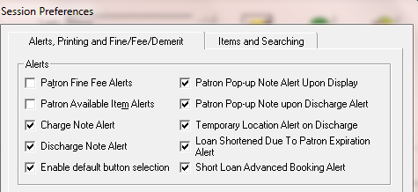
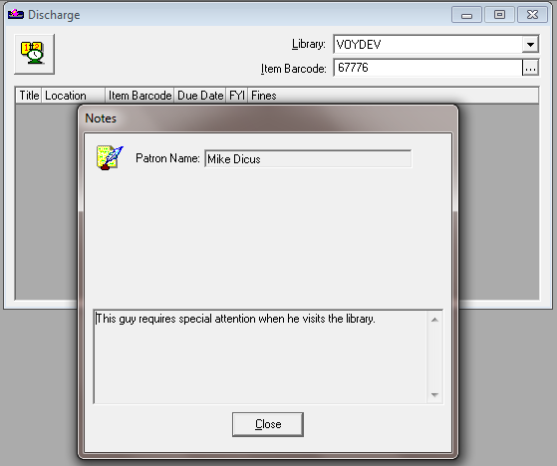
Display Patron Pop-up Notes Upon Discharge

Slide 37
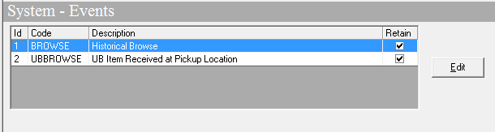
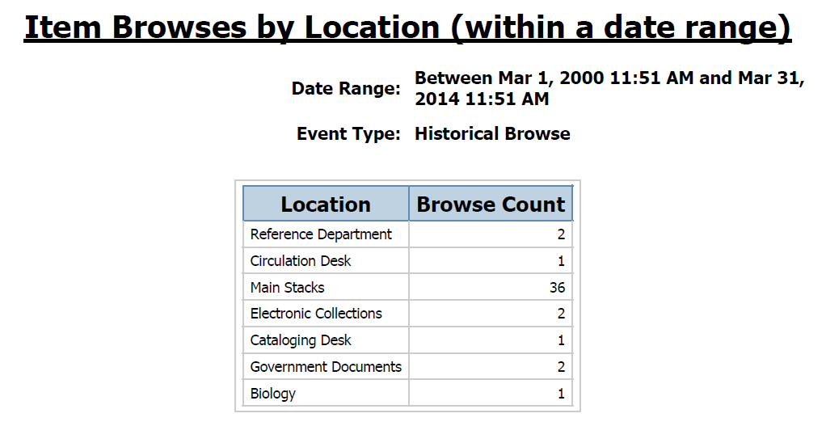
Save Date/Time For Historical Browses

Slide 38

OOTB Browse Reports
Item Browses by Location (within a date range)
Item Browses by Location and Item Type (within a date range)
Item Browses by Title (within a date range)
Item Browses by Title and Bib Format (within a date range)
Item Browses by Classification (within a date range)
Dewey, LC, NLM, and SuDoc
Available in Access Reports and Analyzer

Slide 39
Agenda
Batch Update features
Circulation
Primo / OPAC (skipped)
Patron self-registration
Change PIN and SMS
Sort order of holdings locations
Display ILL Requests
Cataloging
Acquisitions
Other

Slide 40


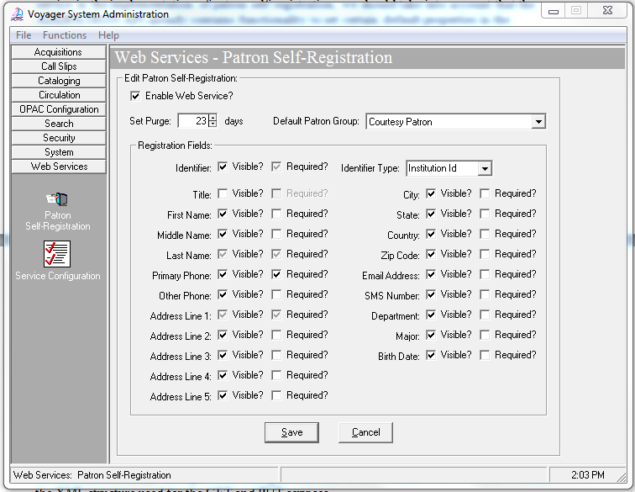
Patron Self Registration Service

Slide 41
Patron Self Registration Service
Service: http://<server>:<port>/vxws/patron
User automatically logged into Primo
Patron group set by default in Sysadmin
vxws.properties:
sites can customize messages
Voyager server /m1/voyager/xxxdb/tomcat/vxws/context/vxws/ directory
Sample default messages:
selfReg.message.0=Patron successfully registered
selfReg.message.47=Missing mandatory field
selfReg.message.58=Patron is already registered. Please log in again or choose a different ID.
Note that if the text for selfReg.message.0 contains the character sequence \\b, that character sequence will be replaced with the newly generated patron barcode

Slide 42
Sysadmin - Other Web Services
Existing service augmented for use with Primo
URL =http://<server>:<port>/vxws/patron/{patid}/patronInformation/address, both GET and PUT
Can now be used to update the patron PIN and/or SMS number.
PIN optionally encrypted, controlled by Primo.

Slide 43
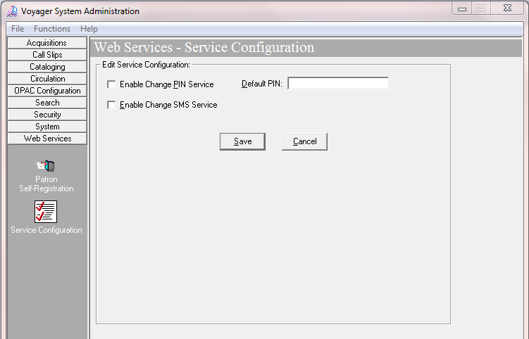
Other Web Services
Notes:
If you wish Primo services to include changing PIN and SMS information, the values in Voyager Sysadmin must be checked.

Slide 44
Location Sort Order
Voyager Extract For Primo
/m1/voyager/xxxdb/ini/PrimoExp-*.ini
New stanza for sort order based on 852b
[LocationSortOrder]
#Indicate how locations in the availability statements should be sorted when displayed in Primo.
#The following example shows the location main is ranked 1, biology is ranked second, and music is
#ranked third.
#If you do not include locations in the list below, they will be sorted alphabetically
#after the locations that are listed. The location is the location code.
#
1=main
2=biology
3=music

Slide 45
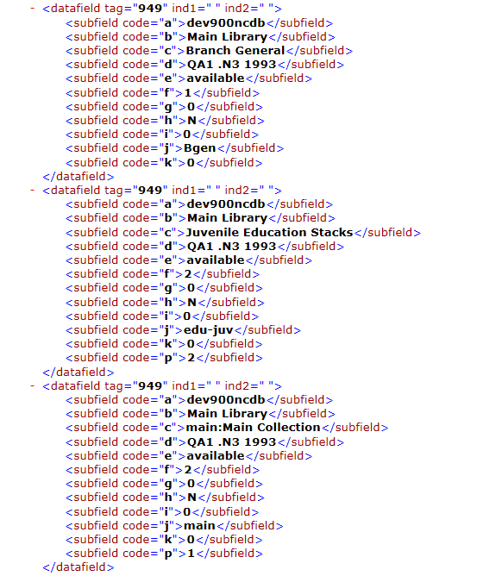
Location Sort Order

Slide 46
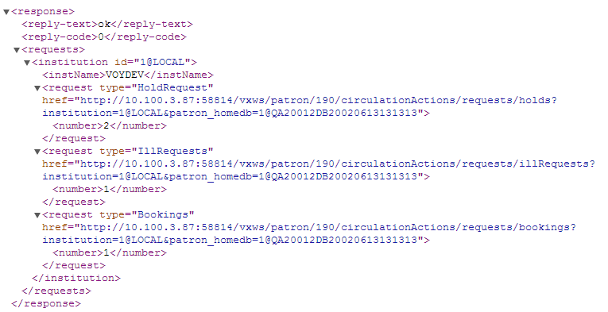
ILL Requests in My Account
http://server:port/vxws/patron/190/circulationActions/requests?institution=1@LOCAL&patron_homedb=1@QA20012DB20020613131313

Slide 47
Agenda
Batch Update features
Circulation
Primo / OPAC
Cataloging
Policy Definitions settings
Print Cataloging Hierarchy
RDA Toolkit
Acquisitions
Other

Slide 48
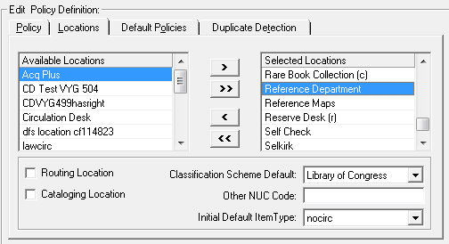
Update Item Location/Type Automatically
Feature relies on having default item types associated with locations in Cataloging Policy Definition

Slide 49
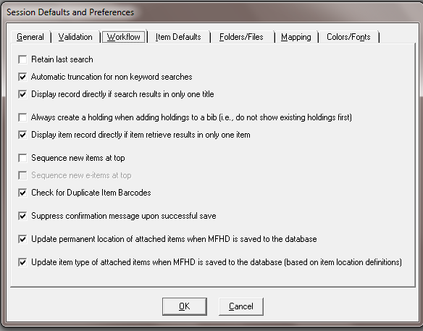
New Settings in Session Defaults and Prefs

Slide 50
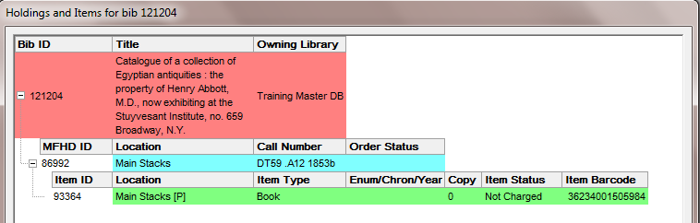
Example from Cataloging Hierarchy

Slide 51
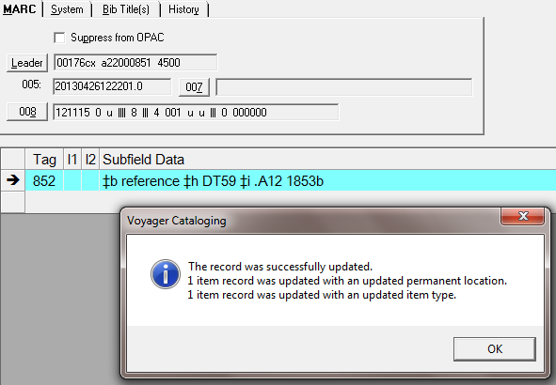
Change Location in MFHD and Save to DB

Slide 52
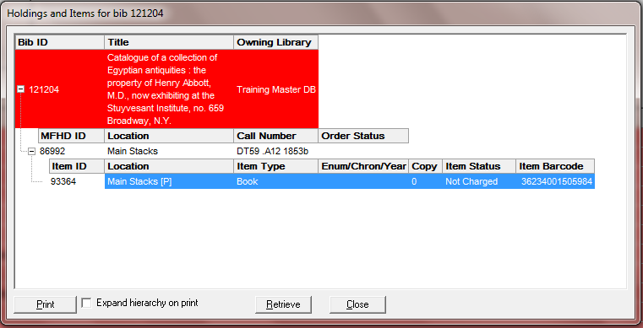
Print From Cataloging Hierarchy
Tick box to expand hierarchy when printed
Added active barcode to the item display & print-out

Slide 53
Link to RDA Toolkit from Cataloging
Links to RDA Toolkit at various levels, depending on cursor position when invoked
MARC Tag level
Indicator level
Subfield level
MARC tag and both indicators level, and optionally subfield level
Uses Shift-F2 keys or menu command
Bib and Authority records only

Slide 54
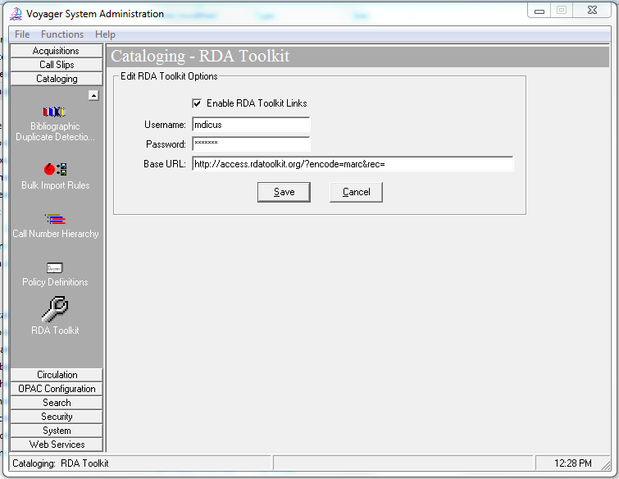
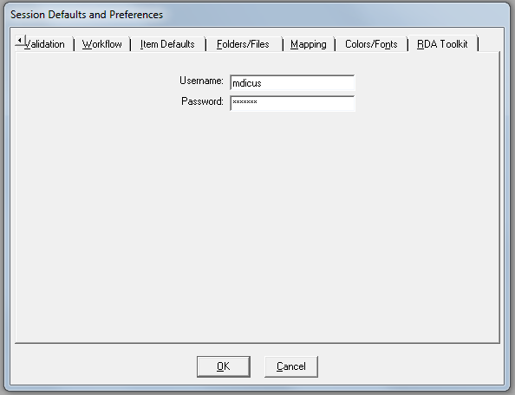
Link to RDA Toolkit from Cataloging

Slide 55
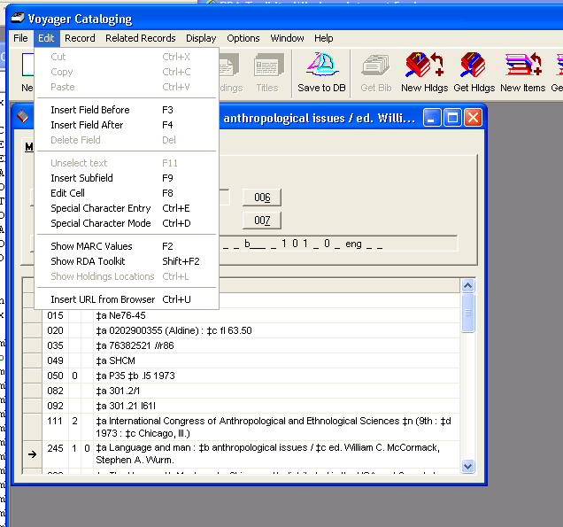
Link to RDA Toolkit from Cataloging

Slide 56
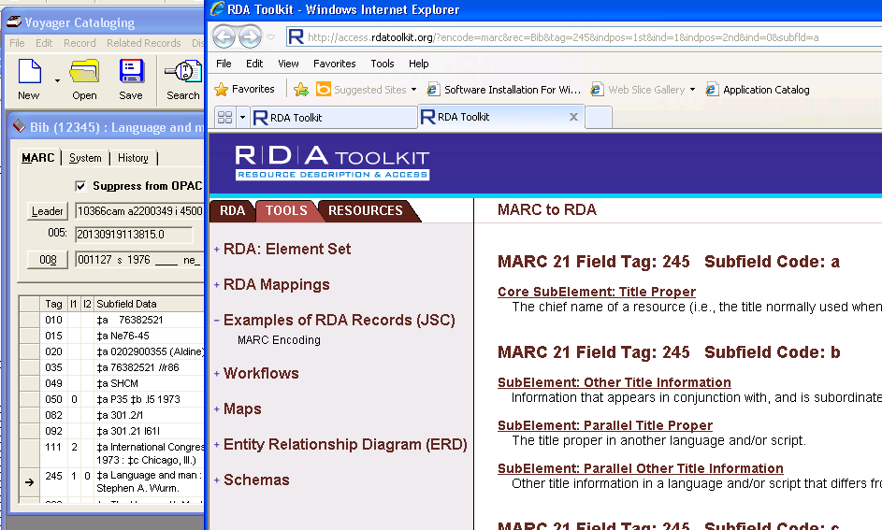
Link to RDA Toolkit from Cataloging

Slide 57
Agenda
Batch Update features
Circulation
Primo / OPAC
Cataloging
Acquisitions
Vendor Names
P.O. Standard Number
Currency Maintenance
Other

Slide 58

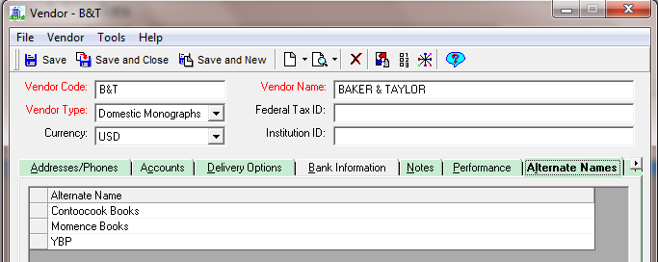
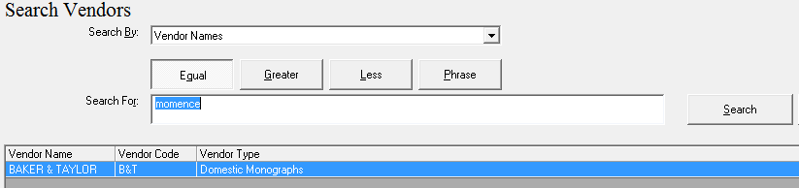
Add Alternate Vendor Names

Slide 59
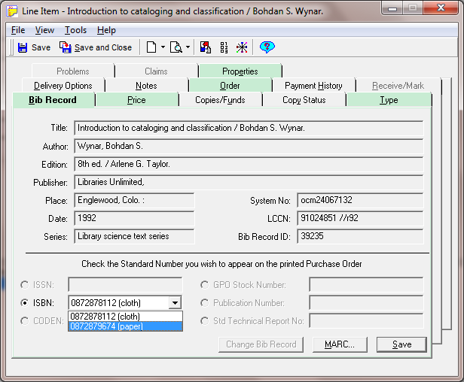
Select Standard Number On P.O.

Slide 60
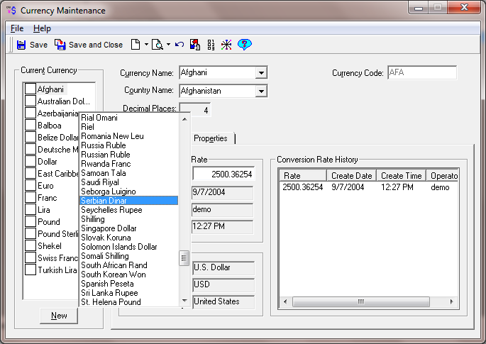
Add New ISO Currencies

Slide 61
Agenda
Batch Update features
Circulation
Primo / OPAC
Cataloging
Acquisitions
Other
Media Booking (skipped)
Warnings
Display changes
Alerts
Standards
Self-Check
VIK

Slide 62


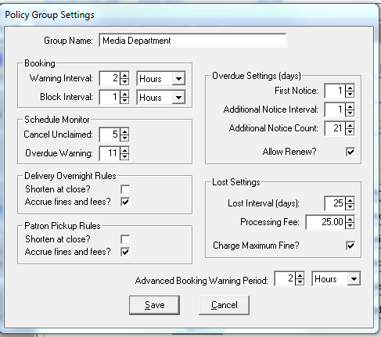
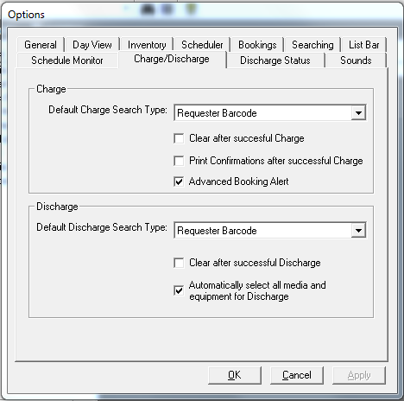

Advanced Booking Warning on Charge

Slide 63

Display of Equipment in Booking
Effective in:
“Equipment” tab of the standard booking form
“Equipment” tab of the Immediate Pickup Booking form
“Equipment” panel of the booking wizard
“Select Equipment for Booking” form
“Add Equipment Type to Booking” form

Slide 64


Display of Equipment Barcode in Booking
Automatically expand barcode column to display largest value

Slide 65
Booking Warning Interval Options in Media
Interval Scale Options:
Minutes
Hours
Days

Slide 66

Display Media Title on Day View in MS
A single media item will display the title on Day View
Message displays if there are multiple titles
Message displays if there are no media items in the booking

Slide 67

Make Media’s Day View Customizable
You can control
Which fields display
Order of fields in display
Which statuses display

Slide 68


Color-code MS Tabs When Data Is Present
Set your preference, just like the tab coloring in Acquisitions

Slide 69

Patron Counters and Bookings
Summary display of patron counters and booking activity

Slide 70

Display Item Status on Media Tab

Slide 71

Display Patron Notes In Media Scheduling

Slide 72

Alert Staff When Lost Media Item Discharged

Slide 73

Discharge Alerts Based on Item/Equip. Status

Slide 74


Limit To Available Equipment When Booking

Slide 75

Remove SSN from MS Patron Display
SSN search option removed
SSN display removed from search results

Slide 76
Increasing Support for Standards
Enrich content of OpenURLs created by Voyager
Provide granular control over block options in SIP2
Add patron birthdate to SIP2 messages
Add option to customize on-screen messages in SIP2
Update ISO currencies supported in Voyager
MARC 21 tag table updates

Slide 77
Apply Item Blocks in Self Check
Pre-9.0, all self-check blocks were hardcoded
Added functionality to the SIP2 self-check module to use the appropriate circulation profile to determine which item blocks may be automatically overridden by the self-check module, rather than the hardcoded set in use prior to 9.0.
New blocks available in SelfCheck:
Block Code | Meaning
43 | Item scheduled for a short loan request.
44 | TERM renewal precedes permitted renewal period.
48 | Item has been scheduled and cannot be charged or renewed.
49 | Item has call slip request for another patron.
128 | Item is misrouted. Please consult library personnel for assistance.
Certain blocks that require operator input will continue to be blocked regardless of the value for the block in the Circ profile for the self-check user.
Block Code | Meaning
26 | Item does not have an assigned loan period.
27 | Item is non-circulating.
104 | Item has a term loan period, but a term due date has not been set.
107 | The renewal due date calculated precedes the item's current due date.
108 | The renewal due date calculated is in the past.

Slide 78
Enhancing Stability and Performance
Developing new tools and processes to:
Automate the process of detecting when you need to run a regen
Monitor Oracle table space and data file size
Rotate log files
Improve Oracle memory tuning tools in the VIK
Update WebAdmin with new features
See the Voyager 9.0 Release Notes for details.

Slide 79


Voyager Product Update
Any questions?

Slide 80
Thank You

