Slide 1
Introduction to Voyager 9
Primo OPAC
Notes:
Welcome to our session: Introduction to Voyager 9

Slide 2
Copyright Statement and Disclaimer
All of the information and material, including text, images, logos and product names, is either the property of, or used with permission by, Ex Libris (USA), Inc. The information may not be distributed, modified, displayed or reproduced – in whole or in part – without the prior written permission of Ex Libris (USA), Inc.
TRADEMARKS
Ex Libris, the Ex Libris logo, Aleph, SFX, MarcIT, MetaLib, DigiTool, Verde, Primo, Voyager, MetaSearch, MetaIndex and other Ex Libris products and services referenced herein are trademarks of Ex Libris, and may be registered in certain jurisdictions. All other product names, company names, marks and logos referenced may be trademarks of their respective owners.
DISCLAIMER
The information contained in this document is provided on an "AS IS" basis for general information purposes only without any representations or warranties, whether express or implied, including any implied warranties of satisfactory quality, completeness, accuracy or fitness for a particular purpose.
Ex Libris, and its subsidiaries and related corporations disclaim any and all liability for use of this information, even if advised of the possibility that loss, damage or expenses may arise.

Slide 3




Agenda
Primo / OPAC
  Patron self-registration
  Change PIN, SMS and
  Patron Group
  Sort order of holdings locations
  Display ILL Requests

Slide 4



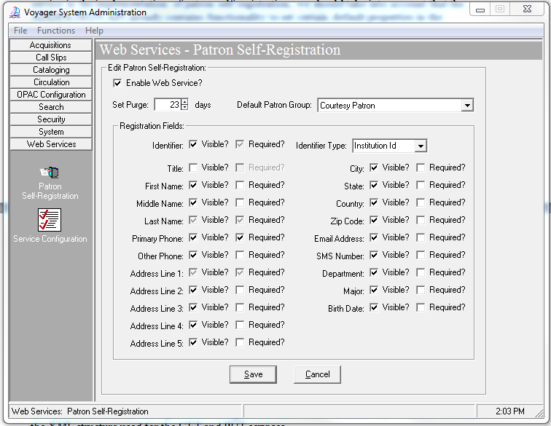
Patron Self Registration Service

Slide 5
Patron Self Registration Service
  Service: http://<server>:<port>/vxws/patron
    User automatically logged into Primo
    Patron group set by default in Sysadmin
  Communications: vxws.properties
    Voyager server directory /m1/voyager/xxxdb/tomcat/vxws/context/vxws/ui/eng
    Add option.displayRequestGroups=Y
    Customize Messages (Samples for Self Registration below):
  selfReg.message.0=Patron successfully registered
  selfReg.message.47=Missing mandatory field
  Note that if the text for selfReg.message.0 contains the character sequence \\b, that character sequence will be replaced with the newly generated patron barcode
  Voyager settings: Sysadmin (next screen)

Slide 6
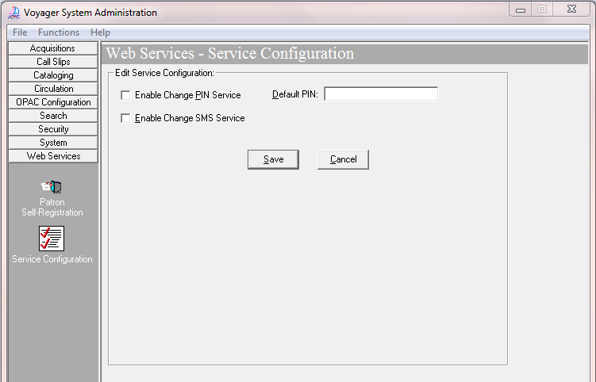
Other Web Services
Notes:
If you wish Primo services to include changing PIN and SMS information, the values in Voyager Sysadmin must be checked. Along with the Primo display settings

Slide 7
Sysadmin - Other Web Services
  Existing service augmented for use with Primo
    URL =http://<server>:<port>/vxws/patron/{patid}/patronInformation/address, both GET and PUT
    Can now be used to update the patron PIN and/or SMS number.
    PIN optionally encrypted, controlled by Primo
    Primo options set in Personal Settings Fields mapping table – Back Office

Slide 8
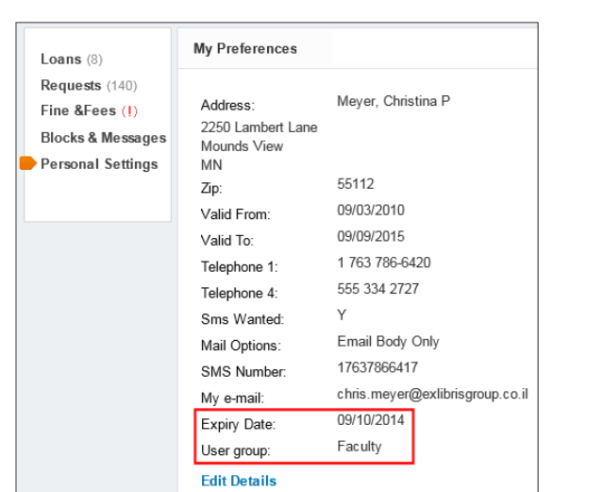
Sysadmin - Other Web Services
Primo MyAccount Display –Personal Setting

Slide 9
Location Sort Order
Voyager Extract For Primo – voyager server
/m1/voyager/xxxdb/ini/PrimoExp-*.ini
New stanza for Primo Locations Tab sort order based on 852b
[LocationSortOrder]
#Indicate how locations in the availability statements should be sorted when displayed in Primo.
#The following example shows the location main is ranked 1, biology is ranked second, and music is
#ranked third.
#If you do not include locations in the list below, they will be sorted alphabetically
#after the locations that are listed. The location is the location code.
#
1=main
2=biology
3=music

Slide 10
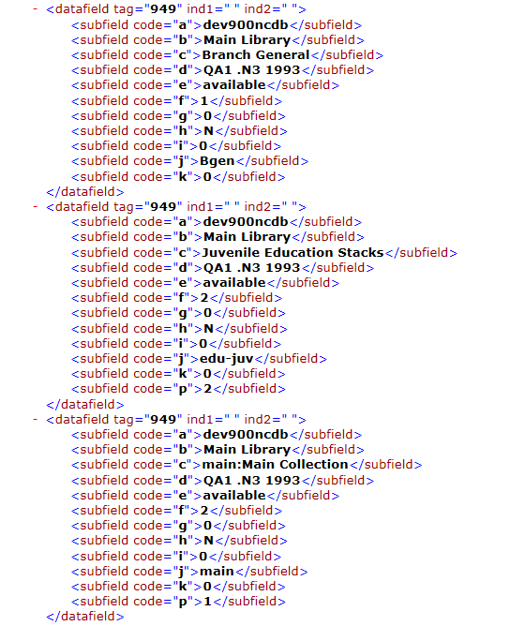
Location Sort Order (xml output)
Notes:
This is sample output of the previous command. Builds a 949 tag with other data. 2 subfields of interest j with the location code and p with the location order for display

Slide 11
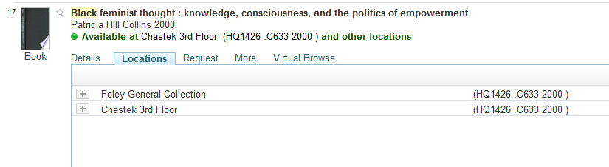
Location Sort Order (Primo)
Extract options allows control of Library location display order on the Locations tab in Primo (sample below)

Slide 12
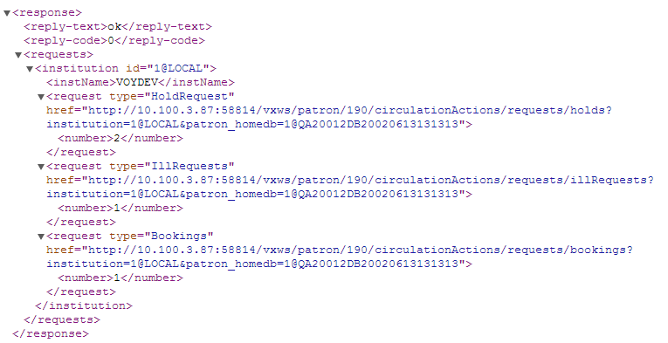
ILL Requests in My Account
MyAccount display of ILL requests tracked through Voyager
http://server:port/vxws/patron/190/circulationActions/requests?institution=1@LOCAL&patron_homedb=1@QA20012DB20020613131313
Notes:
By ILL requests, we mean ILL products which created and managed requests and possible created in Voyager. This would include ILLIAD, CLIO,

Slide 13
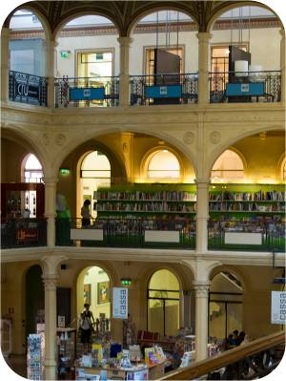

Introduction to Voyager 9
Impacts to Primo

Slide 14
Thank You

