Slide 1
Introduction to Voyager 9
Media Scheduling
Notes:
Welcome to our session: Introduction to Voyager 9

Slide 2
Copyright Statement and Disclaimer
All of the information and material, including text, images, logos and product names, is either the property of, or used with permission by, Ex Libris (USA), Inc. The information may not be distributed, modified, displayed or reproduced – in whole or in part – without the prior written permission of Ex Libris (USA), Inc.
TRADEMARKS
Ex Libris, the Ex Libris logo, Aleph, SFX, MarcIT, MetaLib, DigiTool, Verde, Primo, Voyager, MetaSearch, MetaIndex and other Ex Libris products and services referenced herein are trademarks of Ex Libris, and may be registered in certain jurisdictions. All other product names, company names, marks and logos referenced may be trademarks of their respective owners.
DISCLAIMER
The information contained in this document is provided on an "AS IS" basis for general information purposes only without any representations or warranties, whether express or implied, including any implied warranties of satisfactory quality, completeness, accuracy or fitness for a particular purpose.
Ex Libris, and its subsidiaries and related corporations disclaim any and all liability for use of this information, even if advised of the possibility that loss, damage or expenses may arise.

Slide 3




Agenda
Media Booking
  Warnings
  Display changes
  Alerts

Slide 4


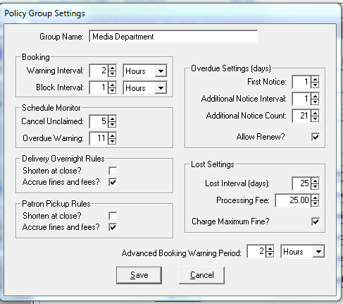
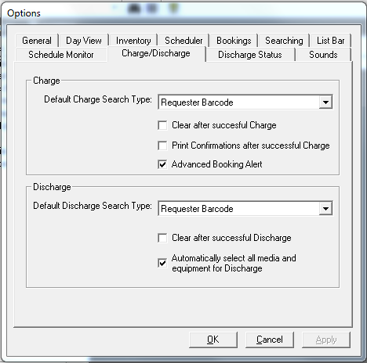
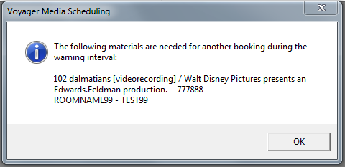
Advanced Booking Warning on Charge
Notes:
MSSA – policy settings
Tools – options – charge/discharge tab

Slide 5
Booking Warning Interval Options in Media
Interval Scale Options:
Minutes
Hours
Days
Notes:
The block interval is amount of time prior to the next booking a new booking is blocked.
The warning intervals is how much time prior to the next booking a warning pops up when someone is trying to schedule a new booking.
In media sysadmin policy group settings

Slide 6
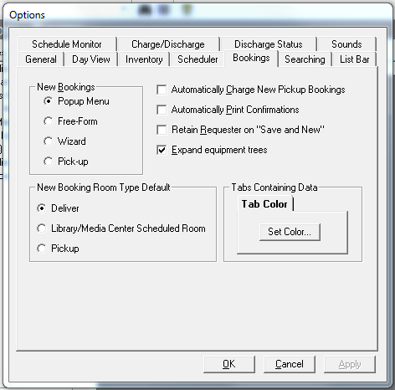
Display of Equipment in Booking
    Effective in:
    “Equipment” tab of the standard booking form
    “Equipment” tab of the Immediate Pickup Booking form
    “Equipment” panel of the booking wizard
    “Select Equipment for Booking” form
    “Add Equipment Type to Booking” form
Notes:
Expand equip tree
See next slide – left side on bottom for example
Set on tools options bookings

Slide 7
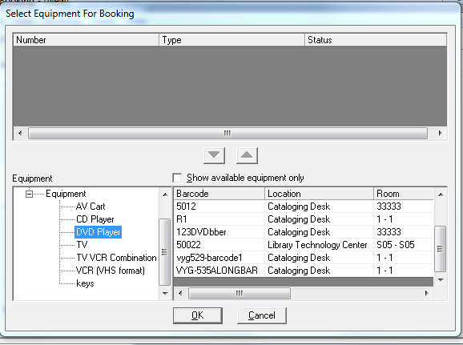
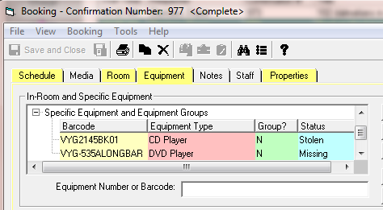
Display of Equipment Barcode in Booking
Automatically expand barcode column to display largest value
Notes:
Left side – example of expanded equipment tree
Square – example of auto expanded barcode

Slide 8
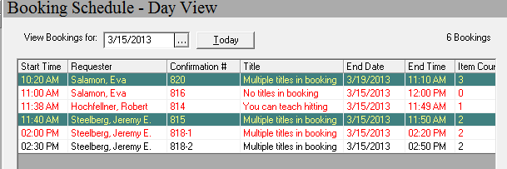
Display Media Title on Day View in MS
A single media item will display the title on Day View
Message displays if there are multiple titles
Message displays if there are no media items in the booking
Notes:
Can now add Title to the Day View but display may not be a title as the booking may not include one title
See next slide for more

Slide 9
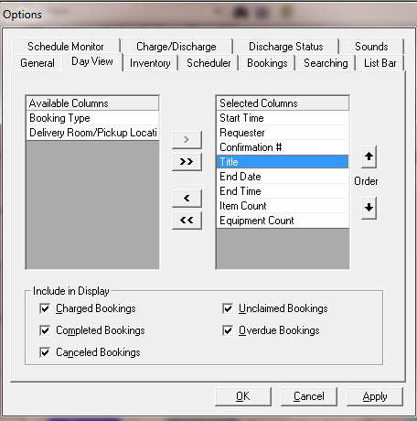
Make Media’s Day View Customizable
  You can control
  Which fields display
  Order of fields in display
  Which statuses display
Notes:
Tools – options – Day View

Slide 10
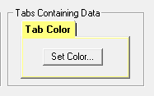
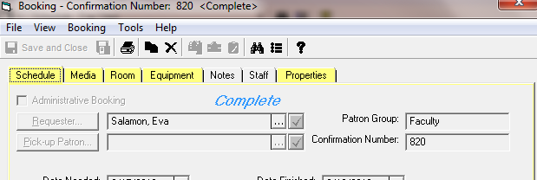
Color-code MS Tabs When Data Is Present
Set your preference, just like the tab coloring in Acquisitions
Notes:
Tools – options – bookings
Don’t forget that other Option tabs also have color settings. Such as searching has suppressed records

Slide 11
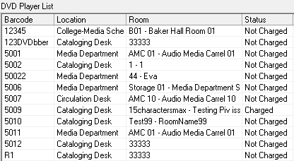
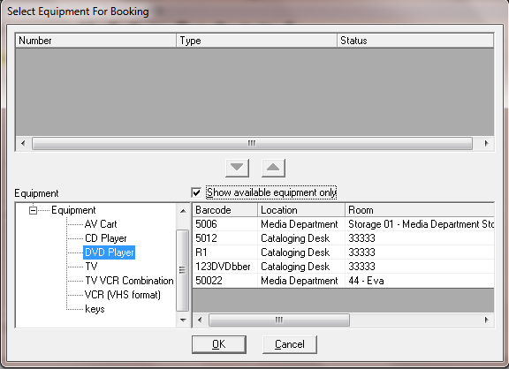
Limit To Available Equipment When Booking
Notes:
Check box on booking screen to limit to “available’ equipment only

Slide 12
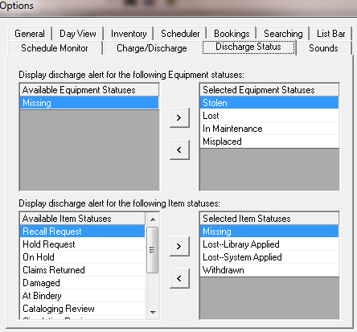
Discharge Alerts Based on Item/Equip. Status
Notes:
Tools – options – discharge status
Select Equipment or Item status alerts which you would like to receive

Slide 13
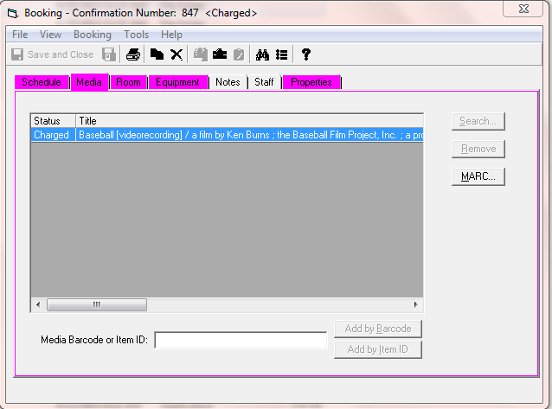
Display Item Status on Media Tab
Notes:
Next several slides contain changes implemented in the system which you will notice
Ie status now appears on media tab
Next slide

Slide 14
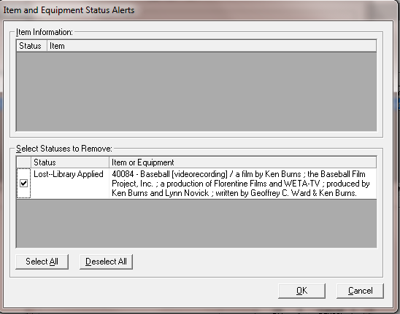
Alert Staff When Lost Media Item Discharged
Notes:
Alert auto received when lost item discharged

Slide 15
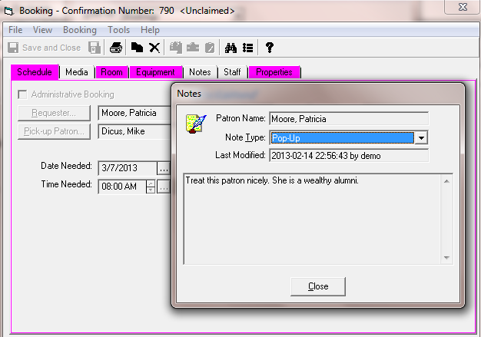
Display Patron Notes In Media Scheduling
Notes:
Patron notes will display (no edit)

Slide 16
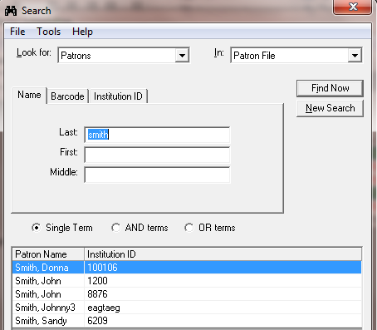
Remove SSN from MS Patron Display
SSN search option removed
SSN display removed from search results
Notes:
Better yet, SSN no longer displays

Slide 17
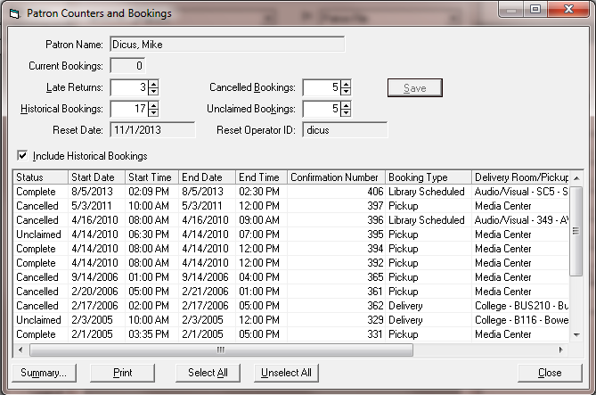
Patron Counters and Bookings
Summary display of patron counters and booking activity
Notes:
A even better, the Patron counters screen where counters can be reset now includes a summary of current and historical bookings. These can all be printed or selectively printed for your or the patron’s convenience.

Slide 18
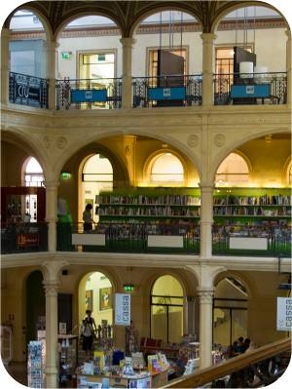

Introduction to Voyager 9
Media Scheduling
Notes:
I hope the introduction to Voyager 9 Media Scheduling changes has been of use to you.
Next slide

Slide 19
Thank You

