Slide 1
Pick and Scan
Voyager 9
Notes:
Welcome to our session: Introduction to Voyager 9
Need to revise Primo and Media sections to shorten

Slide 2
Copyright Statement
All of the information and material inclusive of text, images, logos, product names is either the property of, or used with permission by Ex Libris Ltd. The information may not be distributed, modified, displayed, reproduced – in whole or in part – without the prior written permission of Ex Libris Ltd.
TRADEMARKS
Ex Libris, the Ex Libris logo, Aleph, Alma, SFX, SFXIT, MetaLib, DigiTool, Verde, Primo, Voyager, MetaSearch, MetaIndex and other Ex Libris products and services referenced herein are trademarks of Ex Libris, and may be registered in certain jurisdictions. All other product names, company names, marks and logos referenced may be trademarks of their respective owners.
DISCLAIMER
The information contained in this document is compiled from various sources and provided on an "AS IS" basis for general information purposes only without any representations, conditions or warranties whether express or implied, including any implied warranties of satisfactory quality, completeness, accuracy or fitness for a particular purpose.
Ex Libris, its subsidiaries and related corporations ("Ex Libris Group") disclaim any and all liability for all use of this information, including losses, damages, claims or expenses any person may incur as a result of the use of this information, even if advised of the possibility of such loss or damage.
© Ex Libris Ltd., 2014

Slide 3
Agenda
Overview
New in Voyager 9.0
Security
Changes to Make
Records to Change
Logs
Recap
Resources

Slide 4
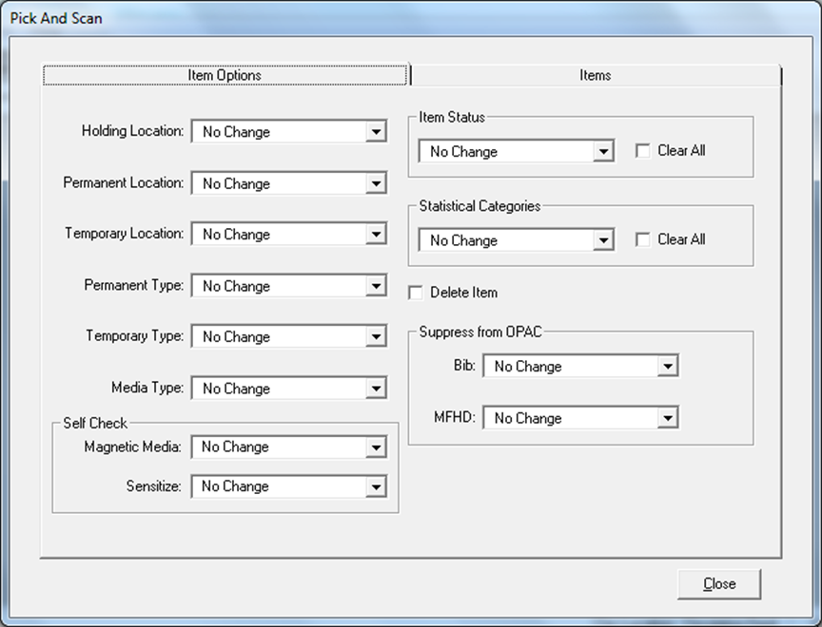
Overview - Past options
Update batch of item or holdings records.
Item location
Item type
SelfCheck flags
Item status
Item statistical category
Holding Location
Delete item records.
Suppress bib and holdings records.

Slide 5
Batch Suppress/Un-Suppress
Batch suppress/un-suppress scenarios:
A Circ operator is participating in a project in which the library is preparing to withdraw a group of materials from the library and wants to suppress these items from view in the OPAC.
A Circ operator is preparing to move a group of items to a new location and wants to change the status of Item records and temporarily suppress these items while the move is underway. Once the move is complete, the records may be un-suppressed so that they will be viewable in the OPAC once again, but now with the new location.
Notes:
Here are some scenarios to help you understand about how or why you might use this function.
Batch suppress/un-suppress scenarios:
A Circ operator is participating in a project in which the library is preparing to withdraw a group of materials from the library and wants to suppress these items from view in the OPAC.
A Circ operator is preparing to move a group of items to a new location and wants to change the status of Item records and temporarily suppress these items while the move is underway. Once the move is complete, the records may be un-suppressed so that they will be viewable in the OPAC once again, but now with the new location.

Slide 6
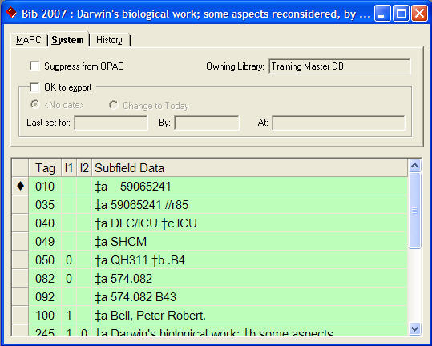
Batch Suppress/Un-Suppress
Before
Notes:
Here, the Bib record is not suppressed from the OPAC.

Slide 7
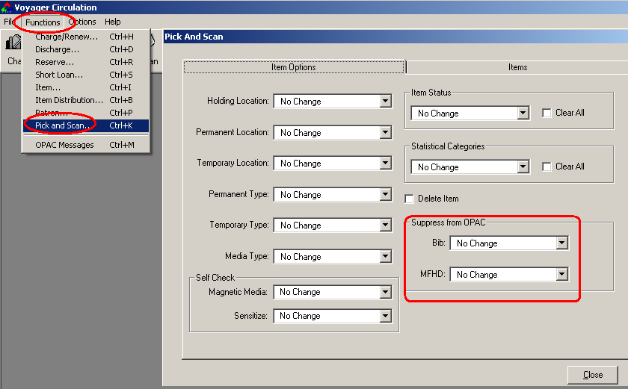
Batch Suppress/Un-Suppress
Notes:
To find the Pick and Scan function, go to FILE > PICK & SCAN – either in Cataloging or Circ modules

Slide 8
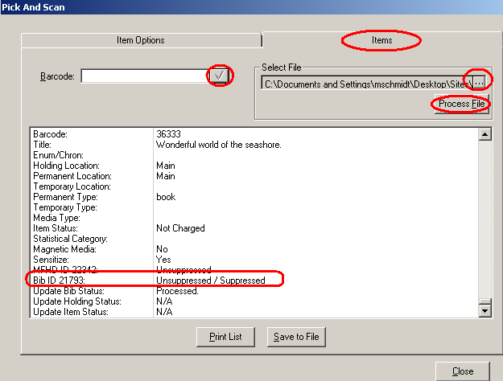
Batch Suppress/Un-Suppress
Notes:
On the basis of the selections made on the Item Options tab, scanning the barcode results in the bib record being suppressed.
As the item is scanned into the barcode box, the results display in the window below. The slash between values indicates possible areas of change. This list is only visible on this screen. The list should be printed or saved if you need a log of changes.

Slide 9
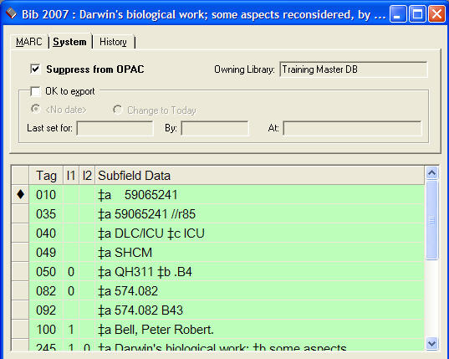
Batch Suppress/Un-Suppress
After
Notes:
This screenshot shows the results of having suppressed the individual record using the Pick and Scan functions.
Open Pick and Scan, change Bib Record to Suppress, enter barcodes for:
19787
96256
22507
29448
31105

Slide 10
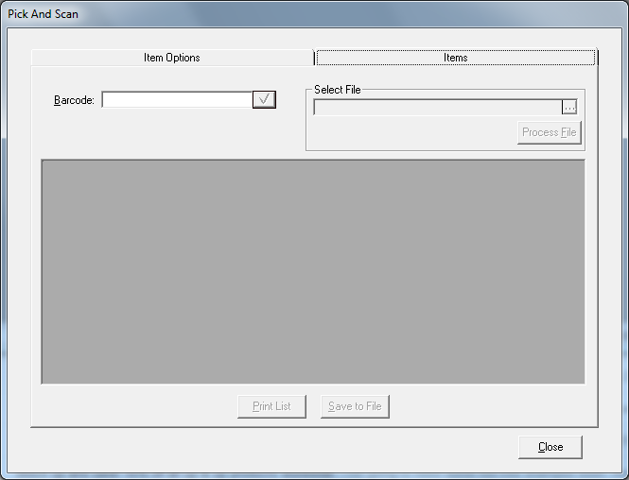
Overview - Past options
Input item barcodes or item IDs.

Slide 11
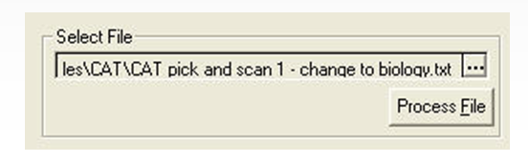
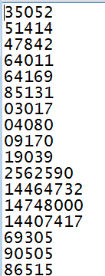
Overview - Past options
Notes:
We can also process a file of records provided we have a list of barcodes in a text file.
Sample files for processing in CIRC WebCast trainer’s files folder.
Now, let’s go on to ISBN-ISSN validation.

Slide 12
Agenda
Overview
New in Voyager 9.0
Security
Changes to Make
Records to Change
Logs
Recap
Resources

Slide 13
New in Voyager 9.0
Update more fields in item records.
Update copy number, pieces, price, and free text fields
Update, add, or remove item status and statistical categories
Update holdings records
Ability to update or delete the 852 Subfield ‘K’ in the Holdings Record
Update more records
Ability to delete bibliographic and holdings records
Ability to update related records

Slide 14

New in Voyager 9.0
Flexibility
Ability to use item IDs, holding IDs, and bibliographic IDs with Pick and Scan
Use Pick and Scan in Preview Mode
More information
Display Call Number in the Processing Report
Logging Options

Slide 15
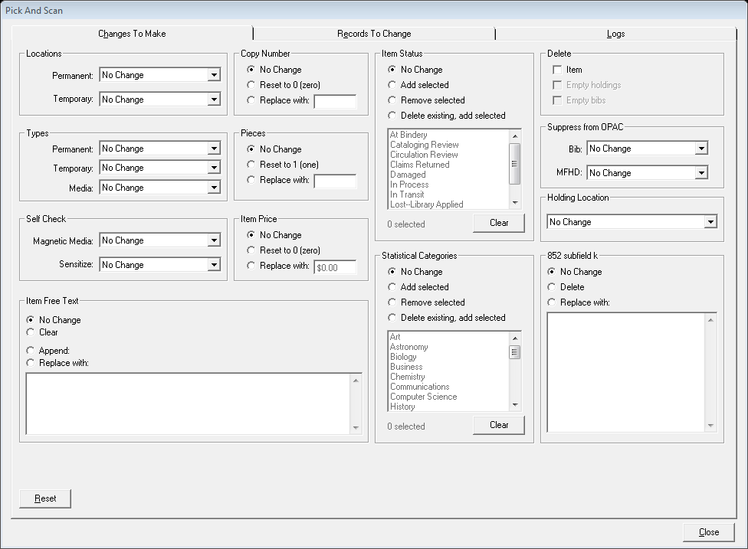
New in Voyager 9.0 - Workspace
Changes to Make tab
Notes:
This was called the item options tab in previous releases.

Slide 16
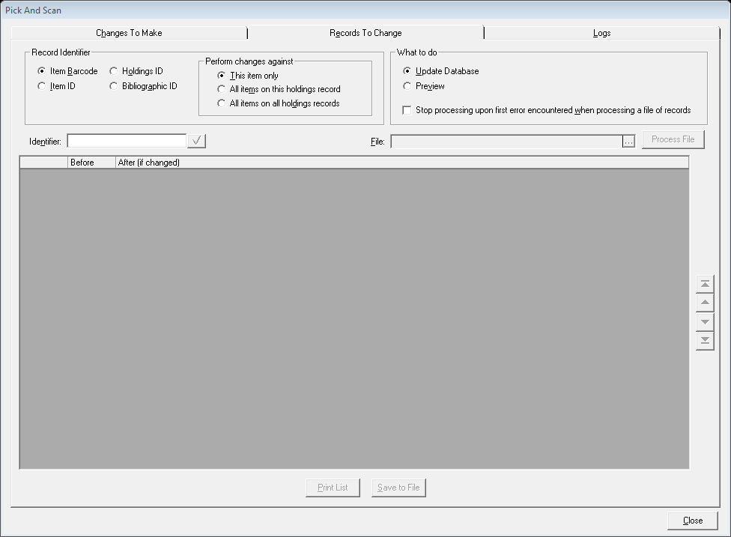
New in Voyager 9.0 - Workspace
Records to change tab
Notes:
This was called the items tab in previous releases. It now allows you to input MFHD_ID and BIB_ID, edit linked records, and use in preview mode.

Slide 17
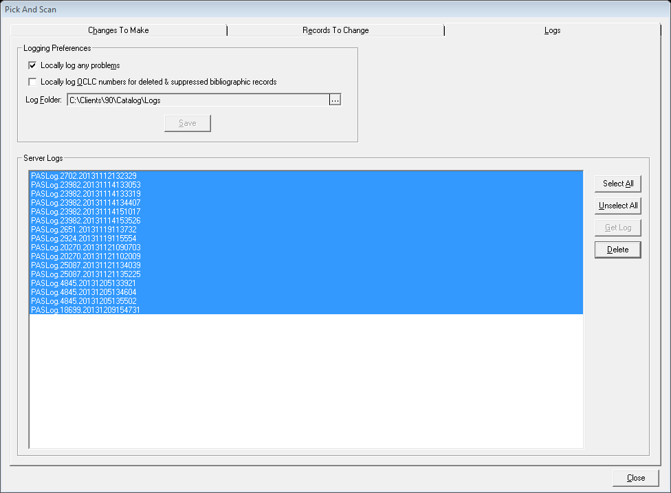
New in Voyager 9.0 - Workspace
Logs tab
Notes:
This is a new tab for managing the logging feature added in Voyager 9.

Slide 18
Agenda
Overview
New in Voyager 9.0
Security
Changes to Make
Records to Change
Logs
Demo
Recap
Resources

Slide 19
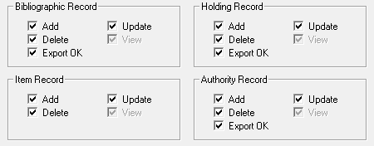
Security - Cataloging Profiles
Update Item Records
Delete Item Records
Update Holdings Records
Delete Holdings Records
Delete Bibliographic Records
Notes:
These are the permissions required to use Pick and Scan in Cataloging.

Slide 20
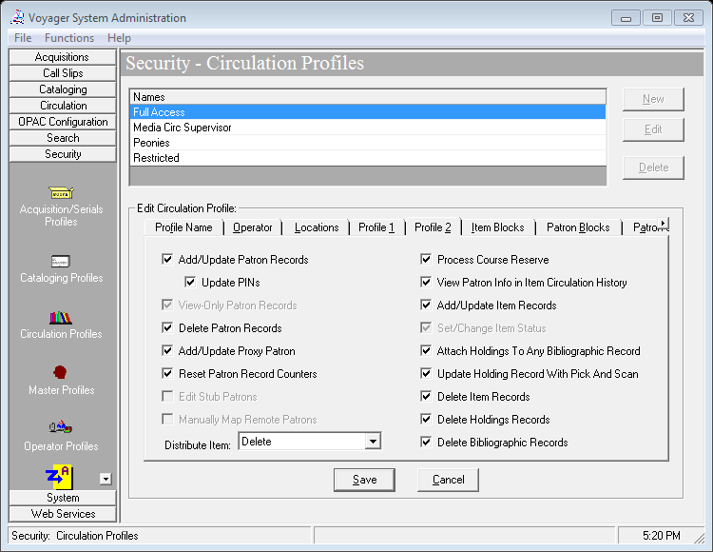
Security - Circulation Profiles
Notes:
For the Circulation Security Profiles, the options were added for the deleting of MFHDs and Bib records. And, all of the pick and scan related options were moved to the Profile 2 tab.

Slide 21
Agenda
Overview
New in Voyager 9.0
Security
Changes to Make
Records to Change
Logs
Demo
Recap
Resources

Slide 22
Changes to Make - item records
Past options
Locations
Item Types
SelfCheck

Slide 23
Changes to Make – item records
Update additional fields in item records
Copy Number
Pieces
Item Price
Item Free text

Slide 24
Changes to Make – item records
Item status and Item Statistical Categories
Add selected
Remove selected
Delete existing, add selected

Slide 25
Changes to Make - Holdings Record
Edit holdings locations
Edit or delete 852 Subfield k

Slide 26
Changes to Make – Delete and Suppress records
Delete item records and related records.
Must be deleting item records.
Empty holdings deletes MFHDs.
Empty bibs deletes bibliographic records.
Suppress Bib and MFHD records as in the past.

Slide 27
Agenda
Overview
New in Voyager 9.0
Security
Changes to Make
Records to Change
Logs
Demo
Recap
Resources

Slide 28

Records to change – Record Identifier
Can change multiple items linked to a Bibliographic record or MFHD.

Slide 29


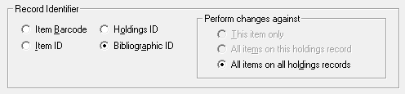
Records to Change - Related Records
Options change based on Record Identifier chosen.

Slide 30
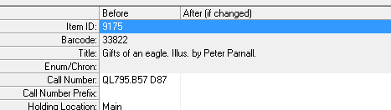
Records to Change – Call Number display
No configurations needed in order for Call Number to display

Slide 31
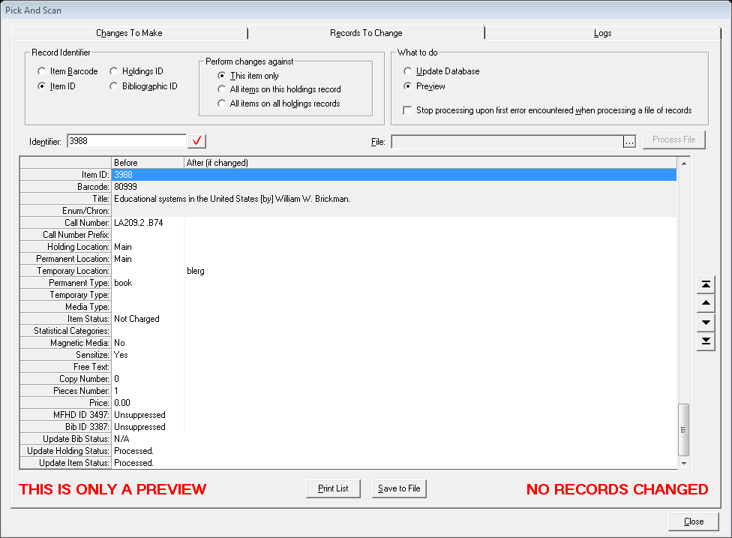
Records to change - Preview Mode
Selecting Preview will not change records.
A reminder displays at the bottom of the window.

Slide 32
Agenda
Overview
New in Voyager 9.0
Security
Changes to Make
Records to Change
Logs
Demo
Recap
Resources

Slide 33
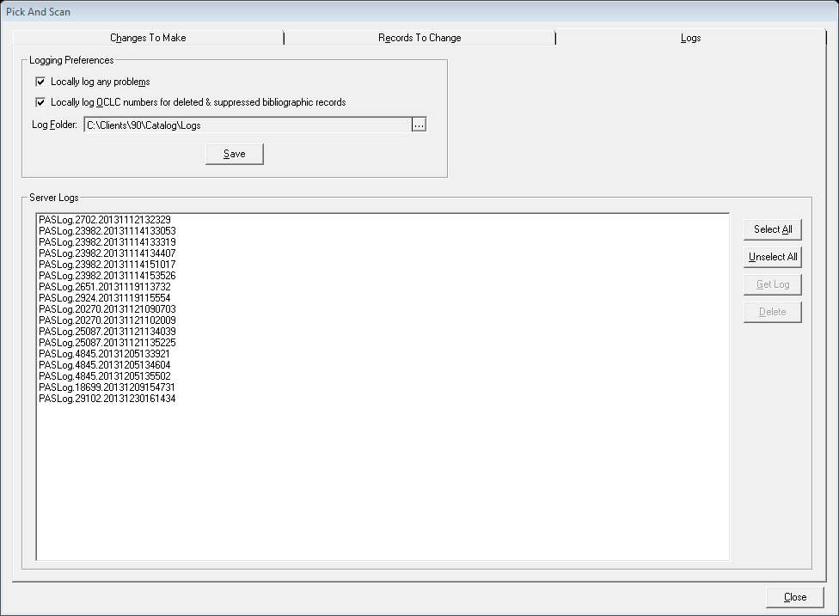
Logs
Logging has been added with a tab for managing options and logs.

Slide 34
Logs
Logs are copies of the processing report.
Options for locally logging problems or OCLC numbers of deleted or suppressed numbers.

Slide 35
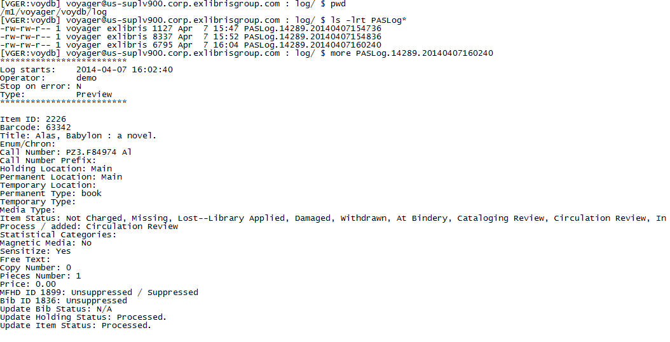
Logs
Logs can be downloaded or deleted from server in Logs tab.
Logs are stored in /m1/voyager/xxxdb/log with a PASLog prefix.

Slide 36
Agenda
Overview
New in Voyager 9.0
Security
Changes to Make
Records to Change
Logs
Demo
Recap
Resources

Slide 37
Agenda
Overview
New in Voyager 9.0
Security
Changes to Make
Records to Change
Logs
Demo
Recap
Resources

Slide 38
ReCap
New workspace layout – 3 tabs
More options for updating item records and related holdings records
Can delete related Empty Bibs and MFHDs
Preview Mode and logging capabilities added
Can extract OCLC numbers for batch update of deleted and suppressed records

Slide 39
Agenda
Overview
New in Voyager 9.0
Security
Changes to Make
Records to Change
Logs
Demo
Recap
Resources

Slide 40
Resources
Cataloging User’s Guide
(Documentation Center > Voyager > Core Voyager Documentation)
KCS Articles
(Ex Libris Support Portal > Articles > Search)
Search for “pick and scan”
Voyager Support
(Ex Libris Support Portal > Cases > Create New Case)

Slide 41
Thank You
Donna.Smith@exlibrisgroup.com

